Slide 1

Flagway App for the Algebra & Young People’s Project
Team Member(s): Musfiqur Sazal, Deya Banisakher Product Owner(s): Mohsen Taheri, Mario Eraso
Instructor: Masoud Sadjadi School of Computing and Information Sciences Florida International University
Final Presentation
<Fall 2016>
Notes:
7 seconds.
Greet your audience, thank them for attending your presentation, introduce yourself, introduce your project, introduce your team members, and quickly indicate what each of you did in a high-level manner, and put more emphasis on your part/contribution.

Slide 2
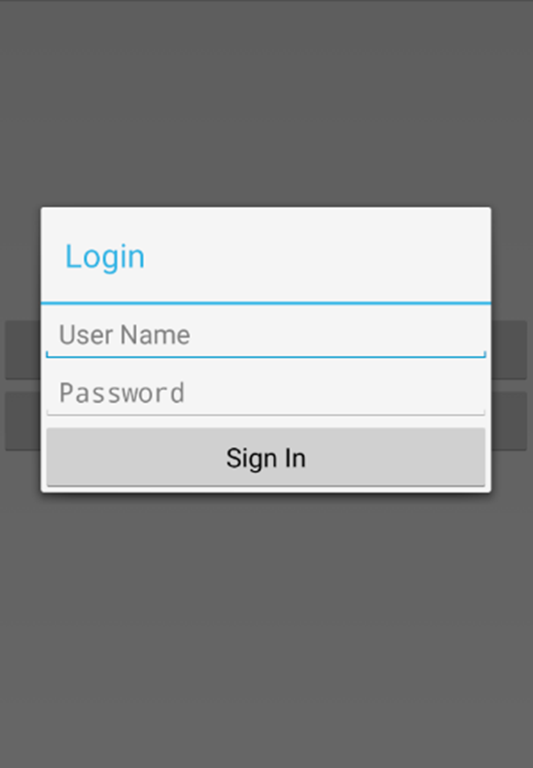
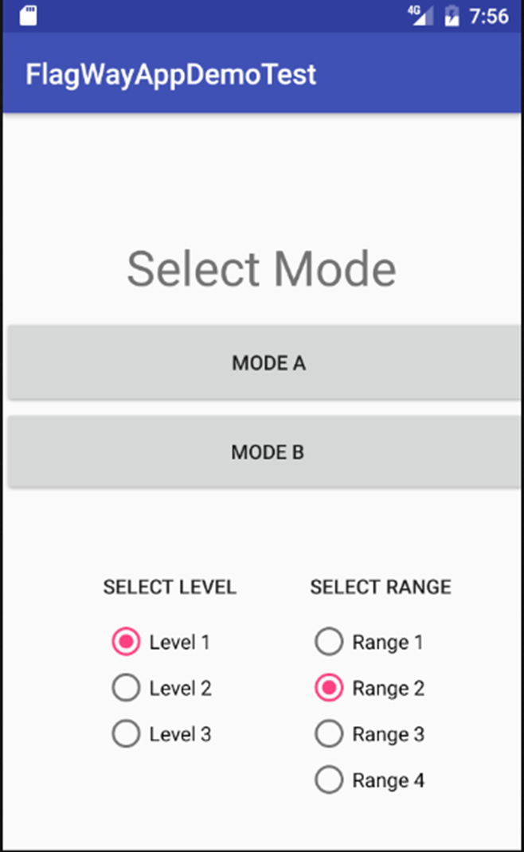
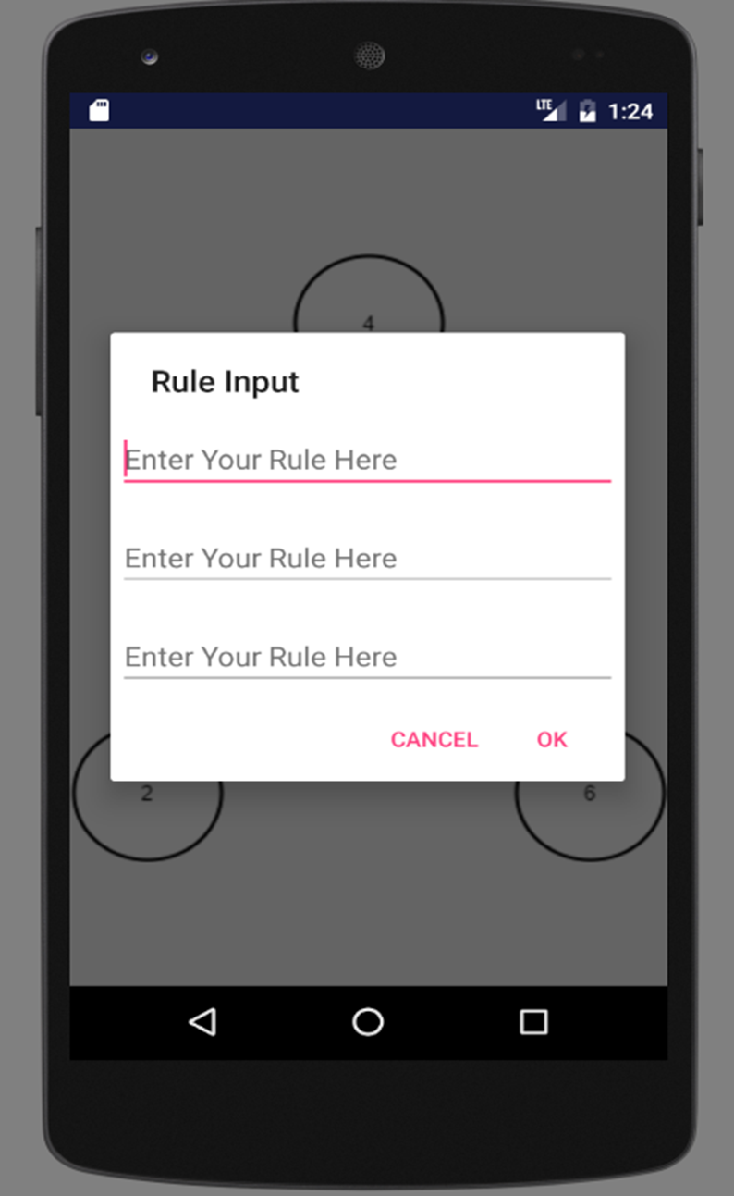
Project definition
Notes:
10 seconds.
Introduce the problem that the whole project (in all versions) tackles with GIF or screenshot.

Slide 3
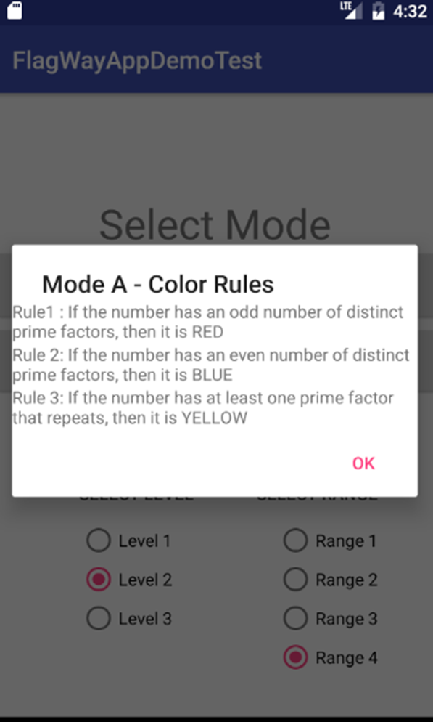
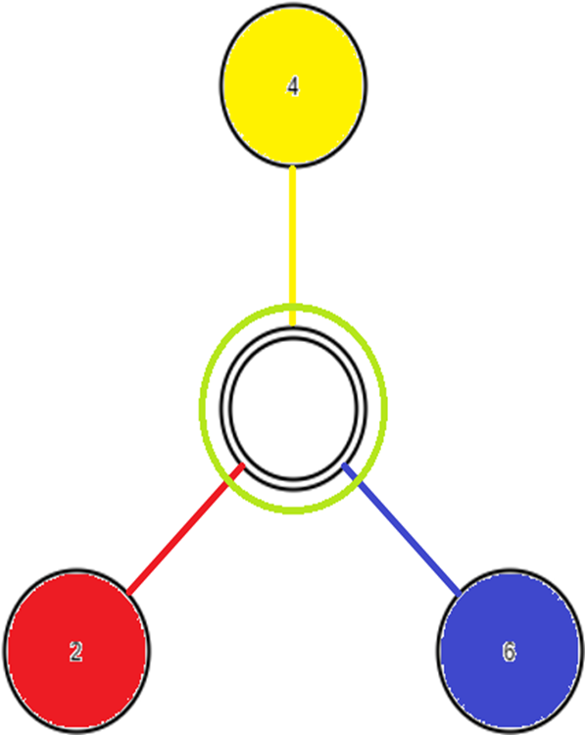
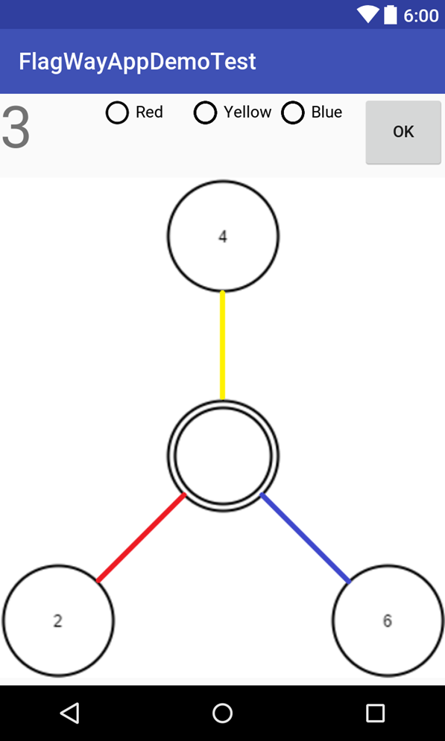
Project definition
Notes:
20 seconds.
Introduce the problem that the your project (in new version) tackles with GIF or screenshot.

Slide 4
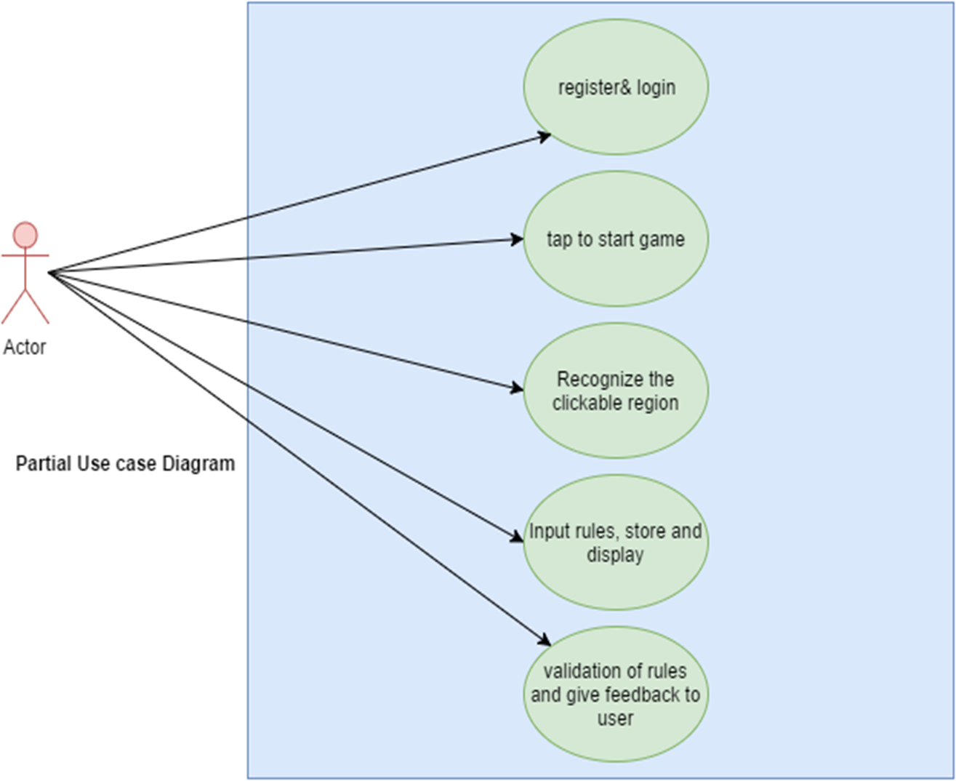
Requirements: Use Cases
Notes:
5 seconds
Show the Use Case Diagram for the whole project. Highlight your use cases.

Slide 5
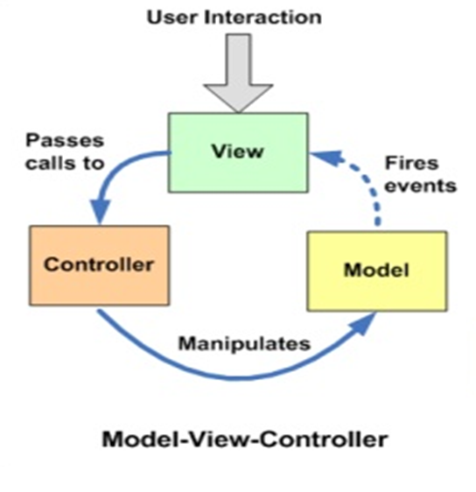
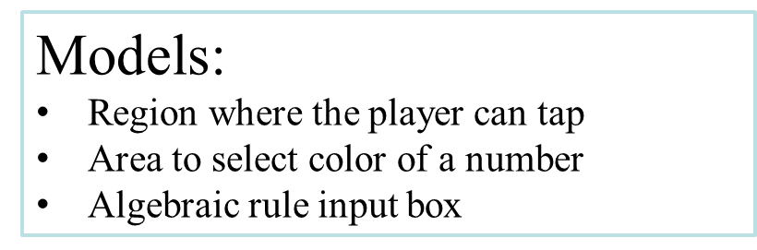
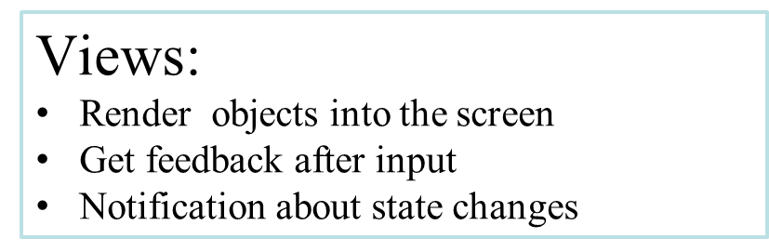
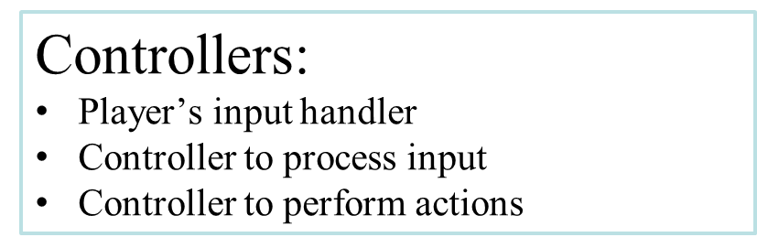
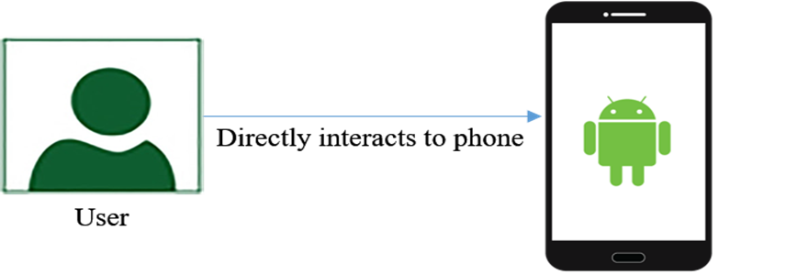
System Design: Architecture
Notes:
20 seconds
System design: Highlight the parts that you contributed to them.
1. System decomposition; identify the architecture patterns used
2. System deployment – h/w and s/w requirements

Slide 6
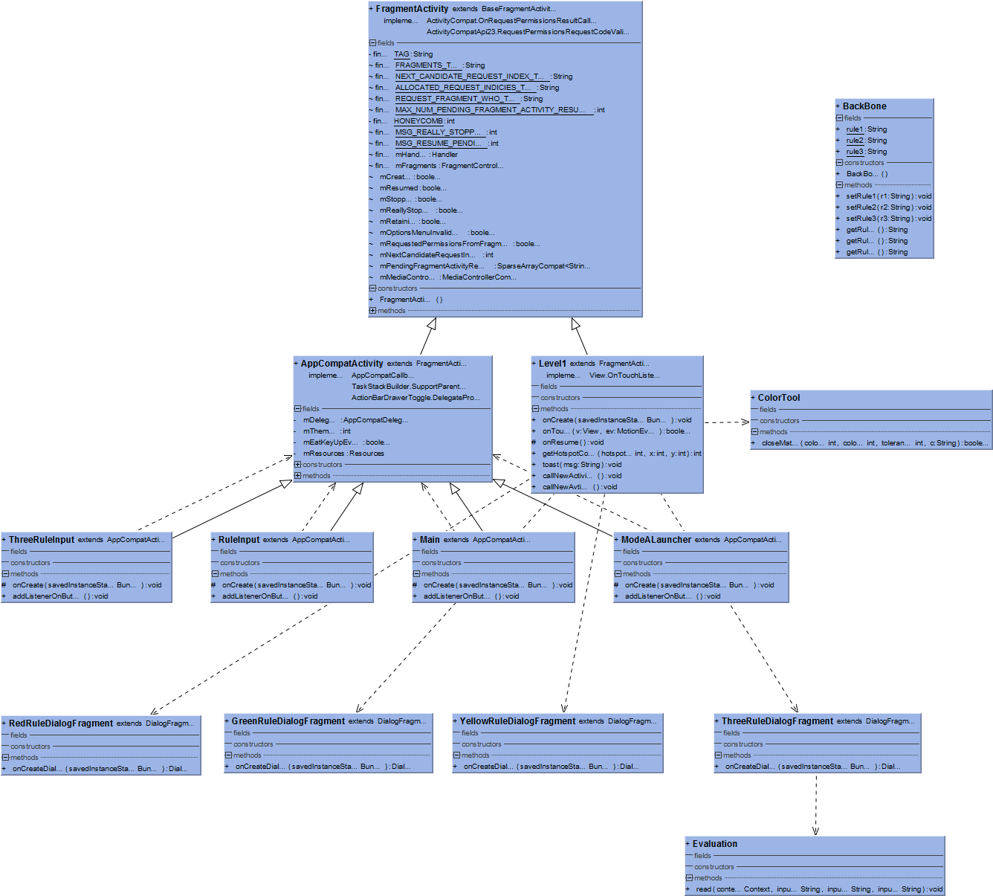
Minimal Class Diagram
Notes:
10 seconds.Minimal class diagram. Highlight the classes that you created/modified
Identify the design patterns used (one or more slides).

Slide 7
User Stories
1. Develop a very basic prototype from scratch
2. Design UI for initial game level
3. Integrate UI and basic game
4. Input the algebraic rules of game
5. Interact with game interface
6. Develop game mode and setting menu
7. Select the rules the number follows and scoring
Notes:
5 seconds.
List the user stories that you worked on them.(put in order of importance). Stay focused on the parts that you have been working.

Slide 8
User Story #1
Develop an initial/demo version of the game
The prototype will have only basic features
May not have all functions workable
Acceptance Criteria:
Product owner should have a big picture from the prototype
Well organized and easily understandable as our target customer is school going children
Notes:
60 seconds
The tile of user story
The most important user story you worked on it. You have to describe this one very well and be proud of that.
Please present and show the complexity of your work, code, algorithms, and technical challenges and technologies you have used. (you could use screenshot if you want. Visual presentations are better than text presentation)
Go into the details of the most important/significant tasks using bullet lists or visual graphs or state chart diagram
Sequence Diagram for this user story is mandatory (in another separate page if required)
Demo using screenshots or GIF (in another separate page if required)

Slide 9
User Story #2
This will be an initial/primitive design to accelerate development of the prototype app.
The design will consist of 4 circles containing initial numbers.
Acceptance Criteria
The shape must reflect user requirement demonstrated in the sprint planning meeting.
The UI must be simple and not cluttered.
Notes:
20 seconds
The tile of user story
Please present and show the complexity of your work, code, algorithms, and technical challenges and technologies you have used. (you could use screenshot if you want. Visual presentations are better than text presentation) - Go into the details of the most important/significant tasks using bullet lists or visual graphs or state chart diagram - Demo using screenshots or GIF (in another separate page if required)
Sequence Diagram for this user story is optional

Slide 10
User Story #3
Develop an initial/demo version of the game (Up-to level 1)
The prototype app will have the UI for level 1 show up when the app is opened.
Acceptance Criteria
Only the circles and initial numbers appear on the screen.
No text or explanation of the image must be present.
Notes:
20 seconds
The tile of user story
Please present and show the complexity of your work, code, algorithms, and technical challenges and technologies you have used. (you could use screenshot if you want. Visual presentations are better than text presentation) - Go into the details of the most important/significant tasks using bullet lists or visual graphs or state chart diagram - Demo using screenshots or GIF (in another separate page if required)
Sequence Diagram for this user story is optional

Slide 11
User Story #4
The user will get some place to input their rules
The user can give any kind of input to the game whatever they want
Acceptance Criteria
The app should take any kind of input ( Text, numbers, special character and even blank space)
The app should take three rules both individually and all three at a time
Notes:
20 seconds
The tile of user story
Please present and show the complexity of your work, code, algorithms, and technical challenges and technologies you have used. (you could use screenshot if you want. Visual presentations are better than text presentation) - Go into the details of the most important/significant tasks using bullet lists or visual graphs or state chart diagram - Demo using screenshots or GIF (in another separate page if required)
Sequence Diagram for this user story is optional

Slide 12
User Story #5
The users open the game application on their smartphone. Then the app will prompt to select the game mode, level of difficulties and range of numbers to be played with. The user then select the mode, range and level and the app will store the user’s response. Finally the user can proceed to the desired game window.
Acceptance Criteria
All the options must be clearly visible and understandable
Users can select the options by clicking or selecting from menu (no typing required)
Aesthetics are not an issue as this will be a prototype
Notes:
20 seconds
The tile of user story
Please present and show the complexity of your work, code, algorithms, and technical challenges and technologies you have used. (you could use screenshot if you want. Visual presentations are better than text presentation) - Go into the details of the most important/significant tasks using bullet lists or visual graphs or state chart diagram - Demo using screenshots or GIF (in another separate page if required)
Sequence Diagram for this user story is optional

Slide 13
User Story #6
After the user has selected the mode and settings desired, the game flashes the user with level-1 and mode B interface. Each circle will take the user respective rule and record it in the game. If they click on central circle they will be prompted with a screen displaying all the three rules.
Acceptance Criteria
The app should take any kind of input ( Text, numbers, special character and even blank space)
The app should show the right place to click
The pop up that will display rules must be in the center of the screen
Notes:
20 seconds
The tile of user story
Please present and show the complexity of your work, code, algorithms, and technical challenges and technologies you have used. (you could use screenshot if you want. Visual presentations are better than text presentation) - Go into the details of the most important/significant tasks using bullet lists or visual graphs or state chart diagram - Demo using screenshots or GIF (in another separate page if required)
Sequence Diagram for this user story is optional

Slide 14
User Story # 7
Select the rules the number follows and scoring
Number will appear based on rules and level
Each level has specific range
Show score based on performance
Scored is to be calculated in three levels
Notes:
20 seconds
The tile of user story
Please present and show the complexity of your work, code, algorithms, and technical challenges and technologies you have used. (you could use screenshot if you want. Visual presentations are better than text presentation) - Go into the details of the most important/significant tasks using bullet lists or visual graphs or state chart diagram - Demo using screenshots or GIF (in another separate page if required)
Sequence Diagram for this user story is optional

Slide 15
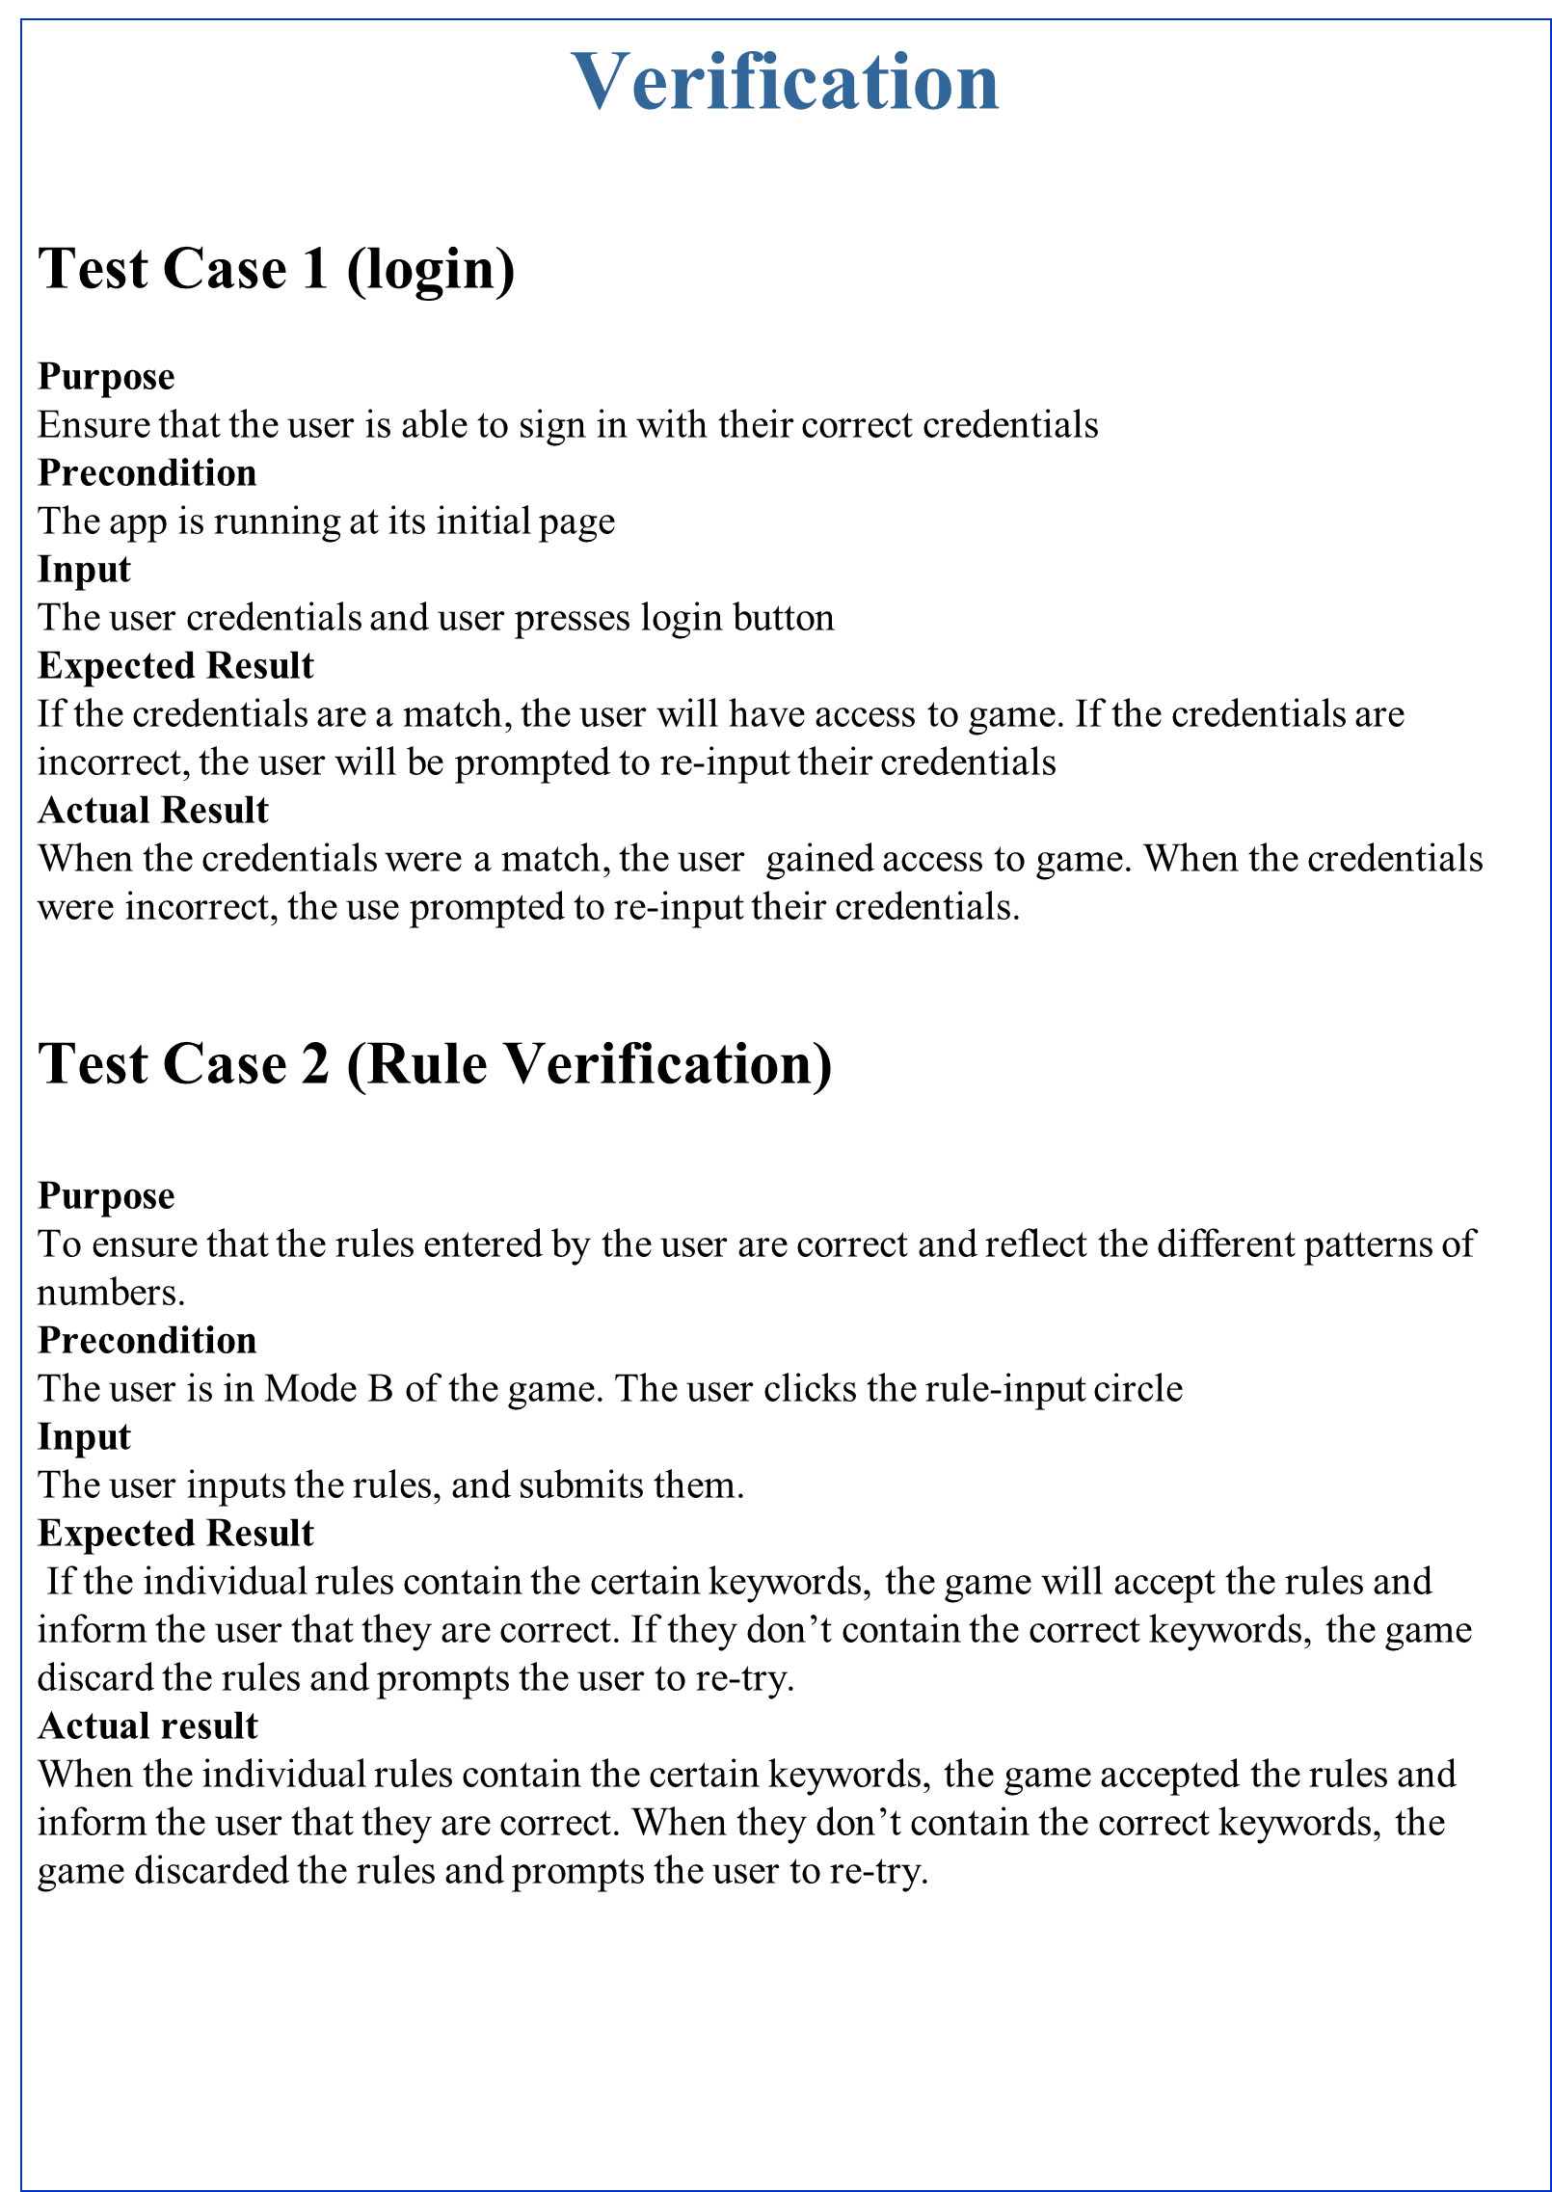
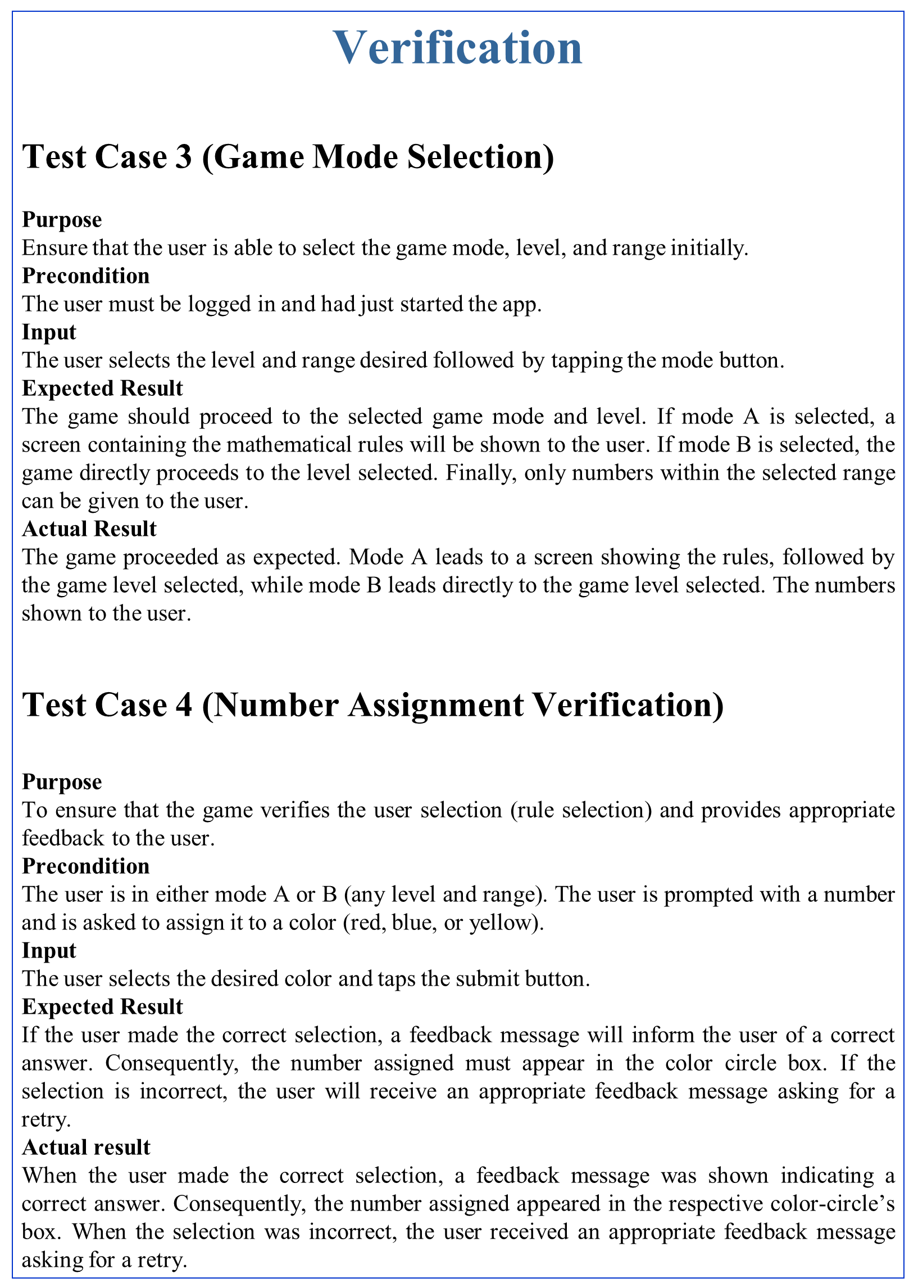
Test Suites and Test Cases
Verification
Test Case 3 (Game Mode Selection)
Purpose
Ensure that the user is able to select the game mode, level, and range initially.
Precondition
The user must be logged in and had just started the app.
Input
The user selects the level and range desired followed by tapping the mode button.
Expected Result
The game should proceed to the selected game mode and level. If mode A is selected, a screen containing the mathematical rules will be shown to the user. If mode B is selected, the game directly proceeds to the level selected. Finally, only numbers within the selected range can be given to the user.
Actual Result
The game proceeded as expected. Mode A leads to a screen showing the rules, followed by the game level selected, while mode B leads directly to the game level selected. The numbers shown to the user.
Test Case 4 (Number Assignment Verification)
Purpose
To ensure that the game verifies the user selection (rule selection) and provides appropriate feedback to the user.
Precondition
The user is in either mode A or B (any level and range). The user is prompted with a number and is asked to assign it to a color (red, blue, or yellow).
Input
The user selects the desired color and taps the submit button.
Expected Result
If the user made the correct selection, a feedback message will inform the user of a correct answer. Consequently, the number assigned must appear in the color circle box. If the selection is incorrect, the user will receive an appropriate feedback message asking for a retry.
Actual result
When the user made the correct selection, a feedback message was shown indicating a correct answer. Consequently, the number assigned appeared in the respective color-circle’s box. When the selection was incorrect, the user received an appropriate feedback message asking for a retry.
Notes:
10 seconds
A description of verification process and Test Suites and Test Cases for one of the use cases.
1 One sunny day and one rainy day for the implemented use cases (one or more slides).
2 Automated test scripts for the implemented use cases (if any) (one or more slides).

Slide 16
Summary
The Flagway game app is now in its first version
It will be a powerful tool to implicitly teach mathematics
The game will need to be extended
UI can be made more user friendly
Notes:
10 seconds
Summarize your contribution, mention your effort for Scrum, Mingle, Github, Google Drive Documentation and minutes
Include your contact information
Ask if anyone has any questions for you.
Thank your audience

Slide 17



Contact Information
Design and Developed by:
Md Musfiqur Rahman Sazal (msaza001@fiu.edu)
Deya Banisakher (dbani001@fiu.edu)
Questions?
Thank You!
Notes:
10 seconds
Summarize your contribution, mention your effort for Scrum, Mingle, Github, Google Drive Documentation and minutes
Include your contact information
Ask if anyone has any questions for you.
Thank your audience

