Slide 1












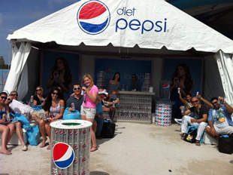

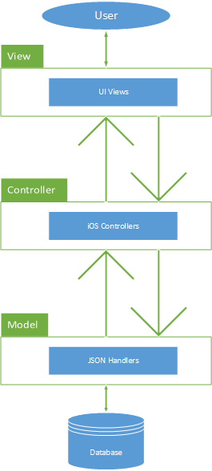
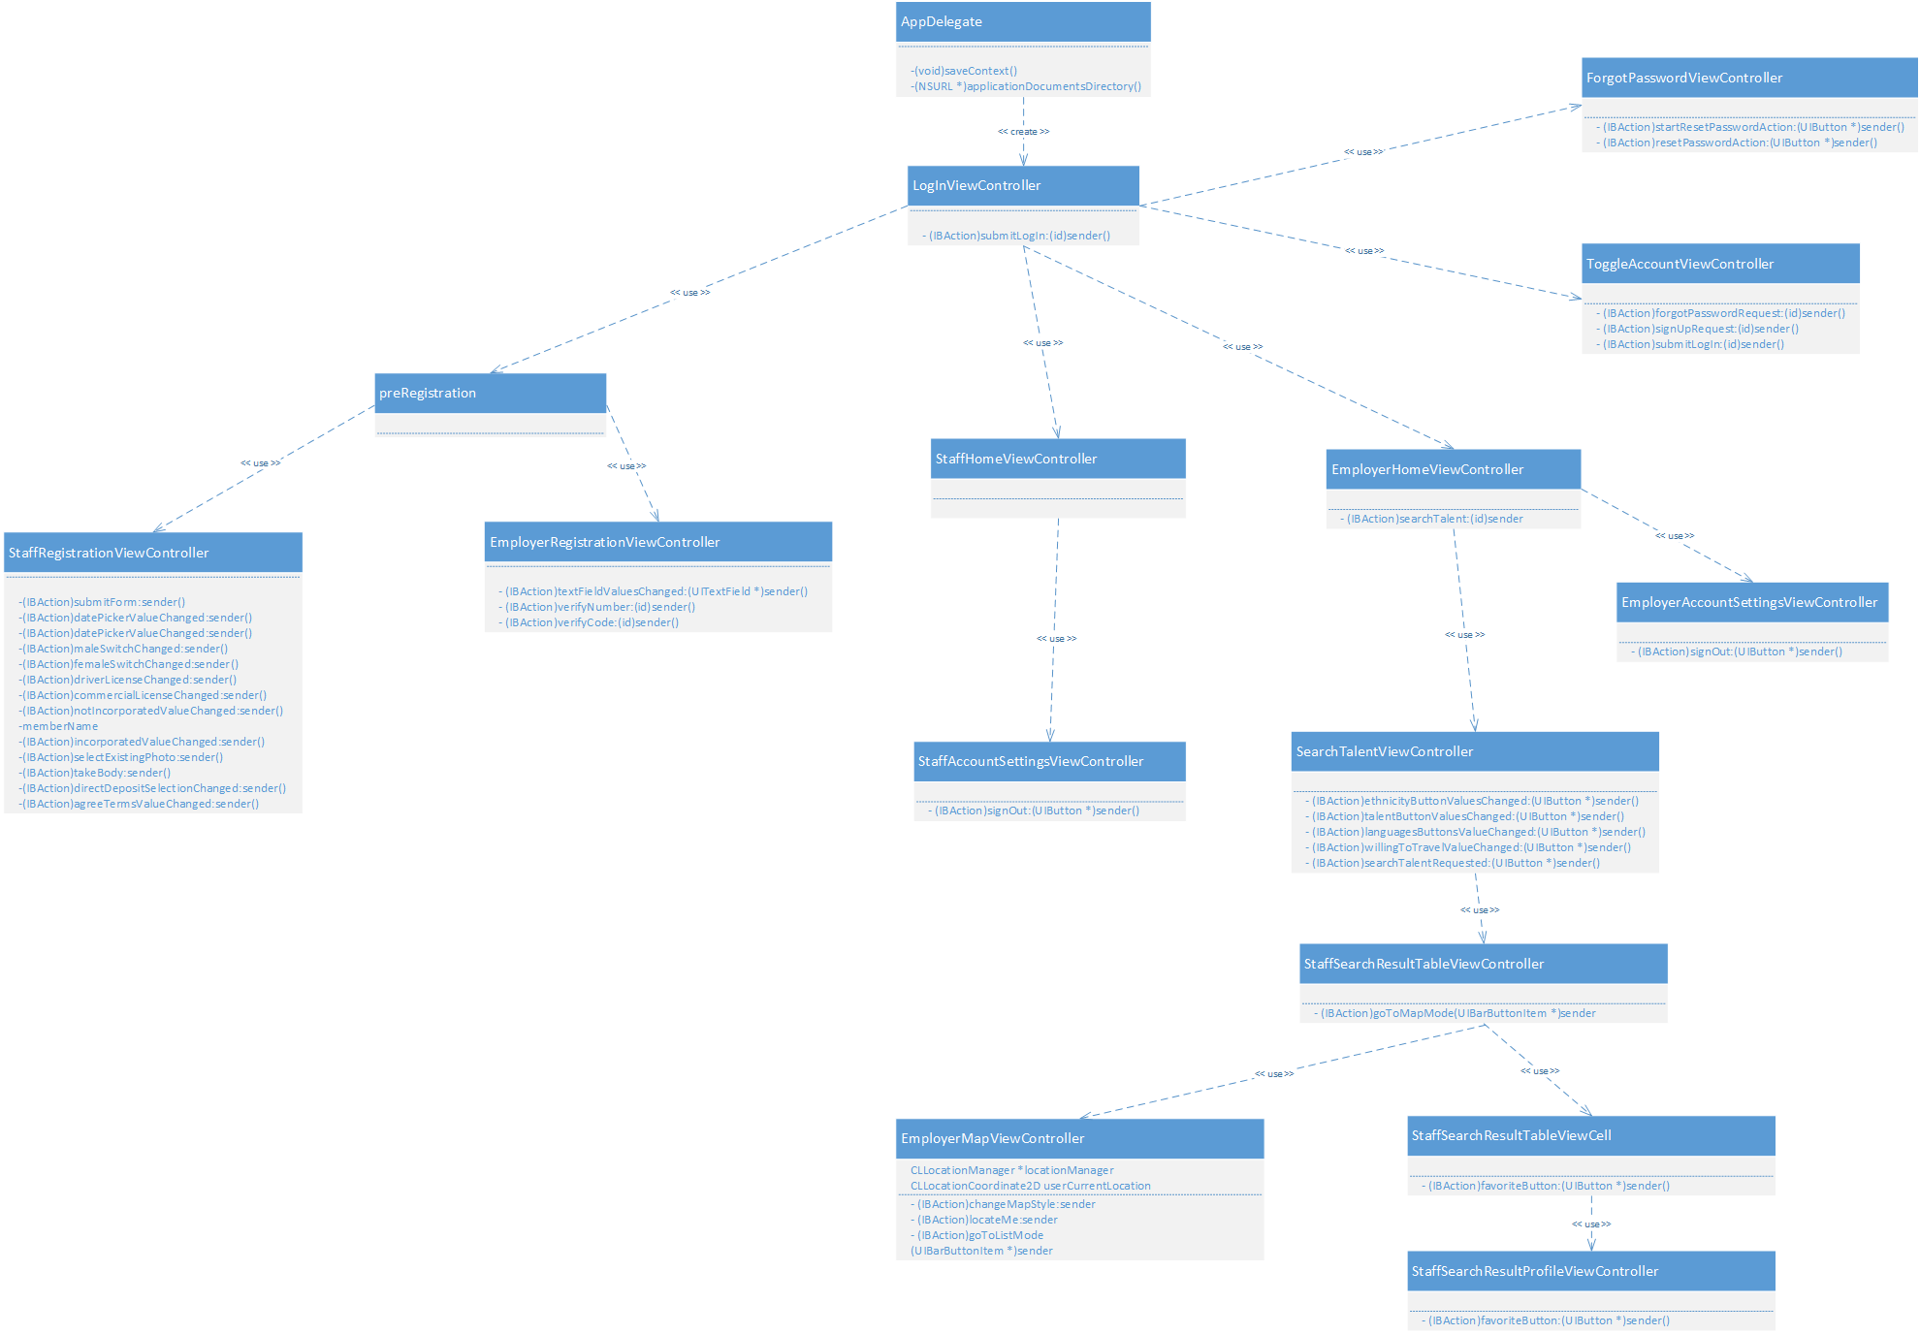
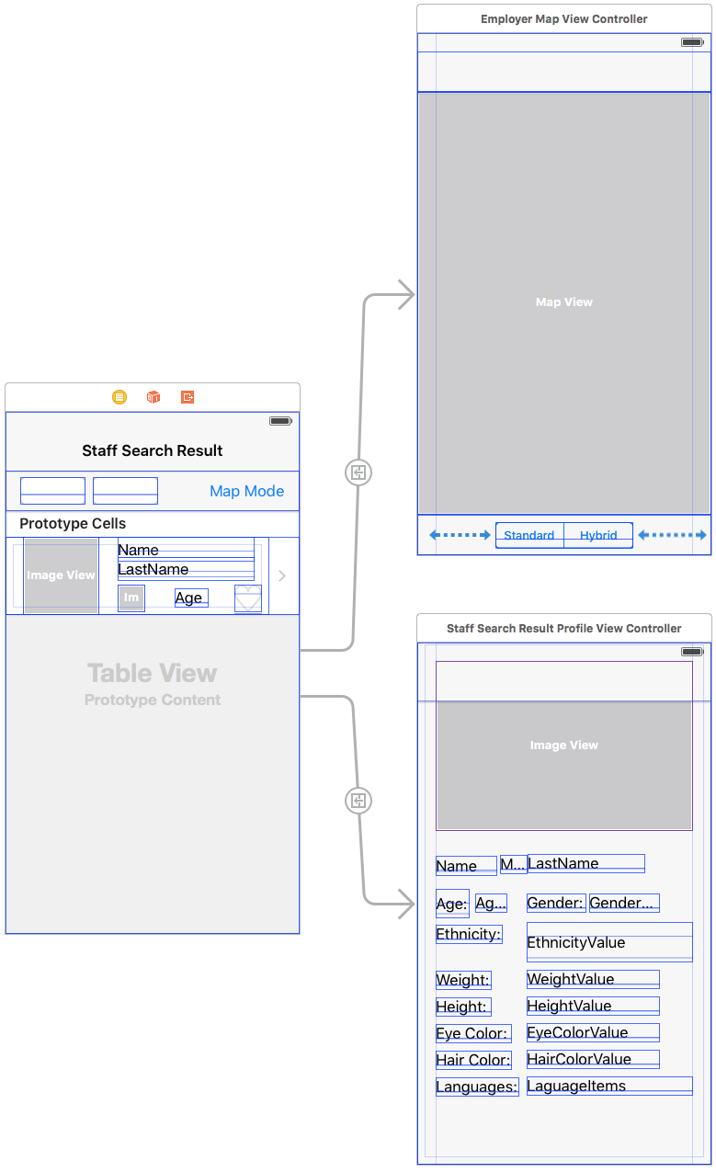
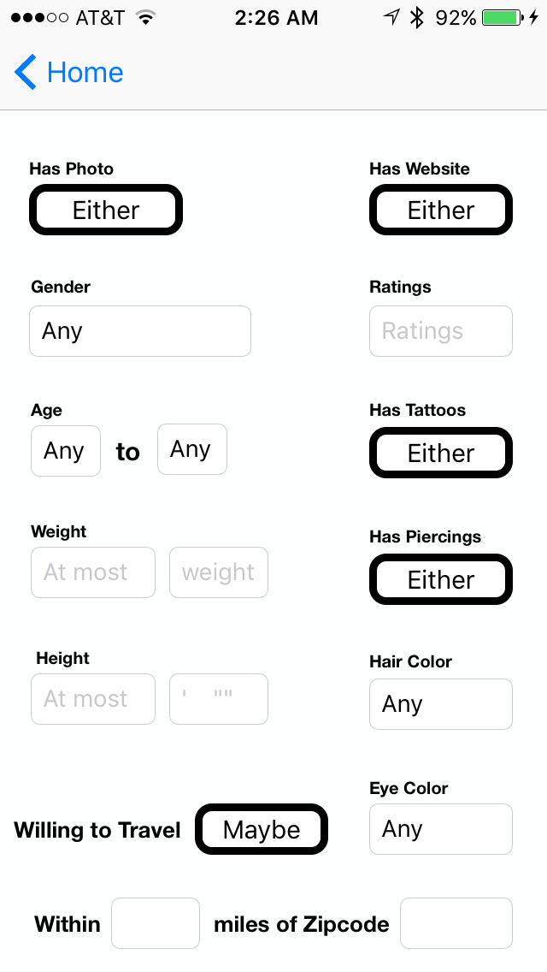
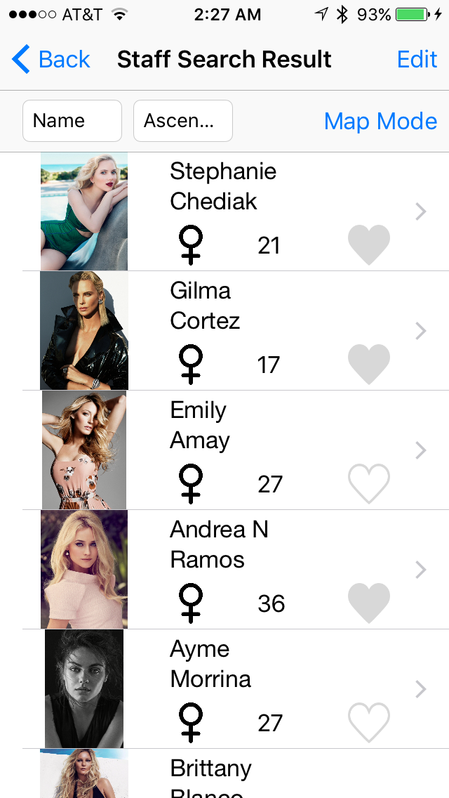
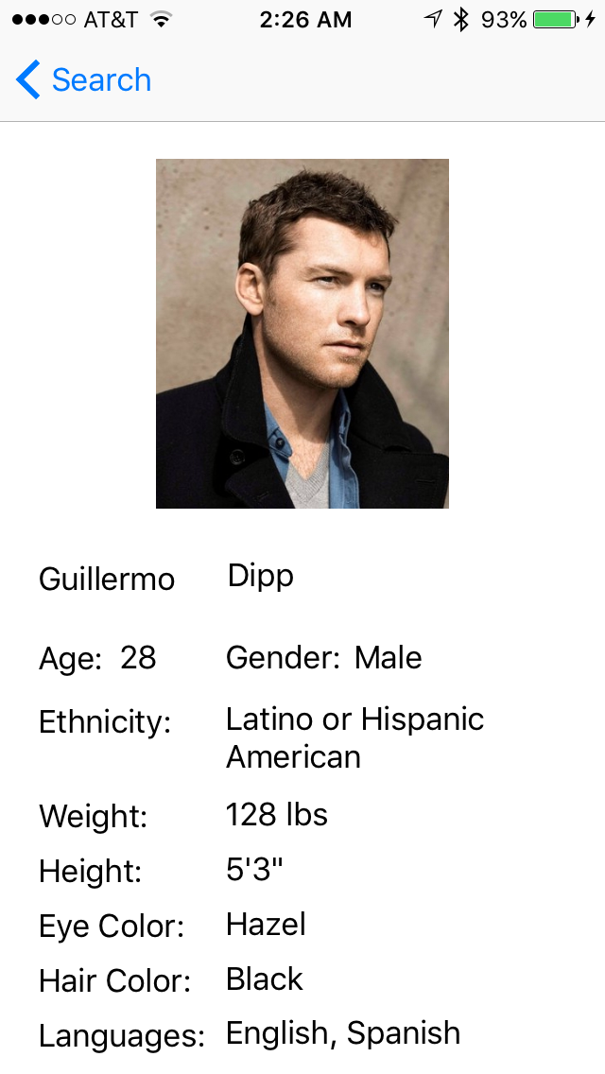
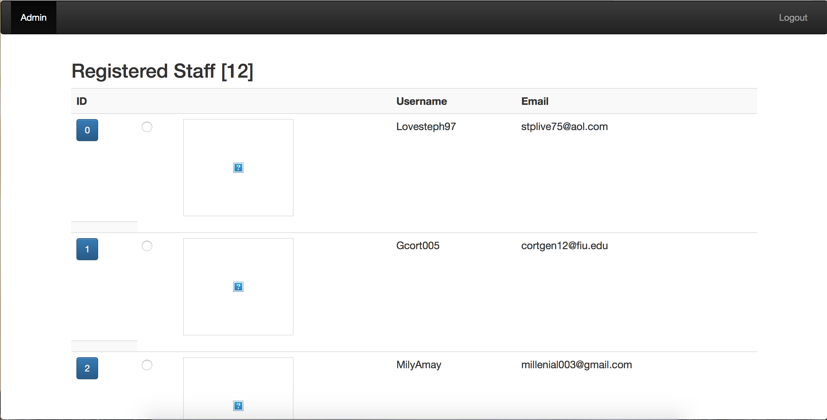

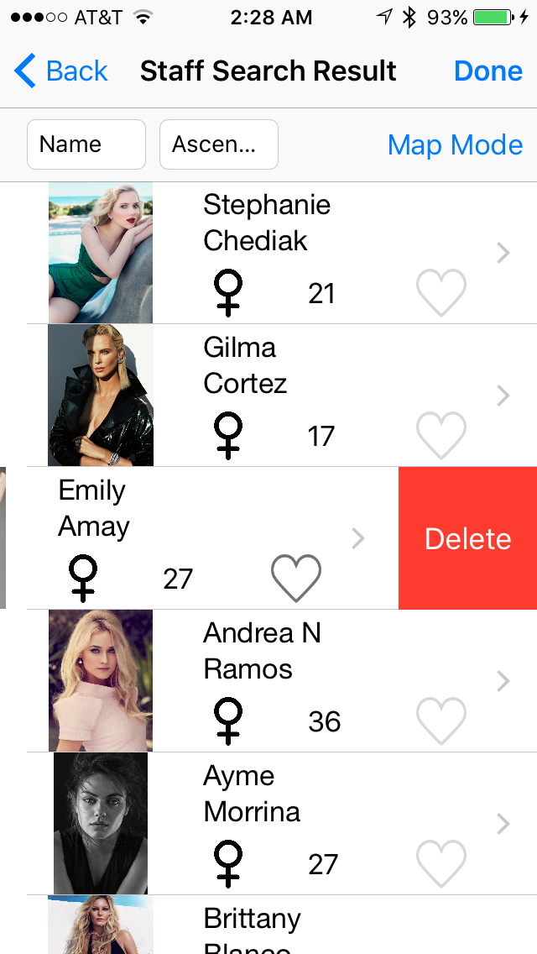
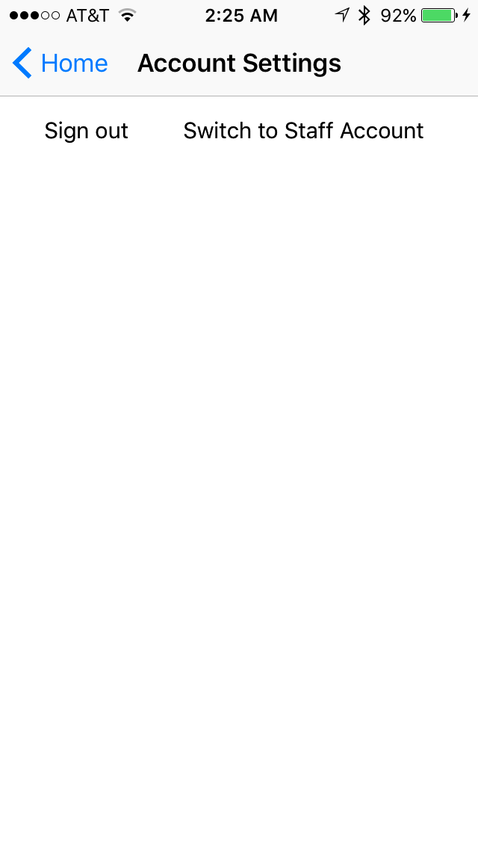


School of Computing & Information Sciences
Senior Project, 2015, Fall
Go Local Staff App 1.0
Student: Wilfredo G Gomez, Florida International University
Mentor: Eduardo Garcia, Go Local Promotions
Instructor: Masoud Sadjadi, Florida International University
Problem
Current System
Requirements
In today’s society there are events happening around us at all times. However, event organizers still need to go through staffing agencies to hire the crew. This creates a huge financial overhead.
The current system in place for these types of services are online staffing agencies with local offices in some metropolitan cities.
The event organizers need to sign a contract with the agency and they will provide the staff.
This restricts the organizers from discovering talents that may not be registered with the agency.
Event organizers end up paying more to the staffing agencies. However, staff get paid less money due to the agencies’ fees.
In order to overcome the problems with the current system, the Go Local Staff App should allow:
Users to sign up for service as different type of actors.
Users to verify their phone number during registration.
Organizers to search and filter a list of staff saved on the database, based on current event’s needs.
Organizers to favorite and un-favorite staff from the resulted list.
Organizers to see staff, already registered, in a map to gauge how far they are from the event.
The owner to use an admin website to see all the users, staff and employers, that are currently registered.
What we are proposing is a way to cut the middle man, the staffing agencies. We will have an iPhone application where crew members can find events around them, and event organizers can post jobs looking for crew in the same vicinity.
System Design
Object Design
Implementation
The iPhone application was built on Xcode using Objective-C. We implemented it using an MVC architectural pattern.
We had a LAMP server hosted on DigitalOcean for our admin website and database.
The application running on the iPhone will connect to the database to show either a detailed information about a registered user, or a map view of the users in the list represented by pins.
The transfer of data from and to the application was done using JSON open standard format.
Verification
Screenshots
Summary
Manual verification was used to test the application.
Data was inserted into the database for testing purposes.
The test data was collected from real life users except their pictures.
The promotions industry right now is over saturated with staffing agencies.
All of these agencies charge different fees and are limited to the staff that goes to them, either physically or online, and actually sign up.
I created, along with my teammate, an iPhone application that tries to address the aforementioned issues.
Using this application, event organizers can see potential staff that are available at a moment’s notice, and that are in the same area where the event is happening.
Similarly, a staff user can see the events listed around him or her and apply if they seem fit to his or her abilities.
The financial burden of a staffing agency is also removed from the equation, since the events organizers will be dealing directly with interested people suitable for the job.
Acknowledgement
The material presented in this poster is based upon the work supported by my product owner, Eduardo Garcia and my teammate, Luis Castillo. I am thankful for all the support I received from my family and friends, specially my parents.

