Slide 1
Go Local Staff App Team Member(s):Luis Castillo Wilfredo Gomez Product Owner(s): Eduardo Garcia Instructor: Masoud Sadjadi School of Computing and Information Sciences Florida International University
Senior Project Final Presentation Fall 2015
12/11/15
Notes:
Greet your audience, thank them for attending your presentation, introduce yourself, introduce your project, introduce your team members, and quickly indicate what each of you did in a high-level manner, and put more emphasis on your part/contribution.

Slide 2
Problem definition
Currently promotional staff and event organizers are limited by staffing agencies in the following manner:
High overhead expenses
Limited number of talent
Sufficient planning required to execute events
There is no alternative system
Notes:
Introduce the problem that the whole project tackles and stay focused on the parts that you have been working. Indicate if there is an existing previous system, enumerate its problems/limitations, etc.

Slide 3
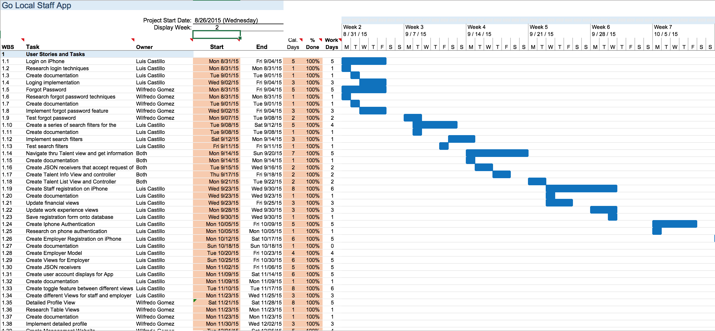
Project Management
Notes:
Project Management (schedule for entire semester) (one slide; Gantt Chart).

Slide 4
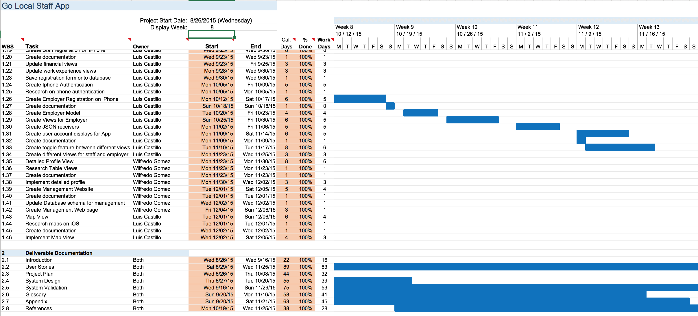
Project Management
Notes:
Project Management (schedule for entire semester) (one slide; Gantt Chart).

Slide 5
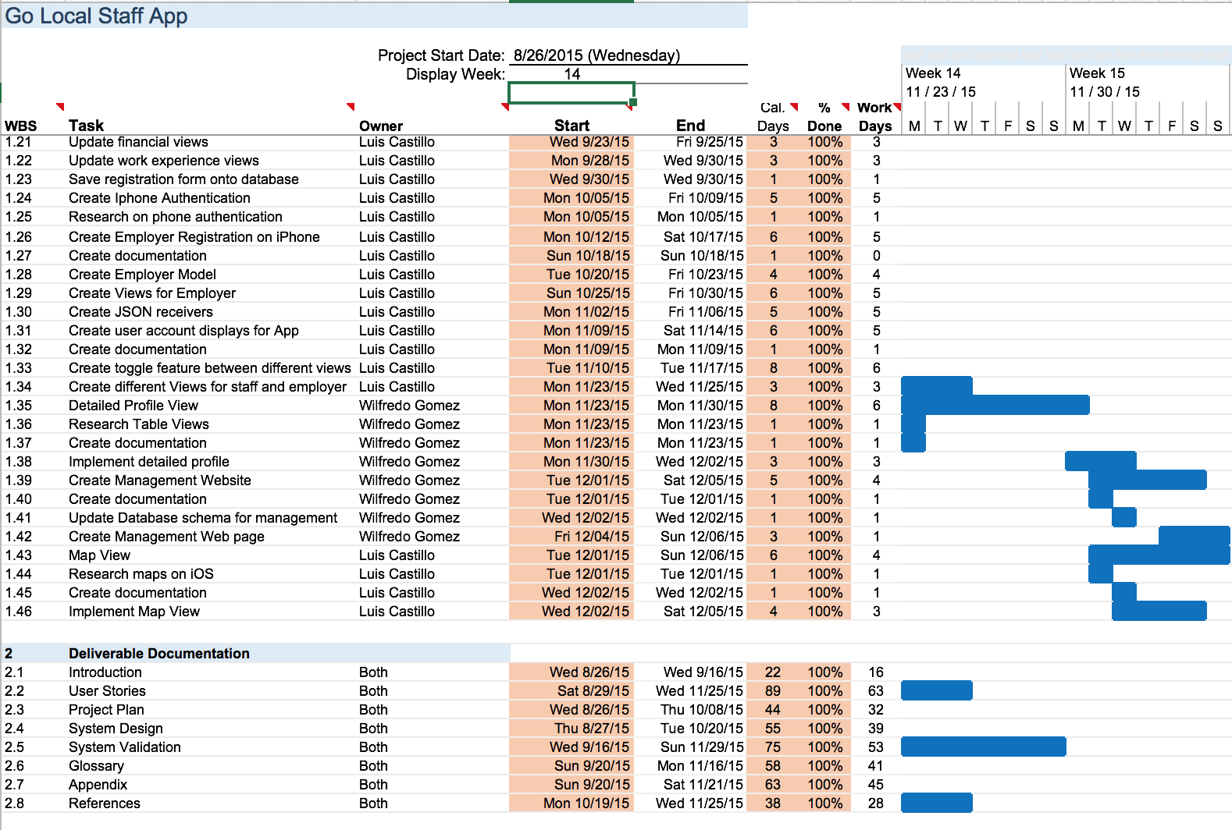
Project Management
Notes:
Project Management (schedule for entire semester) (one slide; Gantt Chart).

Slide 6
User Stories Implemented
Login in iPhone
Register as a Staff user using SMS Authentication
Forgot password on iPhone
Implement search filters for employer staff search
Employer Staff Search
Employer Staff Search Result List
Talent Profile for Staff Search Results
Map for Staff Search Results
Notes:
4. Requirements:
4.1. User stories implemented (one or more slides).
4.2. UML use cases and the use case diagram for the implemented use cases (one or more slides).
4.3. UML sequence diagrams for the implemented use cases.

Slide 7
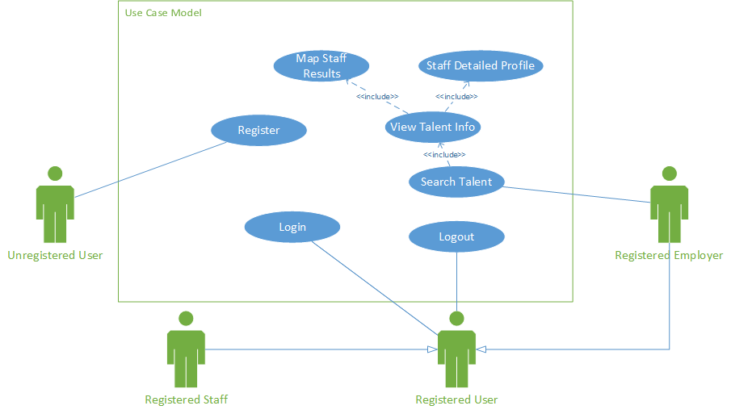
Use Case Model
Notes:
4. Requirements:
4.1. User stories implemented (one or more slides).
4.2. UML use cases and the use case diagram for the implemented use cases (one or more slides).
4.3. UML sequence diagrams for the implemented use cases.

Slide 8
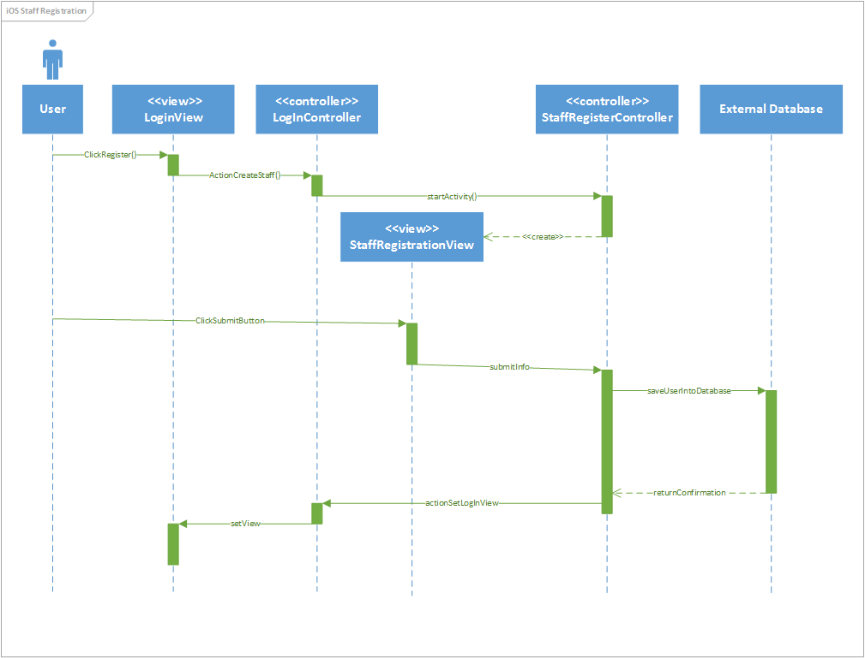
Staff Registration Sequence Diagram
Notes:
4. Requirements:
4.1. User stories implemented (one or more slides).
4.2. UML use cases and the use case diagram for the implemented use cases (one or more slides).
4.3. UML sequence diagrams for the implemented use cases.

Slide 9
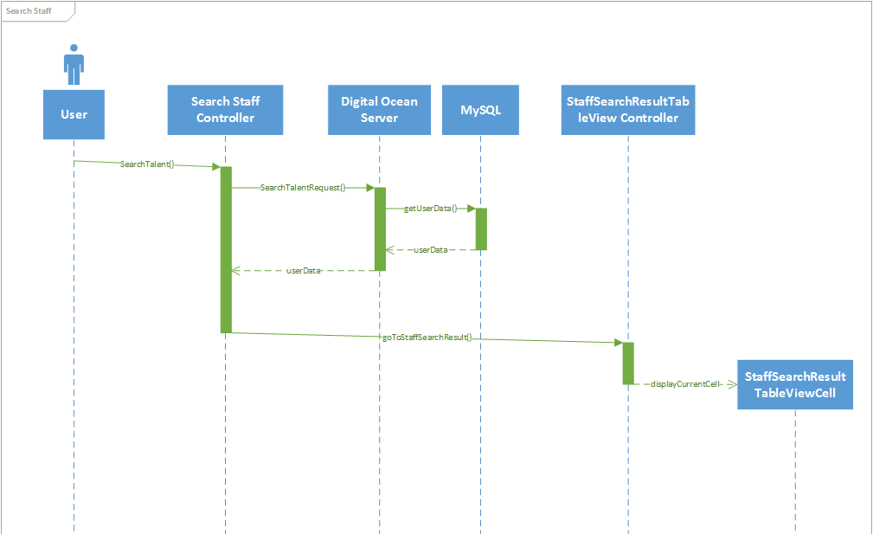
Search Staff Sequence Diagram
Notes:
4. Requirements:
4.1. User stories implemented (one or more slides).
4.2. UML use cases and the use case diagram for the implemented use cases (one or more slides).
4.3. UML sequence diagrams for the implemented use cases.

Slide 10
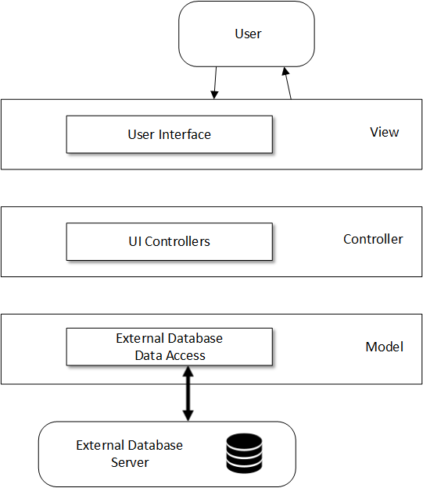
System Design: Architecture
Notes:
5. System design:
5.1. System decomposition; identify the architecture patterns used (one slide).
5.2. System deployment – h/w and s/w requirements (one slide).
5.3. Persistent data design (one slide).
5.4. Security/Privacy (one slide).

Slide 11
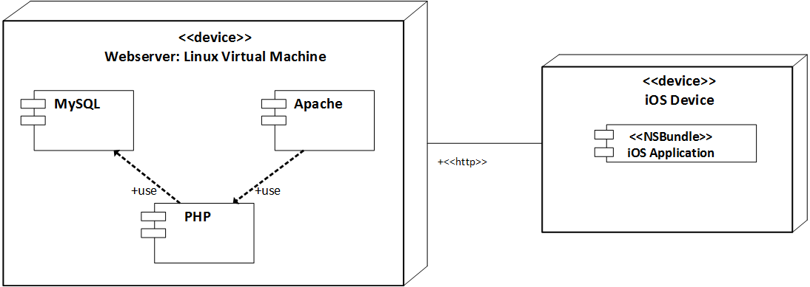
System Design: Deployment
Notes:
5. System design:
5.1. System decomposition; identify the architecture patterns used (one slide).
5.2. System deployment – h/w and s/w requirements (one slide).
5.3. Persistent data design (one slide).
5.4. Security/Privacy (one slide).

Slide 12
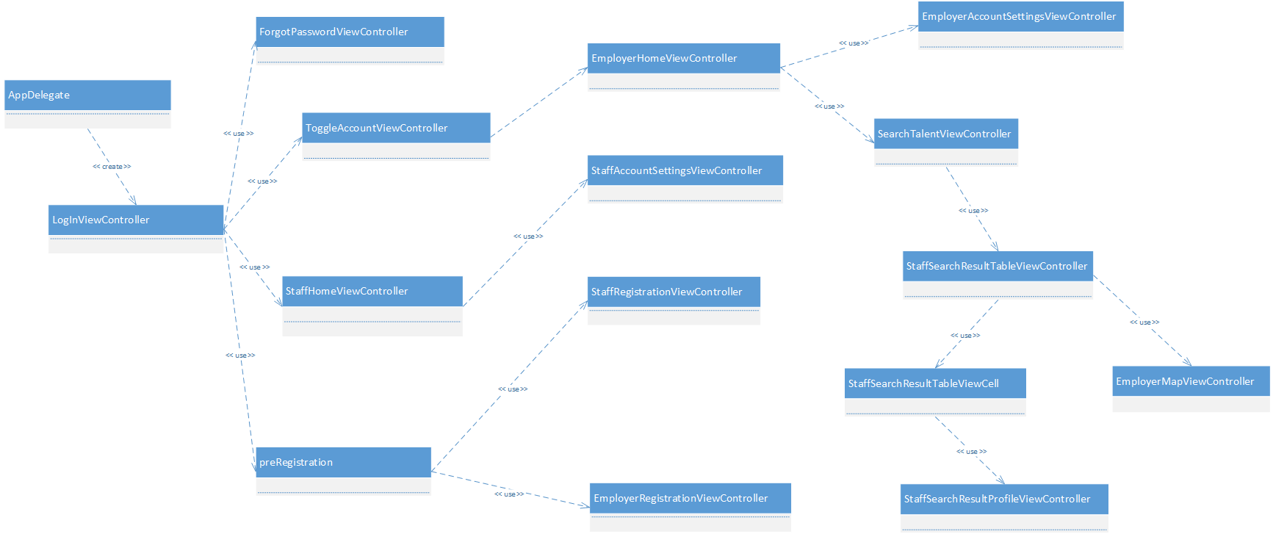
Minimal Class Diagram
Notes:
6. Detailed design:
6.1. Minimal class diagram. Identify the design patterns used (one or more slides).
6.2. State machine for the main control object or the most important object of the implemented uses cases (one or more slides).
6.3. Main algorithm used related to an implemented use case described above (one or more slides).

Slide 13
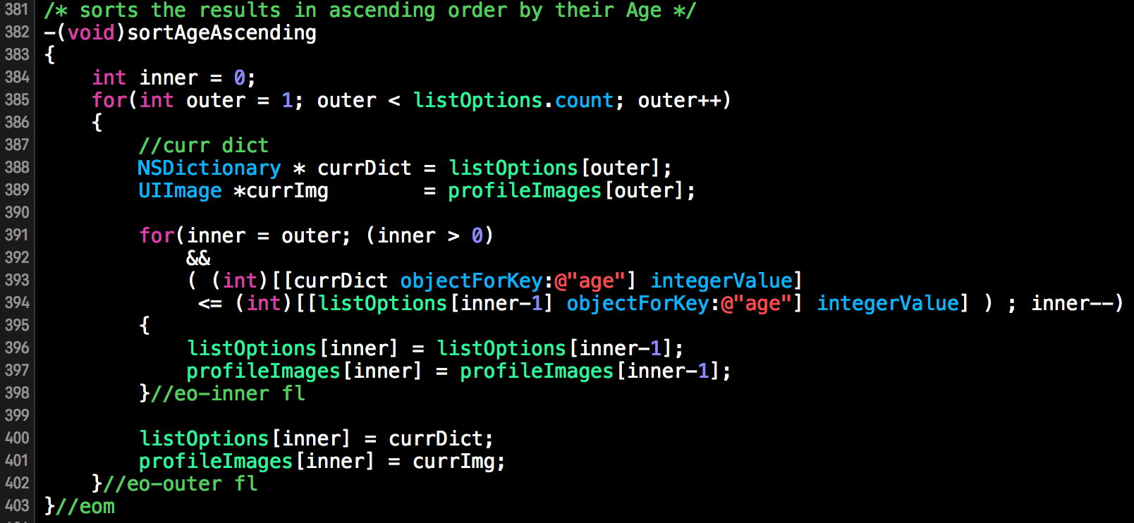
Main algorithm
Notes:
6. Detailed design:
6.1. Minimal class diagram. Identify the design patterns used (one or more slides).
6.2. State machine for the main control object or the most important object of the implemented uses cases (one or more slides).
6.3. Main algorithm used related to an implemented use case described above (one or more slides).

Slide 14
Test Case for Search Staff
Test Case ID: | iOS_Search_Staff_Sunny_Day
Purpose: | To search for people, that have already been registered, that meet specific requirements.
Preconditions: | The app is running The iPhone has internet connection A valid employer user is logged in
Inputs: | User selects multiple requirements for the query
Expected Output: | The app goes to the following view displaying a table view with the list of people meeting those requirements
Notes:
7. Test Suites and Test Cases (one sunny day and one rainy day) for the use case represented in part (5) above (2 slides).
7.1 One sunny day and one rainy day for the implemented use cases (one or more slides).
7.2 Automated test scripts for the implemented use cases (one or more slides).

Slide 15
Test Case for Search Staff
Test Case ID: | iOS_Search_Staff_Rainy_Day
Purpose: | To search for people, that have already been registered, that meet specific requirements.
Preconditions: | The app is running The iPhone has internet connection A valid employer user is logged in
Inputs: | User selects multiple requirements in a way that no results come back
Expected Output: | The app remains in the current view and shows an alert saying that the query didn’t return any result.
Notes:
7. Test Suites and Test Cases (one sunny day and one rainy day) for the use case represented in part (5) above (2 slides).
7.1 One sunny day and one rainy day for the implemented use cases (one or more slides).
7.2 Automated test scripts for the implemented use cases (one or more slides).

Slide 16
Summary
In order to facilitate the financial burden and drawbacks of using staffing agencies, my teammate and I created the Go Local Staff App. Some of my major contributions on the project were:
SMS Authentication on registration and forgot password
Employer Staff Search
Map for Staff Search Results
Notes:
Summarize your contribution
Include your contact information
Ask if anyone has any questions for you.
Thank your audience

Slide 17
Thank you, Any Questions?
lcast053@fiu.edu
Notes:
Summarize your contribution
Include your contact information
Ask if anyone has any questions for you.
Thank your audience

