Slide 1
Go Local Staff App Team Members: Wilfredo Gomez, Luis Castillo Product Owner: Eduardo Garcia Instructor: Masoud Sadjadi School of Computing and Information Sciences Florida International University
Senior Project Final Presentation Fall 2015
Friday, December 11th, 2015
Notes:
Greet your audience, thank them for attending your presentation, introduce yourself, introduce your project, introduce your team members, and quickly indicate what each of you did in a high-level manner, and put more emphasis on your part/contribution.

Slide 2
Problem definition
In today’s society there are events happening around us at all times. However, event organizers still need to go through staffing agencies to hire the crew. This creates a huge financial overhead.
What we are proposing is a way to cut the middle man, the staffing agencies. We will have an iPhone application where crew members can find events around them, and event organizers can post jobs looking for crew in the same vicinity
Notes:
Introduce the problem that the whole project tackles and stay focused on the parts that you have been working. Indicate if there is an existing previous system, enumerate its problems/limitations, etc.

Slide 3
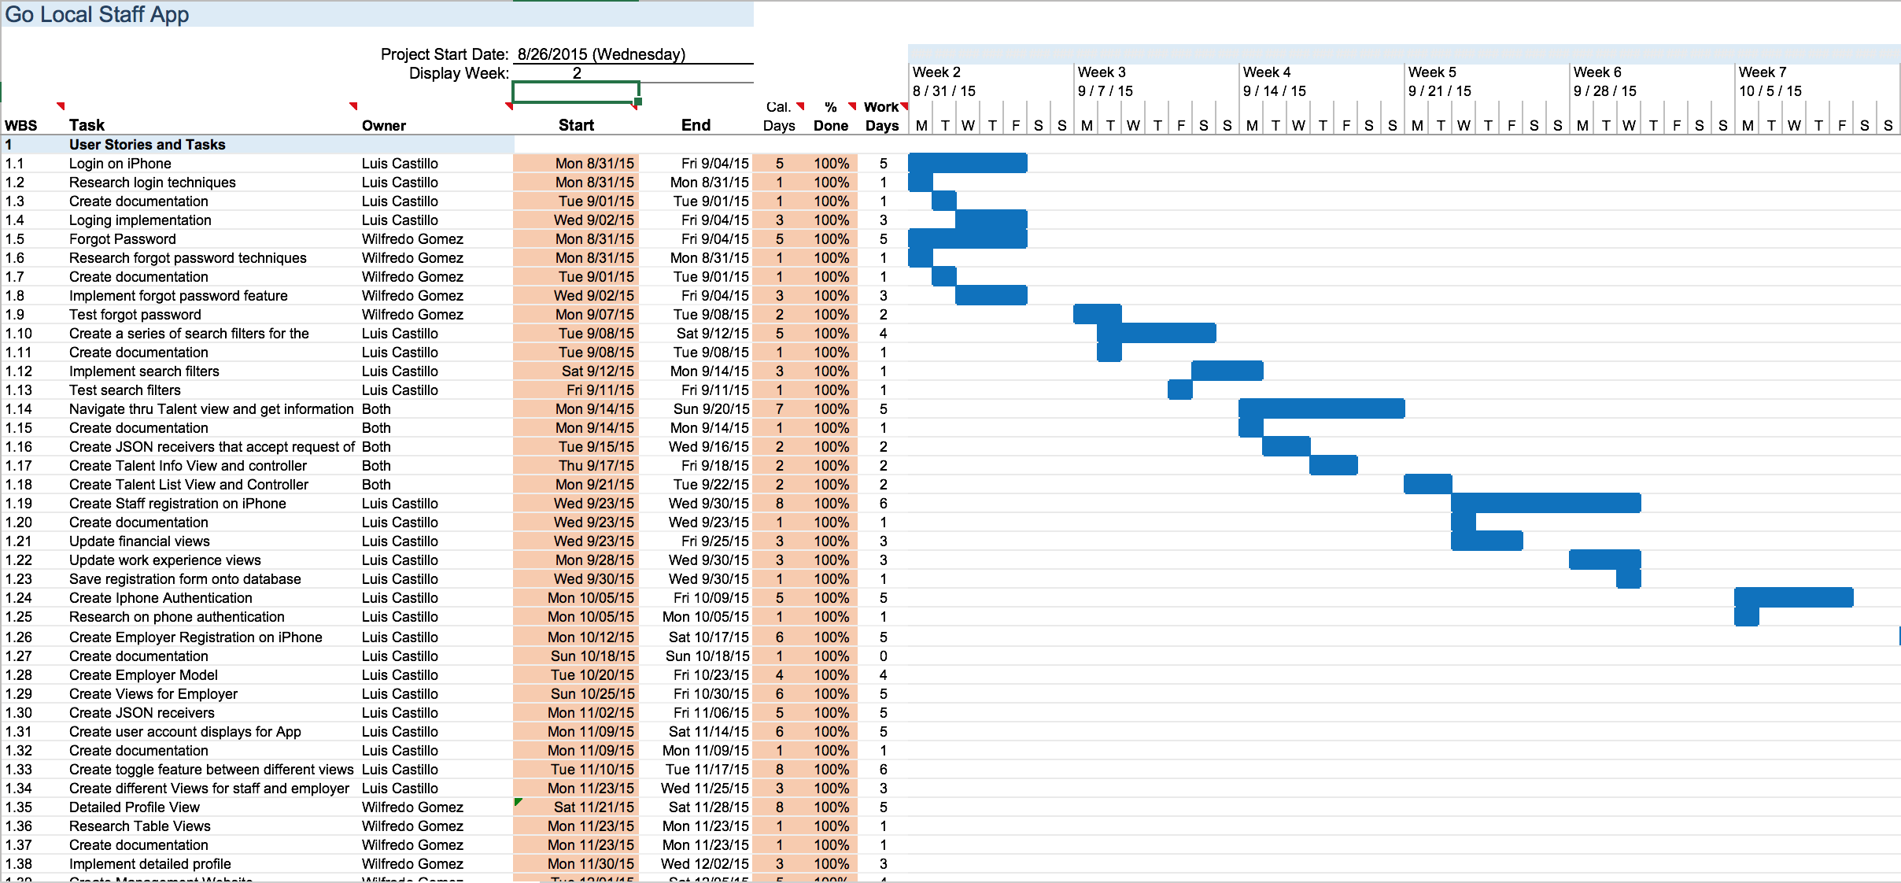
Gantt Chart
Notes:
Project Management (schedule for entire semester) (one slide; Gantt Chart).

Slide 4
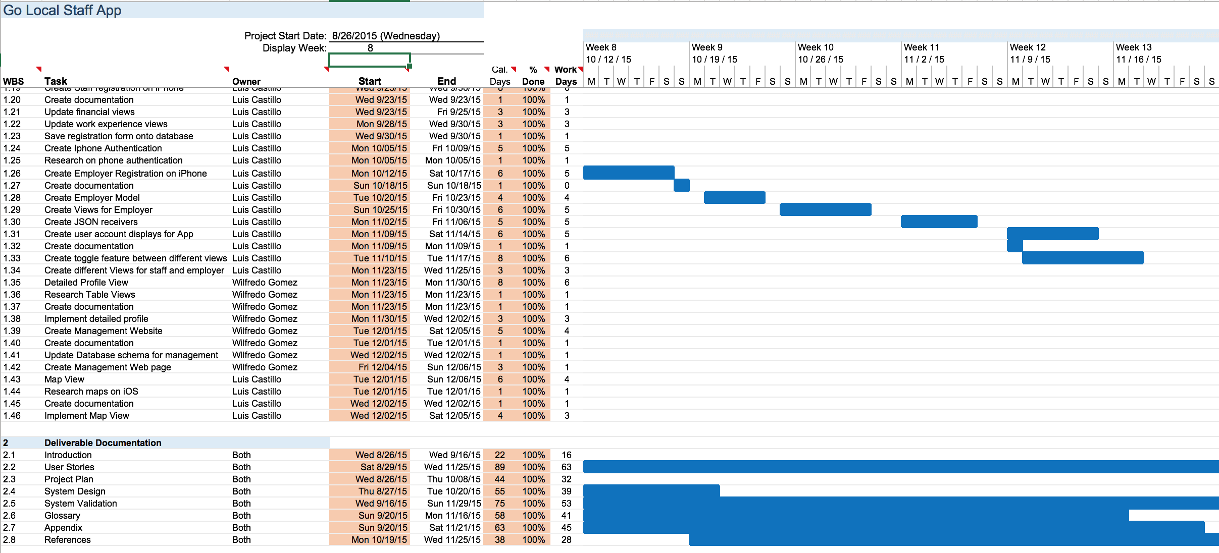
Gantt Chart

Slide 5
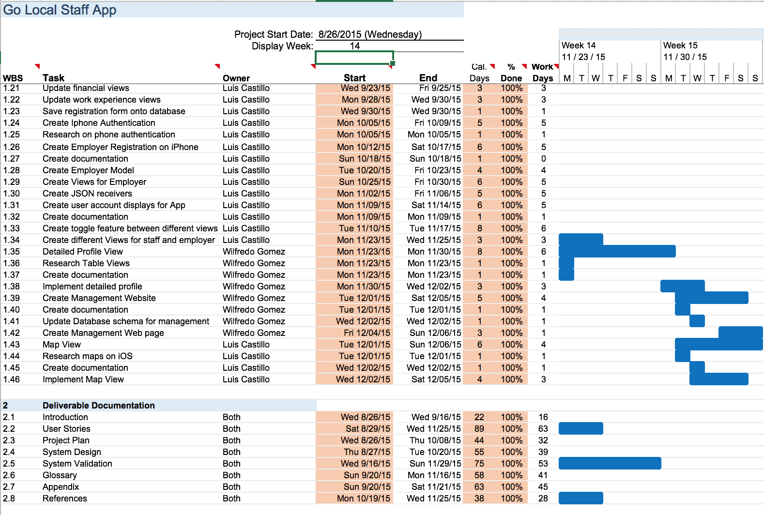
Gantt Chart

Slide 6
Requirements: User Stories
Employer registration
Forgot password
Navigate through talent view and get information on talent
Create detailed profile view
Create management Website
Notes:
4. Requirements:
4.1. User stories implemented (one or more slides).
4.2. UML use cases and the use case diagram for the implemented use cases (one or more slides).
4.3. UML sequence diagrams for the implemented use cases.

Slide 7
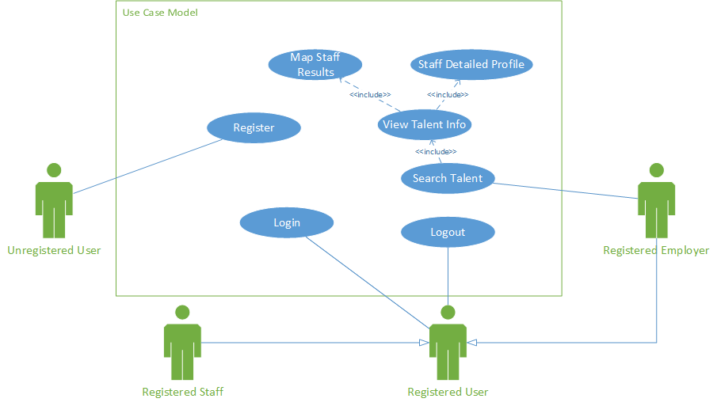
Requirements: Use Cases
Show the Use Case Diagram for the whole project.
Highlight your use cases.
Show all the details of the most significant use case.
Notes:
4. Requirements:
4.1. User stories implemented (one or more slides).
4.2. UML use cases and the use case diagram for the implemented use cases (one or more slides).
4.3. UML sequence diagrams for the implemented use cases.

Slide 8
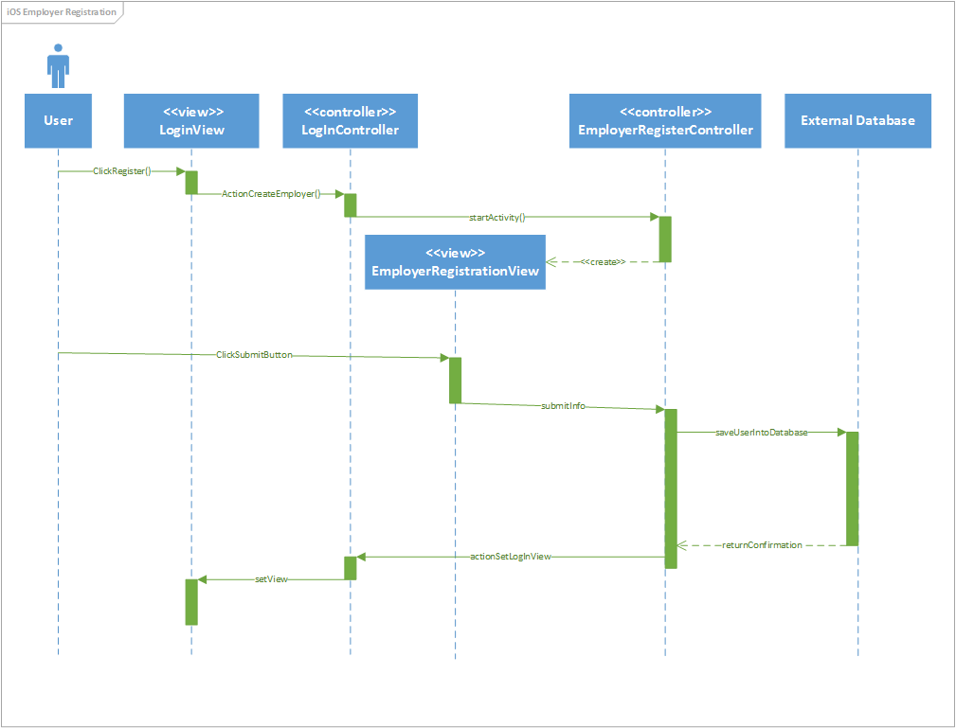
Requirements: Sequence Diagram
Notes:
4. Requirements:
4.1. User stories implemented (one or more slides).
4.2. UML use cases and the use case diagram for the implemented use cases (one or more slides).
4.3. UML sequence diagrams for the implemented use cases.

Slide 9
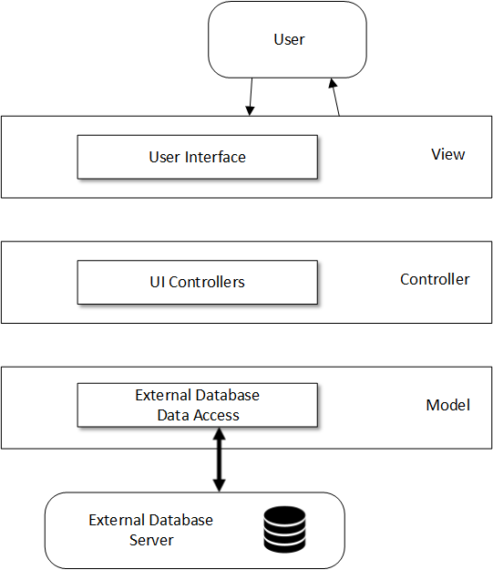
System Design: Architecture
Notes:
5. System design:
5.1. System decomposition; identify the architecture patterns used (one slide).
5.2. System deployment – h/w and s/w requirements (one slide).
5.3. Persistent data design (one slide).
5.4. Security/Privacy (one slide).

Slide 10
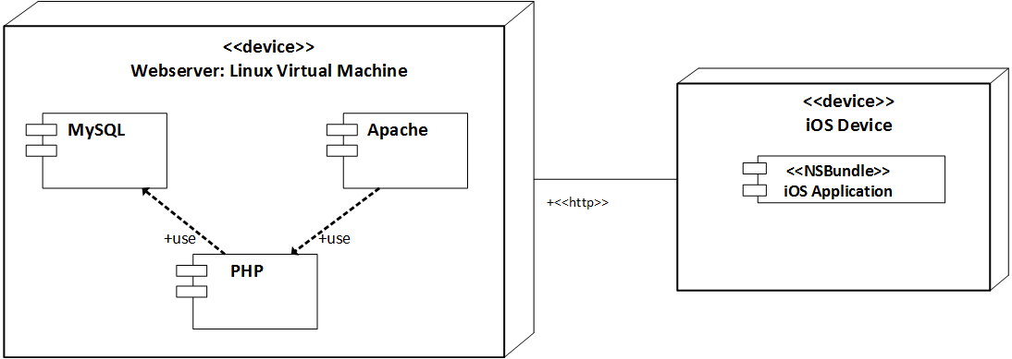
System Design: Deployment
Notes:
5. System design:
5.1. System decomposition; identify the architecture patterns used (one slide).
5.2. System deployment – h/w and s/w requirements (one slide).
5.3. Persistent data design (one slide).
5.4. Security/Privacy (one slide).

Slide 11
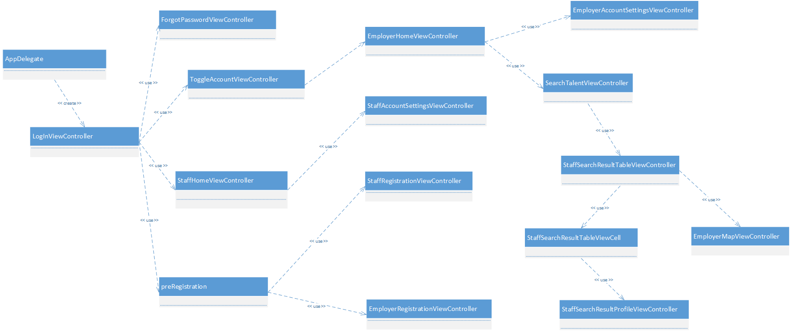
Minimal Class Diagram
Notes:
6. Detailed design:
6.1. Minimal class diagram. Identify the design patterns used (one or more slides).
6.2. State machine for the main control object or the most important object of the implemented uses cases (one or more slides).
6.3. Main algorithm used related to an implemented use case described above (one or more slides).

Slide 12
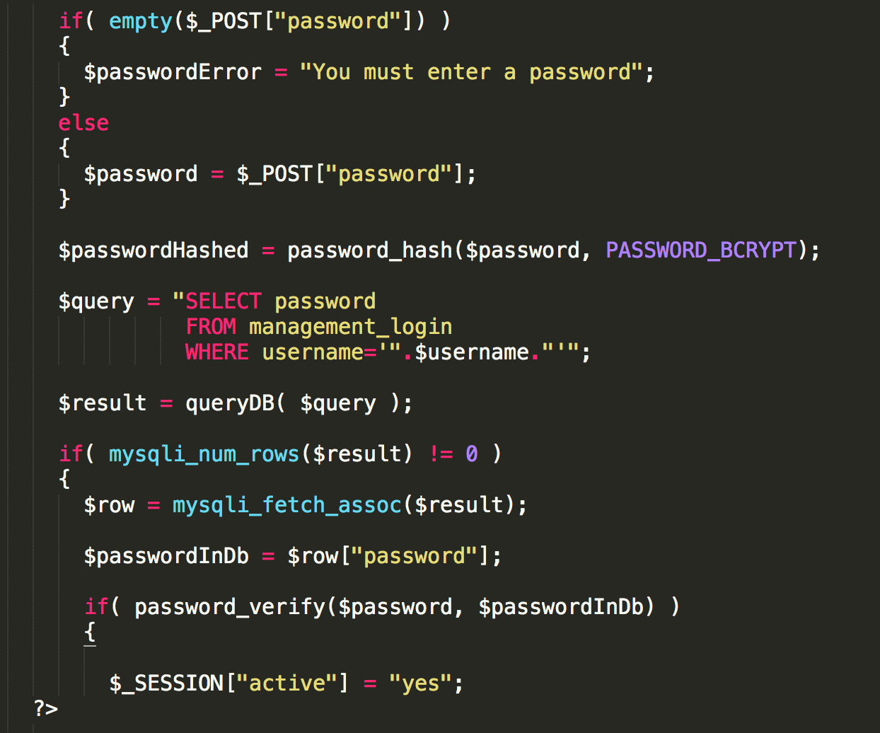
Main algorithm
Notes:
6. Detailed design:
6.1. Minimal class diagram. Identify the design patterns used (one or more slides).
6.2. State machine for the main control object or the most important object of the implemented uses cases (one or more slides).
6.3. Main algorithm used related to an implemented use case described above (one or more slides).

Slide 13
Test Case Management Website Login
Test Case ID: | Management_Website_Login_Sunny_day
Purpose: | To ensure that the admin user can log in successfully.
Preconditions: | The computer that the admin user is using is connected to the Internet.
Inputs: | The user enters valid credentials: username and password.
Expected Output: | The user gets authenticated.
Notes:
7. Test Suites and Test Cases (one sunny day and one rainy day) for the use case represented in part (5) above (2 slides).
7.1 One sunny day and one rainy day for the implemented use cases (one or more slides).
7.2 Automated test scripts for the implemented use cases (one or more slides).

Slide 14
Test Case Management Website Login
Test Case ID: | Management_Website_Login_Rainy_Day
Purpose: | To ensure that the admin user can log in successfully.
Preconditions: | The computer that the admin user is using is connected to the Internet.
Inputs: | The user enters invalid credentials: username and password.
Expected Output: | The user does not get authenticated.
Notes:
7. Test Suites and Test Cases (one sunny day and one rainy day) for the use case represented in part (5) above (2 slides).
7.1 One sunny day and one rainy day for the implemented use cases (one or more slides).
7.2 Automated test scripts for the implemented use cases (one or more slides).

Slide 15
Summary
In order to help alleviate the financial overhead that staffing agencies create, my teammate and I created the Go Local Staff App. Specifically, some of my contributions include:
A way for a user to reset his or her password.
A way to navigate from a list of staff to a specific detailed view.
A detailed profile view for a staff user.
A management website for for an admin user.
Notes:
Summarize your contribution
Include your contact information
Ask if anyone has any questions for you.
Thank your audience

Slide 16
Wilfredo G Gomez
wgome015@fiu.edu
Thank you!
Notes:
Summarize your contribution
Include your contact information
Ask if anyone has any questions for you.
Thank your audience

