Slide 1











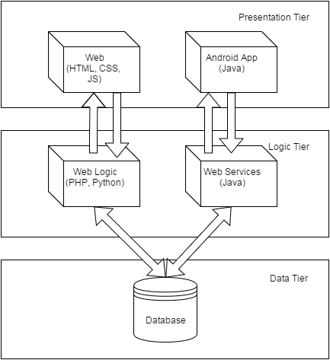
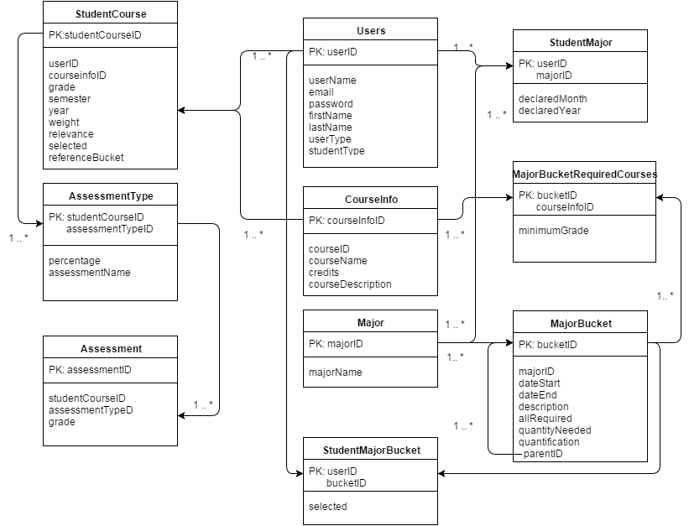
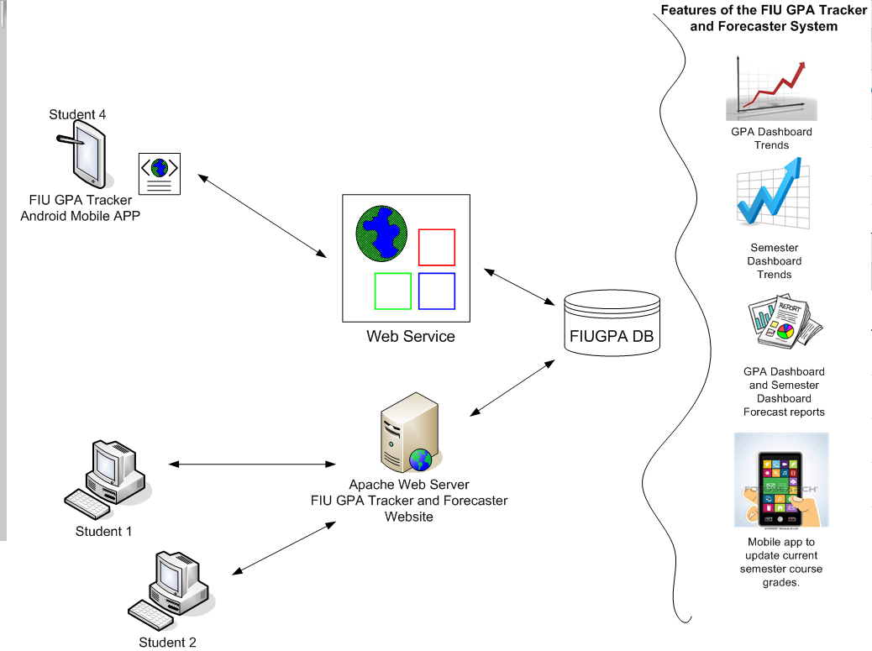

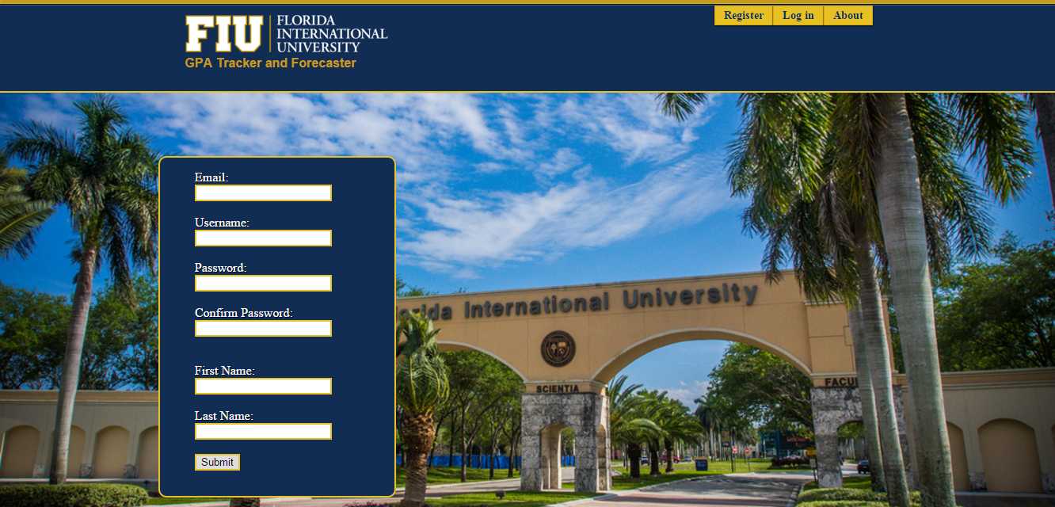
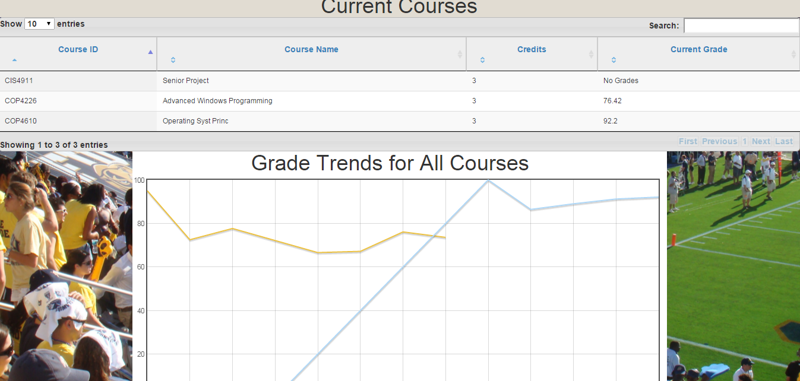



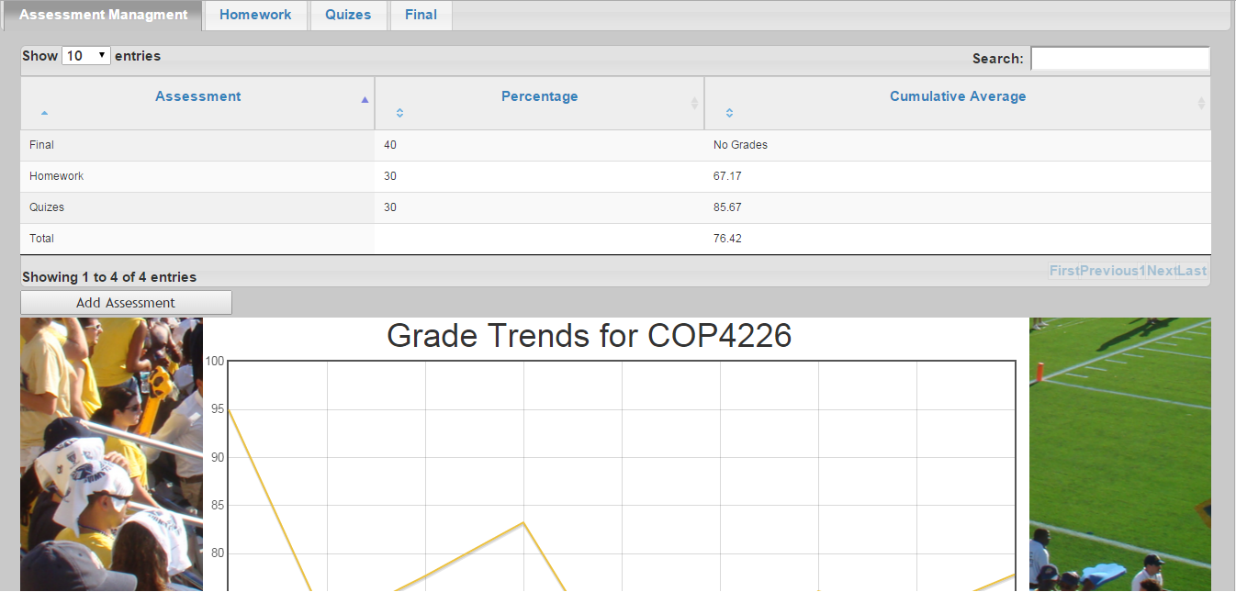
School of Computing & Information Sciences
Senior Project, 2015, Fall
FIU GPA Tracker and Forecaster
Student: Juan Machado, Florida International University
Mentor: Johann Henao, Florida International University
Instructor: Masoud Sadjadi, Florida International University
Problem
Current System
Requirements
FIU students are frequently unaware of GPA requirements needed to get in to graduate school. Furthermore, even if they are aware of what is necessary, they may not know how to or be unwilling to go through the tedious of computing several possible scenarios.
Additionally, many students have trouble keeping up with their academics from semester to semester since professors frequently keep exams and even if everything is returned it is tedious to recalculate average after every new assessment.
Under the current system, to predict what grades they need to achieve a GPA they need to add up all their existing grades, which for upperclassmen could be extensive, and manually create an equation with all their remaining classes to compute what they need.
For semester grades, some professors post grades on Moodle. Others, however, keep all assessment. For a student to keep up they need to keep a log of all their grades and precompute every time they get a new grade.
The system should persistently store the user’s grade and be able to generate a forecast with what a student needs to get to get a certain GPA.
The system should accept grades from user and persistently store them. It should be able to calculate the Grade for every course.
The system should provide users a way automate importing their grades.
The system should give admin privileges to change information about curriculum requirements.
System Design
Object Design
Implementation
We are using a three tier system architecture with the Presentation Tier being controlled done with HTML, CSS, and JS for Web and with Java for the Android app. The Logic tier is done with PHP for Web and Java for web services. They both communicate with the same DB.
Verification
Screenshots
Summary
System testing was done by creating a set of test cases for each user story with defined pre-conditions and expected output. Test cases were a mix of sunny day and rainy day scenarios. Selection of test cases was also done by selecting extremes of what can be inputted. Testing was done on the following browsers:
We strongly believe that this website has the potential to benefit students. Great emphasis has been put into making the website easy and intuitive to use. With the overall GPA Dashboard any student can determine what GPA they need to be able get into graduate school and can automatically compute what grades they need. Furthermore they can ensure they succeed academically in any given semester by being able to track how they are doing in all classes at any given moment.
Acknowledgement
The material presented in this poster is based upon the work supported by … I am thankful to the help that I received from my group members, … .

