Slide 1









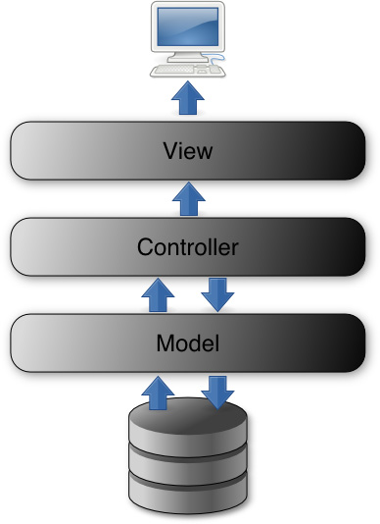

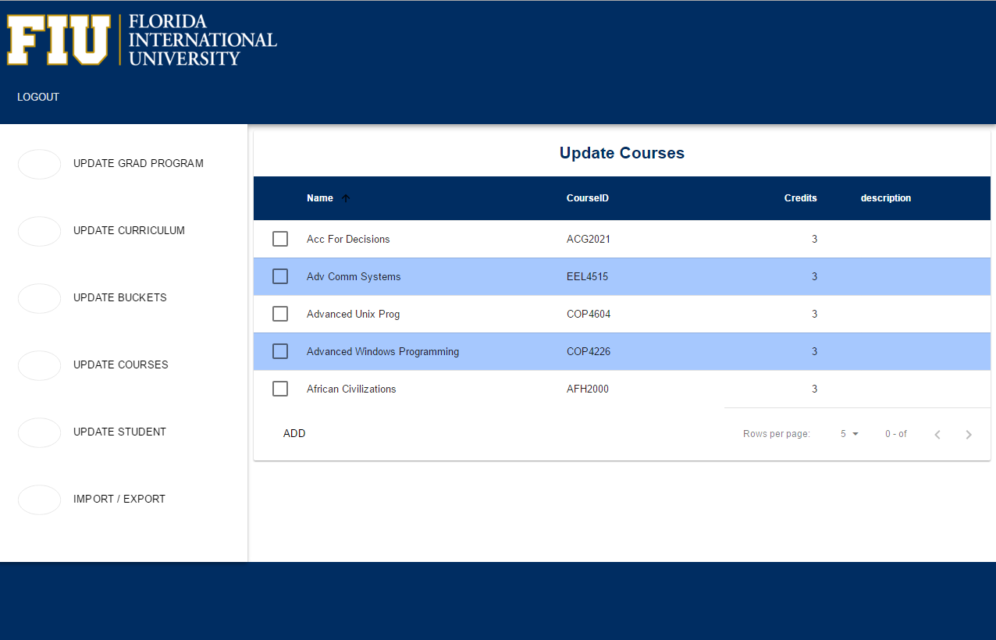
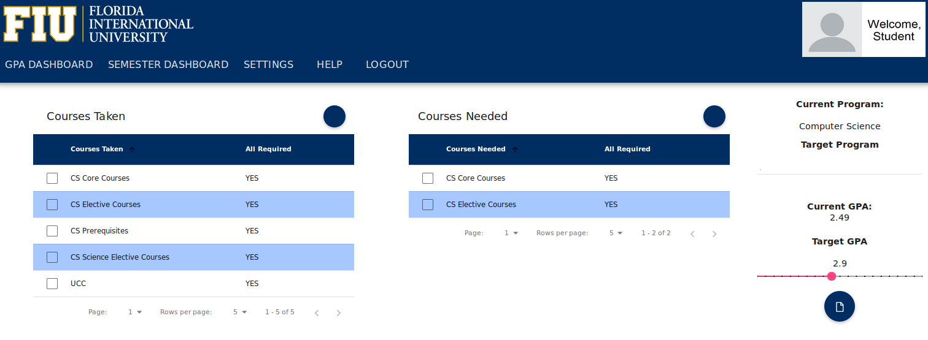


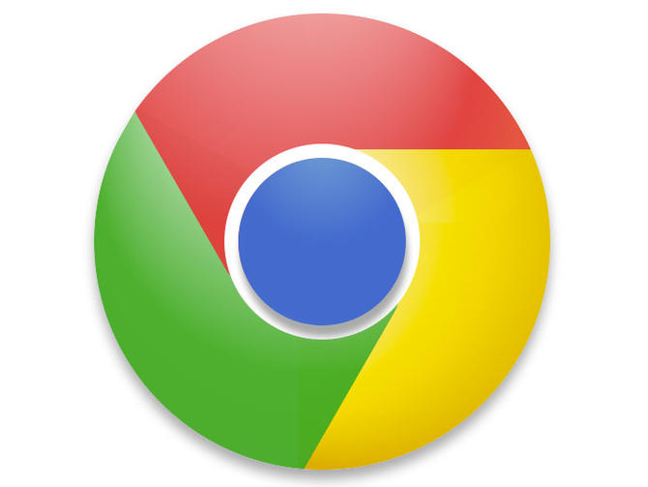

School of Computing & Information Sciences
Senior Project, 2016, Spring
FIU GPA Tracker and Forecaster
Student: Alex Sanchez, Florida International University
Mentor: Johann Henao, Florida International University
Instructor: Masoud Sadjadi, Florida International University
Problem
Current System
Requirements
Students intending on entering a graduate program often do not know about GPA requirements. They do not have a system in place to track their GPA and ensure they are on track to meet their goal.
Additionally, it is tedious for student’s to calculate their current grades each semester. This may seem like an overwhelming process for the student if they are not sure how their grades should be properly calculated.
An automated system is in place for the student to import their course history. From the course history the system can determine the courses the student is still required to take. They can then give their input on how difficult the course is and how well they want to perform. The forecast reports will give them advice on what grades are needed to achieve their goal. In addition, it will display a graph of their GPA history and display projections of how their GPA will look going forward.
The system should have a modern look and feel and be easy and intuitive to use.
The system should maintain an error log with different types of errors.
The student’s course history as well as courses they still need to take should be displayed.
The system should generate forecast reports that will show the student if they are on track to earn their goal GPA
System Design
Object Design
Implementation
Front end implementation uses html and now AngularJS in place of JQuery. Angular Material is used to update the site to Material Design.
Backend implantation uses PHP to communicate with the database and to log errors. Separate threads and processes are used to ensure the user does not experience performance issues when the system is writing to the log.
Verification
Screenshots
Summary
Unit testing was done using PHPUnit. This allowed an automated test suite to be built and continue testing as new features were added. Integration testing was done on the following browsers:
The FIU GPA Tracker and Forecaster will be a great tool to help student’s plan for success. They can view past grades, track current semester grades, and plan for the future.
The forecast reports will ensure that student’s will achieve their goal "ONE SEMESTER AT A TIME“.
Acknowledgement
The material presented in this poster is based upon the work supported by Johann Henao I am thankful to the help that I received from my group member, Lizette Mendoza.

