Slide 1










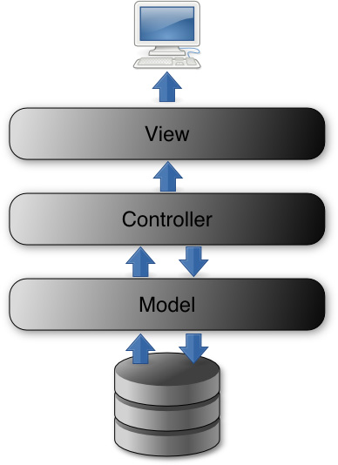
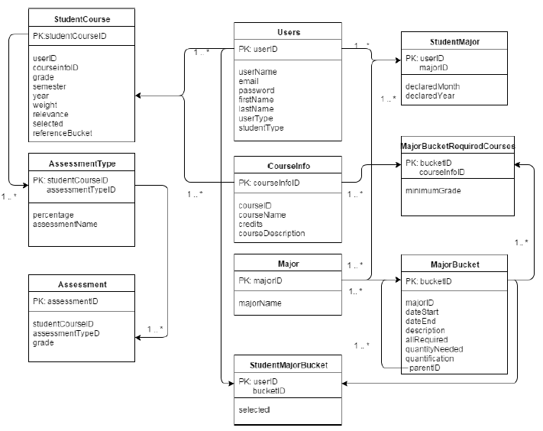



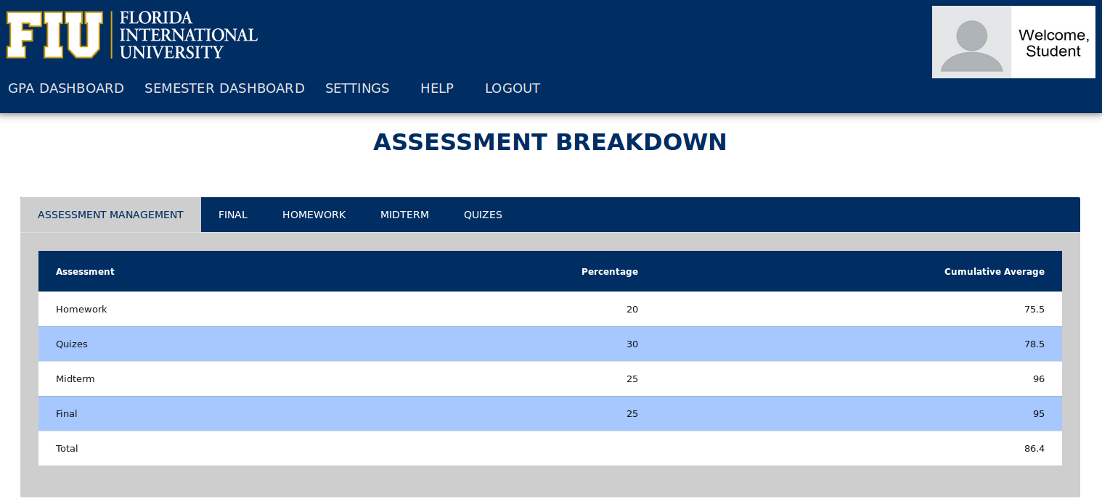
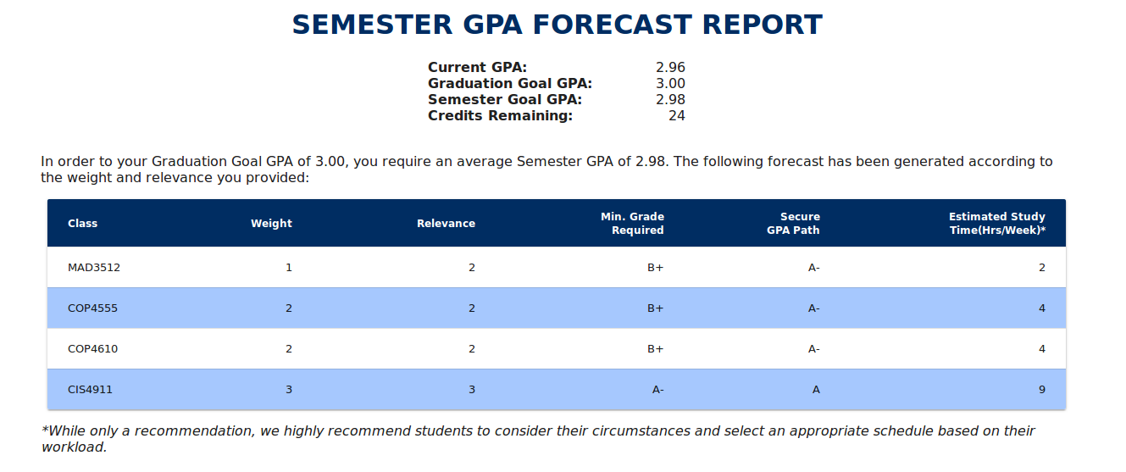

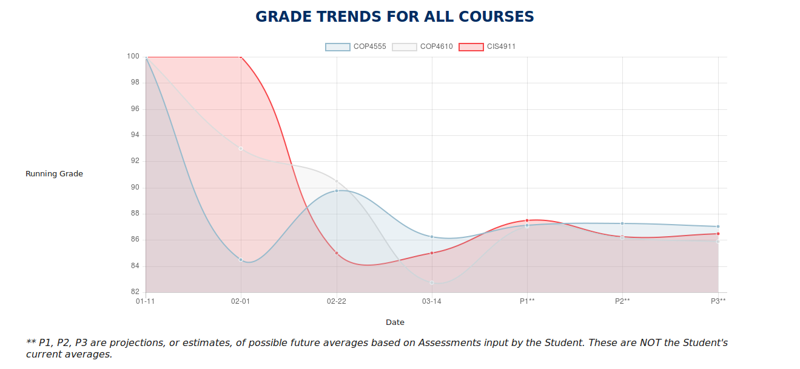


School of Computing & Information Sciences
Senior Project, 2016, Spring
FIU GPA Tracker and Forecaster 2.0
Student: Lizette Mendoza, Florida International University
Mentor: Johann Henao, Florida International University
Instructor: Masoud Sadjadi, Florida International University
Graduate programs, Honor roll, Graduation…
What do they all have in common? They all have a minimum GPA requirement. Unfortunately, many students fail to plan ahead and have found themselves short, if not struggling, to meet their GPA goal by the time graduation rolls around. Even those who are aware may not know how to calculate what they need to achieve their goal, which is a very tedious process to do every semester, and for every new graded assignment.
Some students may become disheartened about their ability to reach their goal when the difficulty level of certain courses increase. Little do they know that their goal is still attainable, even if they don’t get the best grade in the course. Hope is not lost!
The GPA Tracker and Forecaster was built to help students stay on track with their GPA as they progress through journey at FIU. Currently, keeping track of GPAs and grades is a manual process. The GPA Tracker, though, will help students visually see what grades and GPA they need to reach their goal and break it by down by semester on how they can attain it. What’s so unique about this system is that it takes in the student’s input on just how well they want to do in certain courses over others. This easy-to-use system takes care of all the tedious, dirty work of calculating where the student needs to go, how to get there, and projecting where they’re headed.
The GPA Tracker and Forecaster should do the following:
Automatically populate student’s information via PantherSoft’s GPA Audit.
Allow students to input assessment grades and monitor their average over the semester.
Allow student’s to select the weight (course difficulty level) and relevance (level of importance to student) for remaining courses.
Generate Forecast Reports based on a student’s GPA goal, weight and relevance input, and previous and current grades and courses to provide a forecast on what is needed to achieve their goal.
Give administrators the ability to change information about curriculum requirements and student data.
Front-end implementation uses HTML, AngularJS and CSS. Angular Material is a framework that replaced the previous jQuery features in order to add more dynamics and to increase performance and usability. The design was updated to Material Design to give a cleaner, more spacious look.
Back-end implementation included PHP to communicate with the database and log errors. To improve performance, separate threads and processes are used to ensure no issues occur when the system is writing to the log.
Systems tests and unit tests were conducted on the system. Test cases include “test setup”, “input values” and “expected outputs”. Testing took into account a number of different student scenarios, i.e. freshman, senior, etc. Extreme and middle values were tested to complete as much to achieve as much coverage as possible. Tests were conducted on Google Chrome, Mozilla Firefox, and Internet Explorer browsers.
Benjamin Franklin once said, “If you fail to plan, you are planning to fail!” We are confident that students who use the GPA Tracker and Forecaster 2.0 will have much greater chance of achieving their GPA goal because they are using the tracker to plan – avoiding failure. This tool is a student’s aid to success,
ONE SEMESTER AT A TIME!
The material presented in this poster is based upon the work supported by Johann Henao. I am thankful to the help that I received from my group member, Alex Sanchez.

