Slide 1
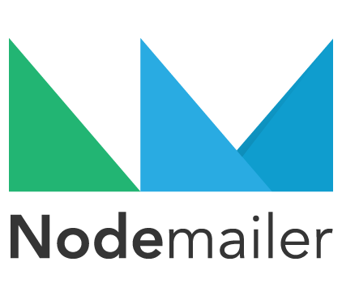


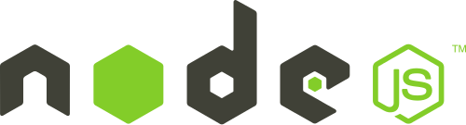
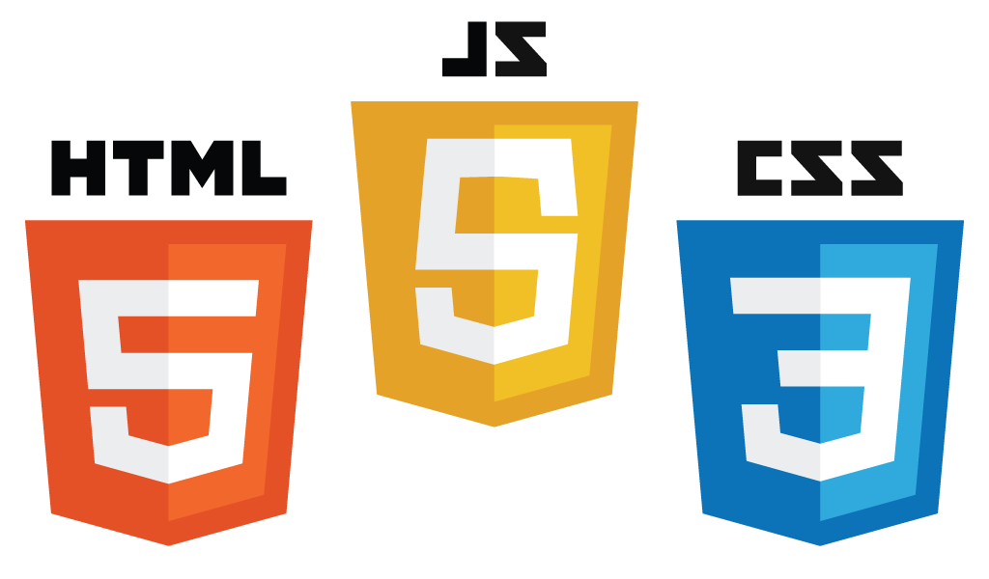
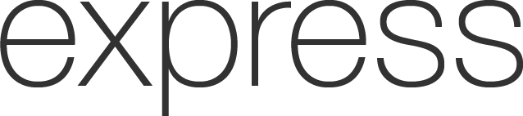

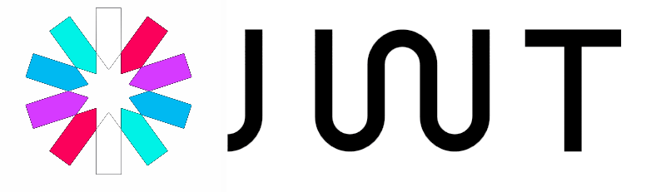


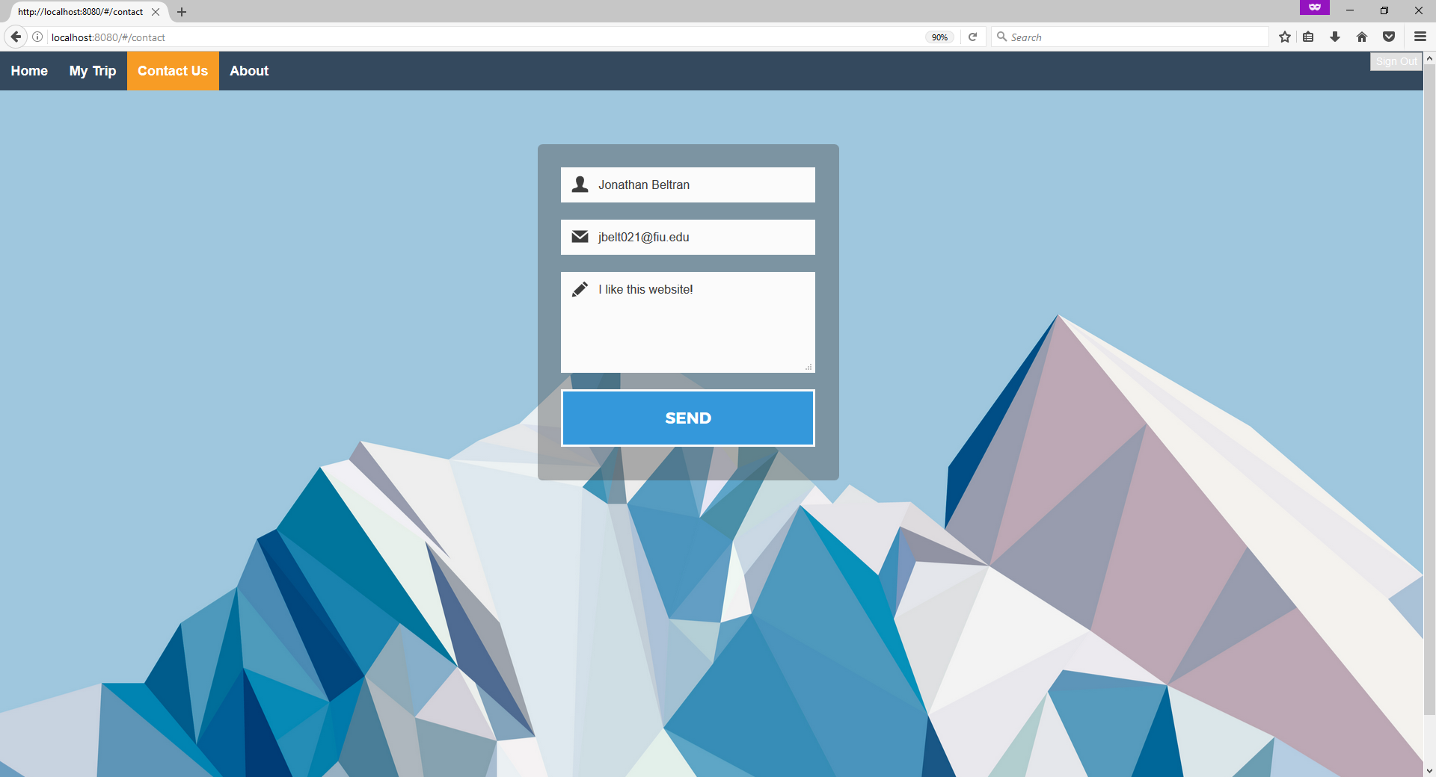
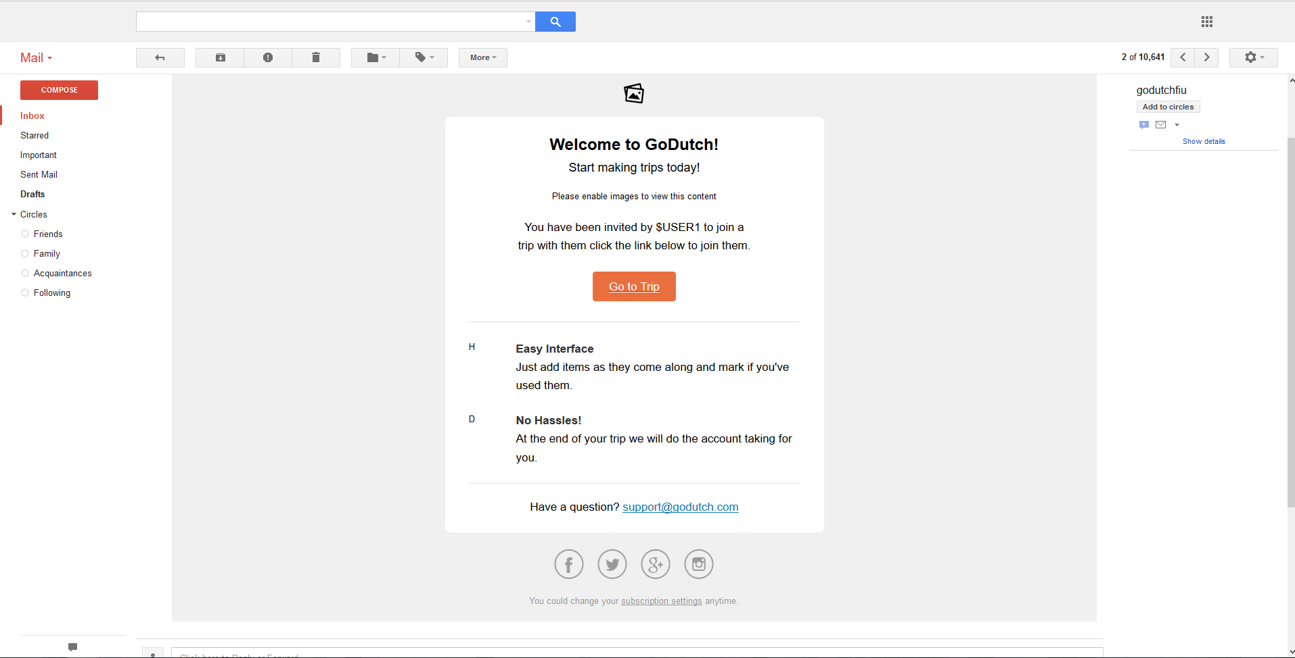
School of Computing & Information Sciences
Senior Project, 2017, Spring
GoDutch v1.0
Student: Jonathan Beltran, Florida International University
Mentor: Dr. Deng Pan, Mohsen Taheri, Florida International University
Instructor: Masoud Sadjadi, Mohsen Taheri, Florida International University
PROBLEM
CURRENT SYSTEM
REQUIREMENTS
When going on trips between friends or collogues, the worst part of the trip is “settling up”. Disputes can happen between friends over the smallest of purchases and usually ends up in people paying more (or less) than what they actually need to. Keeping track of who consumed which item and when they did is also inconvenient. More importantly the entire process can take a group of individuals months before anyone actually “settles up”.
When looking at other applications that attempt to solve the problem of “settling up”, most of these applications are built around a single user editing and maintaining the entire trip. This does not deal with the inconvenience of keeping track of who consumed what item. GoDutch seeks to eliminate this problem by allowing for true collaboration from everyone involved. GoDutch also allow for users to tell the group what they consumed and what they purchased and also calculates the total cost of the trip in the end to minimize transactions.
In order to solve the problems mentioned before we need to create an application that is clear and intuitive. We must also make it easy for the person who creates the trip to be able to invite the friends/collaborators involved in the trip or we simply create another inconvenience. When users do join the trip and begin to make changes, we want all the other users to see these changes immediately, this requires the website to be real-time. More importantly, because this application deals with payments security has to be as important as the function of the application itself.
SYSTEM DESIGN
IMPLEMENTATION
The system was designed following an Model-View-ViewModel. We chose this over model-view-controller because the view can be changed without intervention from the controller. So instead of the traditionally controller from MVC, we are using sockets which send messages that can change the current view of the user. This type of structure is what allows for real-time collaboration to happen however its strain on the server is heavy.
GoDutch uses the sockets.io service to handle our websocket needs. It allows for simple creating and deletion of websockets for all clients who come to our site.
GoDutch uses nodemailer to send SMTP messages which for us service the way users can invite each other to trips. An example email can be seen in Figure 2.
Figure 1 has an example of our Contact Us page
SCREENSHOTS
OBJECT DESIGN
The system was developed following a Front Controller Pattern approach and can be seen in Figure 3. The reason we chose this pattern was because our sockets provide a centralized request handling mechanism. The single handler in this case is the SocketsIO object, its dispatcher are the rooms which a socket can communicate to and the views are the different room functions.
Figure 1. Contact Page example
Figure 3. Front Controller Pattern
Figure 2. Nodemailer example email
ACKNOWLEDGEMENT
The material presented in this poster is based upon the work supported by Zhenglin Pan and Jonathan Beltran. Special thanks to my mentors Mohsen Taheri and Dr. Deng Pan for their advice along the way.

