Slide 1

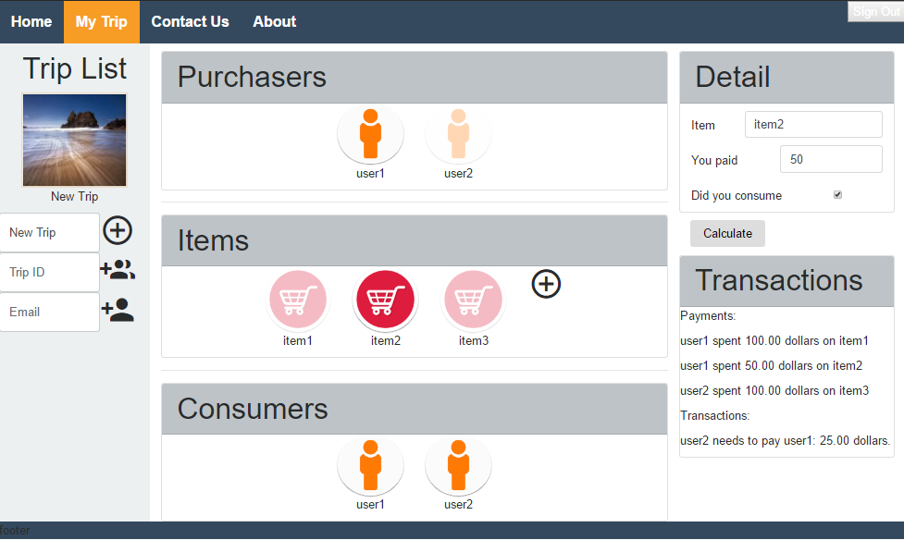
School of Computing & Information Sciences
Senior Project, 2017, Spring
GoDutch v1.0
Student: Zhenglin Pan, Florida International University
Mentor: Dr. Deng Pan, Mohsen Taheri, Florida International University
Instructor: Masoud Sadjadi, Mohsen Taheri, Florida International University
Problem
Calculating group trip cost per person is a boring and time consuming process.
Different individual purchase and consumption situations make fair cost distribution computation fallible.
Manual calculation can result in great amount of unnecessary transactions.
Solution
To solve the problems, we need to automate the cost distribution and in-group transaction calculation process.
A web application is needed to collect participants’ purchase and consumption records.
Minimum-Cost-Max-Flow algorithm is a good fit in this case to analyze and compute cost distribution and transaction.
Requirements
UI must be clean and easy to use.
Users must be able to edit the same trip simultaneously and see changes in real time.
All calculation must happen on the server side.
Algorithm must produce the correct result in 0.1 second for any group within 1000 participants.
System Design
Two architectural patterns are used (Figure 1).
Model-View-ViewModel (MVVM)
View and ViewModel are
connected through data binding
using Angular.js.
ViewModel propagates changes
to Model through routing and
saving services implemented in
Javascript on back end.
Client/Server (C/S)
Users send requests from Client
to Server to utilize services such
as save/load changes and
calculate transaction.
Client and Server communicate
through socket messages
handled by Socket.io.
Object Design
Front Controller
All front requests are sent through Socket and handled by Route (Figure 2).
Figure 1. GoDutch leverages both MVVM and C/S architectural patterns.
Figure 2. GoDutch uses front controller design patterns.
Implementation
GoDutch follows top-to-bottom and left-to-right reading habit with soft color combinations (Figure 3).
The purchasers and consumers of selected item are highlighted.
Transaction list clearly displays payment records and in-group transaction result.
Transaction result is generated using Min-Cost-Max-Flow algorithm (Figure 4).
Purchasers are connected from the Source and all users are connected to the Sink.
All users are fully connected to each other.
Figure 3. GoDutch User Interface.
Figure 4. Min-Cost-Max-Flow Graph Model.
Acknowledgement
The material presented in this poster is based upon the work supported by Zhenglin Pan and Jonathan Beltran. I am thankful to the help that I received from my product owner Dr. Deng Pan and instructor Mohsen Taheri.
Notes:
1

