Slide 1





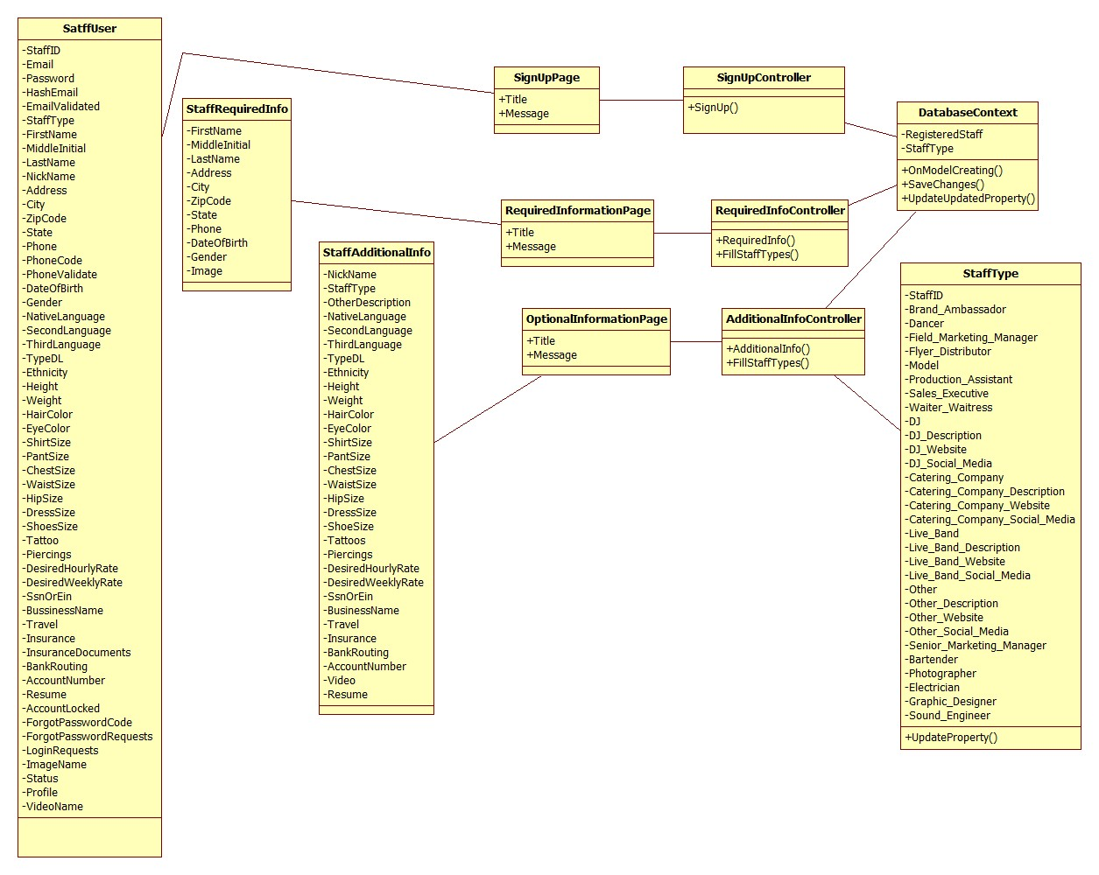
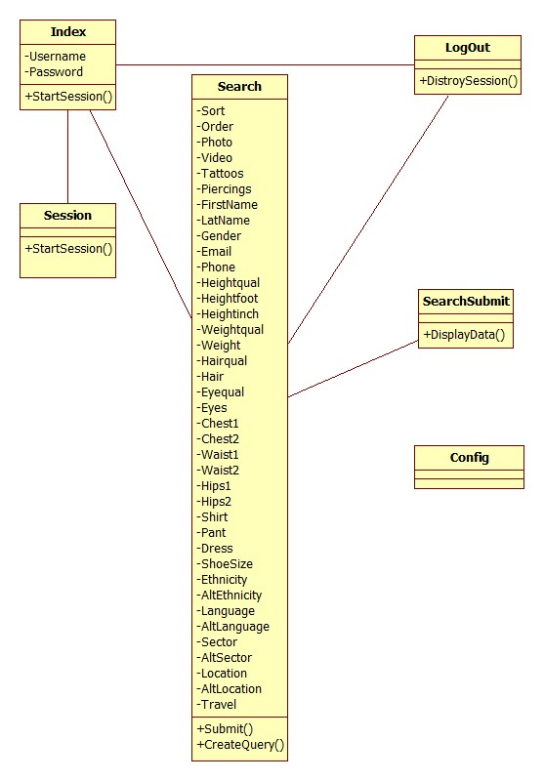
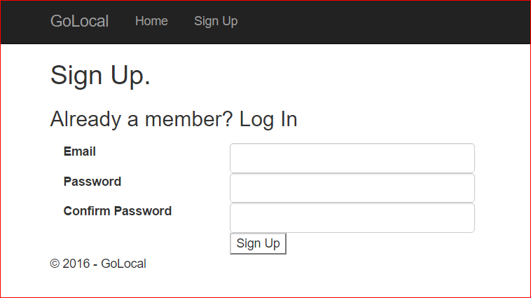
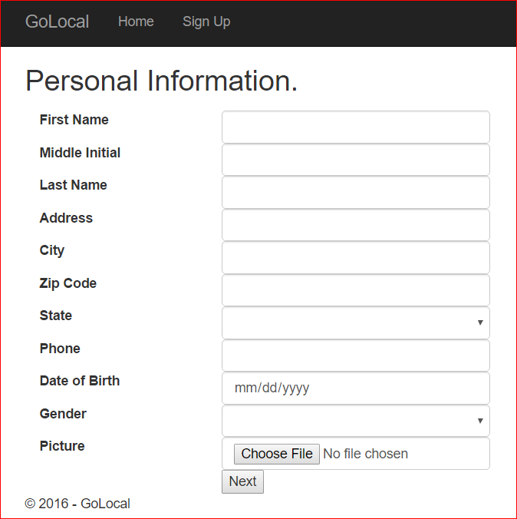
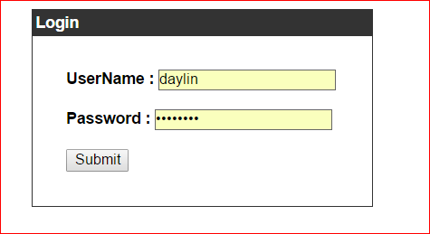
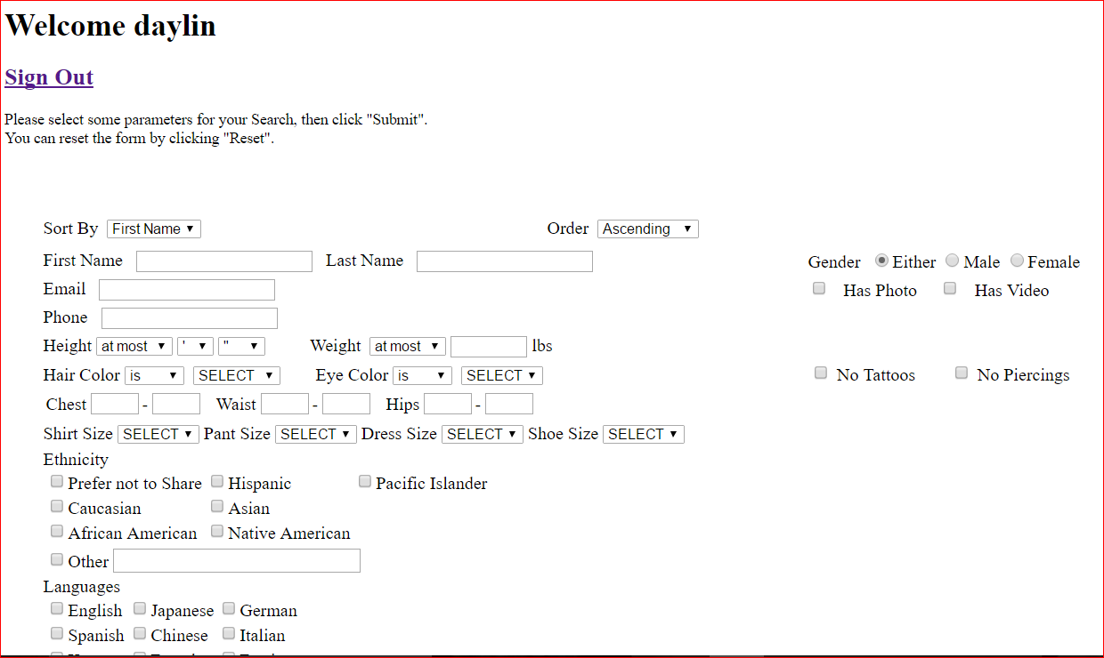
School of Computing & Information Sciences
Senior Project, 2016, Fall
Go Local Staff 3.0
Student: Daylin Gonzalez, Florida International University
Mentor: Eduardo Garcia, Mohsen Taheri, Florida International University
Instructor: Masoud Sadjadi, Florida International University
Problem
In order to find and manage the required staff to host events, employers have to go through a difficult and resource intensive process. Most of the times this process involves a middlemen which incur in high overhead costs as a result.
Current System
Staffing agencies attempt to tackle this problem by providing access to their collection of available talent. However, this collection is limited, often resulting in the need to visit several of these agencies in order to execute an event.
Communication and management are also bottlenecked by having to consult with these middlemen in order to accomplish anything.
Requirements
This web page will allow users to:
Create accounts as staff.
Browse for staff of all professions.
Browse for staff by criteria
View detailed staff information
Solution
Go Local Staff is a web page that aims to solve these issues by eliminating the middleman. The web page allows staff to register by entering personal information, and employers to search for staff by the criteria needed for a specific event. I have worked to implement the backbone of the staff registration and the staff search, including but not limited to:
Staff registration
Staff searching by criteria
Implementation
Registration Page
Visual Studio 2015 IDE.
Model View Controller design pattern.
ASP.Net Core
C Sharp
Razor Tag Helpers
JQuery
The server runs Linux, Nginx, MySQL and Asp.Net Core
Database Query Page
Visual Studio 2015 IDE.
HTML/PHP
Object Design
Registration Page
Database Query Page
System Design
Verification
Testing and validation was handled manually through the use of several test cases for each use case. Both sunny day and rainy day tests were considered to ensure that the system was working in many different conditions.
Summary
Go Local Staff web pages are a secure and efficient way for employers to search and connect with staffs without having to go through middlemen. This system reduces the overhead cost of organizing and hosting a perfect event.
Screenshots
Acknowledgement
The material presented in this poster is based upon the work supported by Eduardo Garcia and Mohsen Taheri.
Notes:
1

