Slide 1


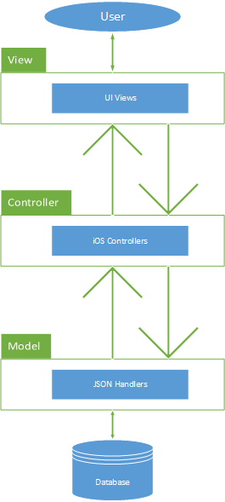
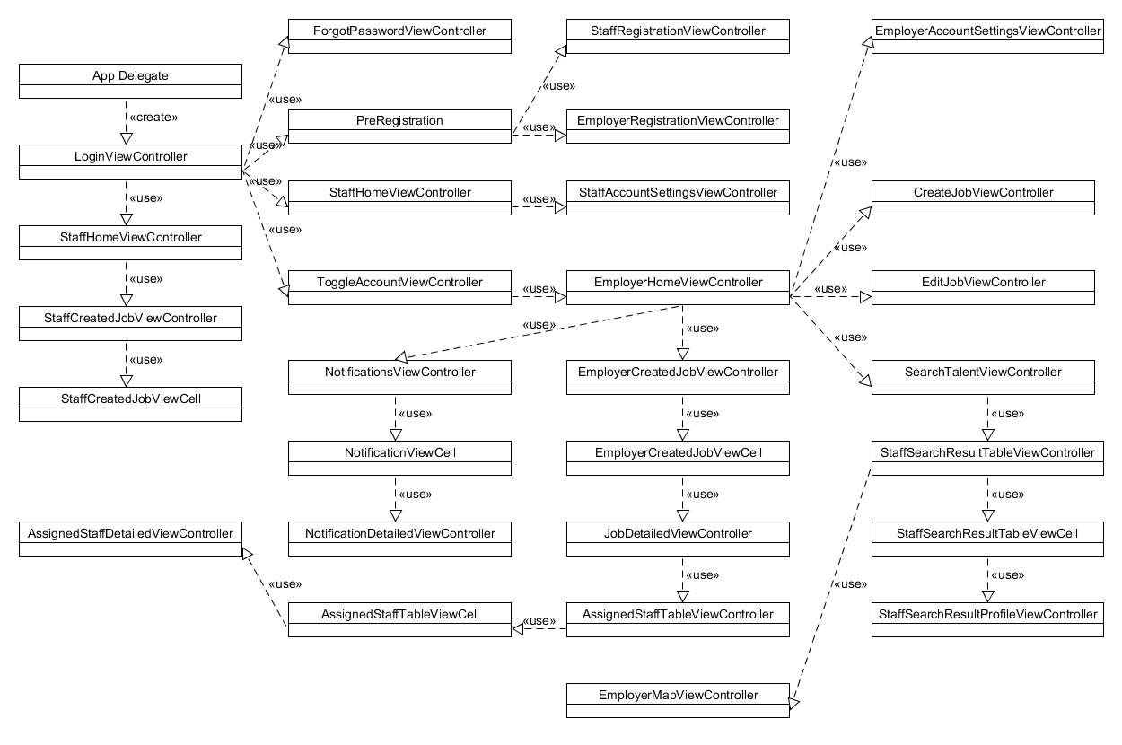
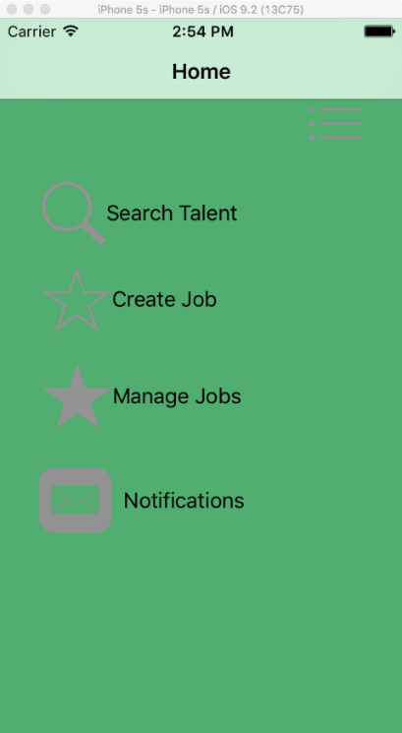
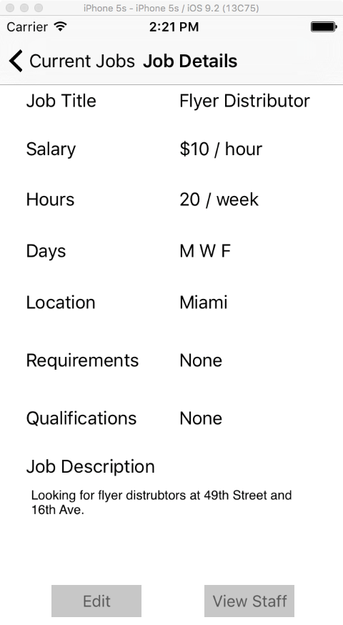
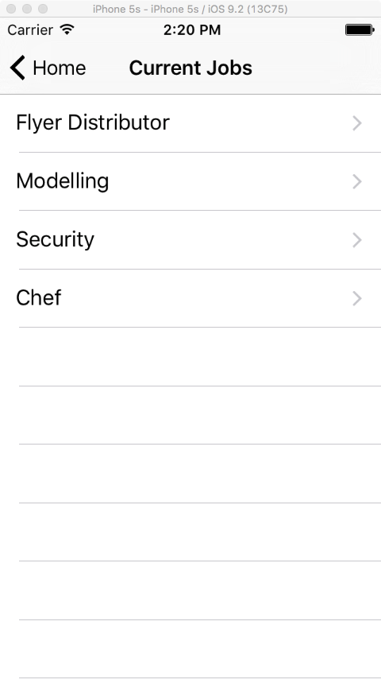
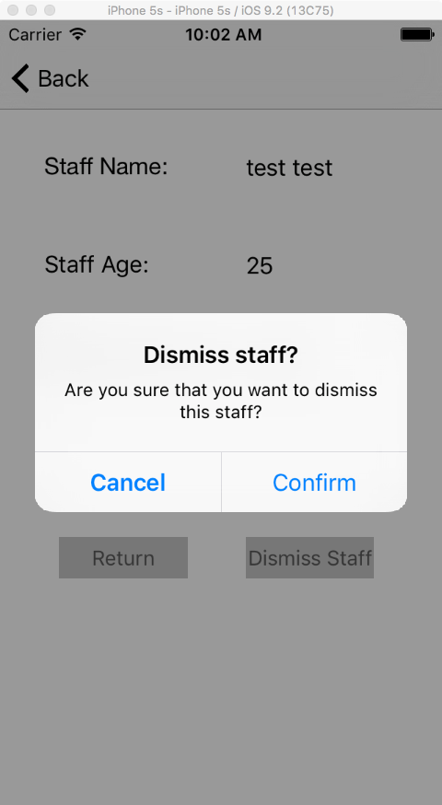
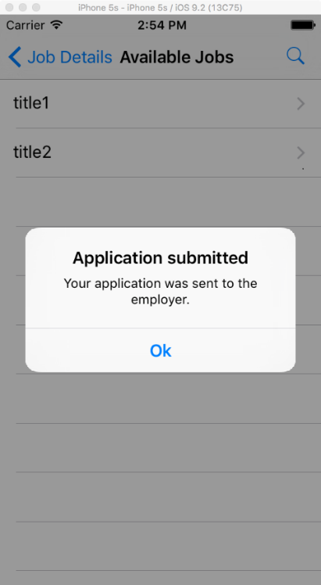
School of Computing & Information Sciences
Senior Project, 2016, Spring
Go Local Staff 2.0
Student: Daniel Gonzalez, Florida International University
Mentor: Eduardo Garcia, Go Local Promotions
Instructor: Masoud Sadjadi, Florida International University
Problem
Finding and managing the staff required to host events is a difficult and resource intensive process. Employers have to go through middlemen to find the staff they need, and incur high overhead costs as a result.
Solution
Go Local Staff is an iPhone application that aims to solve these issues by eliminating the middleman, connecting employers directly to their staff. The app allows employers to search for, employ, and manage staff. I have worked to implement the backbone of the staff and job management, including but not limited to:
Job creation and posting
Staff hiring/dismissal
Job searching
Job management
Requirements
This application will allow users to:
Create and manage accounts.
Browse for staff of all professions.
Create job postings visible to staff.
View detailed job information.
Apply for jobs as staff.
Book staff as an employer.
Manage the employer/employee interactions.
View detailed staff information
Manage job postings.
Receive notifications of pertinent events.
Current System
Staffing agencies attempt to tackle this problem by providing access to their collection of available talent. However, this collection is limited, often resulting in the need to visit several of these agencies in order to execute an event.
Communication and management are also bottlenecked by having to consult with these middlemen in order to accomplish anything.
System Design
Object Design
Implementation
The application is built using Objective-C in the Xcode IDE.
The system uses the model view controller design pattern.
The server runs Linux, Apache, MySQL and PHP and uses JSON POST requests to send and receive data.
Verification
Testing and validation was handled manually through the use of several test cases for each use case. Both sunny day and rainy day tests were considered to ensure that the system was working in many different conditions.
Screenshots
Summary
Go Local Staff is a secure and efficient way for employers to connect with a vast number of staff. This app removes the need for resource intensive middlemen and provides employers the tools needed to the host perfect event.
Acknowledgement
The material presented in this poster is based upon the work supported by Eduardo Garcia and Masoud Sadjadi. I am thankful to the help that I received from my group member, Stephenson Petit-Homme.
Notes:
1

