Slide 1
GoLocalStaff2
Introductory Video
Team Members
Stephenson Petit-Homme, Tester and Document Creator
Daniel Gonzalez, Tester and Document Creator
Product Owner:
Eduardo Garcia

Slide 2
Problem Definition
Event organizers always rely on staffing agencies for staffs whenever they’re planning events. This process raises some issues like:
The signed contract with agencies is expensive
Agencies Application process is lengthly for staff
Limited number of registered staff to agencies
GoLocalStaff solve all three problems

Slide 3
Requirements: User stories implemented
Website/ iPhone
Staff Registration(Website)
Login (Website)
Set up your profile(Website)
Post a resume on the system(Website)
View my saved resume(Website)
Allows employers to post jobs(Website)
Notified staffs when new jobs are posted(Website)
Logout from the website(Website & iPhone)
Create a job (iPhone)
View Job( iPhone)
Edit a job(iPhone)
Accept a job (iPhone)
View assigned staff(iPhone)

Slide 4
Use case: Staff registration
USER STORY DESCRIPTION: As a user, I need to be able to create an account, so that I can use the GoLocalStaff services.
Actors:
Staff
Pre-Conditions:
User is on the registration page
DESCRIPTION:
Use case begins when the user clicks on the signup button.
The user proceeds to enter his or her credentials in the form’s fields.
The user clicks on the submit button to submit his or her information.
Use case ends when the system creates a new account for the user.

Slide 5
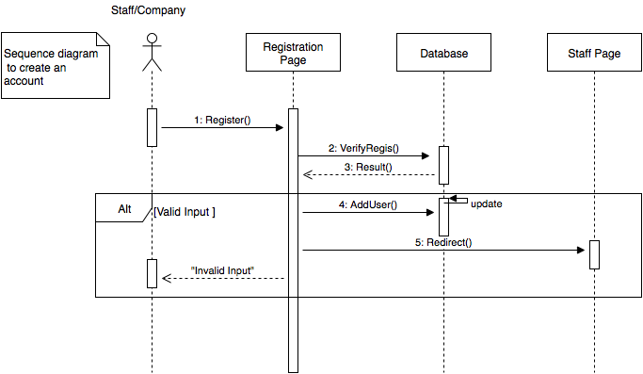
Sequence Diagram:Staff Registration

Slide 6
Use case: Create a Job
USER STORY DESCRIPTION: As an employer, I need to be able to post jobs, so that staff users can apply for them.
Actors:
Employers
Pre-Conditions:
User has already created an employer account
The device is connected to the internet.
The user is on the home screen.
DESCRIPTION:
Use case begins when the user clicks on the create job button.
The system will bring a form with all the required job information.
The user will fill out the form.
The user will click the done button.
Use case ends when the system creates .

Slide 7
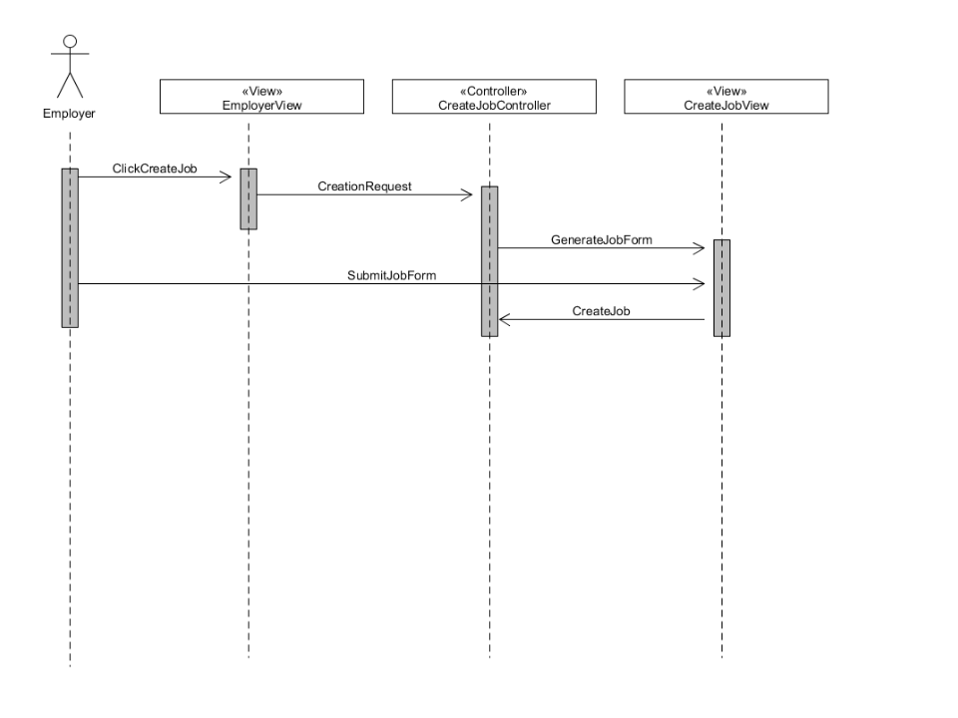
Sequence diagram: Create a job

Slide 8
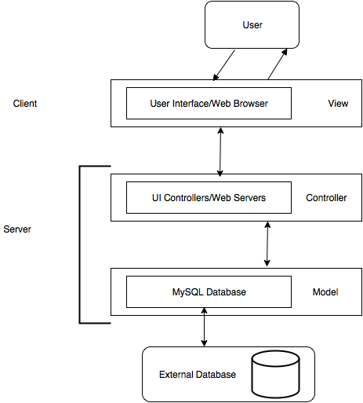
System Design: System Decomposition

Slide 9
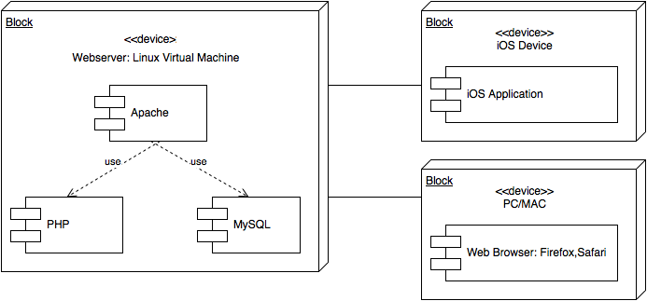
System Design: System Deployment
Hardware Requirements: Software Requirements
Linux based server *Objective-C,PHP,MySQL,
iPhone running iOS 9 or newer HTML,CSS,Xcode

Slide 10
Security/Privacy
Password Hashing
Data Validation
Access Control rules
Secure registration process

Slide 11
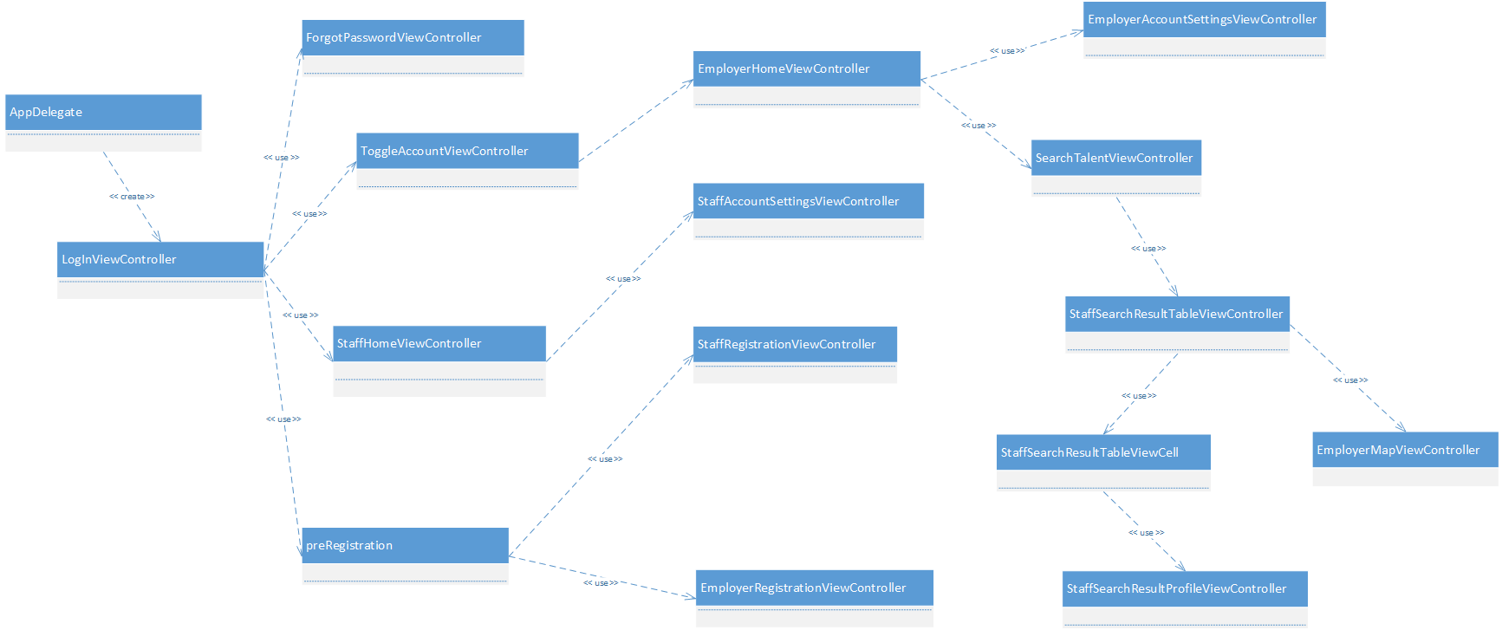
Detailed Design: Class Diagram

Slide 12
Sunny Test
Test Case for Staff Registration
Purpose: To enable users in creating a staff account
Preconditions:
User is connected to the internet
User is at the registration page
Inputs: User fills out the registration page by entering the required informations.
Expected Output:
User receives an email to verify his or her email
Once the email is verified, the system lets the user know that the account has been created

Slide 13
Rainy Test
Test Case for Staff Registration
Purpose: Prevent user from entering malicious input when creating an account
Preconditions:
User is connected to the internet
User is at the registration page
Inputs: User fills out the registration page by entering malicious inputs.
Expected Output:
Warns user of his or her inputs and allow him to reenter the information.

