Slide 1












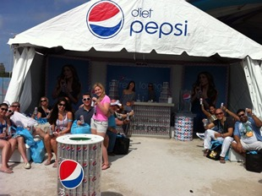
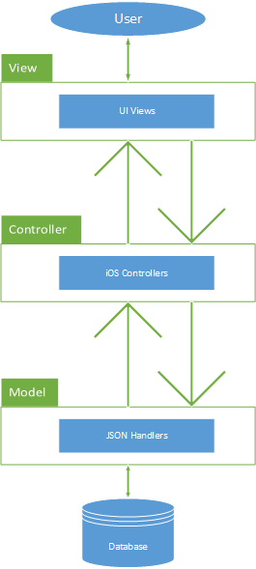
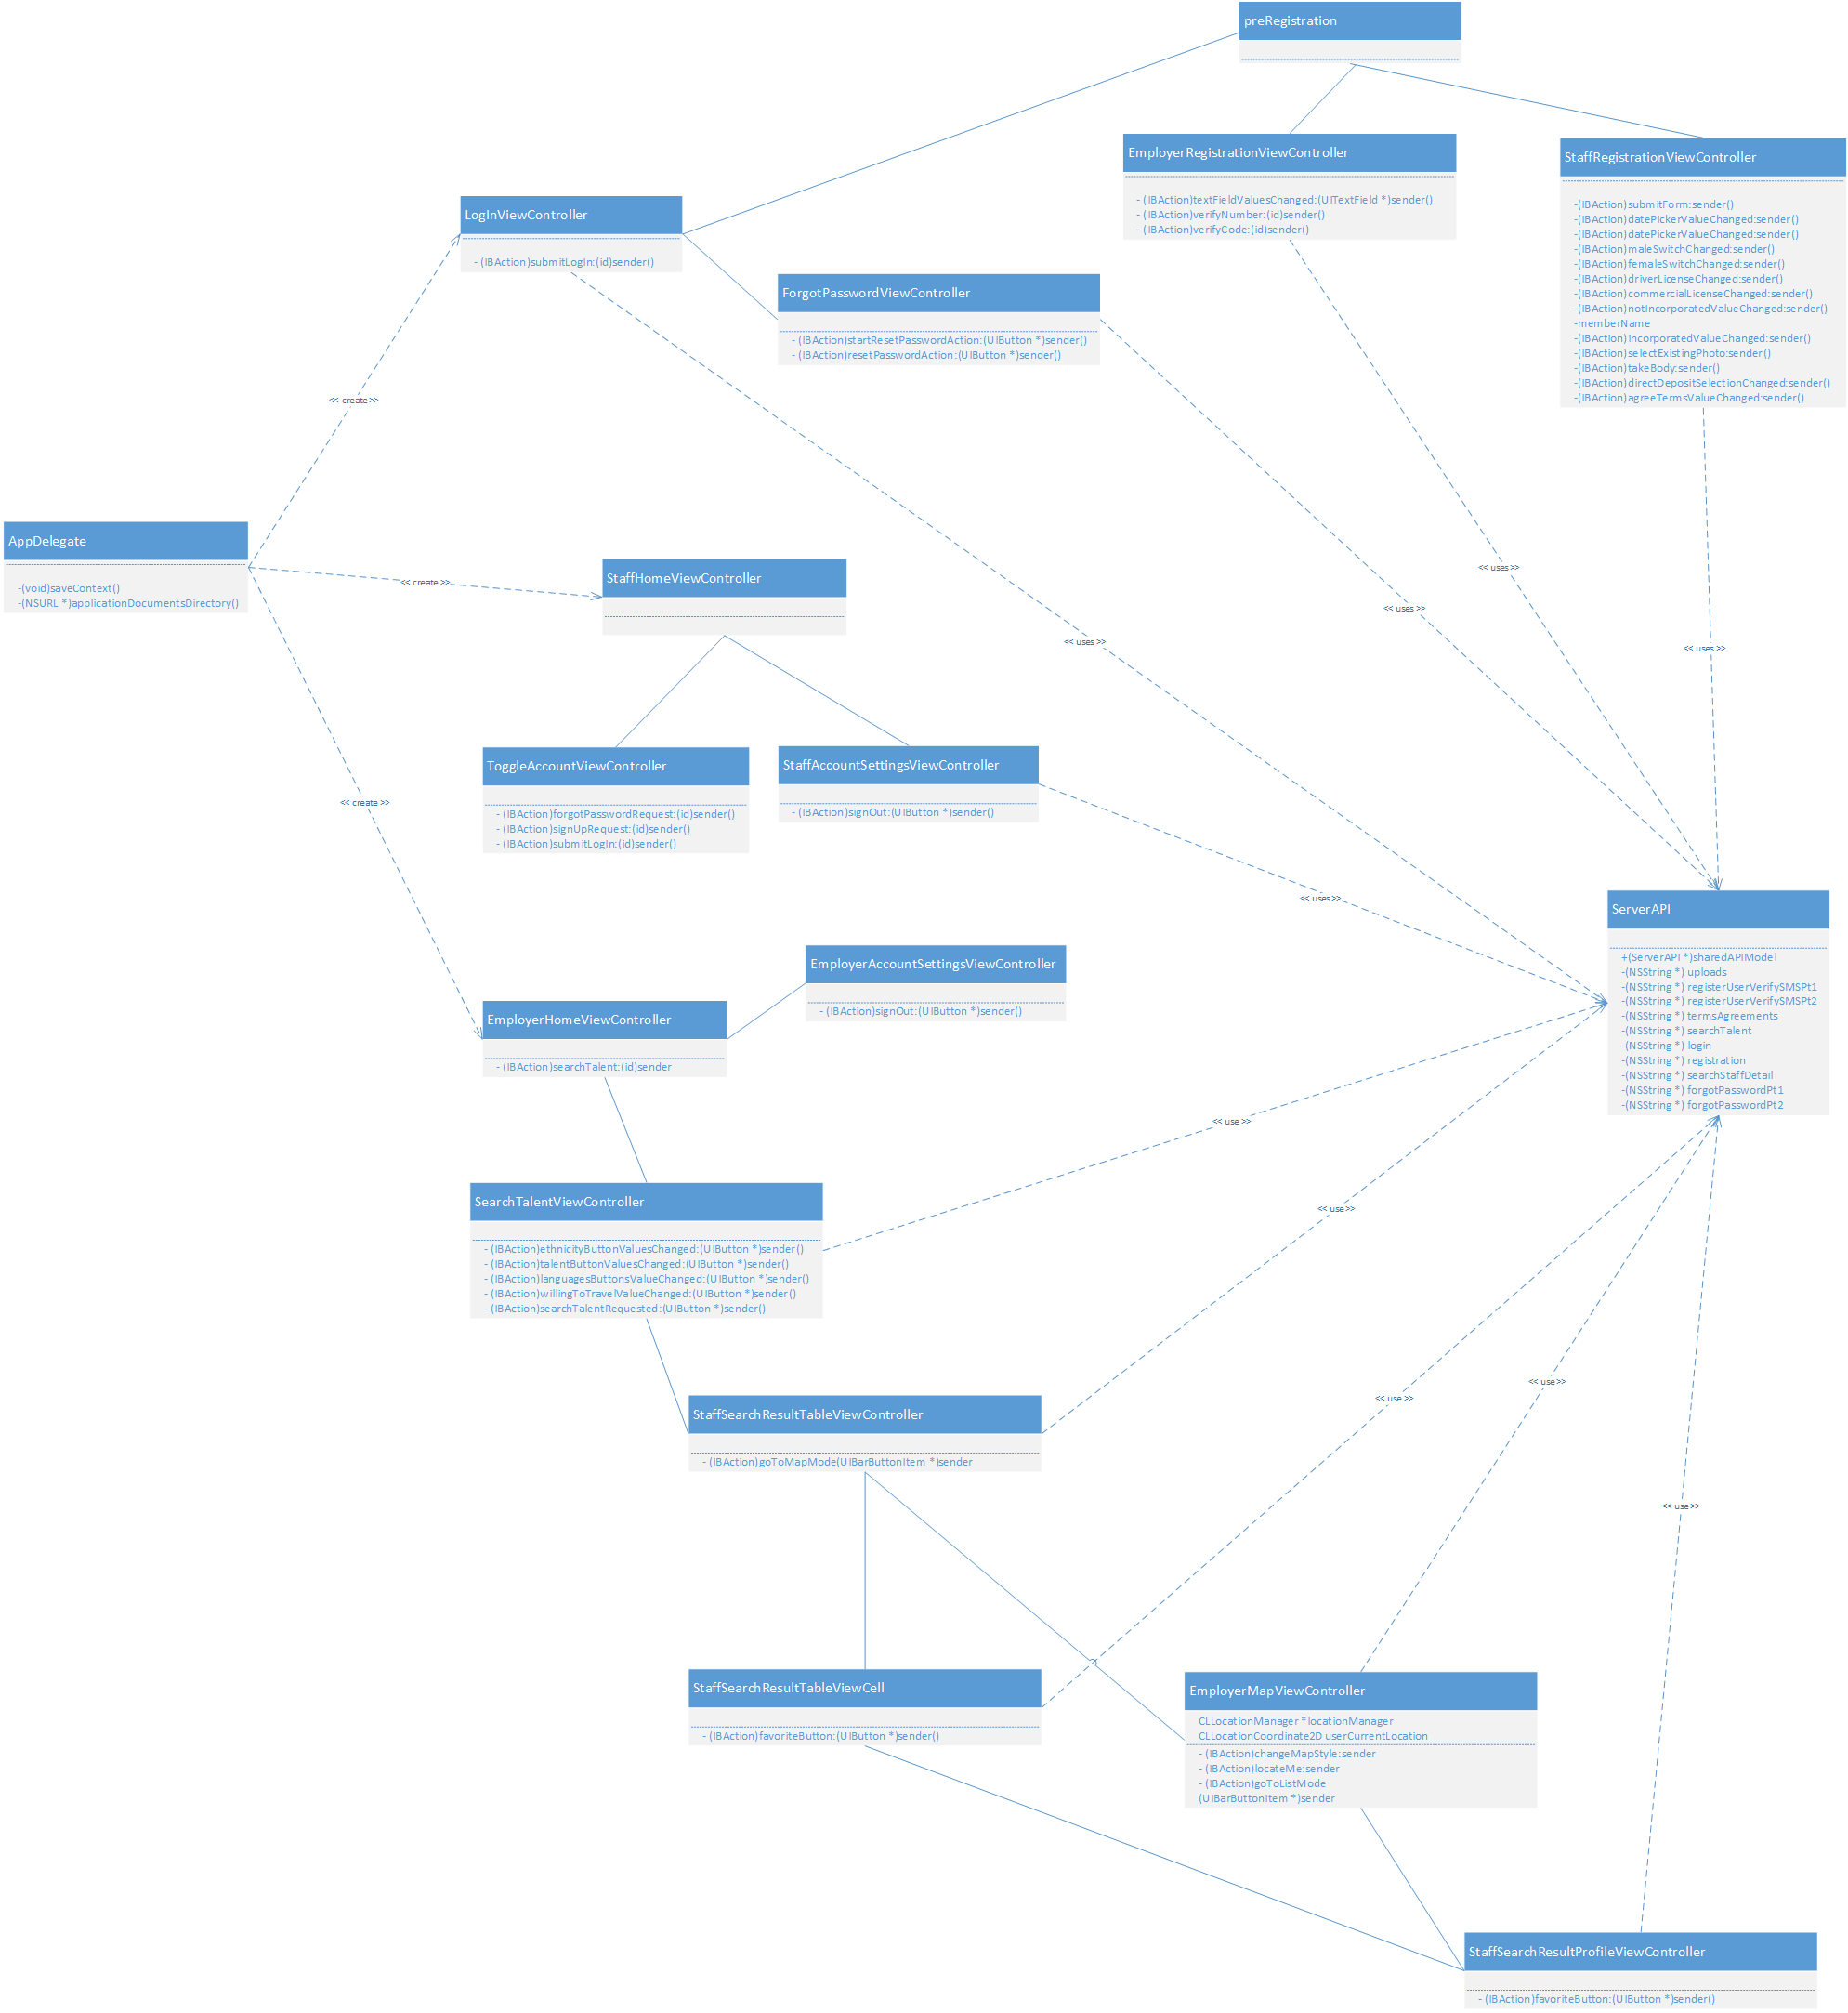
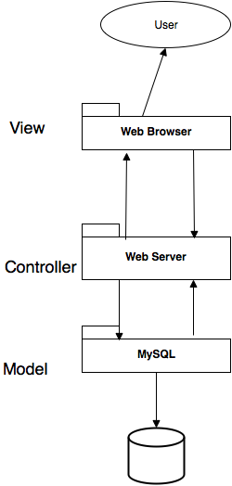
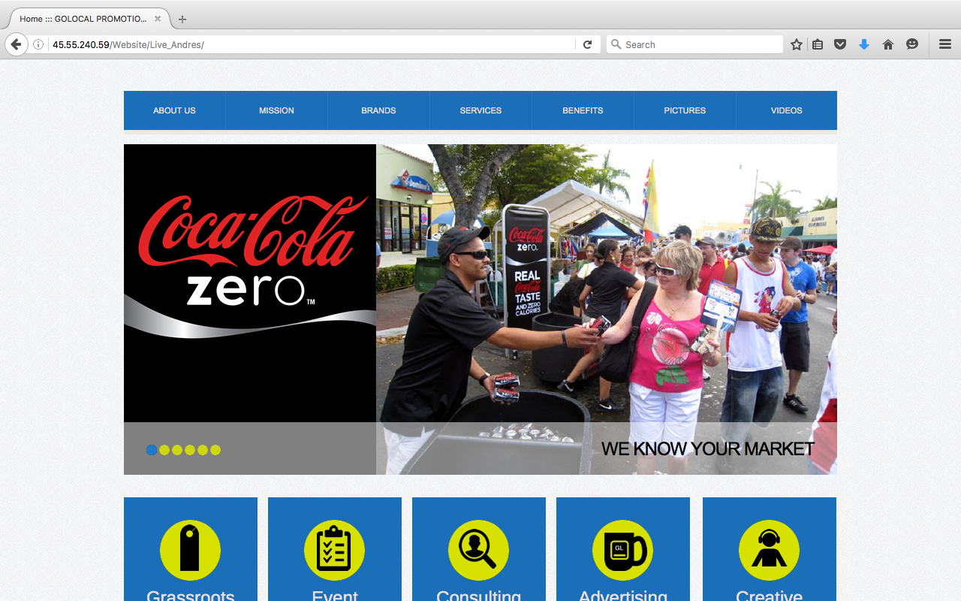
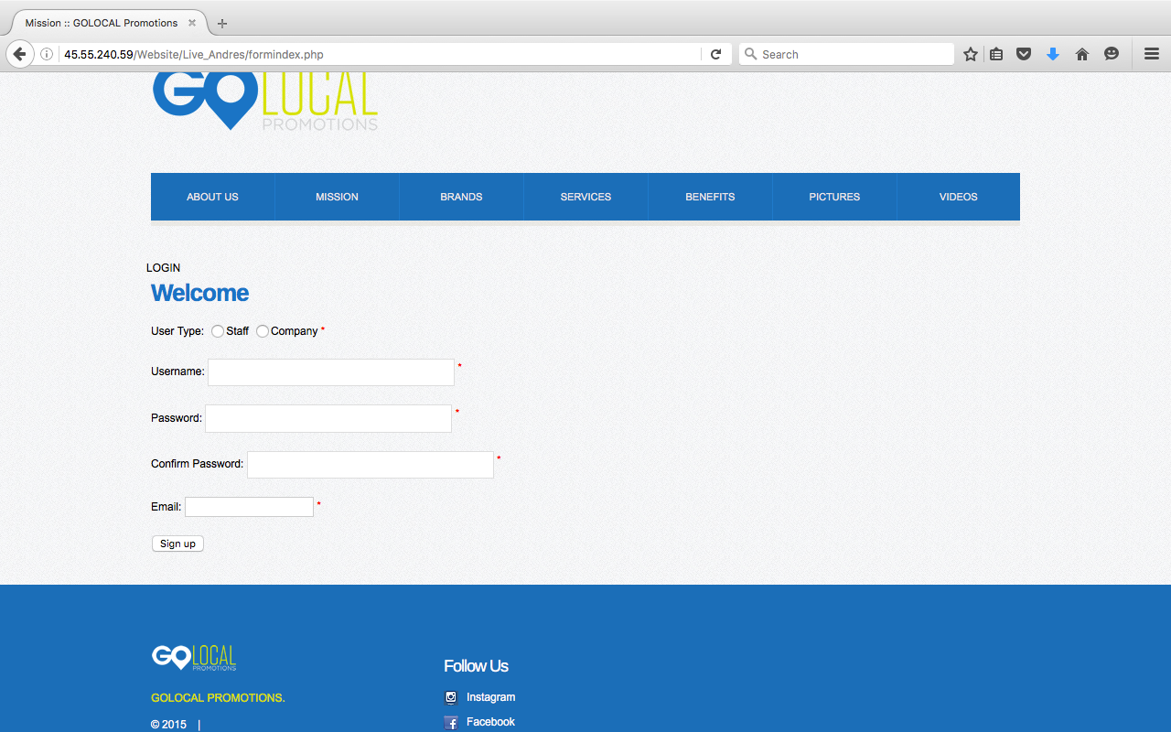
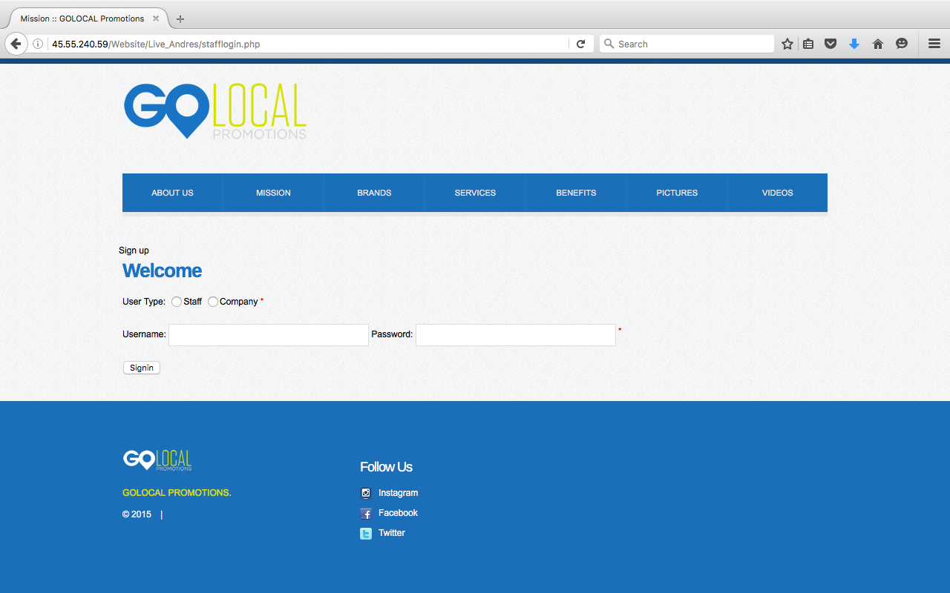
School of Computing & Information Sciences
Other Related Logos
Senior Project, 2015, Fall 2016
<GoLocalStaff2>
Student: Stephenson Petit-Homme, Florida International University
Mentor: Eduardo Garcia, GoLocal Promotions
Instructor: Masoud Sadjadi, Florida International University
Problem
Current System
Requirements
Nowadays, there is an event almost everyday. And it can be very frustrated and costly for events organizers to plan those events since hey must go through staffing agencies to hire their staff or their crew member.
Currently events organizers, staffs and crew members are connected through intermediate staffing agencies. Since those agencies have a limited number of registered staffs, events organizers sometimes should contact more than one agency which costs more time and money.
And depending on the hours that the event is scheduled, event organizers could face more problem because most agencies have a strict schedule. And if a staff is unable to make it to an event, the event organizer suffers while the agency get paid the same amount of money.
The system should allow:
guess users to create a staff or an employer account
users to logout and reset passwords
Users to verify their phone number during registration
Organizers to post jobs
Staff to apply for jobs
Organizers to search and filter staffs based on ratings and events need.
Organizers to see registered staff in a map to see how far they are from the event.
GlobalStaff alleviates the burden by substituting the middleman, the staffing agencies. We have a website where event organizers can post jobs and where registered crew members can apply for them.
System Design
Object Design
Implementation
iPhone
Website
The Website is implemented using both Client-Server architecture and Model View Controller
The system is implemented using HTML,CSS,Javascript,MySQL,and the PHP programming language.
The system uses a Linux,Apache,MySQL and PHP server configuration hosted on DigitalOcean.
An API was created in the server to handle JSON POST request from the mobile application to facilitate the communication between the iPhone application and the server.
Verification
Screenshots
Summary
Manual testing was used to test the system. Some
volunteers created accounts whether as staff or employers
and they also created a their profile. Also staffs user are
notified whenever jobs are posted while employers users are
able to post jobs.
The goal of the GoLocalStaff project is to alleviate events organizers burden of going through staffing agencies when hiring staffs.
Though the promotions industry is over saturated with staffing agencies,GoLocal stands out. It stands out because like other staffing agencies which charge different fees, GoLocalStaff is free of charge.
Acknowledgement
The material presented in this poster is based on the work supported by Eduardo Garcia and Sadjadi Masoud. I am thankful for the help I received from my group member, Wilfredo Gomez, and friends. I am especially grateful for my family’s support.

