Slide 1
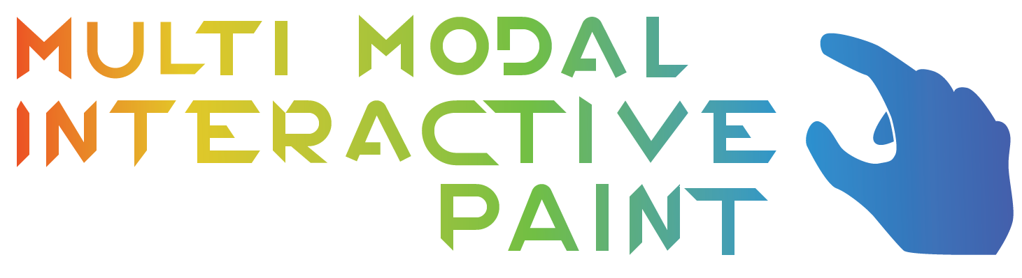


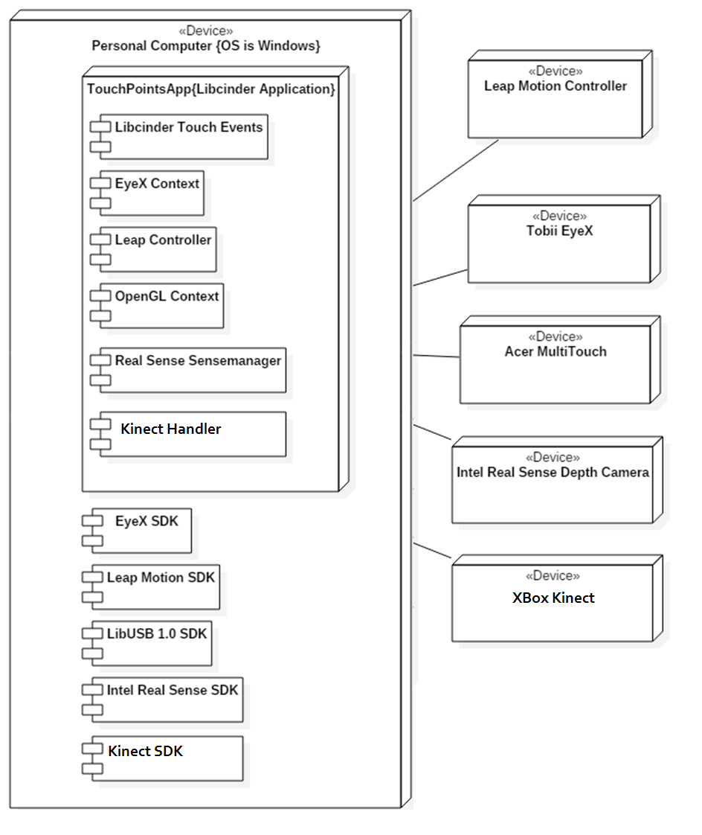
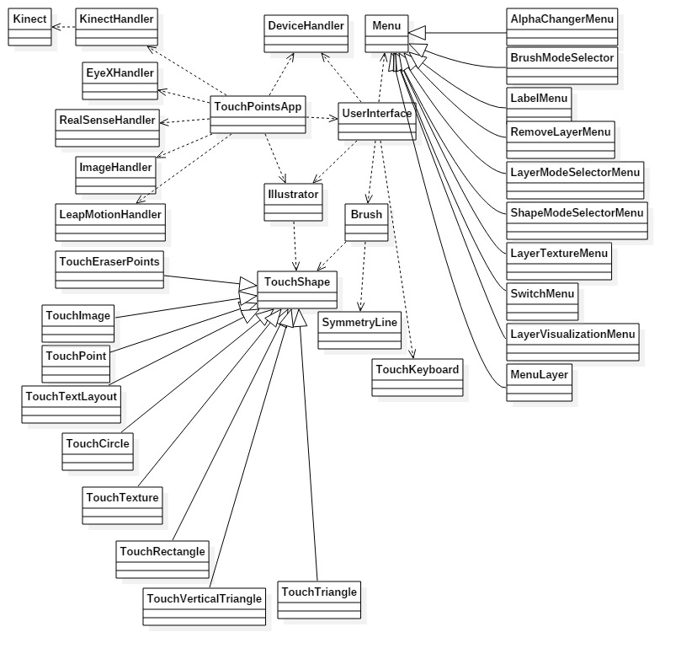
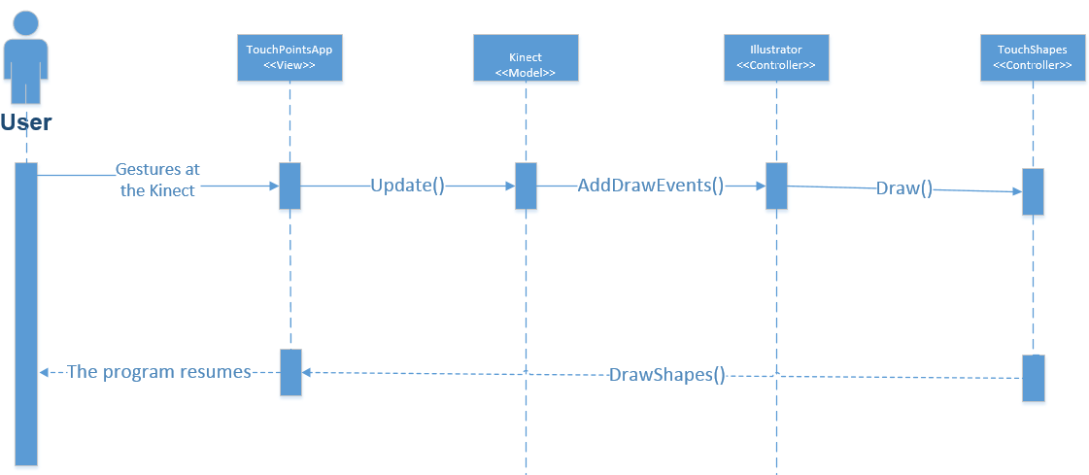
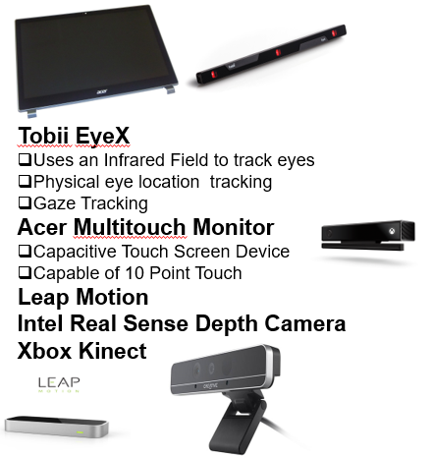
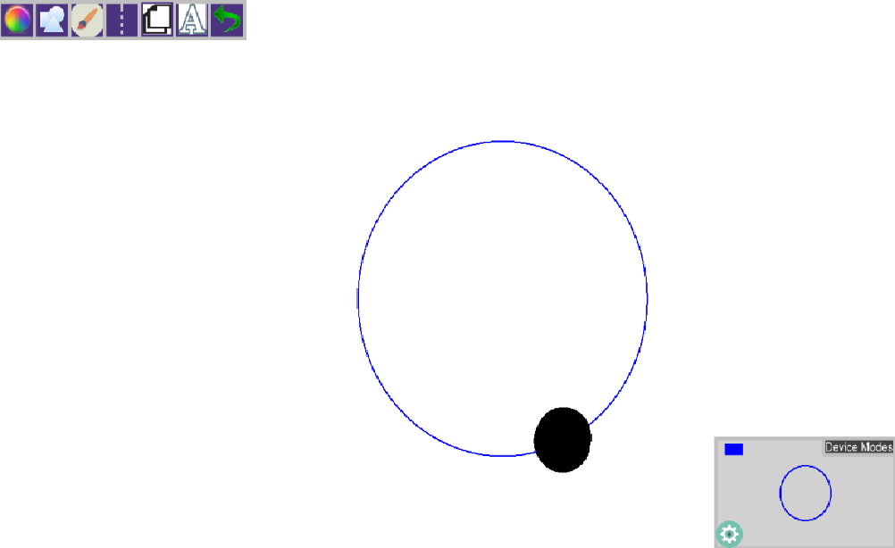
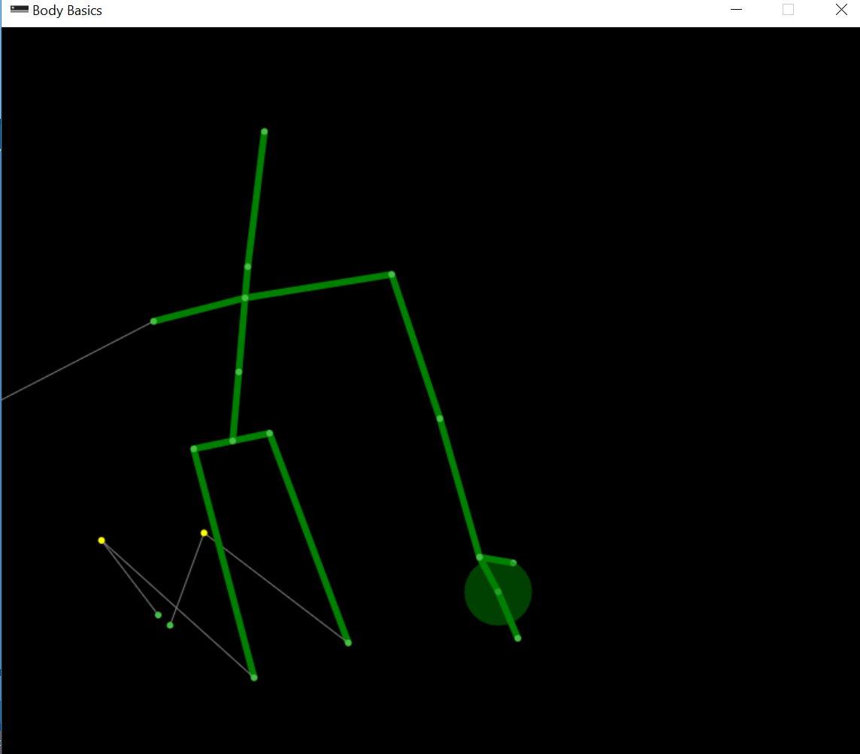
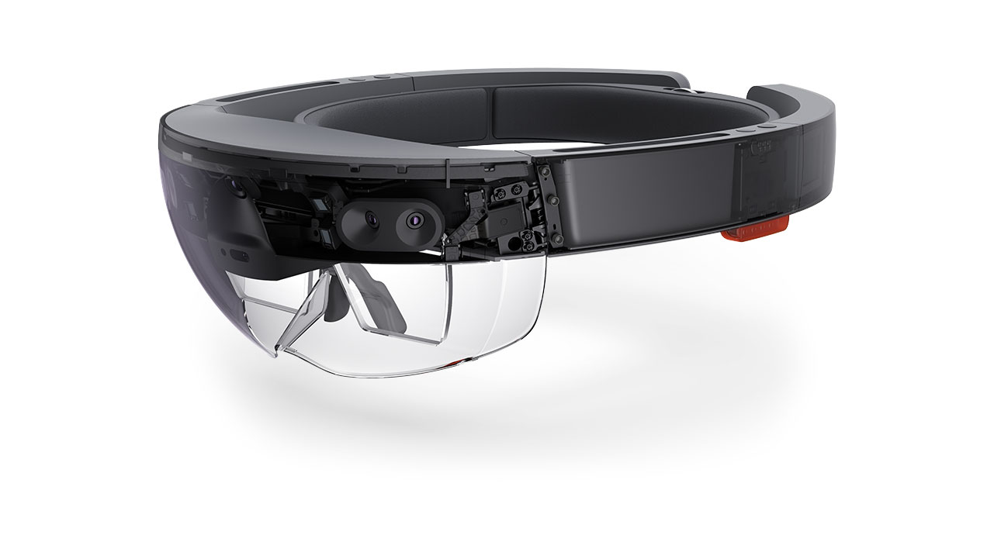
School of Computing & Information Sciences
Senior Project, 2016, Summer
OpenHID Lab
Multi Modal Interactive Paint
Student: Alexander Karpis, Florida International University
Mentor: Dr. Francisco R. Ortega, OpenHID Lab
Instructor: Masoud Sadjadi, Florida International University
Problem
Current System
Requirements
Input devices are usually limited to the keyboard, mouse, joysticks, microphones, and imaging devices.
In order to showcase different forms of input, FIU’s Open HID Lab has developed a multi modal paint application with input from multiple devices in the form of hand gestures and facial expressions.
This project focuses on expanding the input from devices by exploring the input capabilities of devices, and integrating them into the Open HID Lab’s paint application for usage.
A multimodal interactive paint project that can accept input from multiple devices.
This summer project featured extending the development framework, the addition of the Kinect, and the exploration of hololens functionalities.
Our job was to add and explore devices for the previous version of the paint program, as well as implement an extendible and maintainable framework for the project.
As a developer I would have to obtain input from the Kinect and implement the functionality in the form of a paint program.
The developers would need an understandable framework and be able to develop the drawing features and devices within the program.
Application and device framework should provide features that can be implemented and further developed in the future.
System Design
Object Design
Implementation
.
Devices
Screenshots
Summary
Hololens
The purpose of the project was to explore the Kinect’s features and add it’s movement capabilities to the program. This was accomplished with an additional subsystem of components for only the Xbox Kinect.
The solution has the capability of painting with one person, and registering the joints of up to 6 people. When a single persons hands are closed, it will begin to paint until the hand is made open.
Additionally, the Kinect features for Depth perception, Color Imaging, Face Scanning, and registering Speech have been documented and prepared for future usage.
Acknowledgement
The material presented in this poster is based upon the work supported by Dr. Francisco R. Ortega and Dr. Naphtali Rishe from FIU’s High Performance Database Research Center. I am thankful to the help that I received from my group members: Jorge Nonell, Christopher Naranjo, and Eric Aguiar. Special Thanks to Alain Galvan, Jonathan, and Jason Lee Thomas from the OpenHID Lab.

