Slide 1

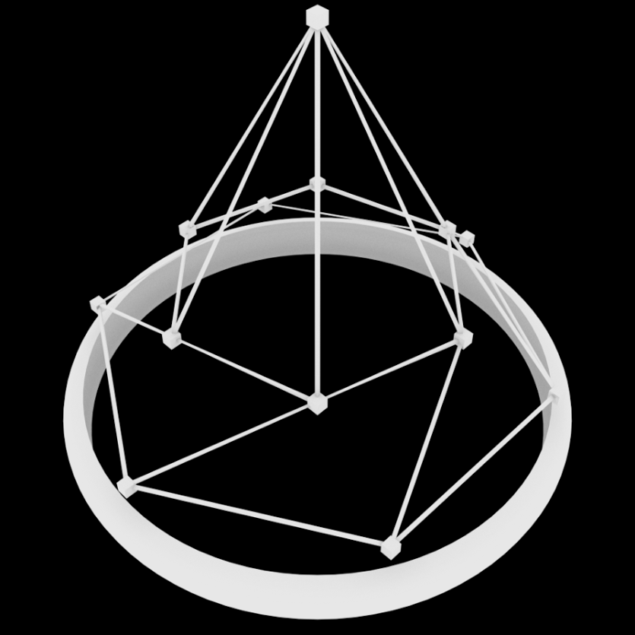
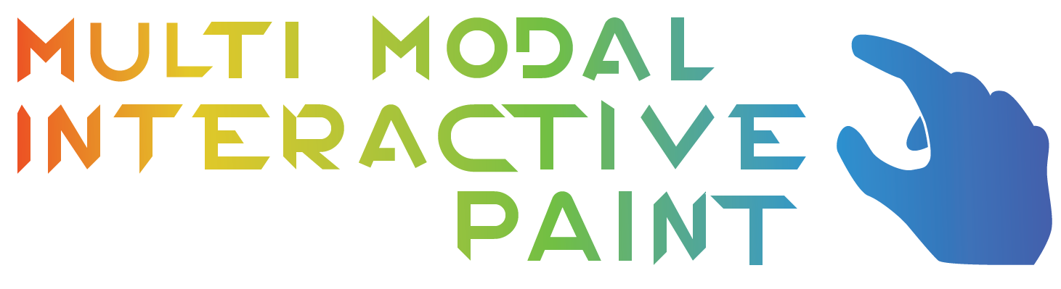

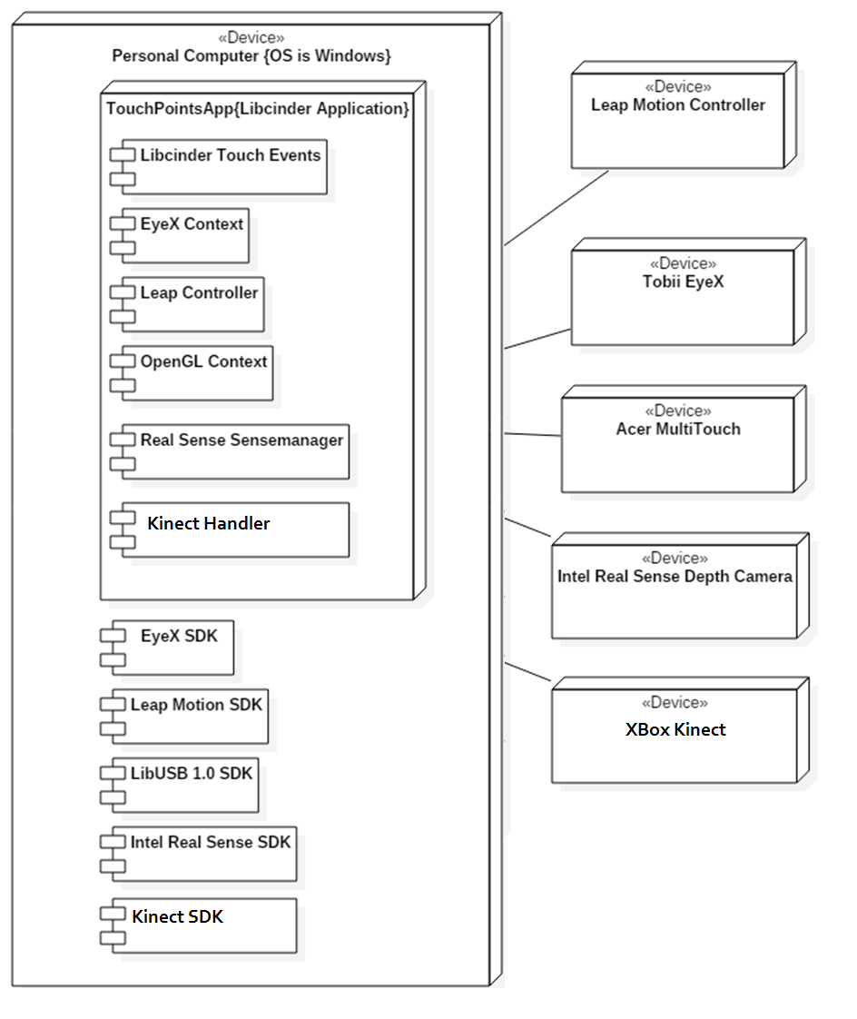
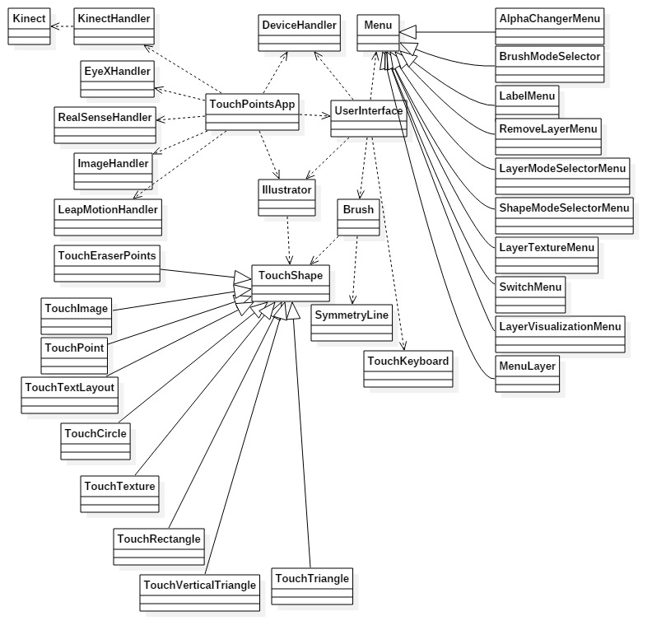
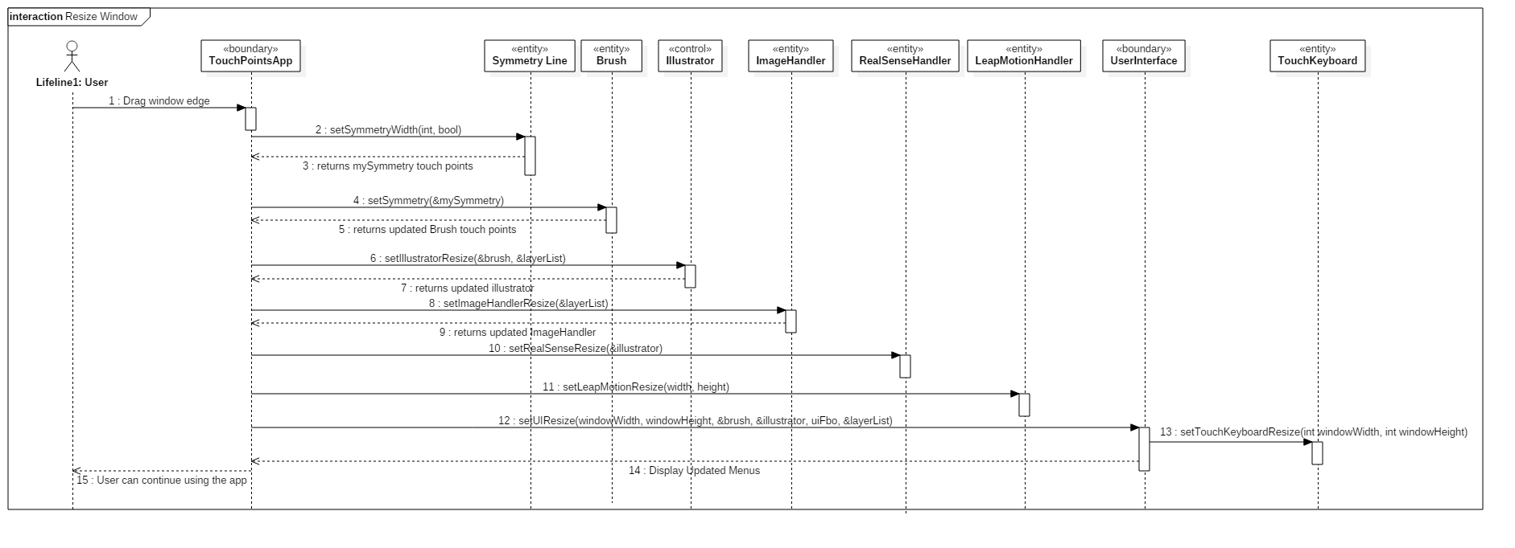
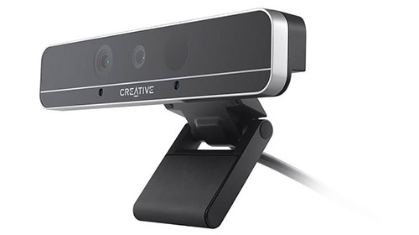
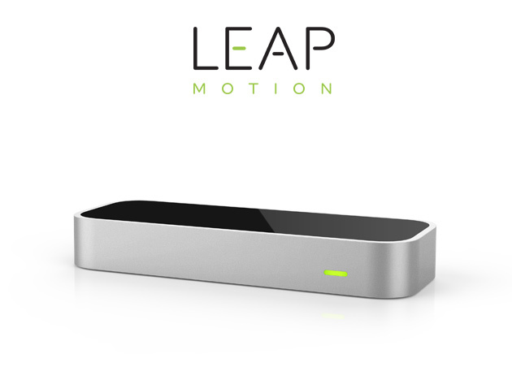
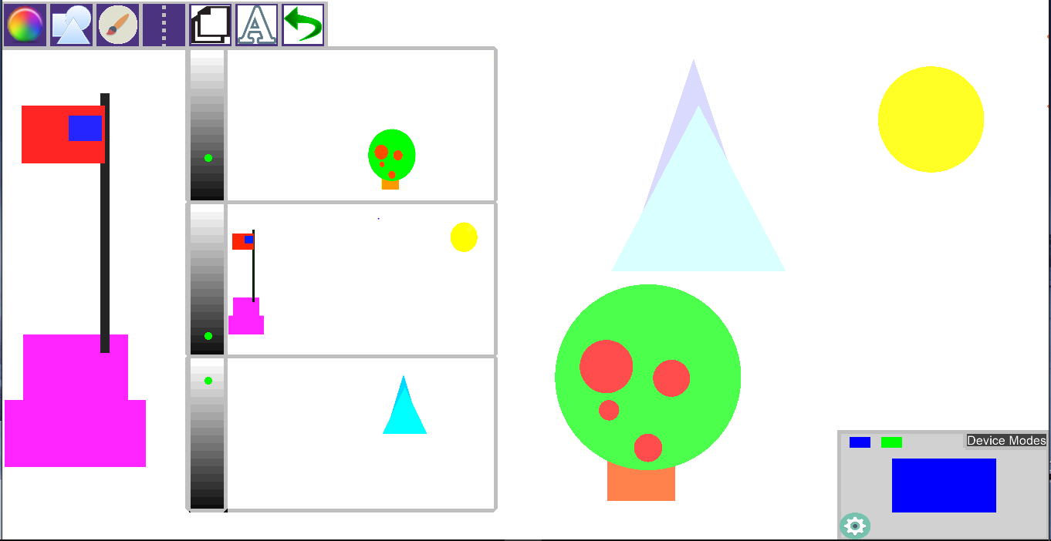
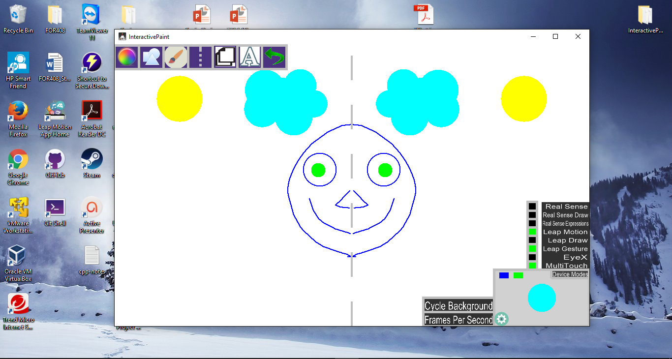
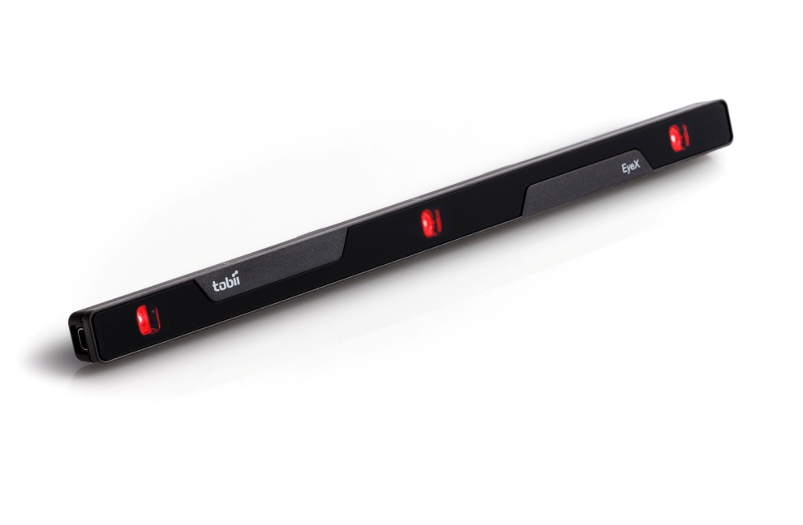
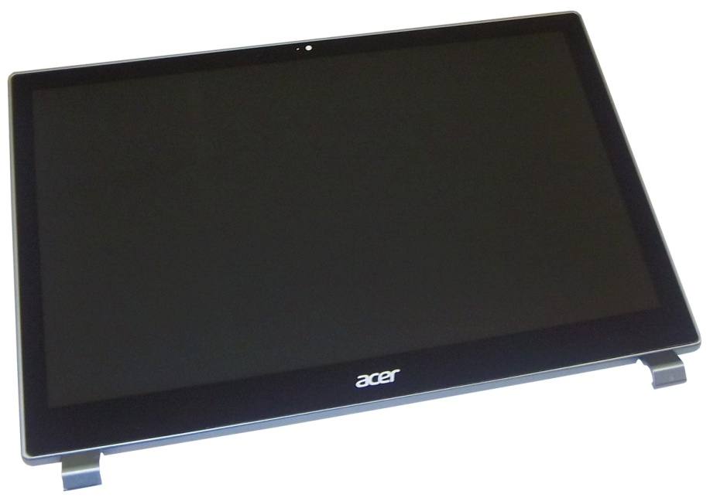
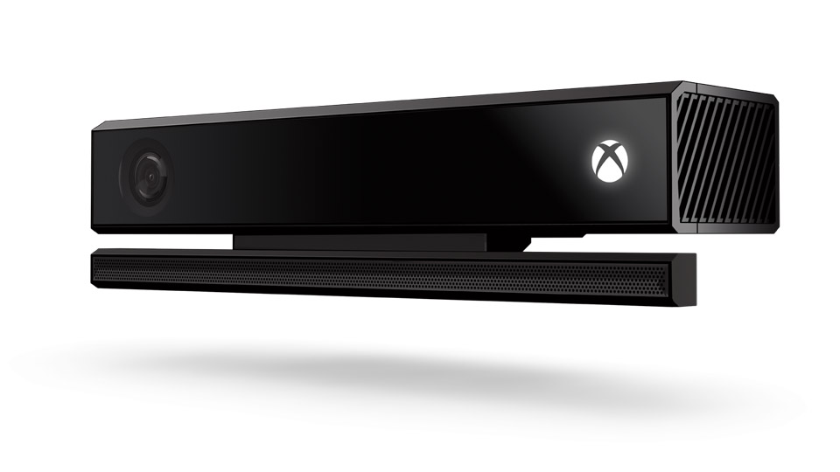
School of Computing & Information Sciences
OpenHID
Lab
Senior Project, 2016, Summer
Multi Modal Interactive Paint
Student: Eric Aguiar, Florida International University
Mentor: Dr. Francisco R. Ortega, OpenHID Lab
Instructor: Masoud Sadjadi, Florida International University
Problem
Current System
Requirements
FIU’s OpenHID lab is developing a smart desk to facilitate student learning.
The smart desk will be equipped with multiple devices which may have:
Touch screen capabilities
Facial expressions
Hand gestures.
OpenHID requires a software solution which can showcase the multi modal functionality of the smart desk while being fun enough to get users accustomed to the smart desk and to test the various user-device interactions for improvements.
Currently there is no unique platform that can take such a range of input devices; which can display the unique functionalities the smart desk will provide with its multi modal device interactions.
In order to progress the development of the smart desk, a software solution will be needed to test how users interact with the smart desk. The application also provides a fun and unique experience where users can use the following devices:
Leap Motion
Intel Real Sense
EyeX
Multitouch Screen
Xbox Kinect
Our job was to further develop the interactive paint program and make it easier for future developers to understand, debug and add features.
As developers we had to analyze and implement appropriate design/architecture principles into the paint program. This would allow for easier understanding of the project, debugging and ability to add features quicker and more efficiently, by utilizing the following design principles:
- Separations of Concern - Don’t Repeat Yourself (DRY)
- Object Oriented Principles - Layered Architecture Style
- Single Responsibility Principle - Composition
- Principle of Least Knowledge (Law of Demeter)
The user would need to seamlessly transition to the updated paint program, be able to control the drawing features and devices within the program.
Application should provide background improvements, fewer limitations, and features that use the devices that will be implemented within the smart desk.
System Design
Object Design
Implementation
Devices
Screenshots
Summary
Multi Modal Interactive Paint is a software solution that provides an interactive paint application where users can learn how to interact with the smart desk and its unique devices.
The paint application will provide smart desk developers with information regarding the various uses of the devices and how to develop an intuitive user interface for device features.
Future Development:
Performance Improvement by threading
Microsoft HoloLens Integration
Speech Recognition
Creation of games to assist in learning the features of the devices used in paint program.
Intel Real Sense Depth Camera
3D Camera: HD Camera, Infrared Camera, Infrared Laser Projector
Face Analysis: Facial Gestures
Leap Motion Sense
Uses Two Chromatic IR Cameras and Three IR LED Cameras
Hand Gestures Recognized
Tobii EyeX
Acer Multitouch Monitor
Xbox Kinect
Acknowledgement
The material displayed in this poster is based upon the work supported by Dr. Francisco R. Ortega from FIU’s High Performance Database Research Center. I would like to personally thank my team member Jorge Nonell for his help. Special Thanks to Alain Galvan from the OpenHID Lab.
Notes:
1

