Slide 1


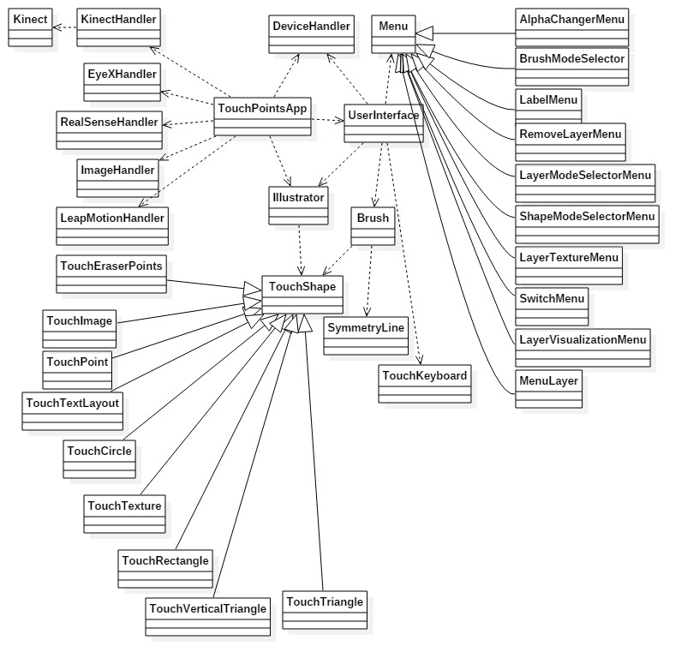
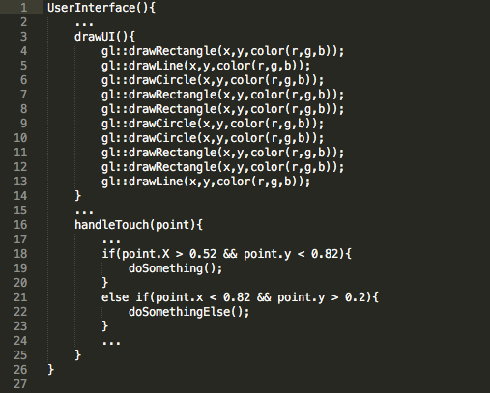
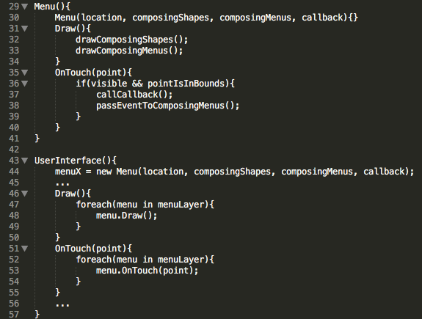
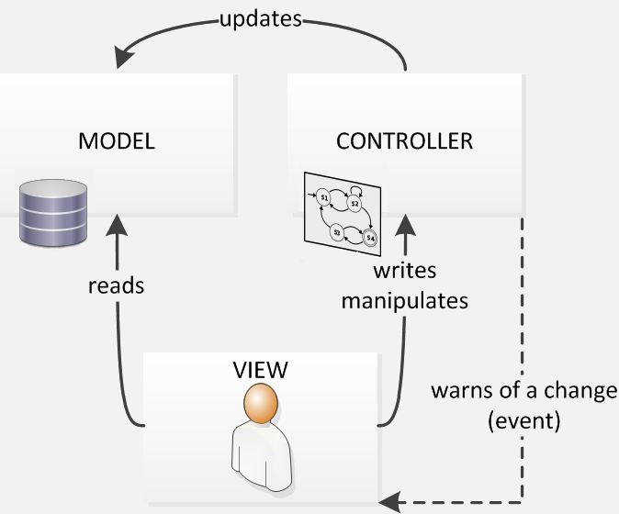
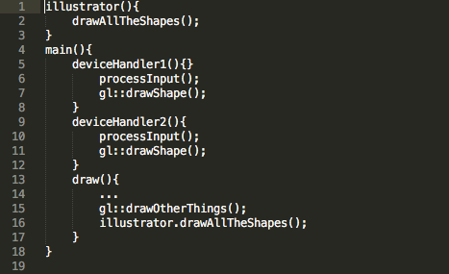
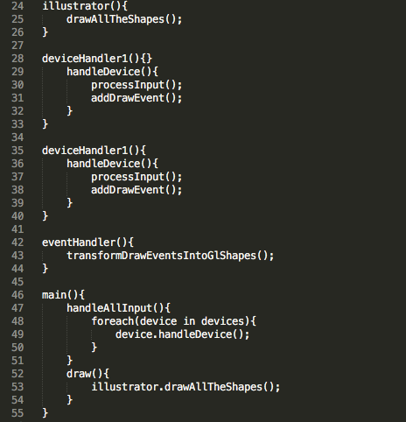
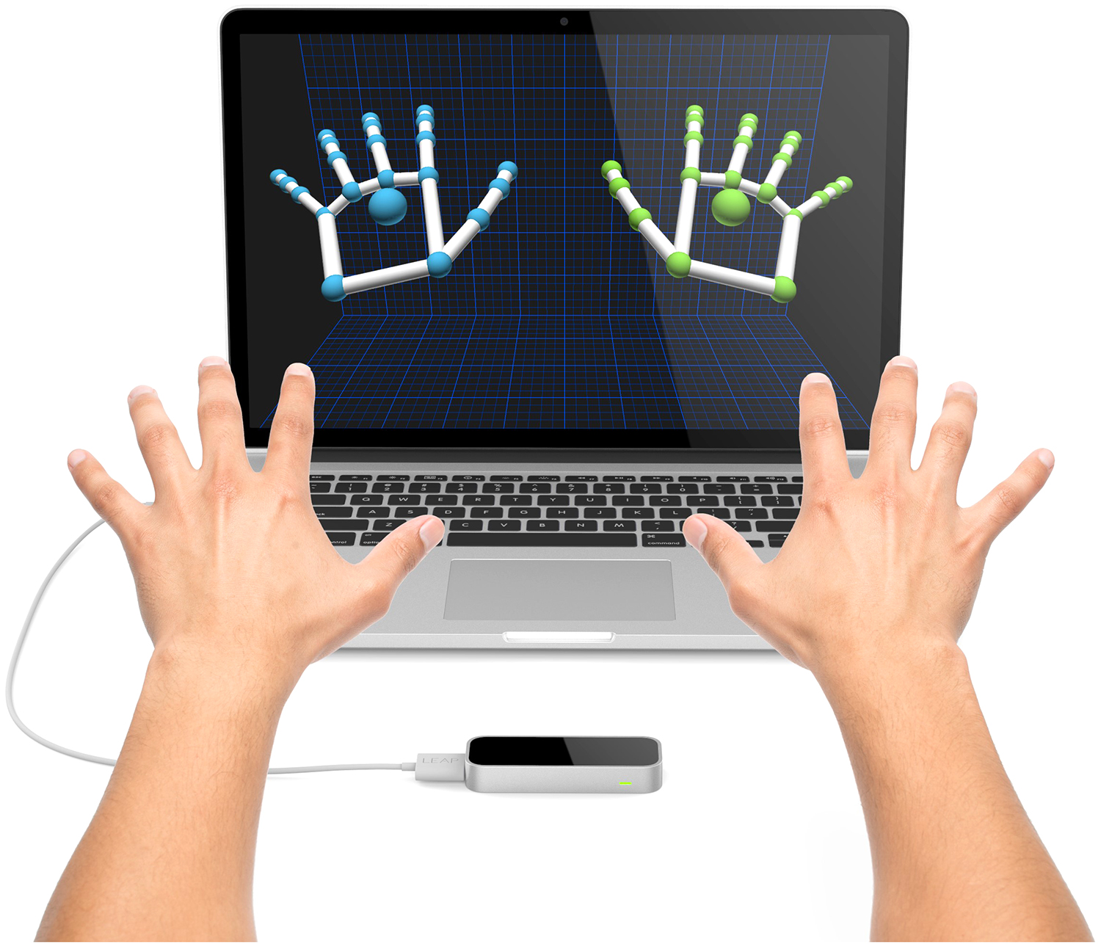
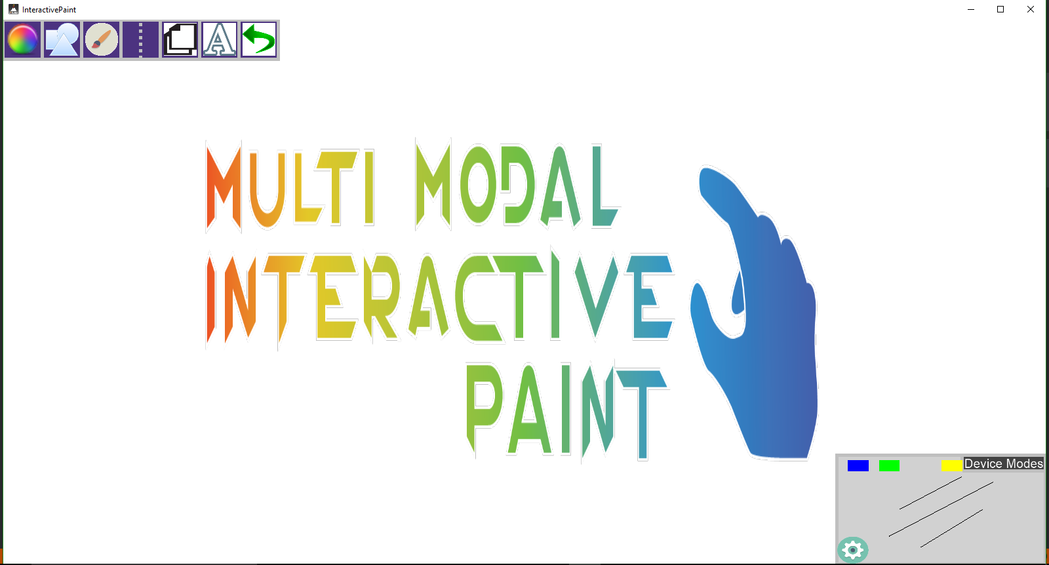
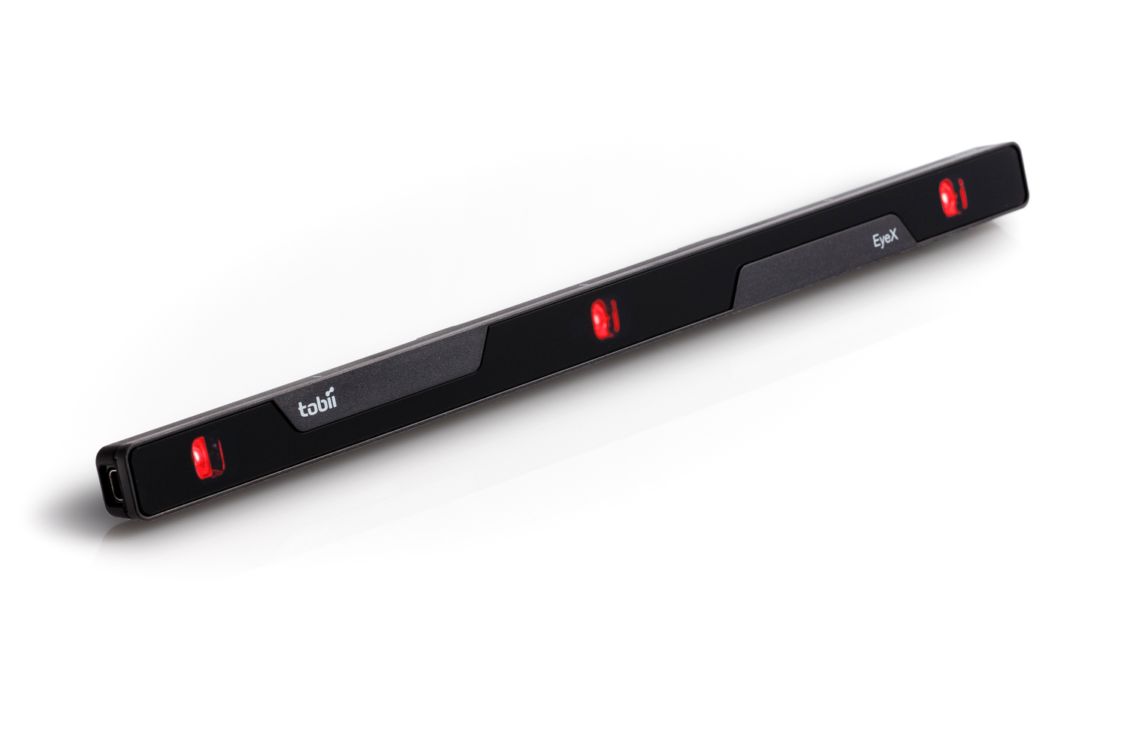
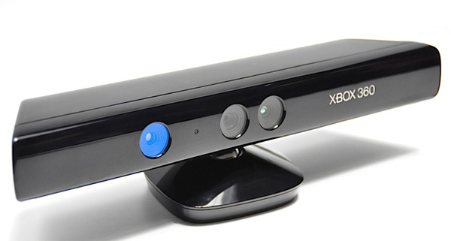
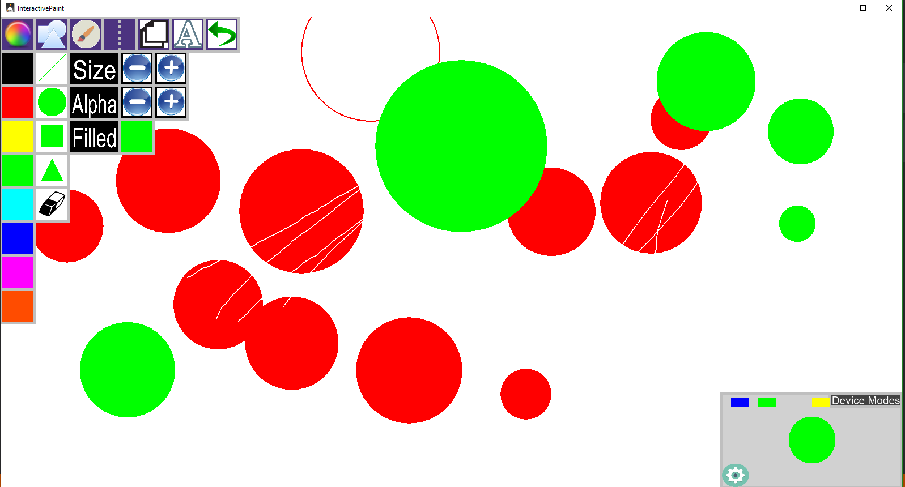
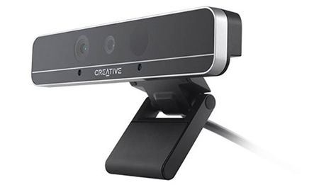
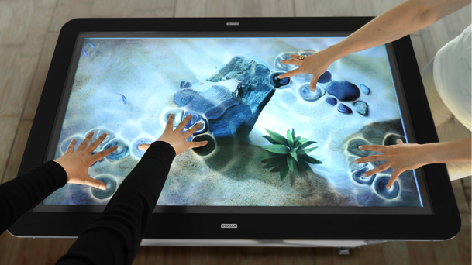
School of Computing & Information Sciences
OpenHID Lab
FIU’s Open Human Interface Devices Lab
Senior Project, 2016, Summer
TAM 4.0
Student: Jorge Nonell, Florida International University
Mentor: Francisco Ortega, Florida International University
Instructor: Masoud Sadjadi, Florida International University
Problem
Current System
Requirements
People have a wide range of preferences when it comes to how they interact with technology, there is currently no unified platform that can take such a range of input. We look to create such a platform in order to improve the accessibility and and usability of technology to users of all interaction preferences.
The previous iteration of the project prototyped as many device features as possible, which did not leave much time to consider software architecture or extensibility.The lack of structure made adding new features time consuming and error prone.
The purpose of our project was to architect the code into distinct modules that separate concerns amongst them.
We wanted to separate functionality into discreet modules so as to more easily extend modules with minimal risk of breaking other functionality.
The current system is a C++ desktop application that integrates input from 5 different input devices to create drawings on screen. The program has a series of input handlers that process input from a specific device and translate that into events that are interpreted as shapes and drawn to the canvas. Some of the devices allow for different modes of interaction, such as the voice recognition capabilities of the Inter RealSense device. This allows for users of differing abilities and skill sets to interact with the software in ways that make most sense to them.
Input Devices:
Leap Motion
Intel RealSense
Tobii EyeX
Multitouch Screen
Xbox Kinect
As a developer, you should be able to work on a new feature of the system and be able to focus only on the application logic of the feature you are designing. There should be a strong separation of concern between subsystems, the developer should not have to know the inner workings of one subsystem to work on another one.
As a developer, there should be a UI framework in place to allow you to easily add UI components that know how to draw themselves and how to respond to user interaction. You should be able add a UI component with out having to manipulate complex OpenGL code.
As a developer, working on the device controller layer should not require I have knowledge of the inner workings of how the rendering engine works. Input devices should create events and the system should interpret them as graphics.
System Design
Object Design
Implementation
We designed used the MVC architecture to be able to handle complex input in the controller layer, translate the input into a model that is easily interpreted by the view layer(OpenGl).
Implement component-based, event-based UI framework
Implement unified drawing system
Before
After
Before
After
Devices
Screenshots
Summary
Supported Devices:
Leap Motion
Intel RealSense
Tobii EyeX
Multitouch Screen
Xbox Kinect
We rearchitected the implementation to follow the principles of:
Separations Of Concern
Object Oriented Principles
Single Responsibility Principle
Principle of Least Knowledge(Law of Demeter)
Don’t Repeat Yourself(DRY)
Layered Architectural Style
Composition
By doing so we have increased the modularity of our code, Every module is responsible for discrete unit of functionality, making the system more loosely coupled. This made the different parts of the system easier to extend or swap out. We have also increased the extensibility of the code by adding proper inheritance to class structures, keeping common code in base classes, making it easier to extend the base functionality of a feature.
Acknowledgement
The material presented in this poster is based upon the work supported by Dr. Francisco Ortega I am thankful to the help that I received from my group members Eric Aguair, Chris Naranjo, and Alex Karpis
Notes:
‹#›

