Slide 1
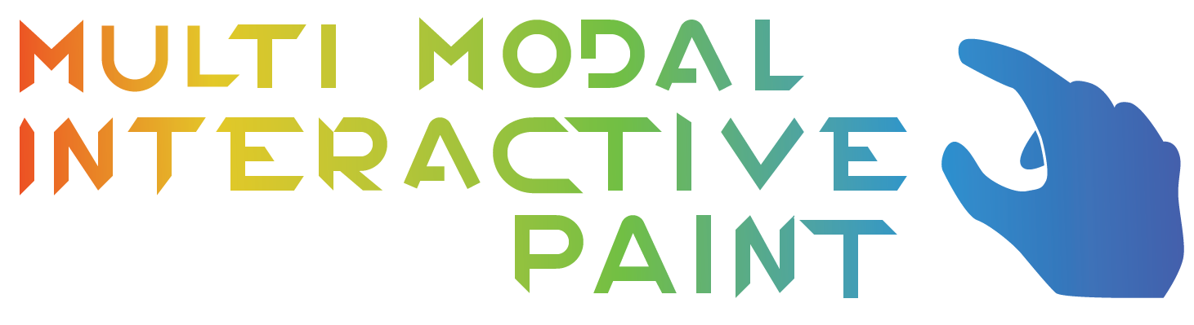

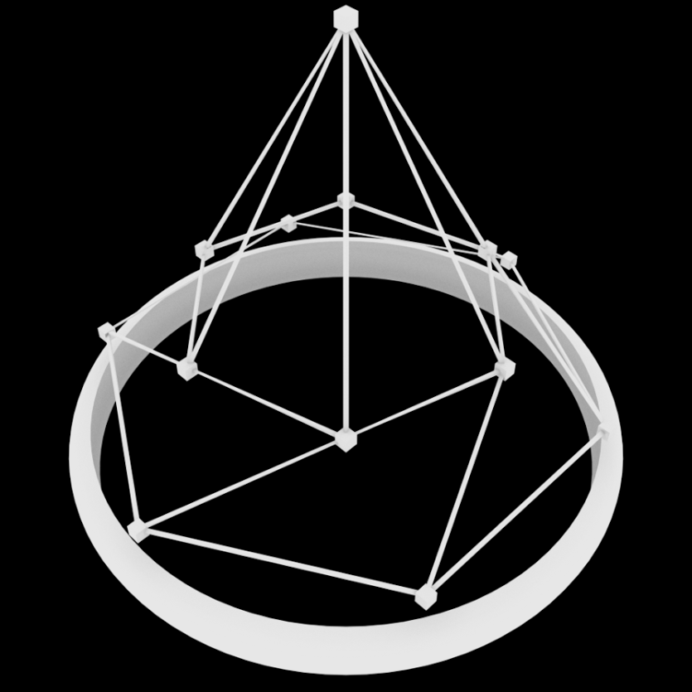
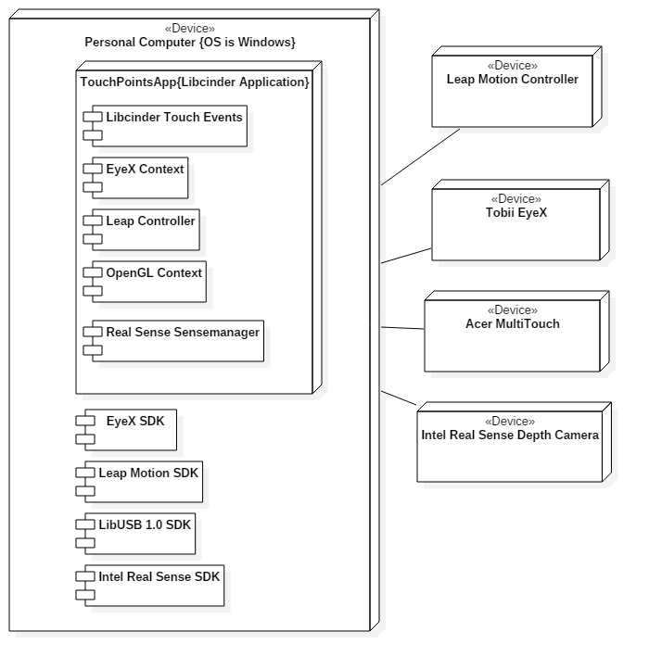
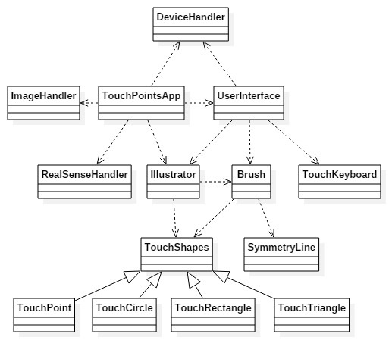
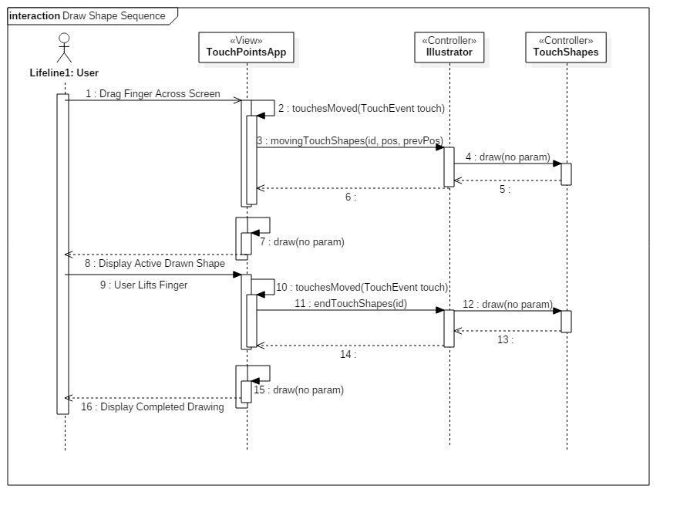
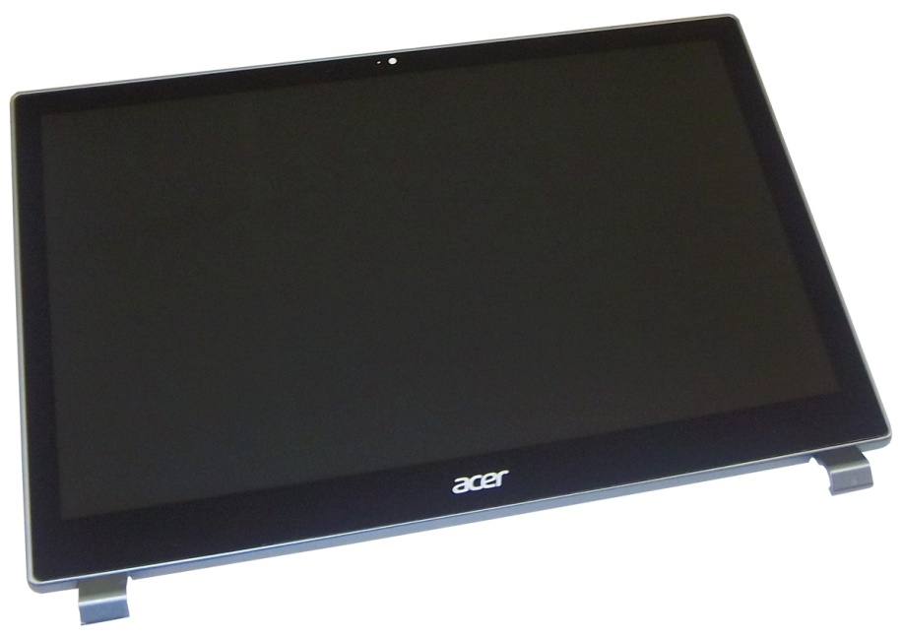
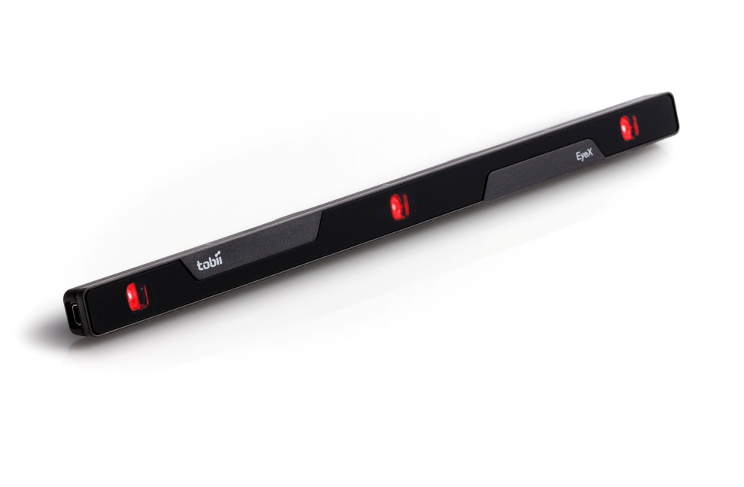
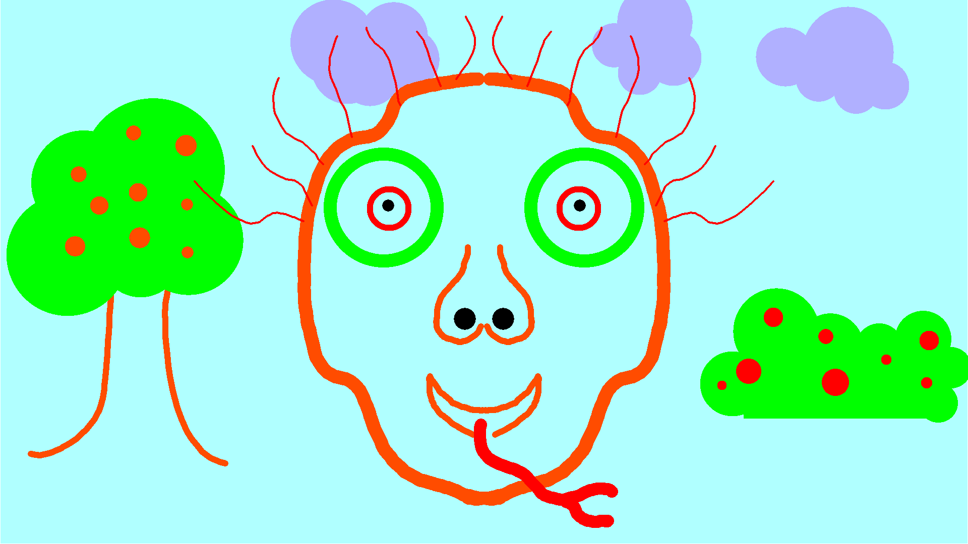
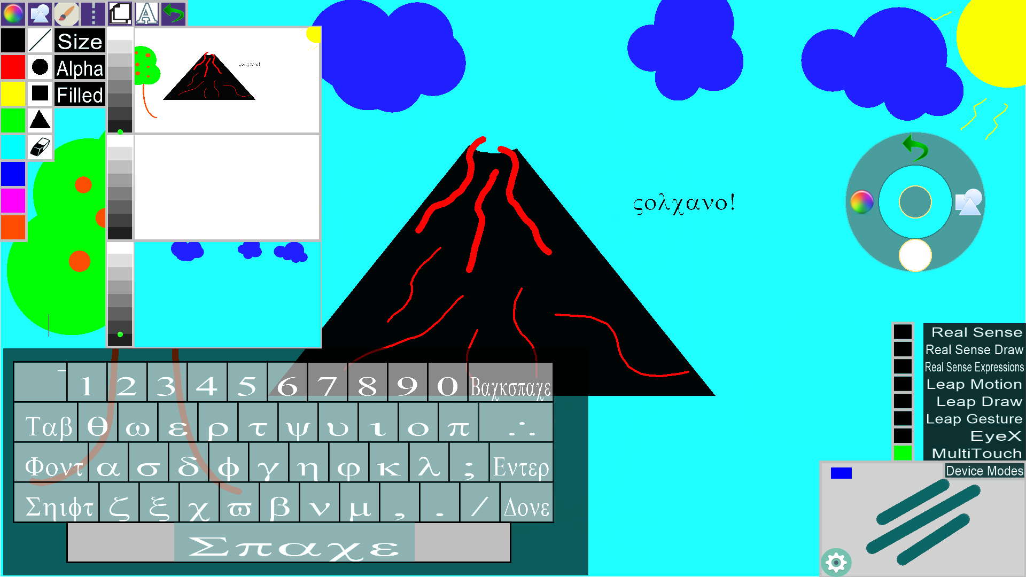
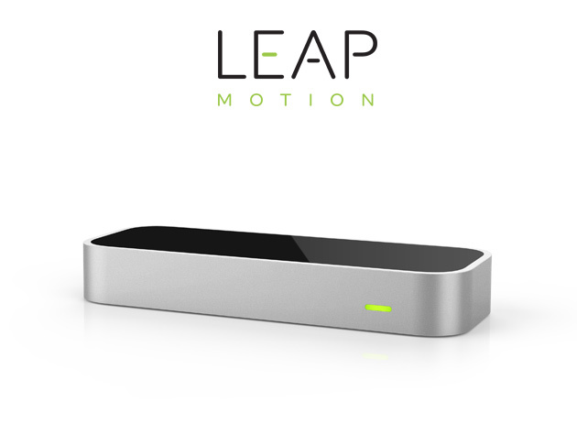
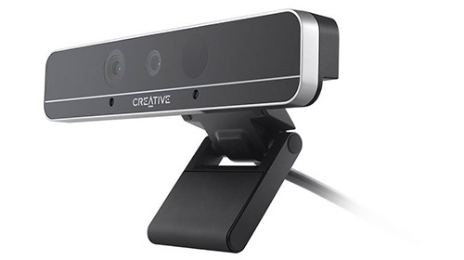
School of Computing & Information Sciences
Senior Project, 2016, Spring
OpenHID Lab
Multi Modal Interactive Paint
Student: Andrew Mitchell, Florida International University
Mentor: Dr. Francisco R. Ortega, OpenHID Lab
Instructor: Masoud Sadjadi, Florida International University
Problem
Current System
Requirements
FIU’s Open HID Lab is Developing a Smart Desk for students, which consists of various devices
Smart Desk Devices
Touch Screen
Tobii EyeX
Intel Real Sense Depth Camera
Leap Motion Controller
They needed a software solution that is fun and interactive that will get users accustomed to the capabilities of the Smart Desk. The Smart Desk also needs a simple way to test the best methods for interacting with each of its distinct devices.
Currently there are no applications that combine the unique functionality provided by the Smart Desk, let alone an application that can be fun and interactive for students who are new to using these cutting edge technologies.
The Smart Desk is also in need of software to help test how these devices can best be utilized to interact with the end user. No current software allows you to change input methods on the fly between various devices and test different methods of input for each device.
We were employed with creating a painting application that benefitted from these unique input methods
Touch Pad
Eye Tracking
Hand Recognition
Facial Expressions
Implementing basic paint functionality is crucial for the applications development. The program should be able to perform functions such as
Drawing
Changing Colors
Changing Shapes
Layer Support
An intuitive UI and control over input devices is also needed for testing these new technologies and discovering how best to use them.
System Design
Object Design
Implementation
.
Devices
Screenshots
Summary
Interactive Paint is a solution that creates a fun and interactive environment to learn, use, and test new and unique input devices. Introducing the technologies in a familiar painting environment will help quickly familiarize students with the devices. Students using this software in tandem with the Smart Desk will help them discover the potential and limitations of various input methods.
In the future we hope to continue adding unique inputs such as speech recognition and 3D Cameras as well as expand the users control over these devices. A tutorial system would also suit the application so the users can learn the devices inside the application instead of turning to the user guide.
Tobii EyeX
Uses an Infrared Field to track eyes
Physical eye location tracking
Gaze Tracking
Acer Multitouch Monitor
Capacitive Touch Screen Device
Capable of 10 Point Touch
Leap Motion
Intel Real Sense Depth Camera
Acknowledgement
The material presented in this poster is based upon the work supported by Dr. Francisco R. Ortega and Dr. Naphtali Rishe from FIU’s High Performance Database Research Center. I am thankful to the help that I received from my group member, Garrett Lemieux. Special Thanks to Alain Galvan and Jason Lee Thomas from the OpenHID Lab.

