Slide 1
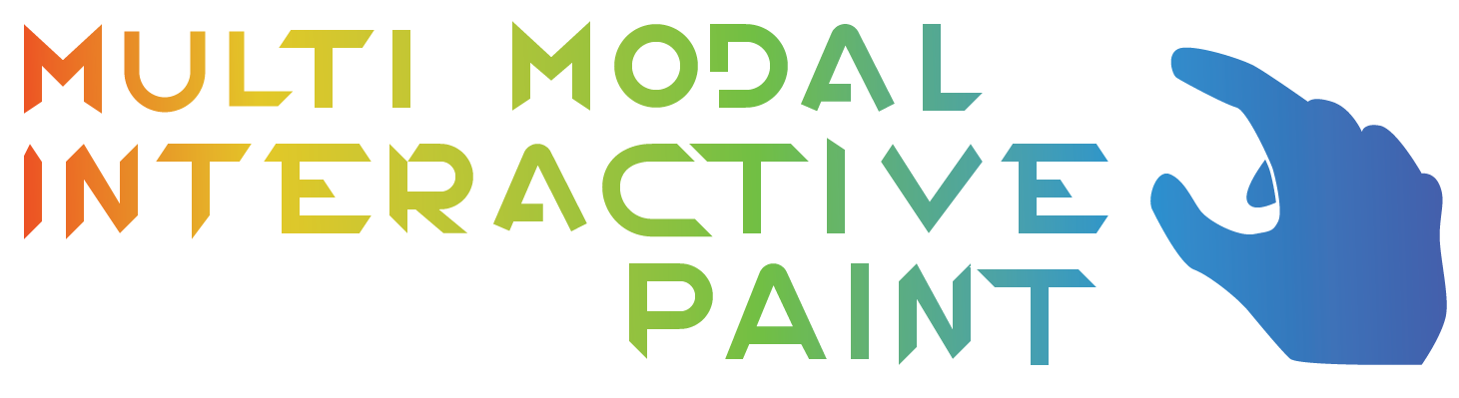

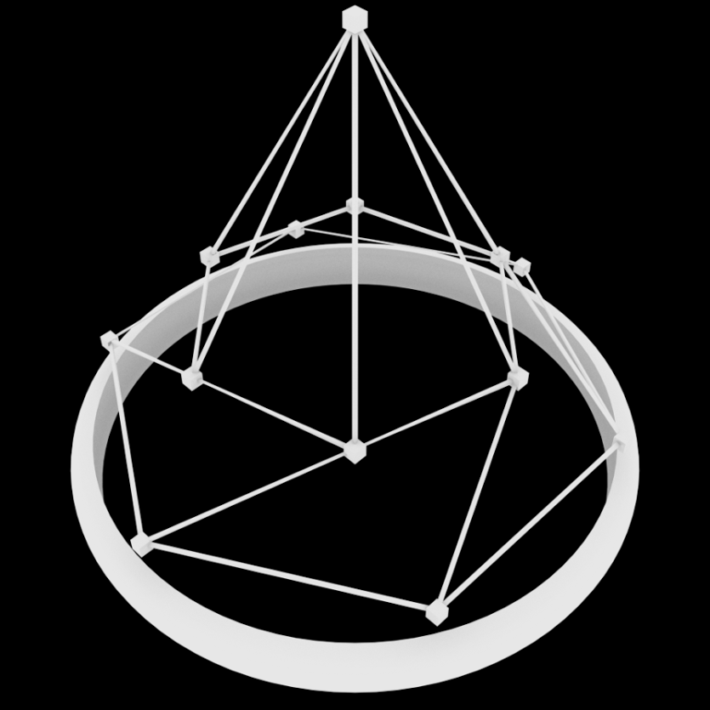
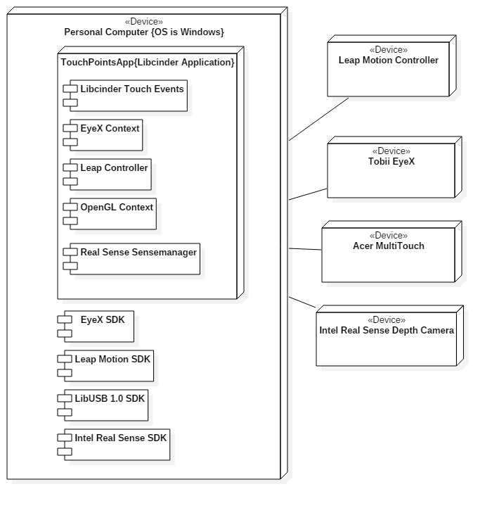
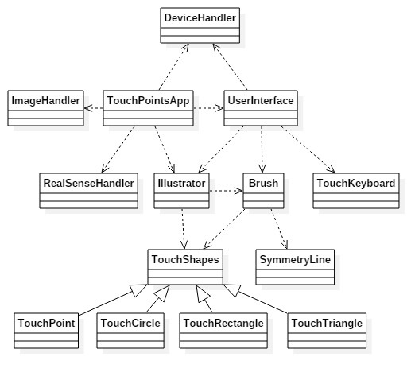
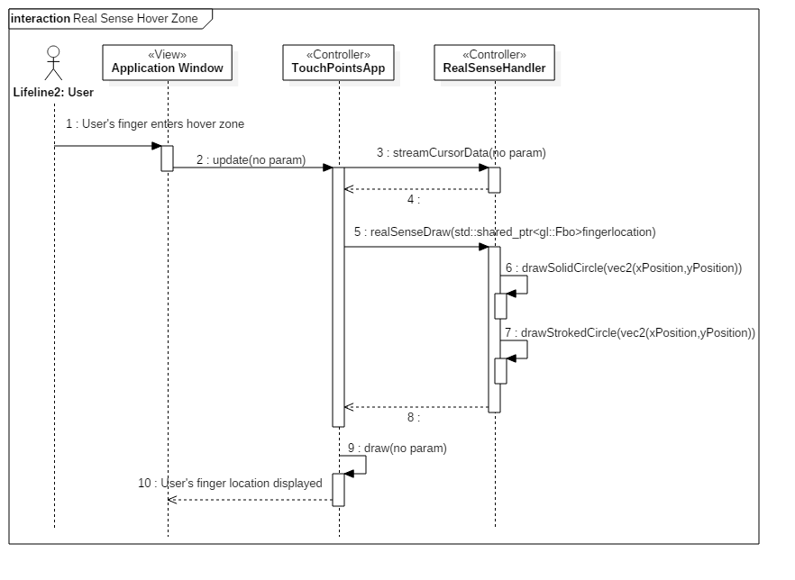

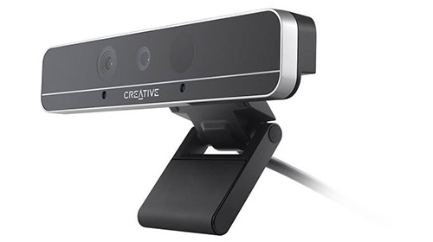
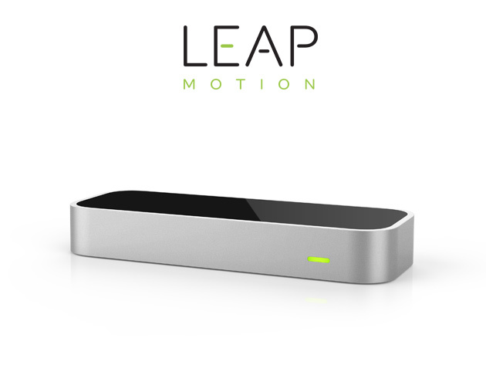
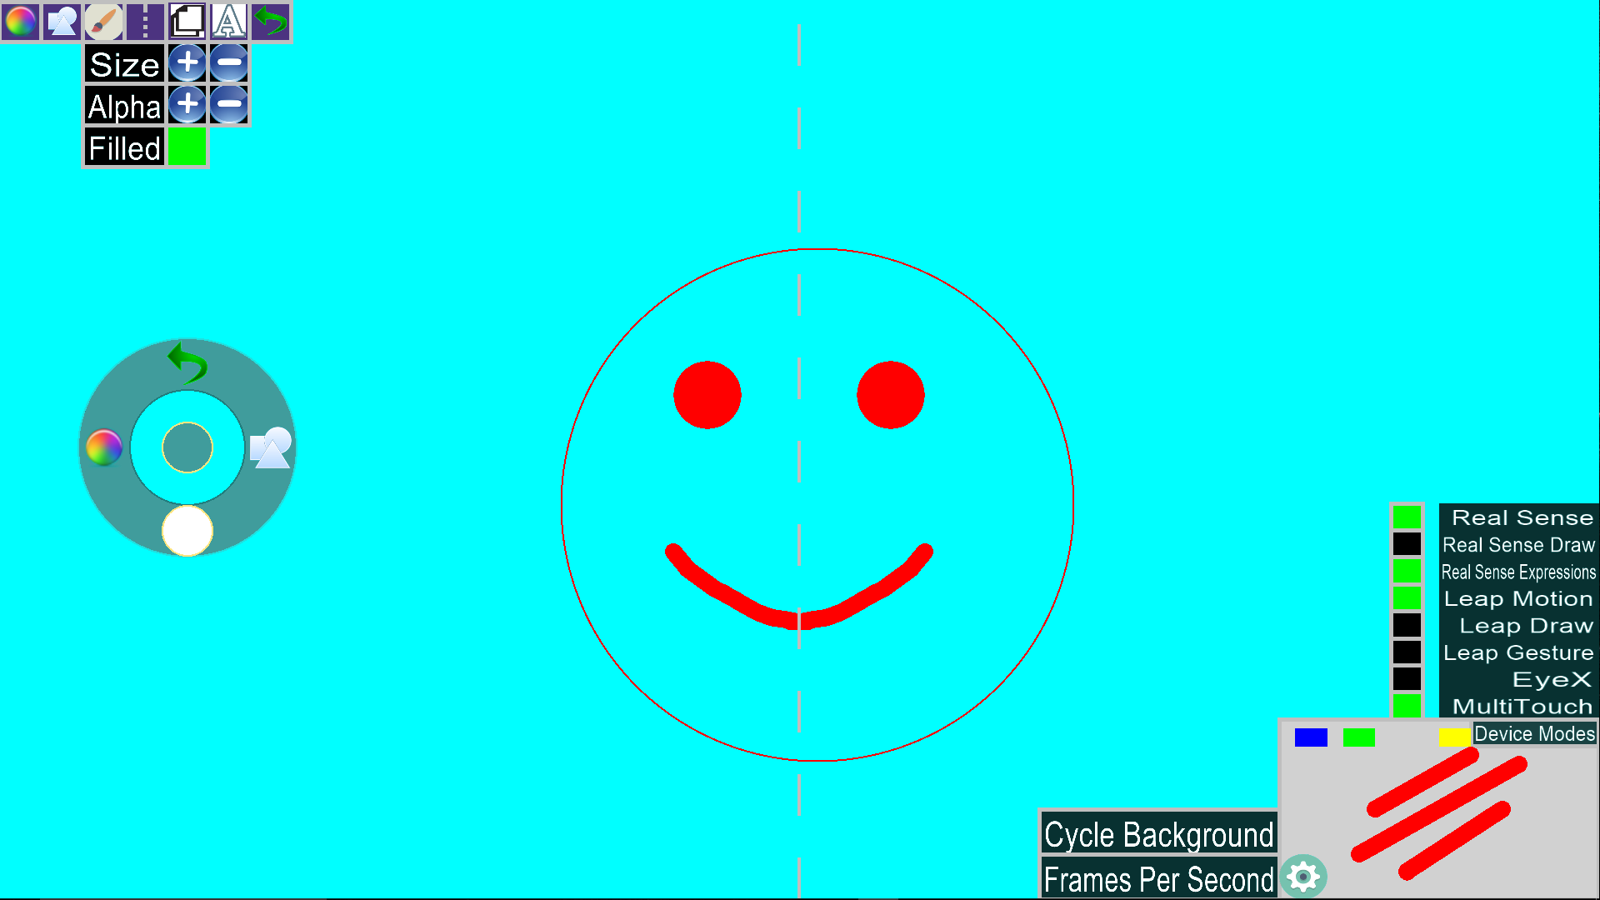
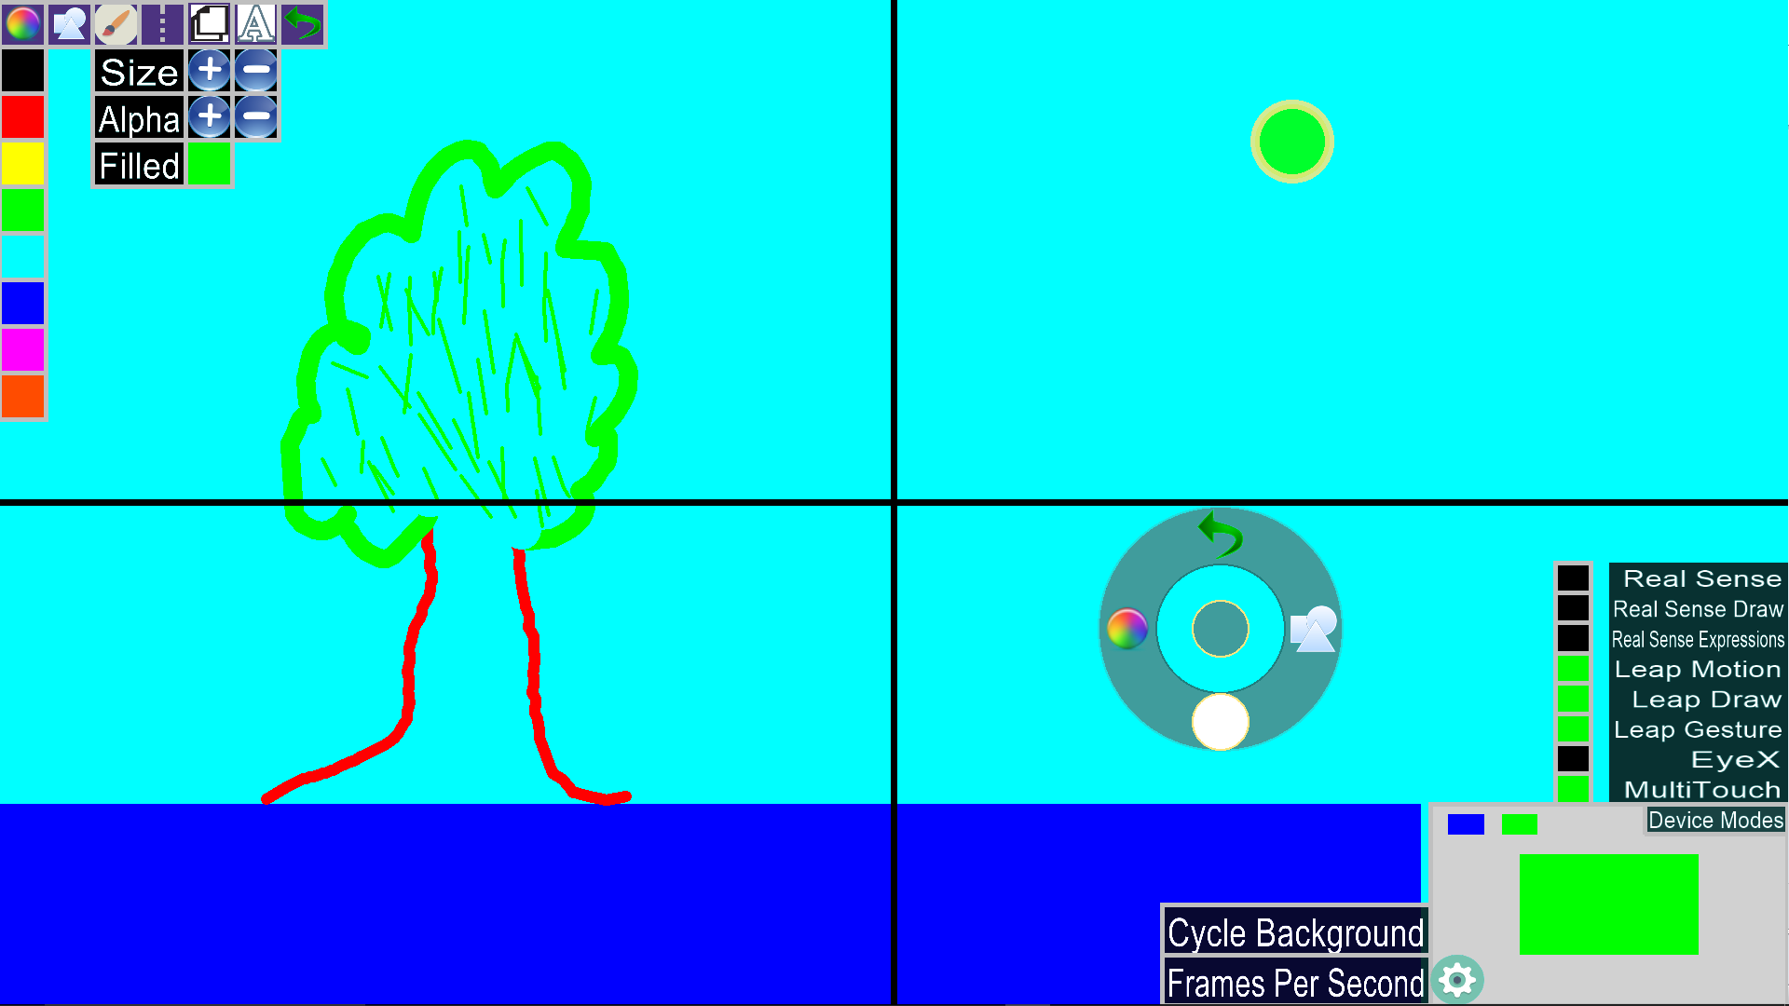
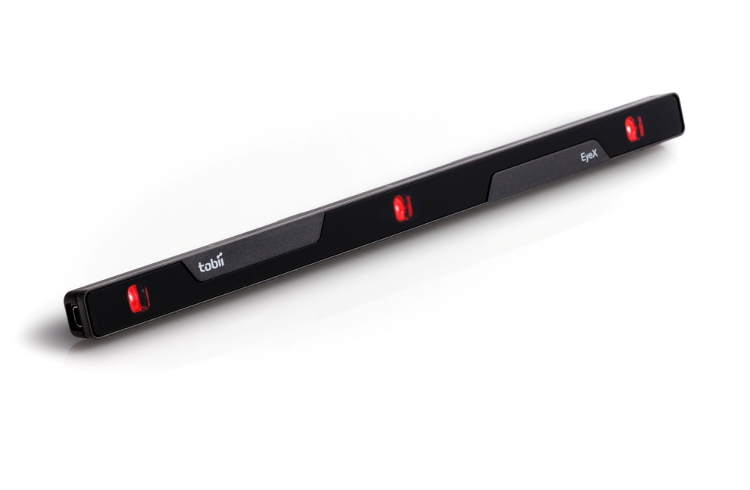
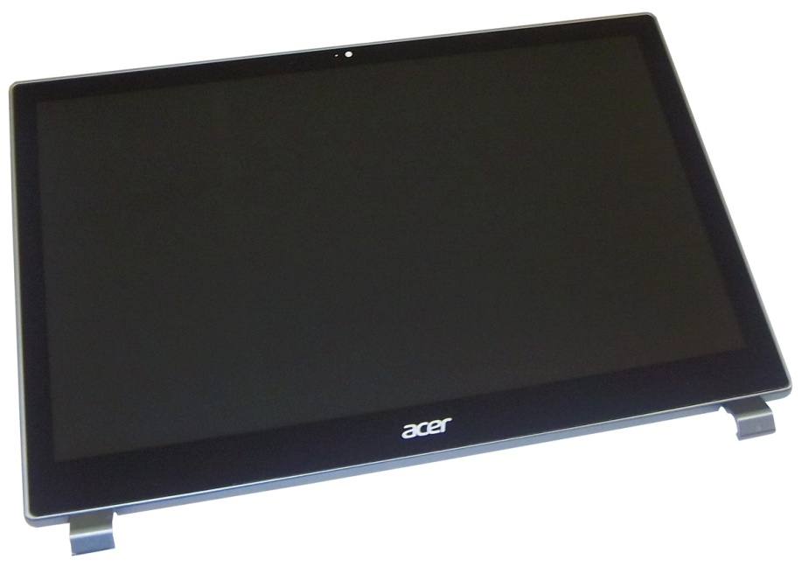
School of Computing & Information Sciences
OpenHID
Lab
Senior Project, 2016, Spring
Multi Modal Interactive Paint
Student: Garrett Lemieux, Florida International University
Mentor: Dr. Francisco R. Ortega, OpenHID Lab
Instructor: Masoud Sadjadi, Florida International University
Problem
Current System
Requirements
FIU strives each year to provide a high level of education and cutting edge technology to students.
FIU’s Open HID Lab is contributing to this goal by developing a smart desk for students.
The desk will be equipped with devices that will allow for input in the form:
Touch screen capabilities
Facial expressions
Hand gestures.
Open HID Lab needs an application that can showcase the multi modal functionality of the smart desk and test user’s interactions with to improve development of the smart desk.
At this time there are no applications that can display the unique functionality the smart desk will provide with its multi modal device interactions.
In order to further the development of the desk an application will be needed to test user interactions with the desk. The application will also provide a unique and fun experience for users that have little or no experience with following devices:
Leap Motion
Intel Real Sense
EyeX
Multitouch Screen
Our job was to develop an interactive paint program that could use several types of user inputs.
As a developer we would have to obtain input from different types of devices and implement the functionality in the form of a paint program.
The user would need an easily understood interface and be able to control the drawing features and devices within the program.
Application should provide features that use the devices that will be implemented within the smart desk.
System Design
Object Design
Implementation
.
Devices
Screenshots
Summary
Multi Modal Interactive Paint is a software solution that provides a unique and interactive application to help users learn how to interact with smart desk and the new devices within the desk.
The paint program will provide the developers of the smart desk with information on user interactions to develop an intuitive user interface for the smart desk.
Future Development:
Speech Recognition
3D Cameras
Creation of games to assist in learning the features of the devices used in paint program.
Intel Real Sense Depth Camera
3D Camera: HD Camera, Infrared Camera, Infrared Laser Projector
Face Analysis: Facial Gestures
Leap Motion Sense
Uses Two Chromatic IR Cameras and Three IR LED Cameras
Hand Gestures Recognized
Tobii EyeX
Acer Multitouch Monitor
Acknowledgement
The material displayed in this poster is based upon the work supported by Dr. Francisco R. Ortega and Dr. Naphtali Rishe from FIU’s High Performance Database Research Center. I would like to personally thank Andrew Mitchell for help I received from my team member. Special Thanks to Alain Galvan and Jason Lee Thomas from the OpenHID Lab.

