Slide 1
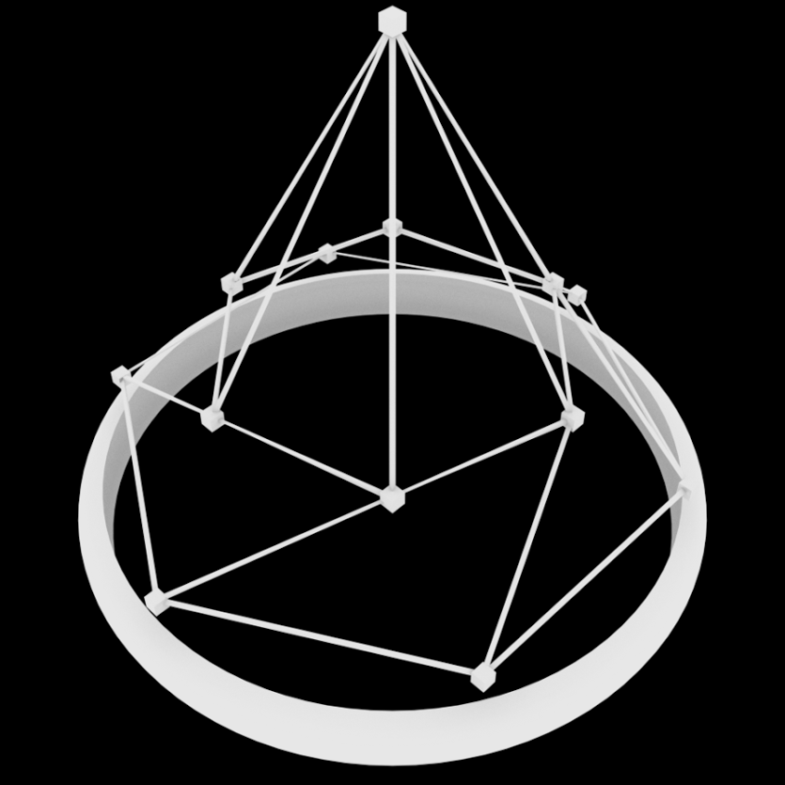

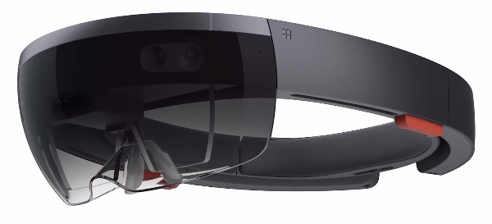


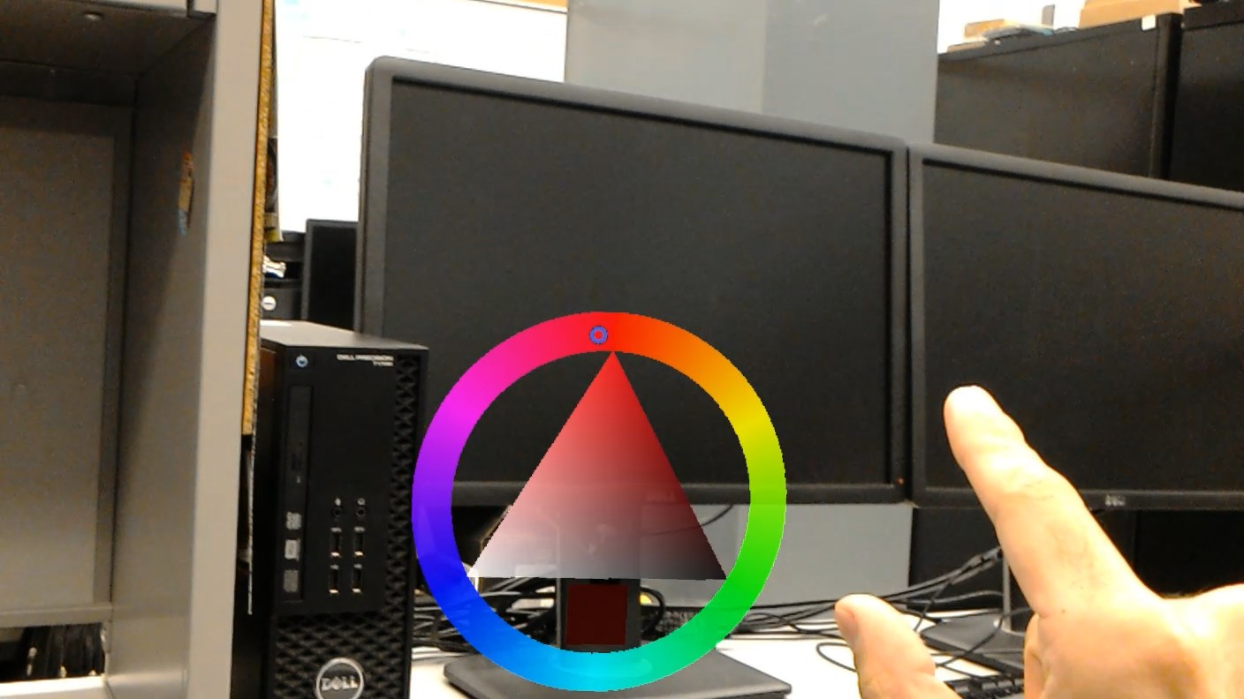
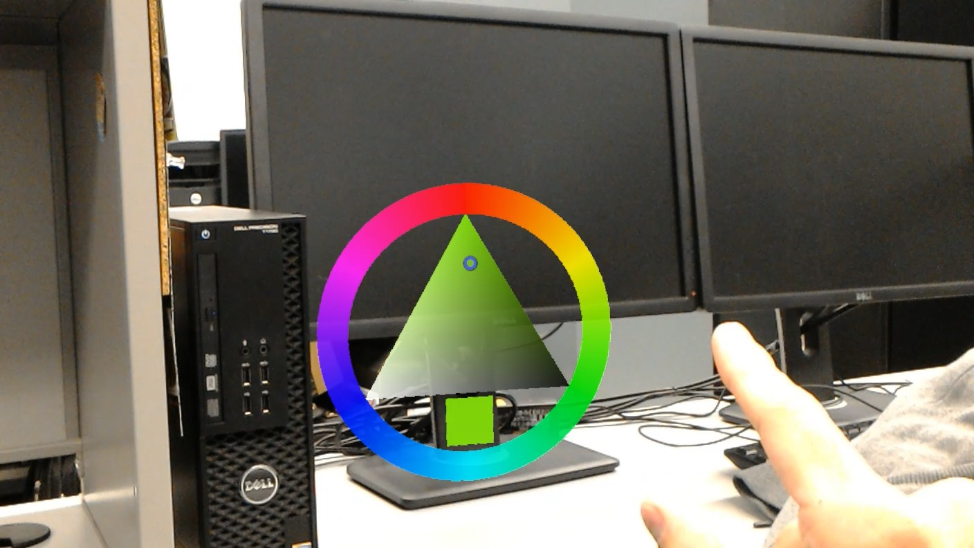
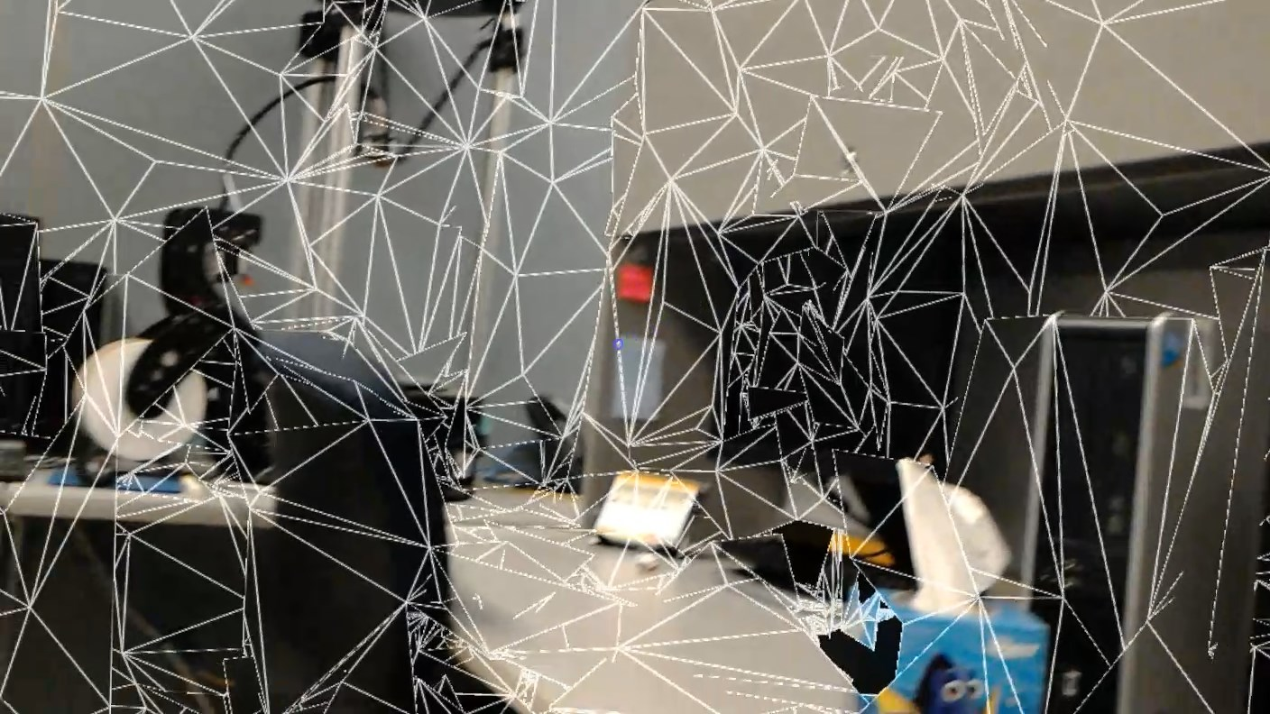
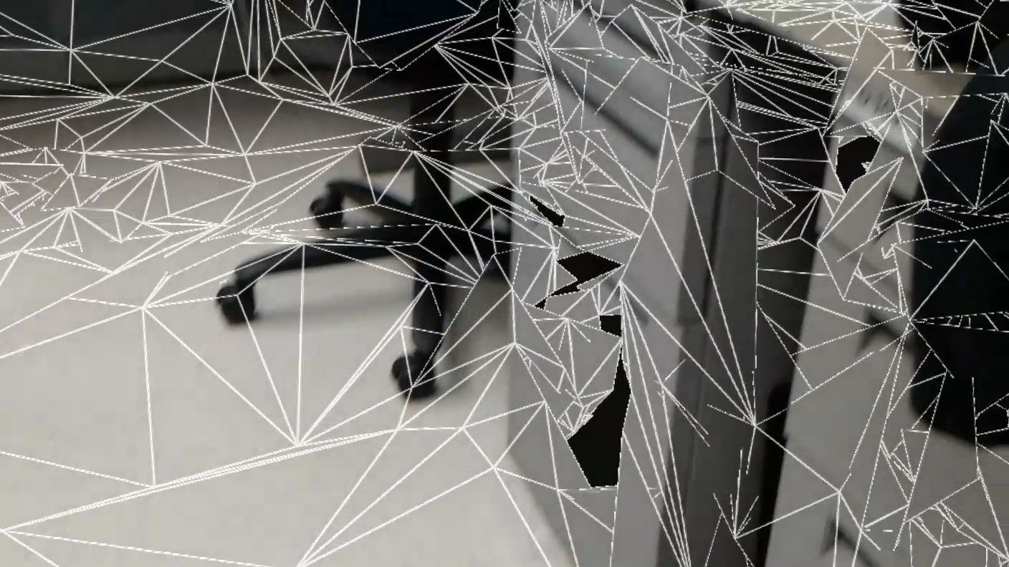
School of Computing & Information Sciences
OpenHID
Lab
Senior Project, 2016, Summer
Multimodal Interactive Paint - AR
Student: Christopher Naranjo, Florida International University
Mentor: Dr. Francisco R. Ortega, OpenHID Lab
Instructor: Masoud Sadjadi, Florida International University
FIU’s Open Human Interface Devices Lab
Problem
Current System
FIU OpenHID Lab is developing a education Smart Desk for students, currently consisting of the following devices:
Multi-touch screen
Tobii EyeX
Intel RealSense Depth Camera
Leap Motion Camera
While the current project is able to take input from a multitude of devices; new generations of input devices are always being released. OpenHID lab needed to explore the capabilities of these devices, and re-architect the current application to support them.
The current application; while supporting a slew of various input devices, does not support an Augmented/Mixed Reality interface.
Requirements
Creating a standalone mixed-reality painting application on Microsoft HoloLens, benefiting from
Gaze/Sight
Hand Gestures
Voice Commands
Create development guide to accelerate future integration into main application
System Design
Using Gaze to control cursor, tap gestures to select color/alpha
Object Design
Dynamically created mesh overlay of world
Built around a component-based design, taking advantage of Unity’s built-in features
Additional use of singleton patterns where needed to prevent unnecessary game object creation
Implementation
Verification
Summary
Project was developed with a test-driven approach; taking advantage of the component-based design that Unity provides.
Bottom-up testing approach was used
Additional real-world testing due to the portability of device:
Light variations
Room brightness
User movement
Body movement
Hologram clipping/occlusion
Physical room
Mapping distance
Surface interactions
Room clutter
Interactive Paint – AR adds a fun and unique way to interact with the real world; and opens up the possibility for endless other applications.
With the groundwork set in this version; and this small proof-of-concept, we hope to continue development and integrate Interactive Paint – AR into the main application in future iterations. As well as potentially add new interactions between multiple AR devices.
Acknowledgement
The material presented in this poster is based upon the work supported by Dr. Francisco R. Ortega(OpenHID), and Dr. Naphtali Rishe(HPDRC). I am thankful for the help that I received from my group members: Eric Aguiar, Alexander Karpix, and Jorge Nonell. Special thanks go to everyone from the OpenHID Lab and MiamiMedTech for their support.
Notes:
1

