Slide 1



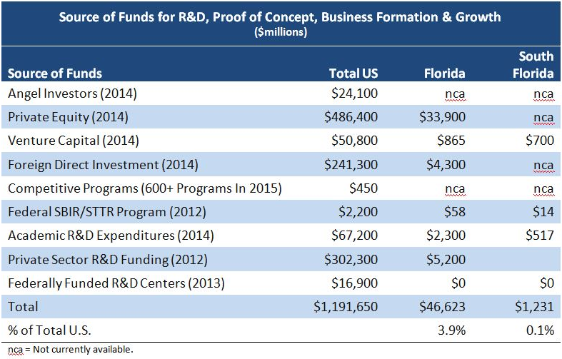
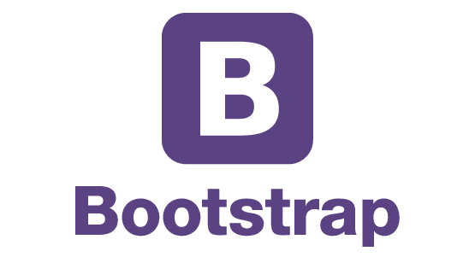






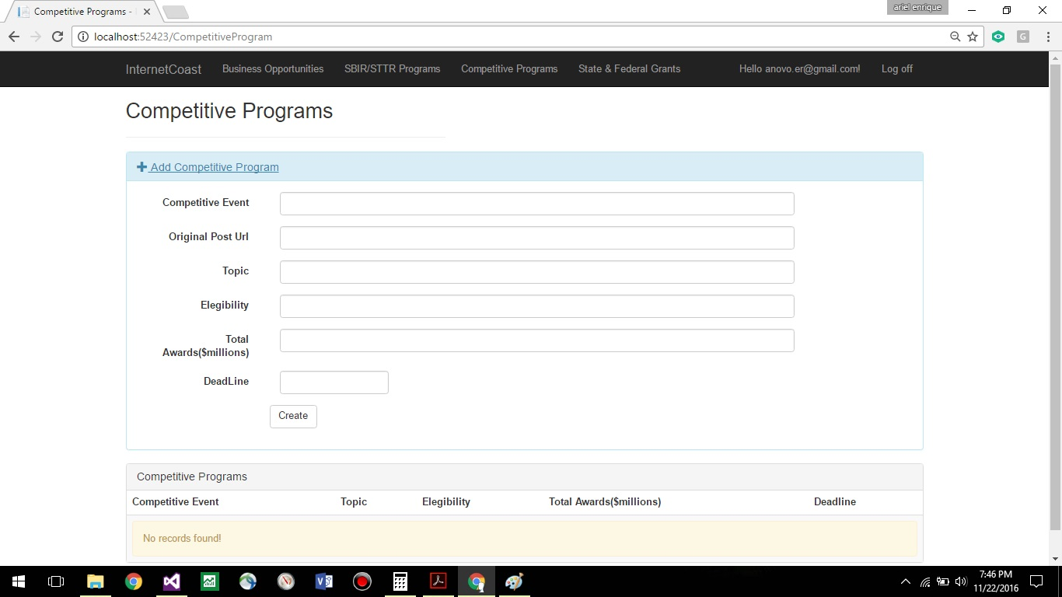
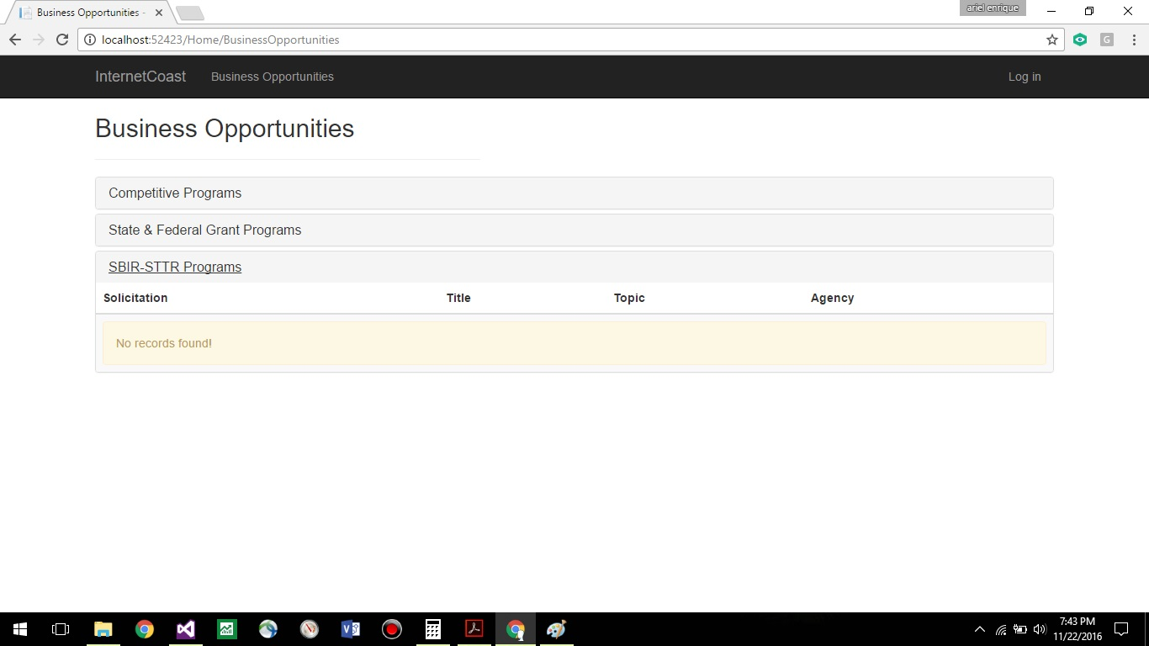
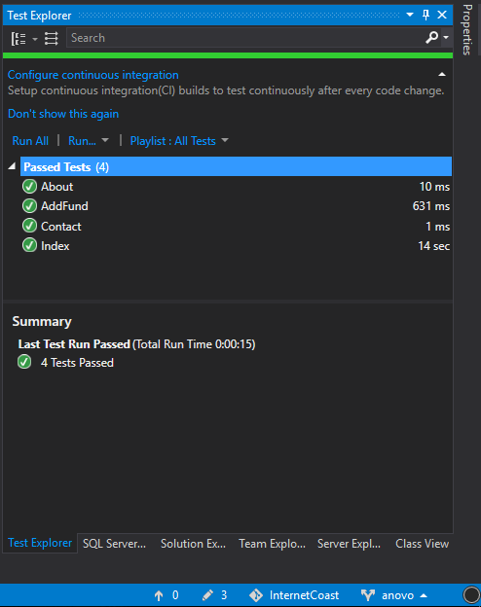
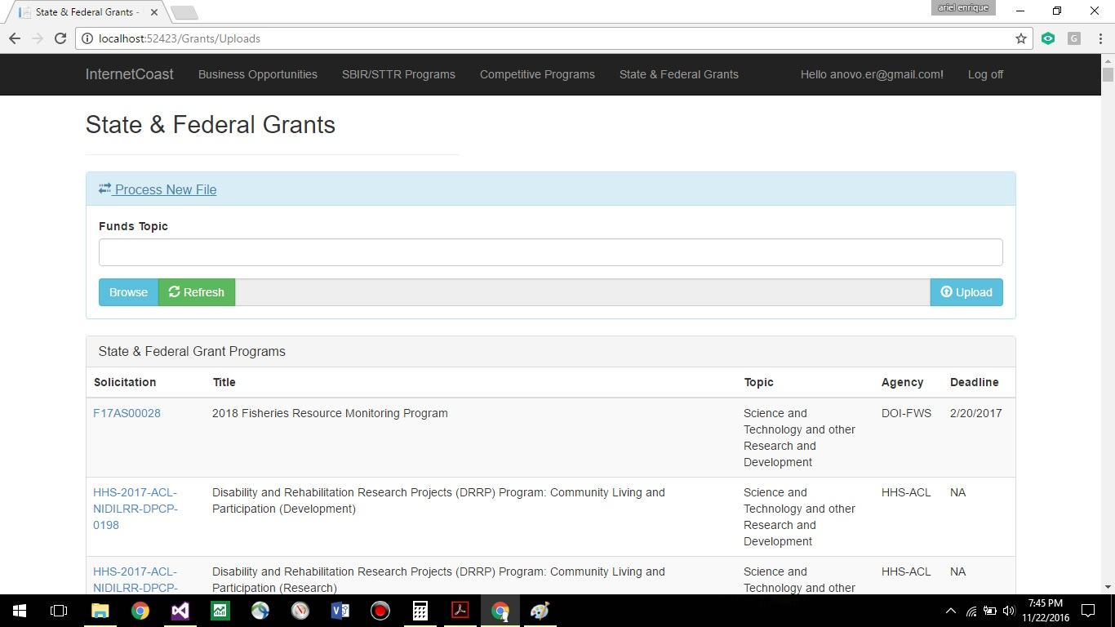
School of Computing & Information Sciences
Advance Software Engineering, 2016, Fall
Internet Coast 1.0
Student: Ariel E. Novo, FIU
Mentor: Mohsen Taheri, FIU and Dale Gregory, President at Internet Coast
Instructor: Masoud Sadjadi, Florida International University
Problem
Current System
Raising capital for startup => challenging and time consuming. Early stage funding sources include founders cash and debt, friends and family.... with angel and venture capital being extremely difficult to obtain.
http://www.icoast.com/main/business-opportunities/
Posting of funds completely manual in pdf format.
Necessity of navigate to several web sites to get the information from.
Costly to maintain and keep op to date.
Requirements
Currently two main roles: Admins and Users.
Admins can:
See the list of funds.
Login.
Add competitive programs information.
Add Federal and State Grants information.
Users can:
See the list of funds.
Windows services are used to:
Add Sbir-Sttr Programs information.
System Design
Object Design
Implementation
Verification
In order to verify the behavior of the application the Microsoft Unit Testing Framework where mainly used. Acceptance tests where also conducted.
Screenshots
Summary
Internet Coast 1.0 is a project that just started during the fall semester 2016. There is a great potential to continue working on this solution and plenty of room for improvement and innovation.
This first version can be used as the platform for supporting all the development needed until reaching a mature software solution.
The final product can become a powerful tool and a reference place for entrepreneurs seeking for funding opportunities.
Acknowledgement
The material presented in this poster is based upon the work supported by Mohsen Taheri. I'm thankful for having the opportunity to have worked with my product owner Dale Gregory, my technical mentor Mohsen Taheri, and finally my instructor Masoud Sadjadi.
Notes:
1

