Slide 1

Learning OpenFlow/SDN Network for Research and Experimentation 1.0
Team Members: Steven Lyons, Jahkell Lazarre Product Owner: Vasilka Chergarova
Mentor: Mohsen Taheri
Instructor: Masoud Sadjadi
School of Computing and Information Sciences Florida International University
Final Presentation
<Fall 2016>
Notes:
7 seconds.
Greet your audience, thank them for attending your presentation, introduce yourself, introduce your project, introduce your team members, and quickly indicate what each of you did in a high-level manner, and put more emphasis on your part/contribution.

Slide 2
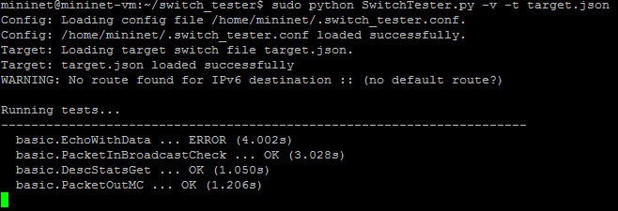
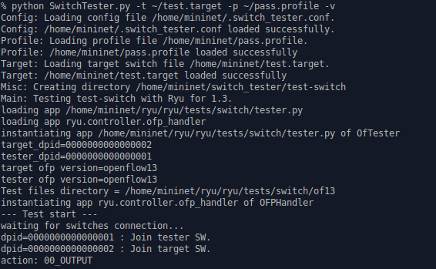
Project definition
SwitchTester is a command line application that allows for automated testing of OpenFlow switches and application compatibility of those switches, easing the efforts needed by Network engineers that are adding switches to their networks.
Notes:
10 seconds.
Introduce the problem that the whole project (in all versions) tackles with GIF or screenshot.

Slide 3
Project definition
SwitchTester 1.0:
Automated Testing of OpenfFlow switches:
OFTest for OpenFlow 1.0
Ryu for OpenFlow 1.3
Outputs of Data:
Raw OFTest/Ryu results
JSON of detailed breakdown of OFTest/Ryu results
CSV of simplified breakdown of OFTest/Ryu results
Notes:
20 seconds.
Introduce the problem that the your project (in new version) tackles with GIF or screenshot.

Slide 4
Project definition
SwitchTester 1.0 (cont.):
Testing switches for Application compatibility
Outputs PASS/FAIL result for switch’s compatibility
Command line arguments:
Verbose messages
Specify config, target, application profile
Force testing
Backup previous results
Allow interactive input
Notes:
20 seconds.
Introduce the problem that the your project (in new version) tackles with GIF or screenshot.

Slide 5
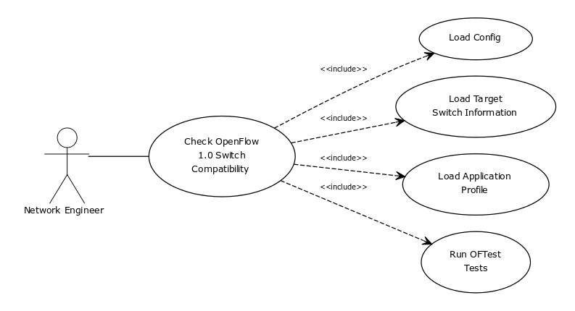
Requirements: Use Cases
Notes:
5 seconds
Show the Use Case Diagram for the whole project. Highlight your use cases.

Slide 6
Requirements: Use Cases
Notes:
5 seconds
Show the Use Case Diagram for the whole project. Highlight your use cases.

Slide 7
System Design: Architecture
SwitchTester subsystems:
OFTTester:
Uses OFTest framework for testing.
RyuTester:
Uses Ryu framework for testing.
Both rely on CoreTester for configuration and function implementation.
SwitchTester picks subsystem using context.
Lends itself to a strategy design pattern.
Notes:
20 seconds
System design: Highlight the parts that you contributed to them.
1. System decomposition; identify the architecture patterns used
2. System deployment – h/w and s/w requirements

Slide 8
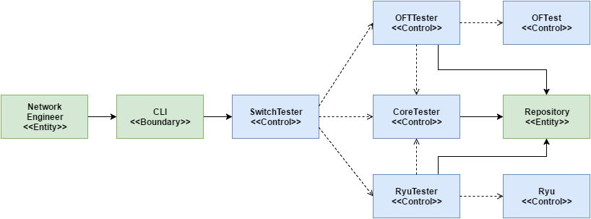
Minimal Class Diagram
Notes:
10 seconds.Minimal class diagram. Highlight the classes that you created/modified
Identify the design patterns used (one or more slides).

Slide 9
User Stories
126
121
143
141
144
142
145
Notes:
5 seconds.
List the user stories that you worked on them.(put in order of importance). Stay focused on the parts that you have been working.

Slide 10
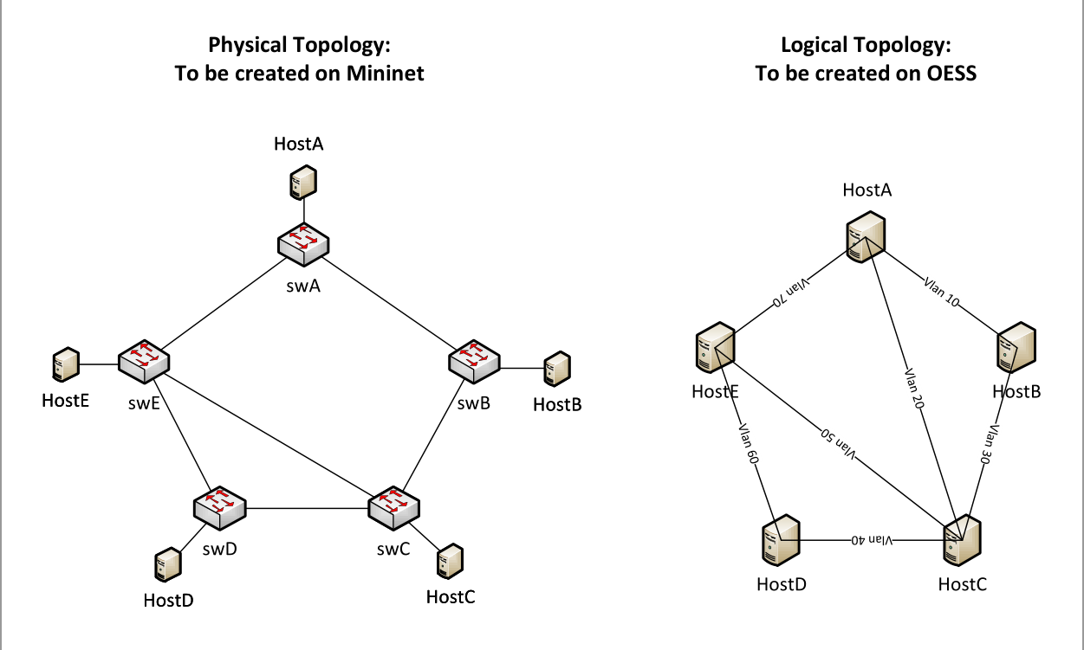
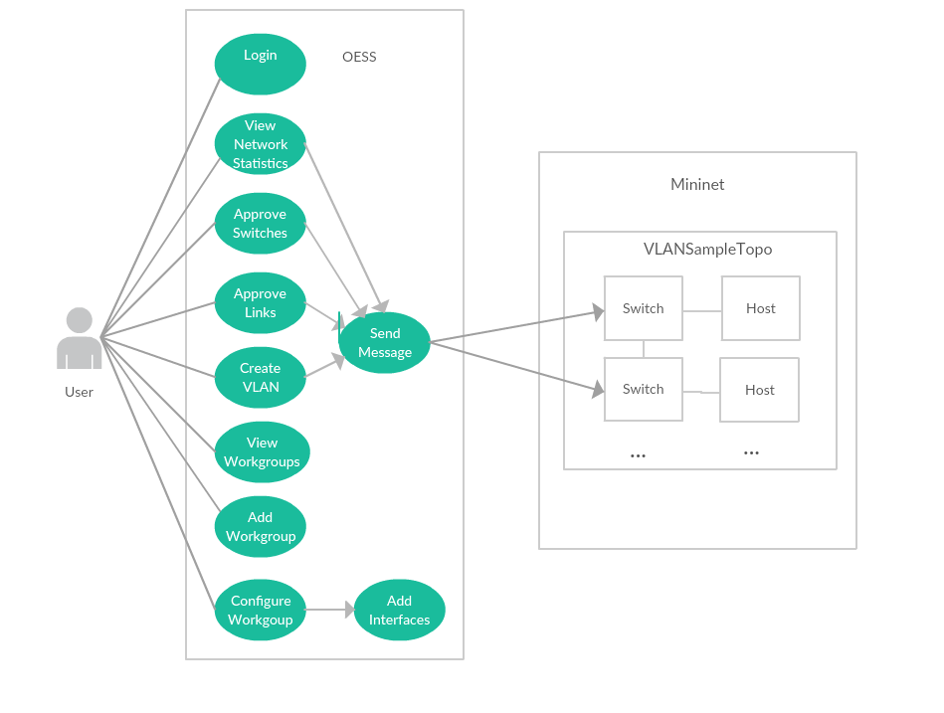
User Story #1
User Story #126 Implement the sample topology using Mininet and OESS.
As a project member I need to simulate the sample topology so that I can show that my testing environment and understanding works properly for future development and testing.
Acceptance Criteria
Be able to demo the working environment.
Creating OpenFlow entry in working environment.
Host connected to Mininet must support VLAN configuration.
Notes:
60 seconds
The tile of user story
The most important user story you worked on it. You have to describe this one very well and be proud of that.
Please present and show the complexity of your work, code, algorithms, and technical challenges and technologies you have used. (you could use screenshot if you want. Visual presentations are better than text presentation)
Go into the details of the most important/significant tasks using bullet lists or visual graphs or state chart diagram
Sequence Diagram for this user story is mandatory (in another separate page if required)
Demo using screenshots or GIF (in another separate page if required)

Slide 11
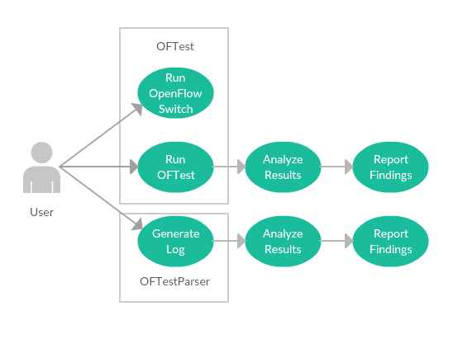
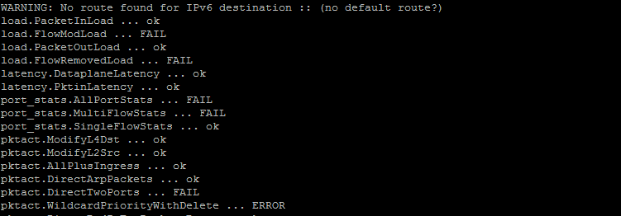
User Story #2
User Story #121 Create an SDN validation environment to test the switch’s Control, Data and Management Planes with OFTest (Part 1)
As a user of AmLight I need a way to validate switches automatically to ease the installation of switches into AmLight.
Acceptance Criteria
Understand what is OFTest
Run on Mininet
Notes:
60 seconds
The tile of user story
The most important user story you worked on it. You have to describe this one very well and be proud of that.
Please present and show the complexity of your work, code, algorithms, and technical challenges and technologies you have used. (you could use screenshot if you want. Visual presentations are better than text presentation)
Go into the details of the most important/significant tasks using bullet lists or visual graphs or state chart diagram
Sequence Diagram for this user story is mandatory (in another separate page if required)
Demo using screenshots or GIF (in another separate page if required)

Slide 12
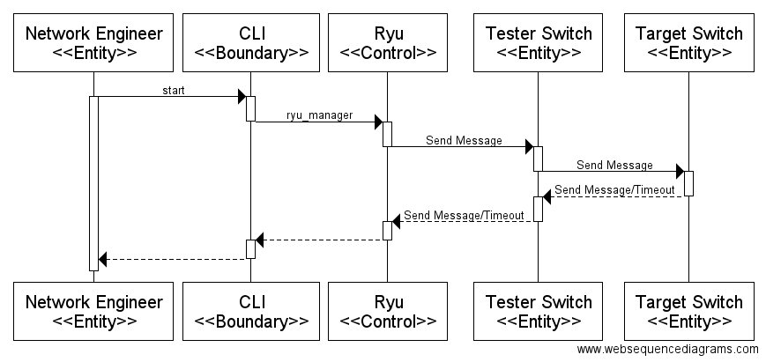
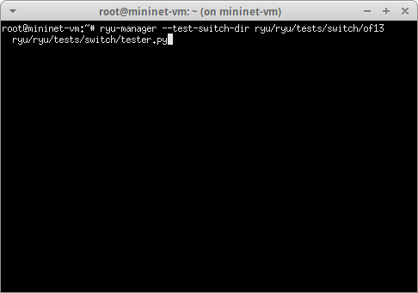
User Story #3
User Story #143 Create an SDN validation environment to test the switch’s Control, Data and Management Planes with Ryu (Part 1)
As a user of AmLight I need a way to validate switches automatically to ease the installation of switches into AmLight.
Acceptance Criteria
Understand what is Ryu
Run on Mininet
Notes:
60 seconds
The tile of user story
The most important user story you worked on it. You have to describe this one very well and be proud of that.
Please present and show the complexity of your work, code, algorithms, and technical challenges and technologies you have used. (you could use screenshot if you want. Visual presentations are better than text presentation)
Go into the details of the most important/significant tasks using bullet lists or visual graphs or state chart diagram
Sequence Diagram for this user story is mandatory (in another separate page if required)
Demo using screenshots or GIF (in another separate page if required)

Slide 13
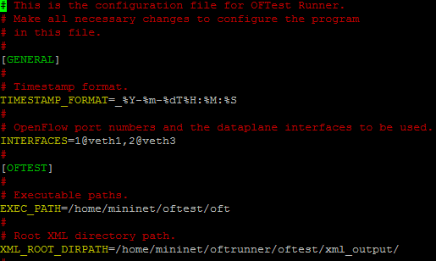
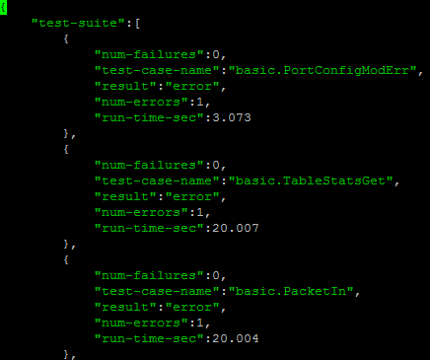
User Story #4
User Story #141 Create an SDN validation environment to test the switch’s Control, Data and Management Planes with OFTest (Part 2)
As a user of AmLight I need a way to validate switches automatically to ease the installation of switches into AmLight.
Acceptance Criteria
Generate report
Notes:
60 seconds
The tile of user story
The most important user story you worked on it. You have to describe this one very well and be proud of that.
Please present and show the complexity of your work, code, algorithms, and technical challenges and technologies you have used. (you could use screenshot if you want. Visual presentations are better than text presentation)
Go into the details of the most important/significant tasks using bullet lists or visual graphs or state chart diagram
Sequence Diagram for this user story is mandatory (in another separate page if required)
Demo using screenshots or GIF (in another separate page if required)

Slide 14
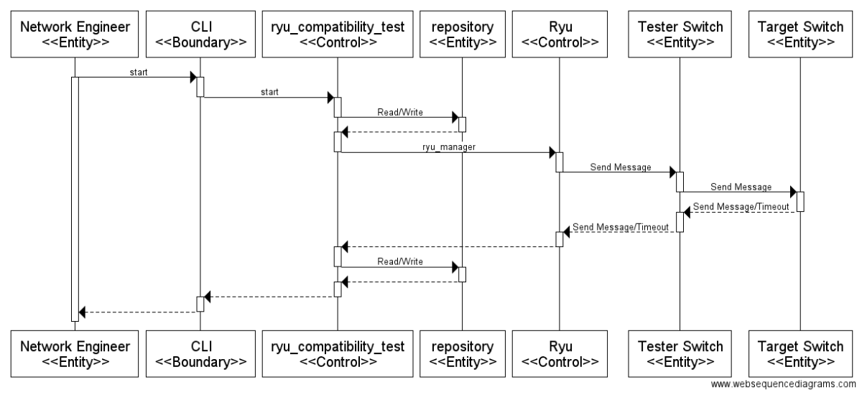
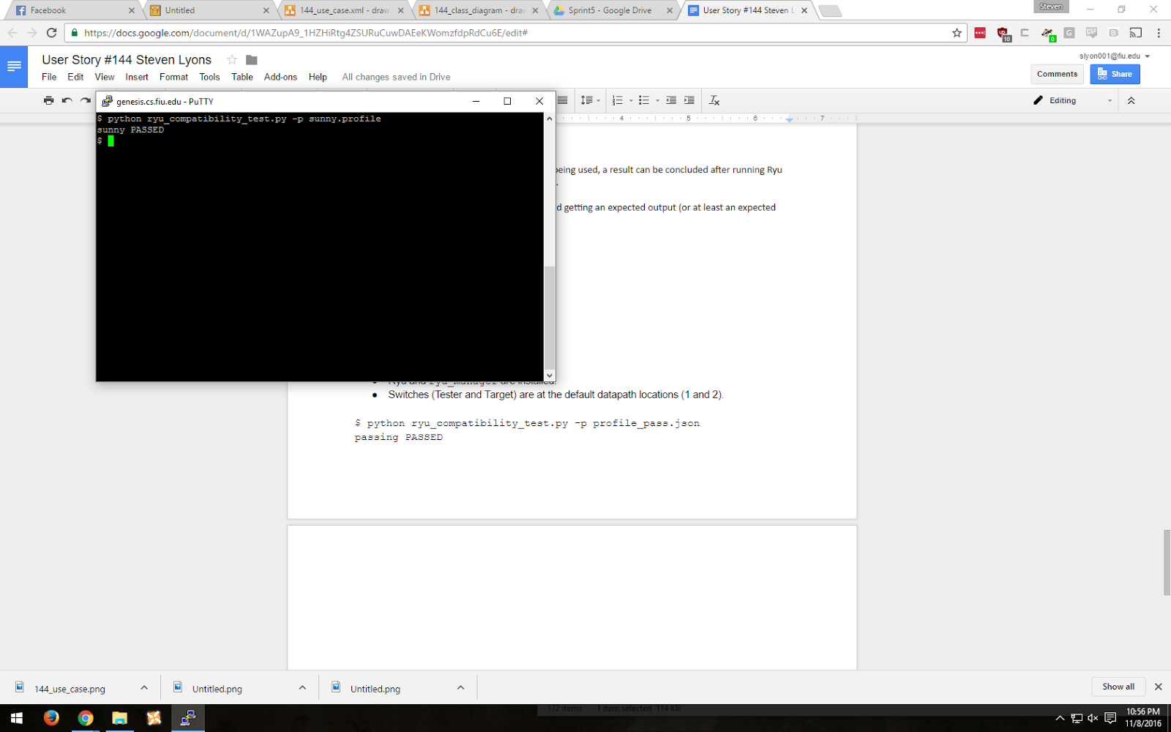
User Story #5
User Story #144 Create an SDN validation environment to test the switch’s Control, Data and Management Planes with Ryu (Part 2)
As a user of AmLight I need a way to validate switches automatically to ease the installation of switches into AmLight.
Acceptance Criteria
Generate Report
Notes:
60 seconds
The tile of user story
The most important user story you worked on it. You have to describe this one very well and be proud of that.
Please present and show the complexity of your work, code, algorithms, and technical challenges and technologies you have used. (you could use screenshot if you want. Visual presentations are better than text presentation)
Go into the details of the most important/significant tasks using bullet lists or visual graphs or state chart diagram
Sequence Diagram for this user story is mandatory (in another separate page if required)
Demo using screenshots or GIF (in another separate page if required)

Slide 15
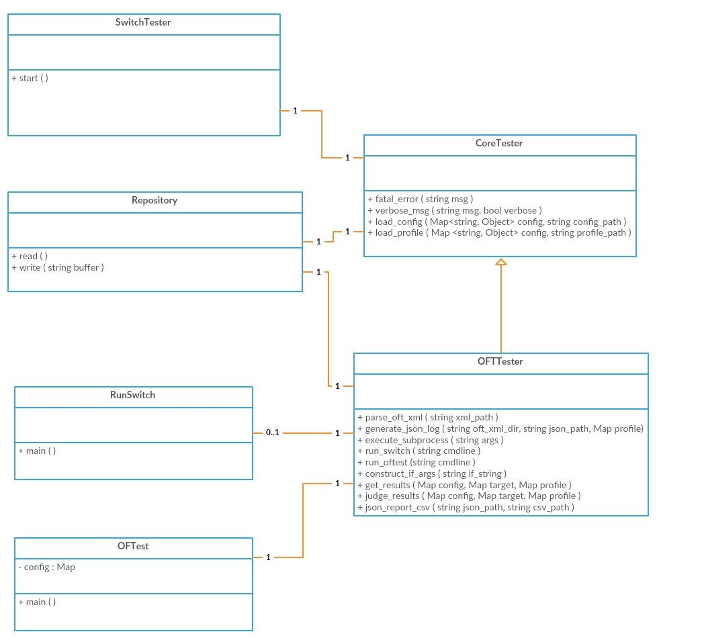
User Story #6
User Story #142 Create an SDN validation environment to test the switch’s Control, Data and Management Planes with OFTest (Part 3)
As a user of AmLight I need a way to validate switches automatically to ease the installation of switches into AmLight.
Acceptance Criteria
Run the script on 2 real devices
Validate your report
Define the application profile
Create another report
Notes:
60 seconds
The tile of user story
The most important user story you worked on it. You have to describe this one very well and be proud of that.
Please present and show the complexity of your work, code, algorithms, and technical challenges and technologies you have used. (you could use screenshot if you want. Visual presentations are better than text presentation)
Go into the details of the most important/significant tasks using bullet lists or visual graphs or state chart diagram
Sequence Diagram for this user story is mandatory (in another separate page if required)
Demo using screenshots or GIF (in another separate page if required)

Slide 16
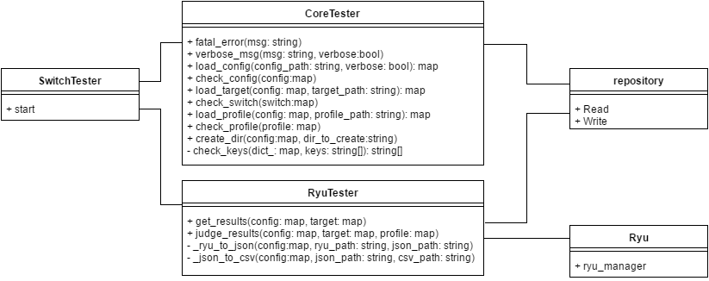

User Story #7
User Story #145 Create an SDN validation environment to test the switch’s Control, Data and Management Planes with Ryu (Part 3)
As a user of AmLight I need a way to validate switches automatically to ease the installation of switches into AmLight.
Acceptance Criteria
Run the script on 2 real devices
Validate your report
Define the application profile
Create another report
Notes:
60 seconds
The tile of user story
The most important user story you worked on it. You have to describe this one very well and be proud of that.
Please present and show the complexity of your work, code, algorithms, and technical challenges and technologies you have used. (you could use screenshot if you want. Visual presentations are better than text presentation)
Go into the details of the most important/significant tasks using bullet lists or visual graphs or state chart diagram
Sequence Diagram for this user story is mandatory (in another separate page if required)
Demo using screenshots or GIF (in another separate page if required)

Slide 17
Test Suites and Test Cases
Purpose:
A text file consisting of a Ryu test result was used for quick testing of several functions, along with sample profiles and target switch configurations that had expected outputs, such as judge_results ending in either a PASS or FAIL situation, as expected of the profile.
Precondition:
Ryu test result has “act OUTPUT,OK” in the simplified csv file. Target switch with name of “test-sw” and of-version of “1.3”.
sunny.profile:
{
“model”:”sunny”,
“compatibility”: [
“act OUTPUT”
]
}
Expected Result:
sunny: test-sw PASSED
Actual Result:
sunny: test-sw PASSED
Status:
Passed
Purpose:
A text file consisting of a Ryu test result was used for quick testing of several functions, along with sample profiles and target switch configurations that had expected outputs, such as judge_results ending in either a PASS or FAIL situation, as expected of the profile.
Precondition:
Ryu test result has “act OUTPUT,OK” in the simplified csv file. Target switch with name of “test-sw” and of-version of “1.3”
rainy.profile:
{
“model”:”rainy”,,
“compatibility”: [
“act OUTPUT”,
“doesnt exist”
]
}
Expected Result:
rainy: test-sw FAILED
Actual Result:
rainy: test-sw FAILED
Status:
Passed
Notes:
10 seconds
A description of verification process and Test Suites and Test Cases for one of the use cases.
1 One sunny day and one rainy day for the implemented use cases (one or more slides).
2 Automated test scripts for the implemented use cases (if any) (one or more slides).

Slide 18






Notes:
10 seconds
Summarize your contribution, mention your effort for Scrum, Mingle, Github, Google Drive Documentation and minutes
Include your contact information
Ask if anyone has any questions for you.
Thank your audience

