Slide 1


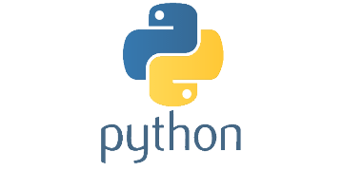
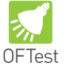




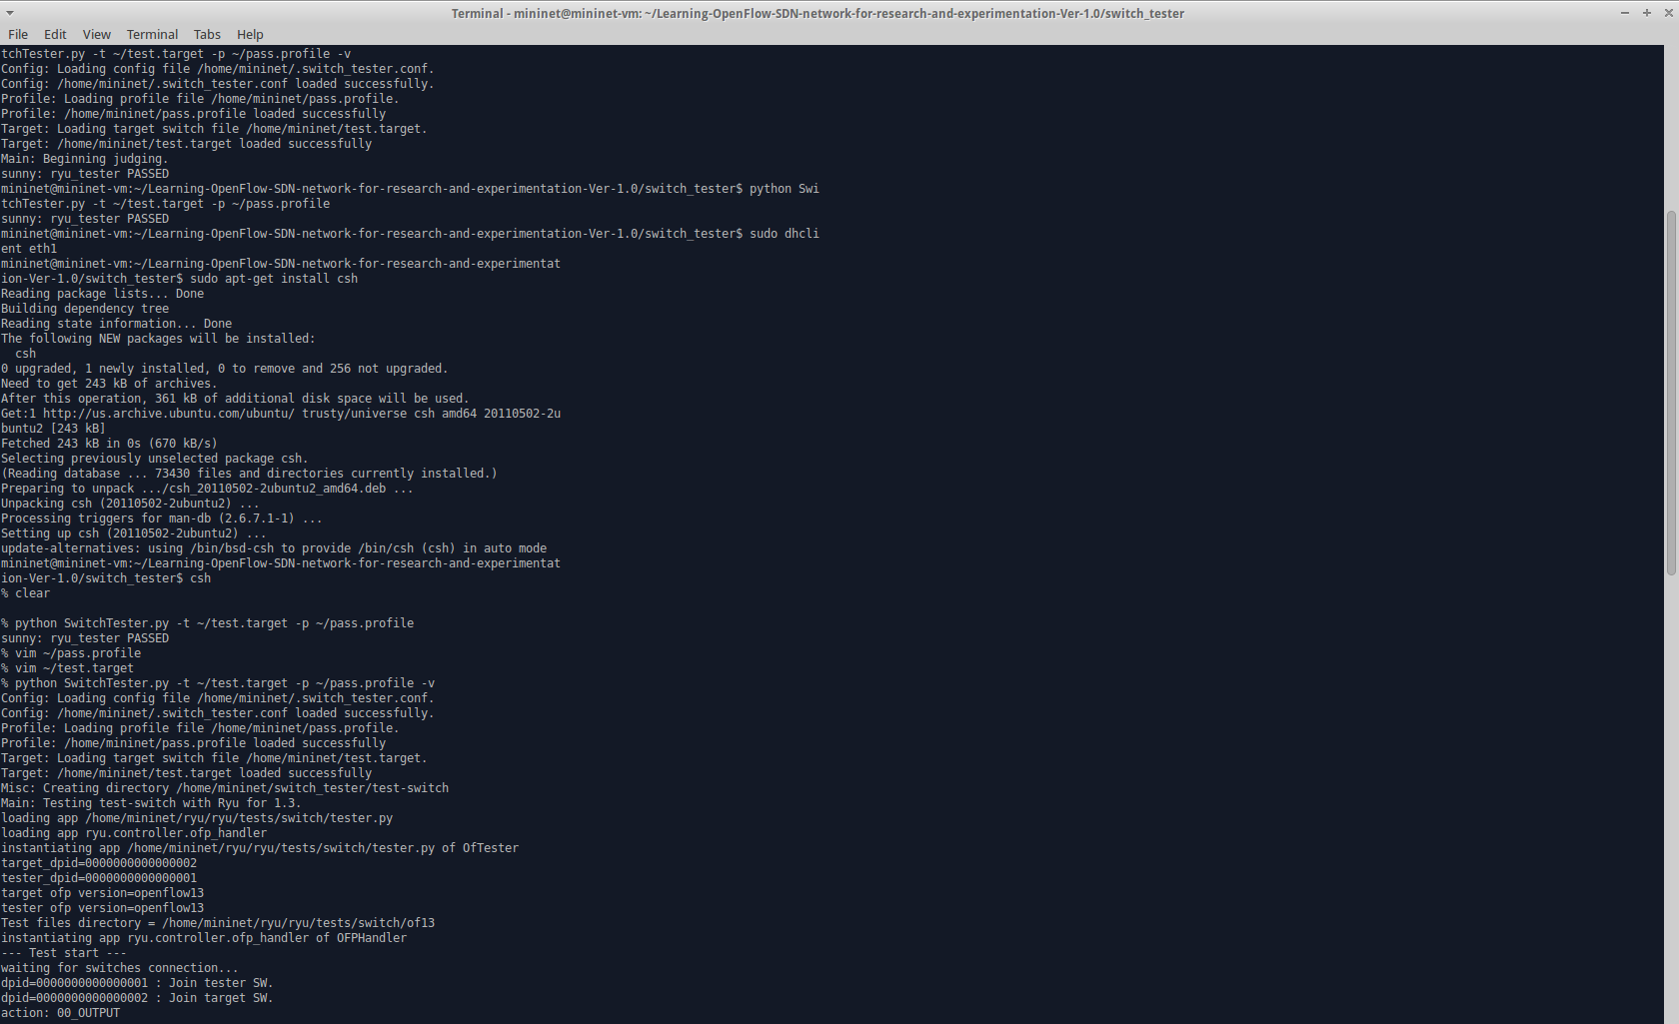
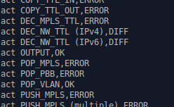
School of Computing & Information Sciences
Advanced Software Engineering, 2016, Fall
Learning OpenFlow/SDN Network for
Research and Experimentation 1.0
Student: Steven Lyons, Florida International University
Mentors: Vasilka Chergarova, CIARA FIU,
Jeronimo Bezerra, CIARA FIU,
Mohsen Taheri, Florida International University
Instructor: Masoud Sadjadi, Florida International University
Problem
Current System
Requirements
Research in the field of Software Defined Network (SDN) is largely unaware of several restrictions encountered when deploying a proposed architecture on real devices. OpenFlow implementation documentation has limitations when working with different switches from different vendors. Different versions of OpenFlow (1.0,1.3, 1.4, etc.) may also give unpredictable errors, and in some cases crash the switch. AmLight is a production network and cannot have such errors.
Automated testing of switches using Ryu and OFTest frameworks.
Network engineers can get detailed digested results in JSON file.
Network engineers can get simplified digested results in CSV file.
Can check whether a switch would work under a particular application.
Personal Contributions:
All of the above, focused on the Ryu framework.
The system allows for Network engineers to:
Automate Ryu testing of OpenFlow switches.
Digest results of the Ryu testing.
Output detailed digested results into JSON file.
Output simplified digested results into CSV files.
Use application profiles and results to determine switch compatibility.
Solution
Implementation
Automated solution in Python for testing OpenFlow network configurations.
Produce reports using OFTest and Ryu.
Will be implemented in the AmLight testing methodology.
Tested on Ubuntu Linux Distro
Tested using Mininet
Programmed in Python 2.7
Tests OpenFlow switches against OpenFlow 1.3 specifications
System Design
Object Design
The solution has the SwitchTester running Ryu tests, which utilizes two switches where one is picked (tester) to test the other (target).
Verification
Screenshots
Summary
Testing was primarily done using two Open vSwitches on Mininet and using the results to determine if the switch passes the qualifications specified by the application profile.
Test Case 1 (Sunny Day):
Purpose: Test that if all qualifications passed, the switch passes.
Precondition: Switch passes all tests related to the qualifications in application profile.
Expected Result: sunny: test-switch PASSED
Actual Result: sunny: test-switch PASSED
Status: SUCCESS
Test Case 2 (Rainy Day):
Purpose: Test that if not all qualifications passed, the switch fails.
Precondition: Switch didn’t pass some/all tests related to the qualifications in application profile.
Expected Result: rainy-test: test-switch FAILED
Actual Result: rainy-test: test-switch FAILED
Status: SUCCESS
Automated testing using the Python solution is feasible and usable.
Results produced are far clearer and easier to use.
Testing uses application profiles to determine if a switch will work under said application.
AmLight will be implementing the switch validation solution in their testing methodology.
Solution running Ryu testing framework using two switches.
Solution running a switch against an application profile.
Simplified results, as seen in the CSV file.
Acknowledgment
The material presented in this poster is based upon the work done by Steven Lyons and Jahkell Lazarre and supported by our mentors Jeronimo Bazarre, Vasilka Chergarova, and Mohsen Taheri. I am thankful for having been able to meet and work with Jahkell and my mentors,
Notes:
‹#›

