Slide 1






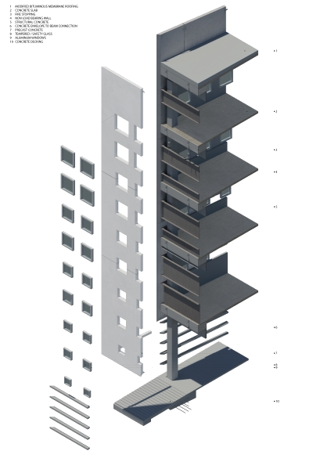
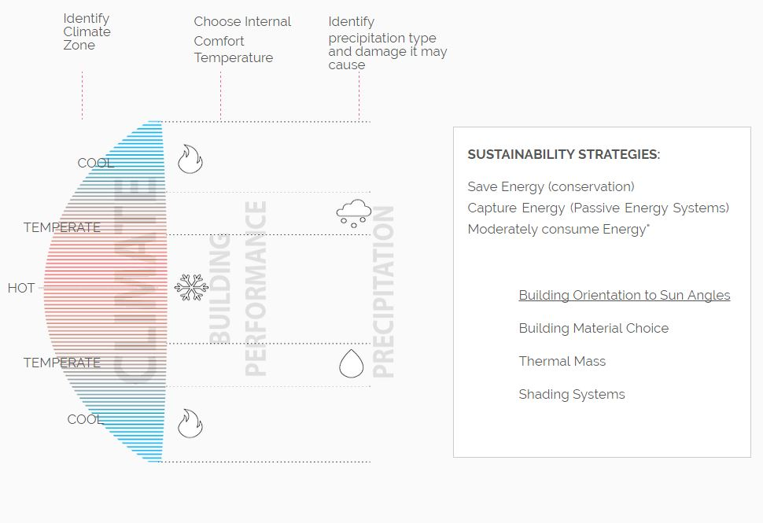
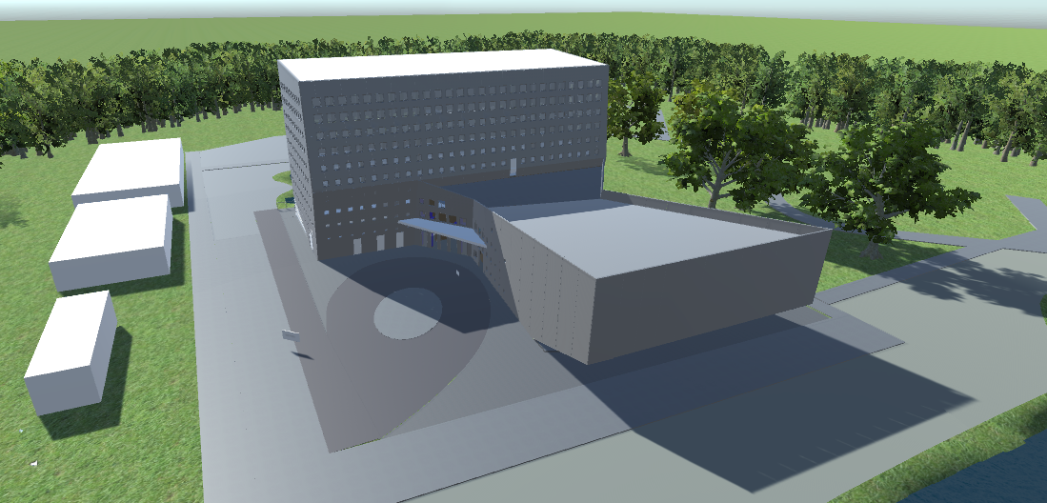
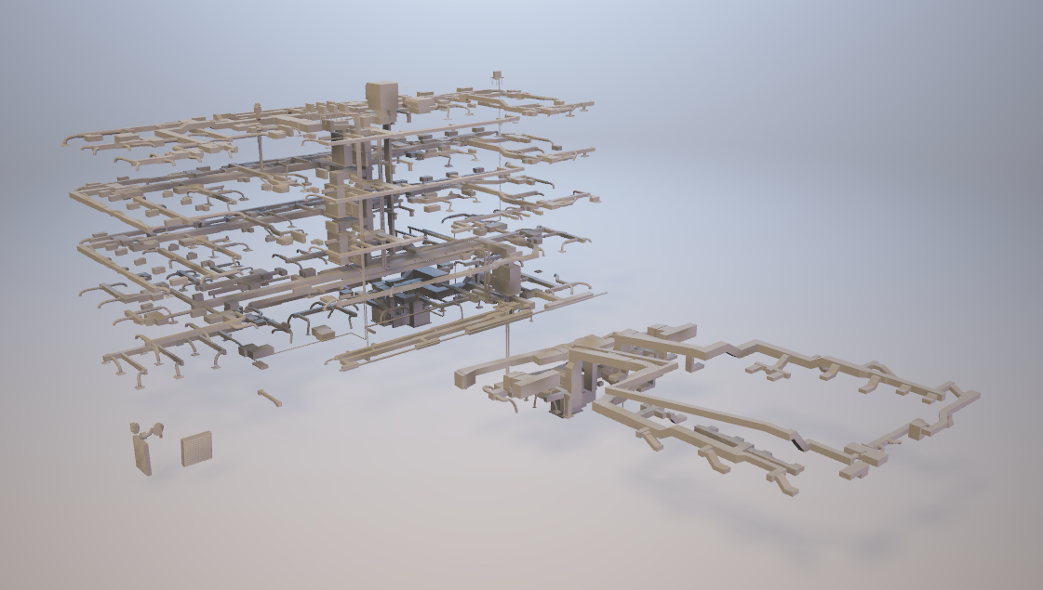
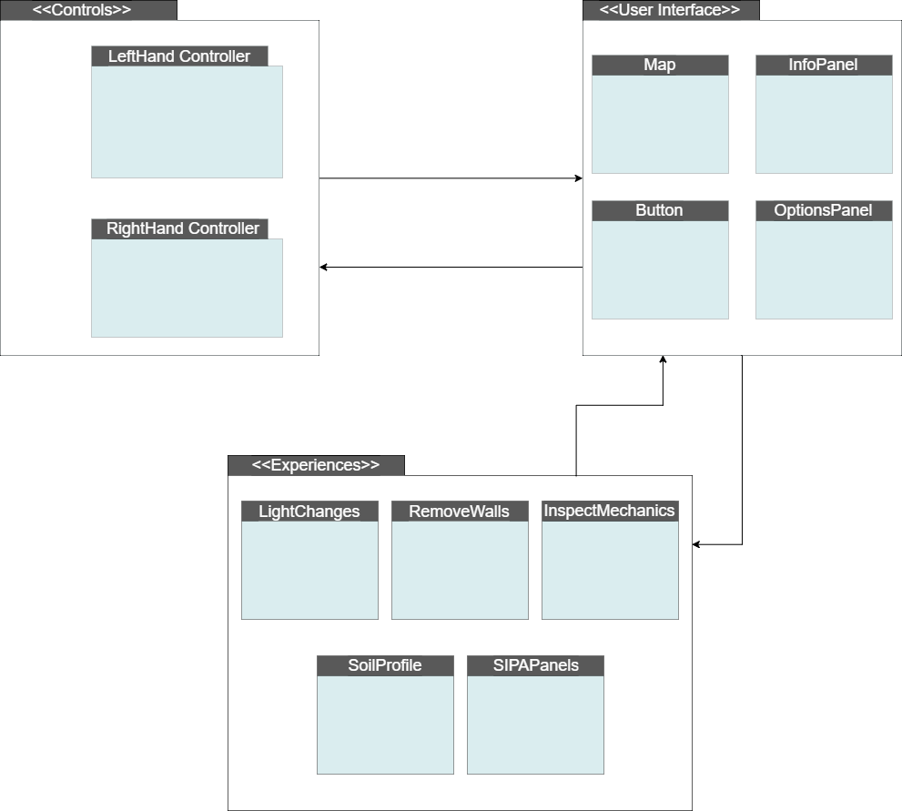
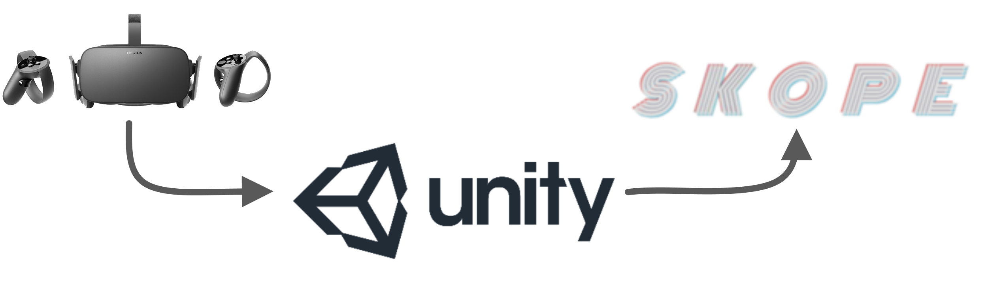
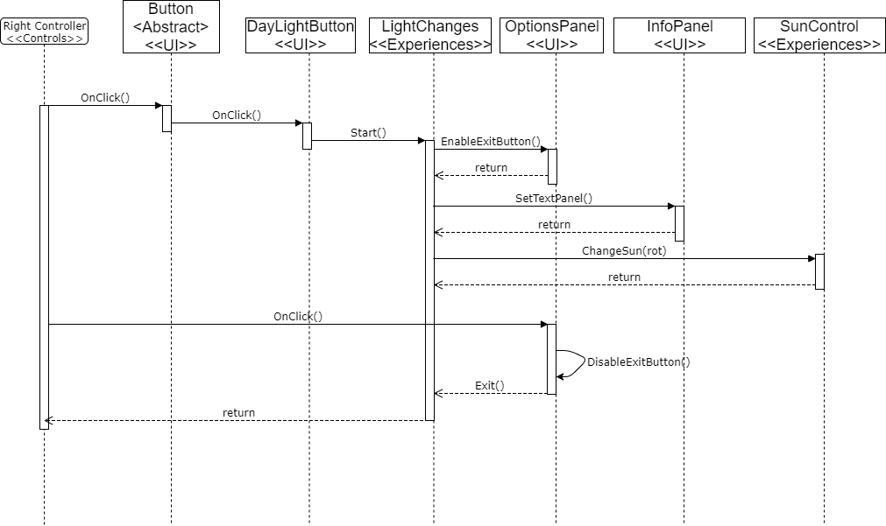
School of Computing & Information Sciences
Senior Project, 2017, Fall
SKOPE VR 1.0
Student: Parker Thomas Scott, Florida International University
Mentor: Albert Elias,Shahin Vassigh, Florida International University
Professor: Masoud Sadjadi, Florida International University
Problem
Solution
Current System
SKOPE aims to prepare students of interdisciplinary sciences using:
Building Information Modeling
Virtual Reality
Augmented Reality
Interactive Lessons
Climate Controls
Create a system which utilizes a virtual reality platform in order to provide:
Realistic Virtual Environment
Walkthroughs
Interactive Simulations
Animations
Experiences which aid in educational process
Version 1.0
SKOPE VR utilizes the Oculus Rift to interact with the environment
Full Scale Model of SIPA
Experiences within simulation for educational purposes and interactivity
ScreenShots
Problem
Solution
The vision for SKOPE is to provide interactive BIM and realistic experiences.
Therefore, we provided this level of interactivity with “experiences” in the Oculus Rift simulation that provide accurate daylight effects and by-level observation of SIPA’s construction.
System Design
Implementation
The implementation utilizes the Oculus Rift which provides:
Interaction with Scene
Developed Libraries
Optimal Simulation Immersion
Audio and Visual Feedback
Verification
Object Design
Test Case ID: LightTest_001 | (Sunny Day)
Purpose | To test the functionality when the user uses the daylight alteration experience while not in an experience.
Preconditions | The user should be near the daylight experience The user should not currently be in an experience
Input | OnClick() triggered by clicking of the daylight alteration button.
Expected Output | Begin daylight alteration experience The UI Controller’s Option Panel should update
Test Case ID: LightTest_002 | (Rainy Day)
Purpose | To test the functionality when the user uses the daylight alteration experience while in another experience.
Preconditions | The user should be currently utilizing an experience The user should be near the daylight experience
Input | OnClick() triggered by clicking of the daylight alteration button.
Expected Output | Begin daylight alteration experience The UI Controller’s Option Panel should update
Requirements
Experiences correlate with purpose
Proper alteration of Environment
Deletion of Walls and GameObjects
Transformation of User’s Location
Rotation of Sunlight/Directional Light
Interfacing with General UI
Summary
Multiple experiences that have some architectural or learning purpose
Users can initialize and end any experience.
Users have the ability to utilize any experience at any given time.
Experiences update User Interface
Experiences receive input from User Interface
Acknowledgement
The material presented in this poster is based upon the work supported by Albert Elias and Shahin Vassigh. I am thankful to the help that I received from my group member, Jose Maldonado.
Notes:
1

