Slide 1


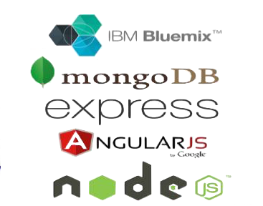

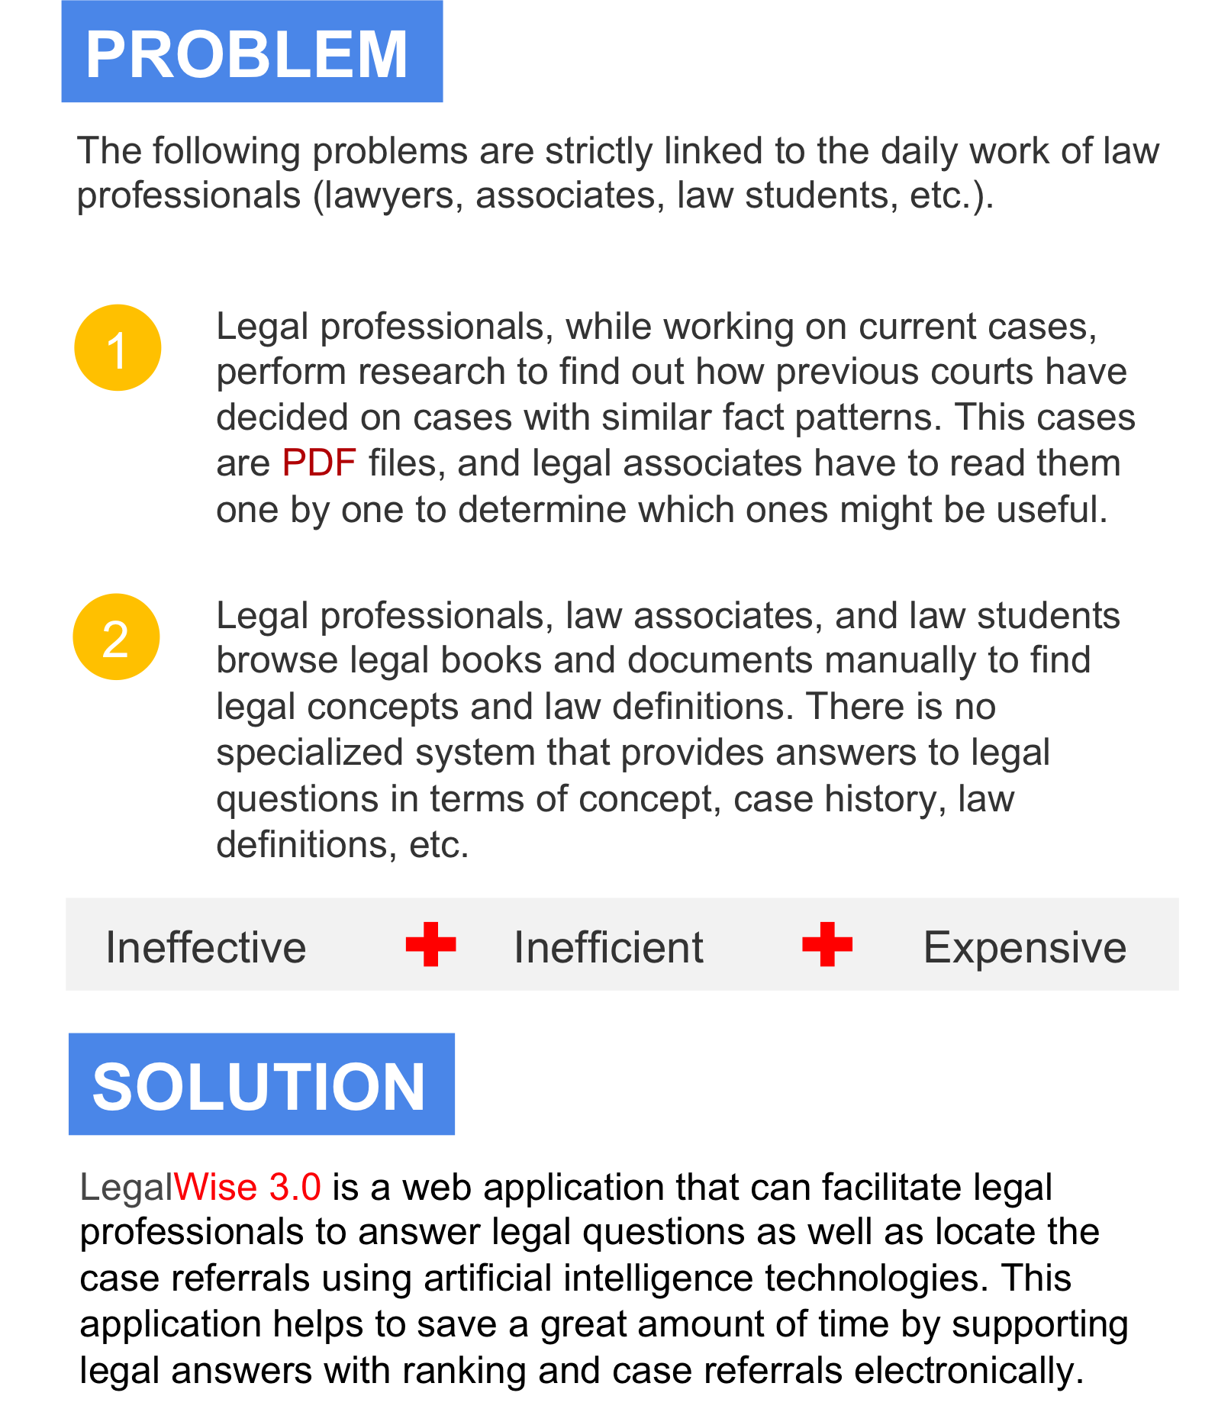
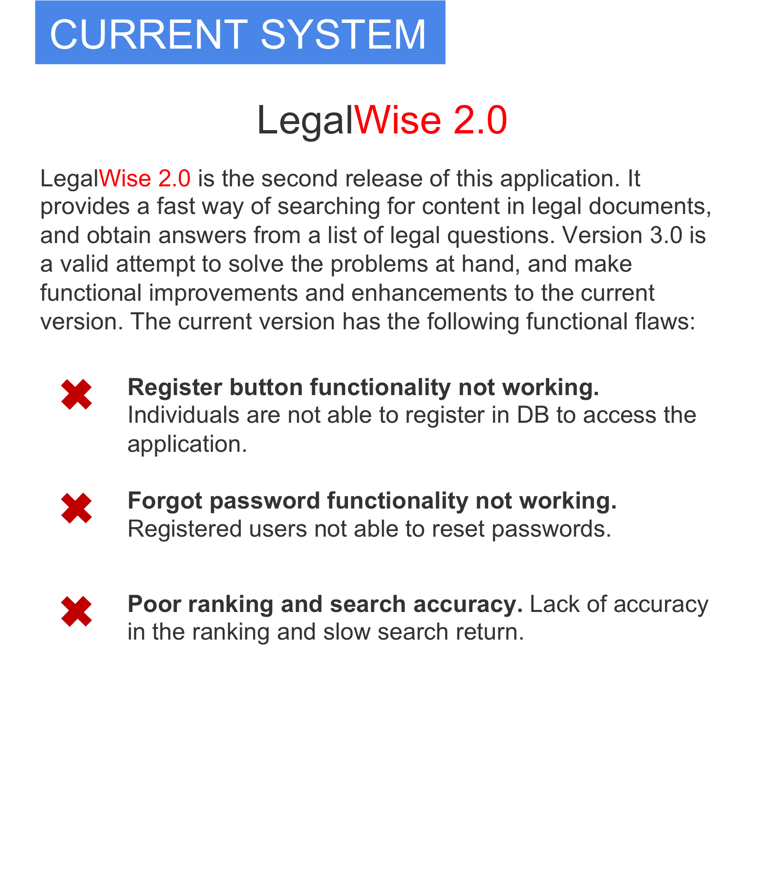
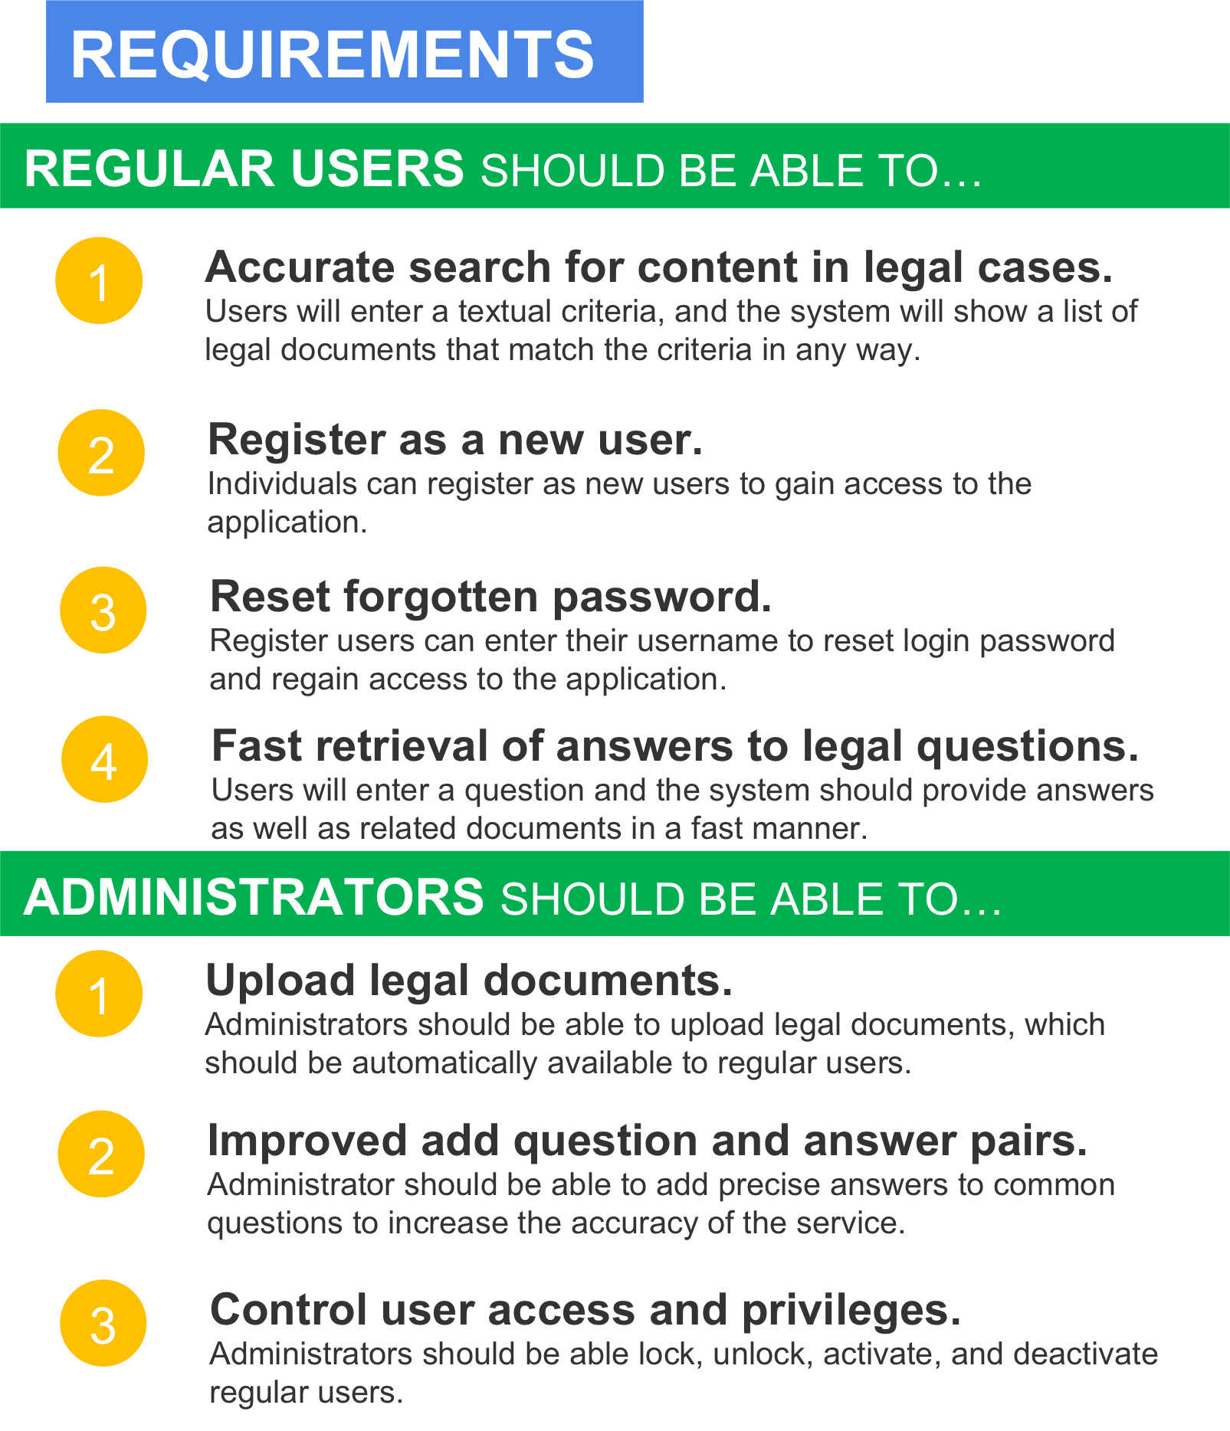
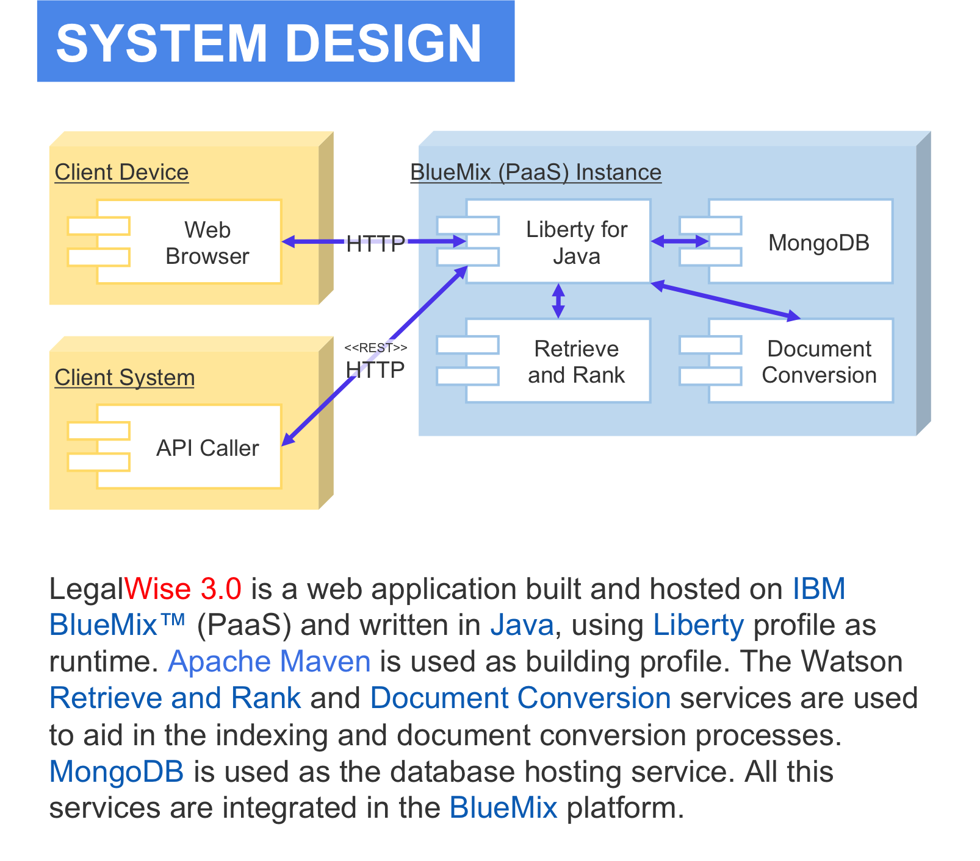
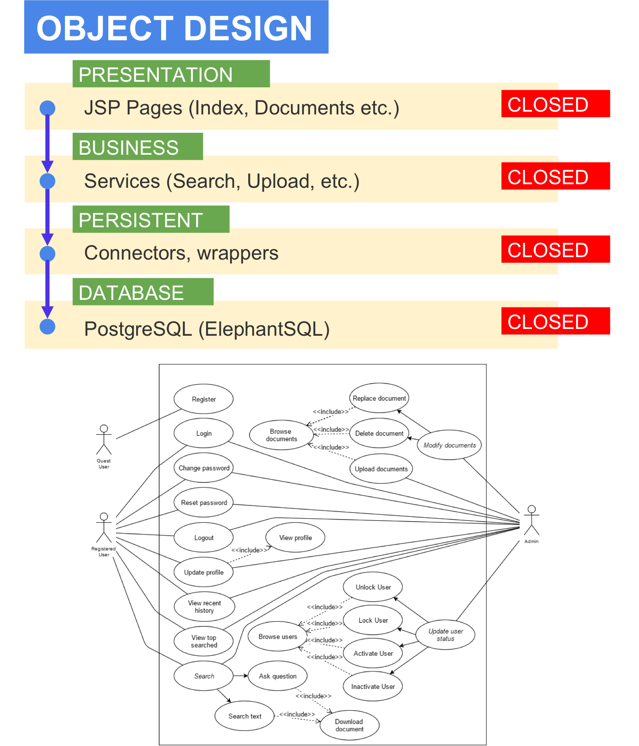
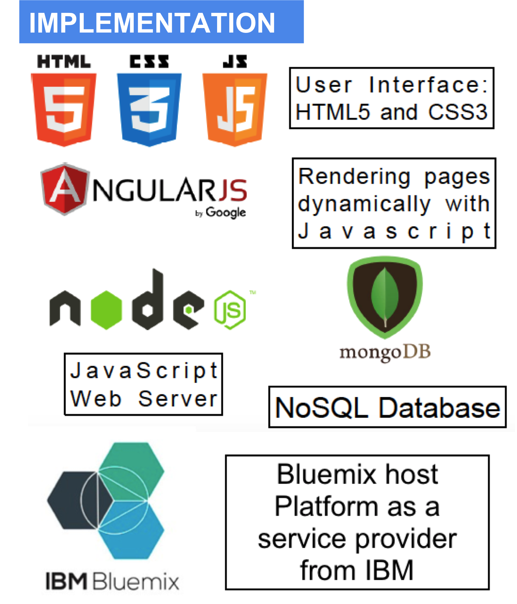
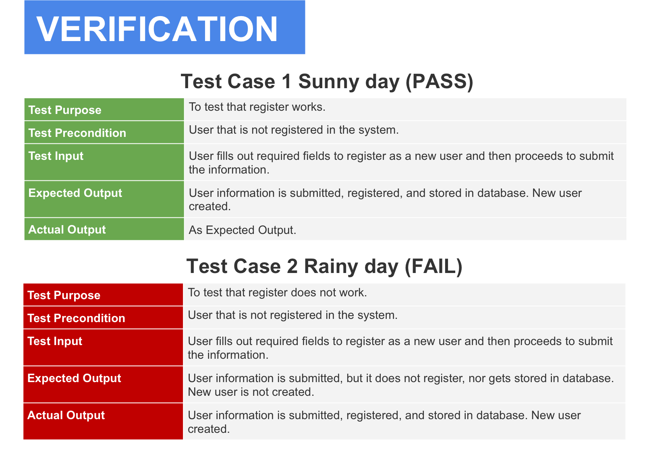
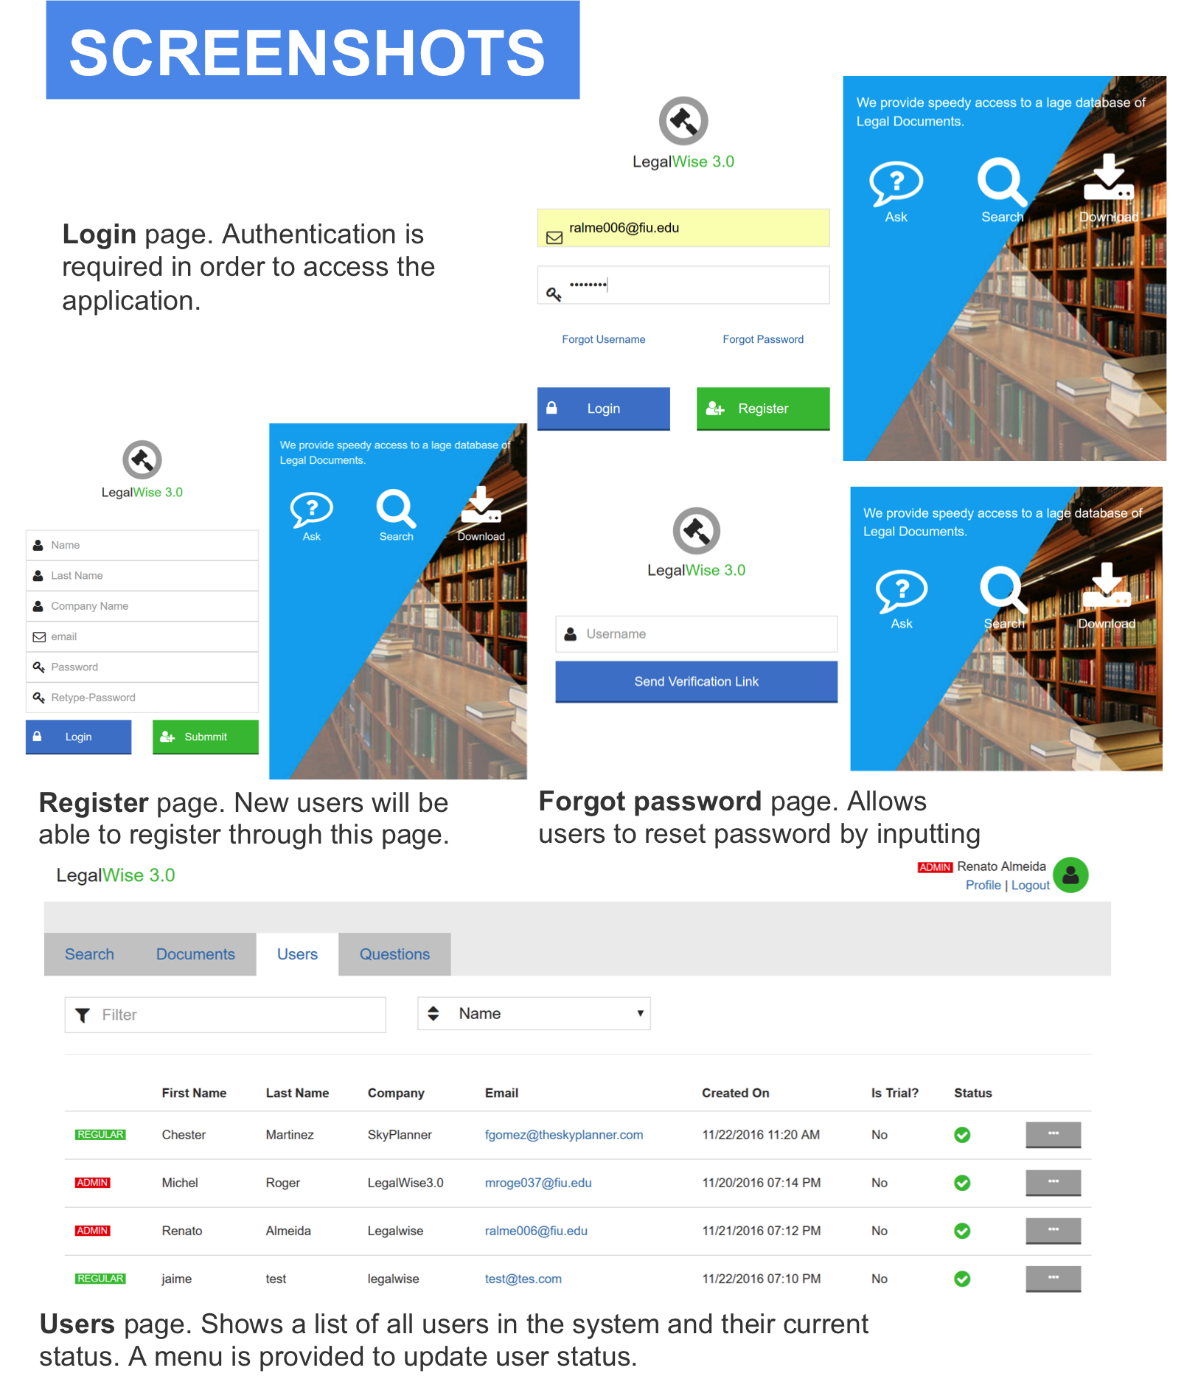
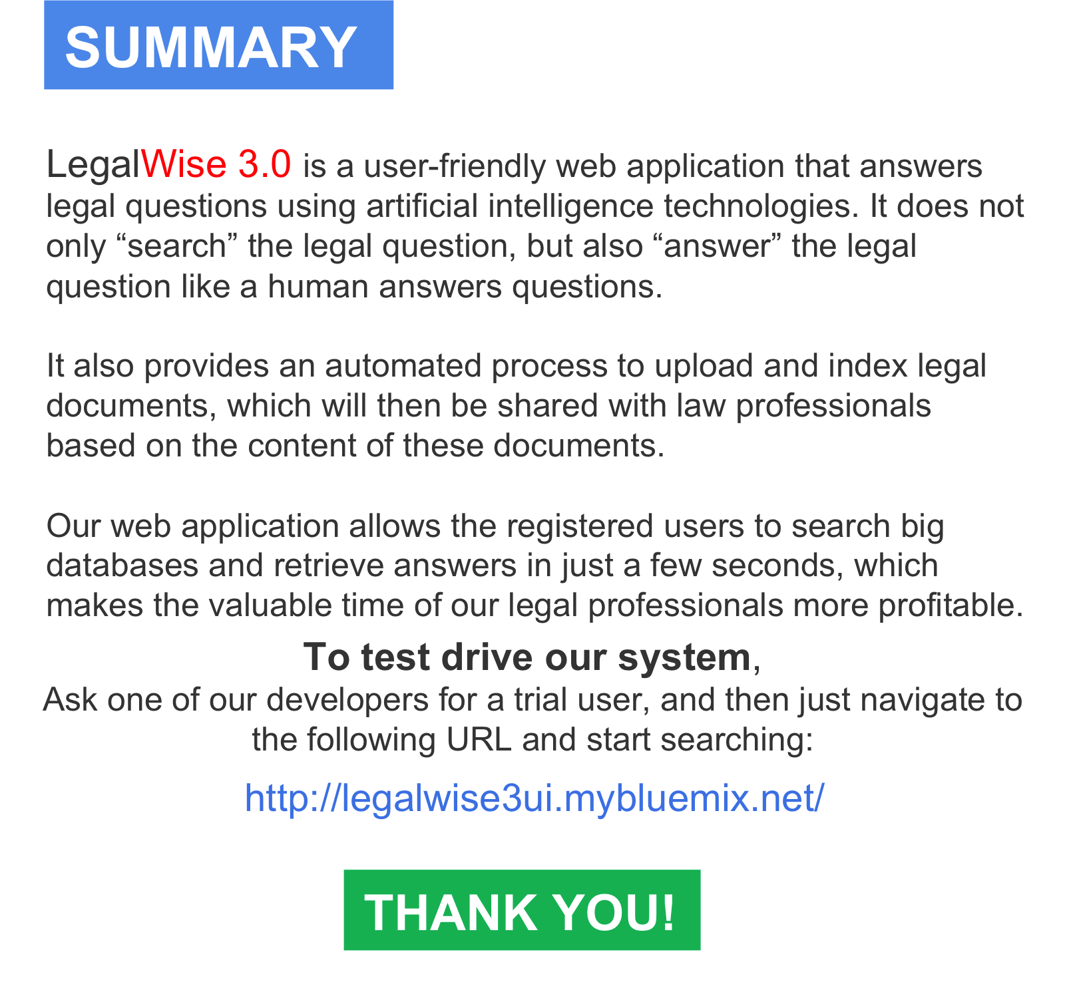

School of Computing & Information Sciences
Student: Renato Almeida, Florida International University
Mentor: Jaime Borras, GeoToll, Mohsen Taheri, Florida International University
Instructor: Masoud Sadjadi, Florida International University
The material presented in this poster is based upon the work supported by Renato Almeida. I am thankful for the help that I received from my teammate Roger Michel and my
project owner Jaime Borras. I would also like to thank Dr. Masoud Sadjadi and Mohsen Taheri for the lessons, feedback, and patience.
Notes:
‹#›

