Slide 1










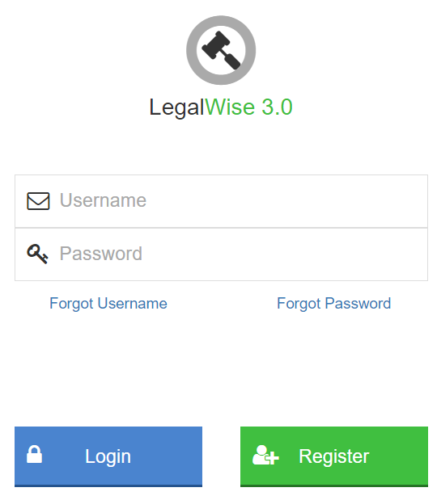
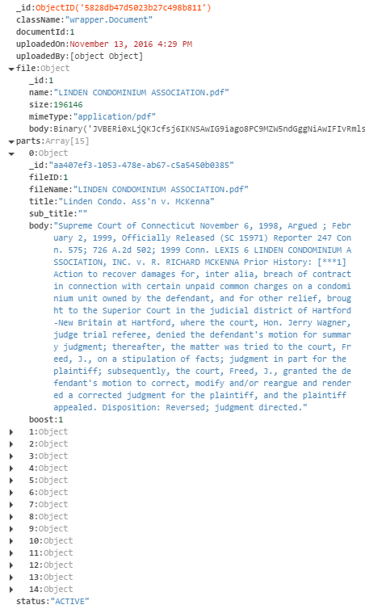
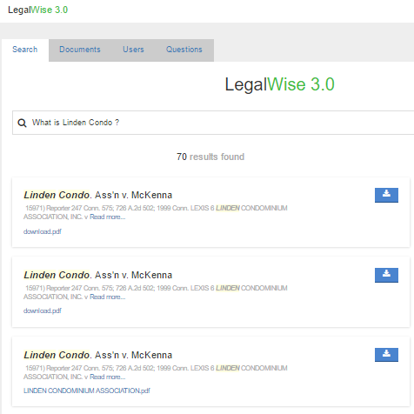
Advanced software Engineering, Fall 2016
Technology Stack
LegalWise 3.0
Student | Michel Angelo Roger Florida International University
Mentor | Jaime Borras CTO at GeoToll
Instructor | Masoud Sadjadi Florida International University
Problem
Current System
Requirements
The following problems are strictly linked to the daily work of law professionals (lawyers, associates, law students).
LegalWise 2.0
REGULAR USERS SHOULD BE ABLE TO…
1
The second version provides a wonderful interface for a user to browser, to retrieve, and to archive documents. On the other hand, it still need to improve and develop a couple of features such as:
Effective ranking of content in legal cases.
Users will enter a textual criteria, and the system will show a ranked list of lit of legal documents that match the criteria in an effective way from high to low accuracy of the searching criteria.
Legal professionals, while working on current cases, perform research to find out how previous courts have decided on cases with similar fact patterns. This cases are PDF files, and legal associates have to read them one by one to determine which ones might be useful.
1
2
Inefficient searching and raking of documents stored. This limits the effectiveness of the system due to the lack of valid answers provided to the user.
High visual to matching queries.
User will \receive a highlighted text as part of the results of the matching documents.
Obtain answers to legal questions.
User will enter a question like textual criteria, and the system will show a more to less related ranked list of lit of legal documents that match the question.
Legal professionals, law associates, and law students browse legal books and documents manually to find legal concepts and law definitions. There is no specialized system that provides answers to legal questions in terms of concept, case history, law definitions, etc.
3
2
Lack of visual results matching the user criteria. User is not able to easily identified the matching section of the documents from the results presented.
Register and Reset Password.
System needs to provide a access to individual person through a registration process and a process to reset their passwords.
4
Ineffective
Inefficient
Expensive
Unsuitable persistence layer for document archival. Relational database are not suit for uninstructed such as fragmented section of the document. This type of date is required to be available in a raw format for the Watson system to be train.
ADMINISTRATORS SHOULD BE ABLE TO…
Upload legal documents.
Administrators should be able to upload legal documents, which should be stored on a unstructured persistence layer.
Solution
1
LegalWise3.0, A User friendly system that provided an easy to use search engine that provided effectives results of legal documents.
No training system for the Watson service. The system doesn’t have a flow or procedure to train the retrieve and ranking service which incur in an ineffective way to retrieve results for a user.
2
Training of the Watson services.
Administrator should be able to train the system from the persistence layer repository.
System Design
System Architecture
Implementation
Presentation
Upload Services
Client Device
BlueMix (PaaS) Instance
JSP Pages (i.e Index, Documents)
The Upload service allows administrators to add legal documents to the Data store and Index table.
Web Browser
HTTP
Runtime
(Liberty Java)
Persistence Layer (MongoDB)
Bussines
CLOSED
Administrator
LegalWise 3.0
Retrieve And Rank
Persistence Layer
Services (i.e Search, Upload)
Validate Request
<<REST>>
HTTP
Watson (Retrieve & Rank)
Watson (Document Conversion)
Persistent
CLOSED
Upload File
Receive File
Create Document with pending status
Client System
Connectors, wrappers
[Error]
[Success]
Covert into answer units
API Caller
Solr (Indexing)
Storage
CLOSED
Notify error
Submit for conversion
Return answer units
NoSQL (MongoDB)
CLOSED
Receive
report
Receive answer units
Document Conversion
LegalWise 3.0 is a web application built and hosted on IBM BlueMix™ (PaaS) and written in Java, using Liberty profile as runtime. Apache Maven is used to manage dependencies and as building profile. The Watson Retrieve and Rank and Document Conversion services are used to aid in the retrieval and document conversion processes. Solr system is used to stored and index the unstructured data for the retrieve an ranking service. MongoDB is used as the NoSQL database hosting service for the app persistence layer. Most of this services are provided by the BlueMix platform, except the MondoDB which is hosted by mlab.
LAYERED ARCHITECTURE PATTERN
Submit for indexing
Receive answer units
Persists Document with active status
LegalWise 3.0 was built using a Layered Architecture, strictly broken down into 4 layers. The Presentation layer contains all UI/UX components, mainly JSP pages. The Business layer includes the logic of all services offered by the application. The Persistent layer contains data access components such as connectors and wrappers. The Storage layer store all persistent information of the application.
All layers in the system are closed: Each layer can only access the layer right next to it in the order.
Notify success to user
Add to Index
Search Services
Notify completion
The Search service return legal documents that match a specified text criteria.
Administrator
LegalWise 3.0
Retrieve and Rank
Submit text to search
Validate Request
Receive query
[Error]
[Success]
Applied Machine Learning algorithm
Receive
Error report
Send error report
Build query
Verification
SCREENSHOTS
Submit to R&R
Search on the Index Store
The principal feature to be tested on the application is the Search service. Below are two of the unit tests used to verify the quality of this feature:
Receive results
Receive results
Build response whit highlighted text
Build result list
Search query: Sunny day
Return result list
Return results
Test Id | LW3_R&R_IT_01__execute_search_success
Test Purpose | Test that the service properly accepts a search request, and the search is fulfilled efficiently
Test Setup | Create a test cluster, configuration, and collection in our Retrieve and Rank instance in BlueMix. Upload the sample document provided into the previously created Solr collection. Train the Watson services with the indexed data Create a request with end point /service/search. Equip request with authentication credentials using the test user. Add a parameter to the request named query with value *:*
Test Input | 1. HttpServletRequest request 2. HttpServletResponse response
Expected Output | The response instance passed to the input must contain a status of 200, first result needs to be the most accurate document based on the search query, and the body of the response must contain the following JSON (pattern):
 | { "numFound": 199, "start": 0, "docs": { "id": "aa407ef3-1053-478e-ab67-c5a5450b0385", "title": "Linden Condo. Ass'n v. McKenna", “body” :"Supreme Court of Connecticut November 6, 1998, Argued;” }, // ... ] }
Note: Green boxes are enhancements or contributions of LegalWise 3.0
Login page. Authentication is required in order to access the application.
SUMMARY
LegalWise 3.0 is a user-friendly web application that provides an accurate and efficient results to an user’s query that could be a simple sentence or question based. It provides an Storage layer that facilitates the training of the system as well as the storage and retrieval of the application data which increase agility and time to market. Those enhancements will helps lawyers, law students, and law associates to quickly find answers to legal questions and concepts, as well as historical data about previously held legal cases which are part of the main problem presented.
Search document: Rainy day
Test Id | LW3_R&R_IT_01_execute_search_error
Test Purpose | Test that the service properly accepts an invalid search request, and properly returns information about the error.
Test Setup | 1. Create a request with end point /service/search. 2. Equip request with authentication credentials using the test user. 3. Make sure the parameter named query does not exist in the request.
Test Input | 1. HttpServletRequest request 2. HttpServletResponse response
Expected Output | The response instance passed to the input must contain a status of 200, the first results should not reflect the most accurate document based on the search query, and the body of the response must contain the following JSON:
 | "docs": { "id": "fc488a05-b07b-4559-be62-abba143f42d6“, "title": "US Bank N.A. v. Mallory“, “body” :"Superior Court of Pennsylvania June 10, 2009, Argued;” },
Documents Store: Document structure on MongoDB for future reference of the training system
Search page. A question is enter in the system, and the system returns a list of answer to the question ranked in a from of most to less accurate with highlighted matching text.
!
To test drive our system,
Go to the below URL and just register yourself
Feel free to ask us for a demo
http://legalwise3.mybluemix.net/
THANK YOU!!
Acknowledgment
The completion of LegalWise 3.0 would not have been possible without the help and support received from team member (Renato Almeida), previous member of LegalWise2.0, and project owner/tutor Jaime Borras. Also, I would like to mention Dr. Masoud Sadjadi and Mohsen Taheri for their valuable guidance and feedback.

