Slide 1







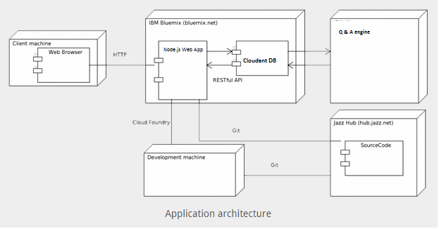
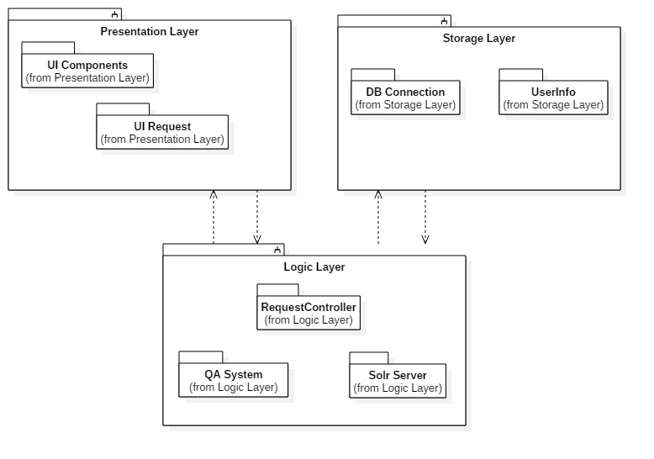
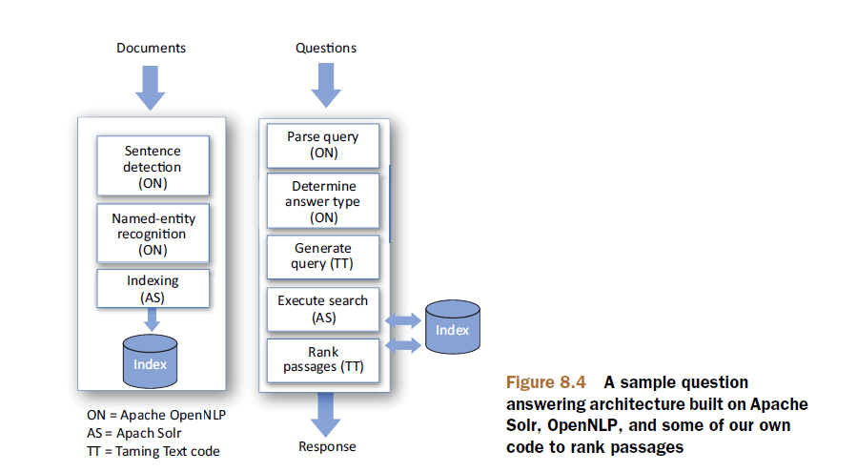

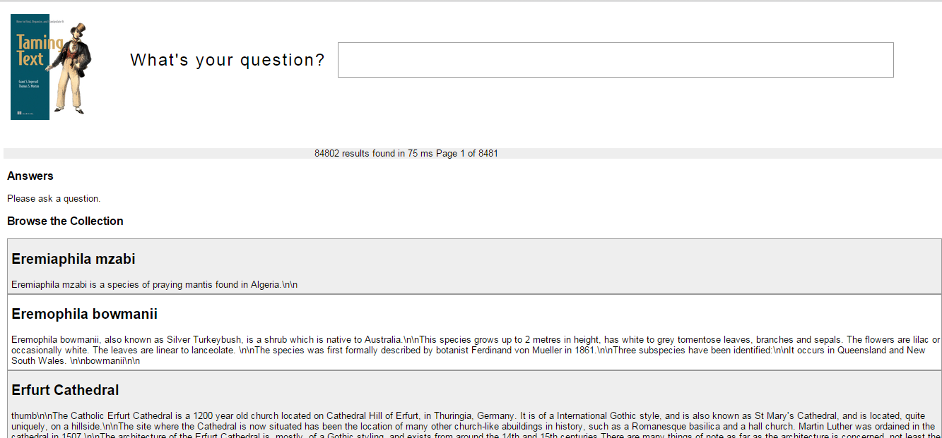
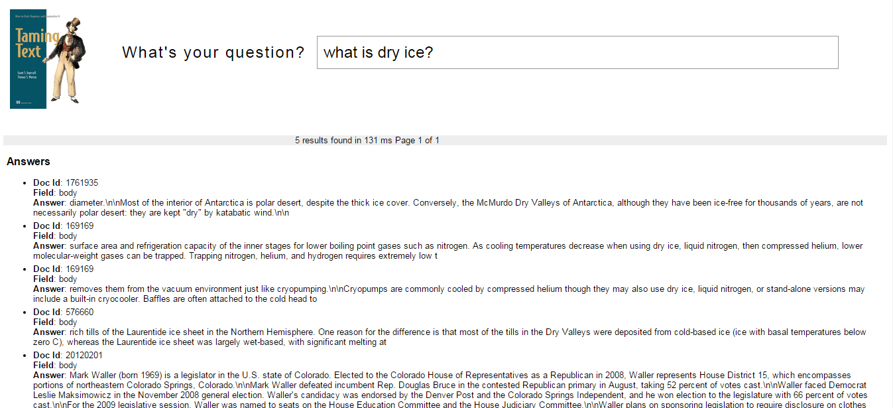
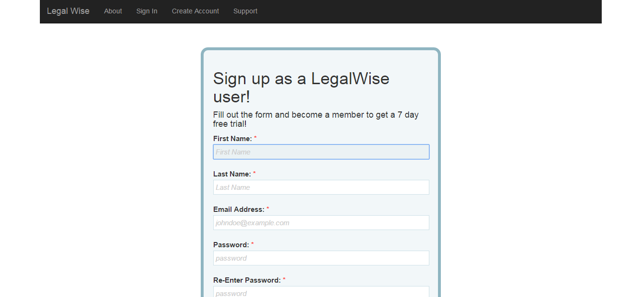
School of Computing & Information Sciences
Senior Project, 2015, Fall
LegalWise
Student: Valeria Lopez, Florida International University
Mentor: Jaime Borras, CTO at GeoToll
Instructor: Masoud Sadjadi, Florida International University
Problem
Current System
Requirements
Legal professionals spend a considerable amount of time and resources to access files and information for future references on cases.
The legal system uses a great amount of human labor to accomplish tedious tasks on formatted documents. When a lawyer is looking for a case referral in order to use it on his/her current case, the staff needs to go over all the related cases and find the appropriate one that suits the circumstances. This process is time consuming and also prone to errors. This system is being use for years making law services very expensive and time consuming.
The requirements of the system for this project are the following:
1. User can log in to the system
2. System sends an email to verify the user when creating a new account.
3. System answers legal questions that the user inputs.
4. User may upload a PDF document to be index on the Solr server.
5. Resets password when user forgets his/her password
System Design
Object Design
Implementation
In order to organize the legal files and return answer to legal questions, we based the application in a Q&A engine.
The Q&A engine uses the Solr server to store and index files. The documents are ranked in Solr based on additional criteria. Then the tool generates possible answer to questions.
Hardware and Software Mapping: To develop the LegalWise web application we decided to use Node.js web application starter from Bluemix. On the backend we have an application built in Java using the Solr sever as Q&A system. The Q&A system was built in UNIX using the code from the Taming Text book. Our system also handles user authentication and stores the user information in the Cloudant DB. The Cloudant DB is a IBM project built in top on CouchDB (NoSql Database).
Presentation Layer: The presentation layer is in charge of the UI and contains all the code that interacts directly with the user.
Logic Layer: The logic layer handles all the interaction between the components of the application. It receives information from the Presentation Layer to be process, send and retrieves information from the database and interacts with the QA system.
Storage Layer: The storage layer handles all the request to the Cloudant Database for users.
Verification
Screenshots
Summary
To test the LegalWise application we implemented System Test and Subsystem Test. On the System Test we include two sunny day and one rainy day test cases.
LegalWise is a user-friendly web application that answers simple legal questions by analyzing the question and retrieving related documents associated with the answer.
LegalWise offers several service membership plans for registered users, such as annual payments, one-time usage, and monthly payments. The user registers for an account and selects the desire service plan.
Our web application allows the user to search big databases with legal documents in just a few seconds making the valuable time of our legal professionals more profitable.
TEST SUITE | LegalWise_003
Purpose: | To test the functionality of use case: LegalWise_003: User ask a question to the application.
Precondition: | The application must be running properly on the IBM Cloud The user must have a valid account to use the system. The Solr Server must be running properly. The user must be log in to the system.
Input : | A user has a valid account and is ready to use the application. The user navigates to the “Ask a Question” page and types a question on the box. Question: What is dry ice?
Expected Output: | The Q&A engine comes back with an answer based on the files indexed on the server. Also comes back with a list of documents that contain any reference with dry ice.
Homepage
QA System
Sign Up
Acknowledgement
The material presented in this poster is based upon the work supported by … I am thankful to the help that I received from my group members, … .

