Slide 1




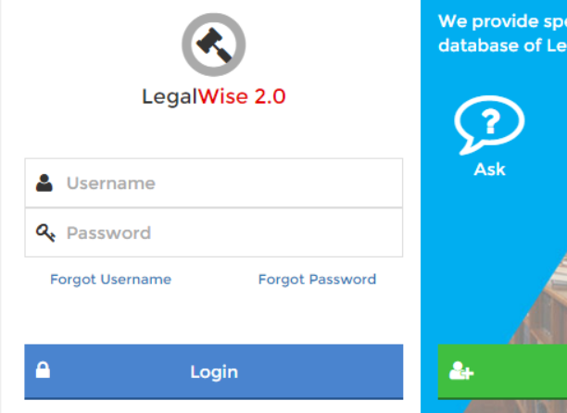
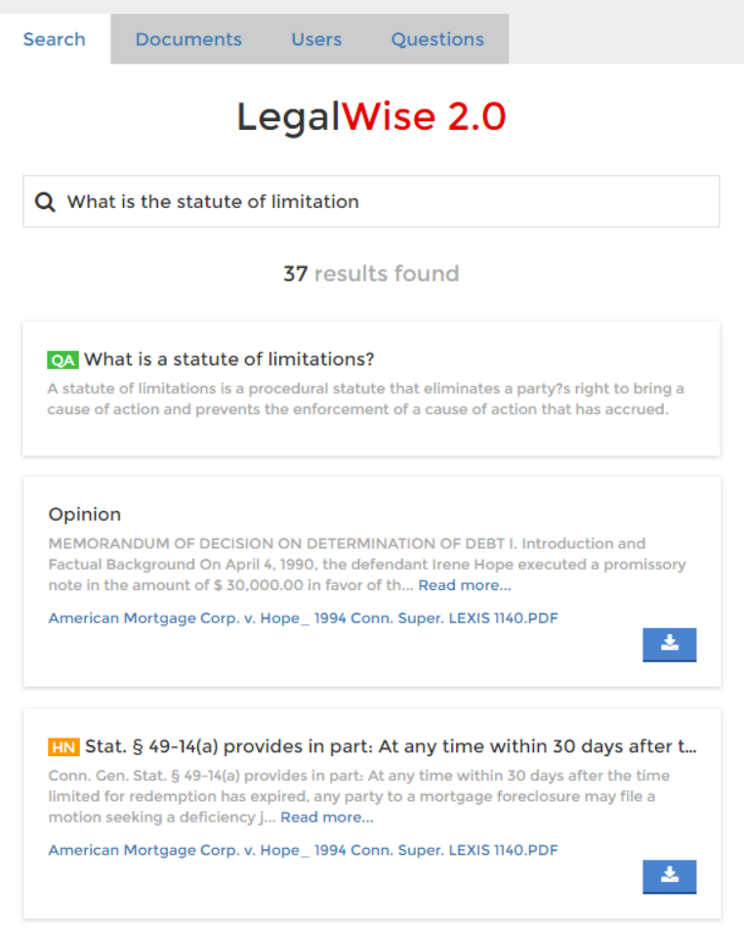
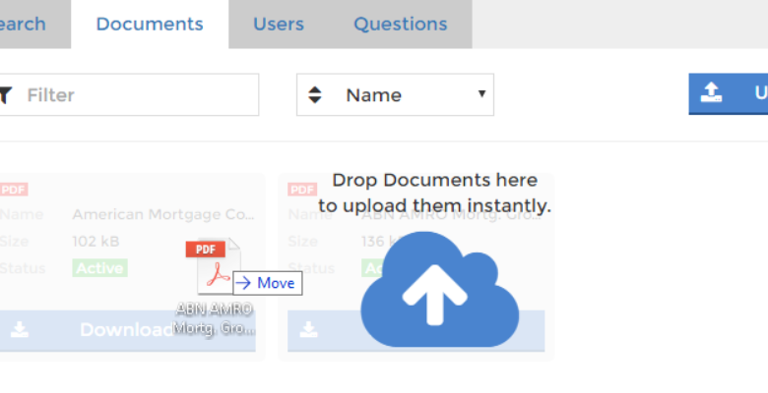
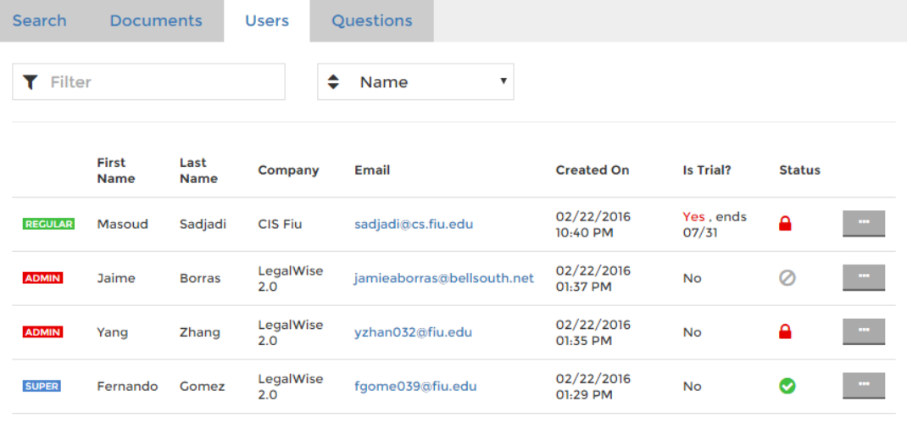
Senior Project, Spring 2016
Student | Fernando Gomez Florida International University
Mentor | Jaime Borras CTO at GeoToll
Instructor | Masoud Sadjadi Florida International University
LegalWise 2.0
PROBLEM
CURRENT SYSTEM
REQUIREMENTS
The following problems are strictly linked to the daily work of law professionals (lawyers, associates, law students, etc.).
LegalWise 1.0
REGULAR USERS SHOULD BE ABLE TO…
Search for content in legal cases.
Users will enter a textual criteria, and the system will show a lit of legal documents that match the criteria in any way.
Legal professionals, while working on current cases, perform research to find out how previous courts have decided on cases with similar fact patterns. This cases are PDF files, and legal associates have to read them one by one to determine which ones might be useful.
LegalWise 1.0 is the first version of this application. It provides a fast way of searching for content in legal documents, and obtain answers from a very small list of legal questions. Version 1.0 is a valid attempt to solve the problems at hand, but it has the following functional flows:
1
1
Download legal case documents.
Each result provided to users should contain a link to download the legal document related to the result.
2
Document upload not supported. This limits the automatic growth of the database as only developers can add new legal documents.
Obtain answers to legal questions.
Users will enter a question and the system should provide answers as well as related documents.
Legal professionals, law associates, and law students browse legal books and documents manually to find legal concepts and law definitions. There is no specialized system that provides answers to legal questions in terms of concept, case history, law definitions, etc.
3
2
No specialized processing of legal documents. Only textual matches within whole documents are considered. No headnotes or question-answer pairs extraction.
ADMINISTRATORS SHOULD BE ABLE TO…
Upload legal documents.
Administrators should be able to upload legal documents, which should be automatically available to regular users.
No administrative control of registered users. Administrative tasks, such as locking an user, have to be performed by a developer.
1
Add question and answer pairs.
Administrator should be able to add precise answers to common questions to increase the accuracy of the service.
2
Unclean and unintuitive user interface. Poor design and uneven flow.
Control user access and privileges.
Administrators should be able lock, unlock, activate, and deactivate regular users.
Ineffective
Inefficient
Expensive
3
SYSTEM DESIGN
SYSTEM ARCHITECTURE
IMPLEMENTATION
PRESENTATION
UPLOAD SERVICE
Client Device
BlueMix (PaaS) Instance
JSP Pages (Index, Documents etc.)
The Upload service allows administrators to add legal documents to the Index table.
Web Browser
HTTP
Liberty for Java
ElephantSQL
BUSINESS
CLOSED
Administrator
LegalWise 2.0
Retrieve And Rank
Document Conversion
Services (Search, Upload, etc.)
Validate Request
<<REST>>
HTTP
Retrieve and Rank
Document Conversion
PERSISTENT
CLOSED
Upload File
Client System
Connectors, wrappers
[Error]
[Success]
Receive File
API Caller
DATABASE
CLOSED
Notify error
Submit for conversion
Covert into answer units
PostgreSQL (ElephantSQL)
LegalWise 2.0 is a web application built and hosted on IBM BlueMix™ (PaaS) and written in Java, using Liberty profile as runtime. Apache Maven is used as building profile. The Watson Retrieve and Rank and Document Conversion services are used to aid in the indexing and document conversion processes. ElephantSQL is used as the database hosting service, which leverages the PostgesSQL DBMS as a service. All this services are integrated in the BlueMix platform.
CLOSED
Receive
report
Receive answer units
Receive answer units
Return answer units
LAYERED ARCHITECTURE PATTERN
Submit for indexing
Add to Index
LegalWise 2.0 was built using a Layered Architecture, strictly broken down into 4 layers. The Presentation layer contains all UI/UX components, mainly JSP pages. The Business layer includes the logic of all services offered by the application. The Persistent layer contains data access components such as connectors and wrappers. The Database layer encapsulates the PostgresSQL database that store all persistent information of the application.
All layers in the system are closed: Each layer can only access the layer right next to it in the order.
Notify success to user
Notify completion
SEARCH SERVICE
The Search service return legal documents that match a specified text criteria.
Administrator
LegalWise 2.0
Retrieve and Rank
Submit text to search
Validate Request
[Error]
[Success]
Receive
Error report
Send error report
Build query
Receive query
VERIFICATION
SCREENSHOTS
Submit to RaR
Obtain results from Index
Receive results
Receive results
Build response
The main process to be tested in this application is the Search service. This is the only service that includes all actors in the system. Following are two of the unit tests used to verify the quality of this feature:
Build result list
Return results
Search document: Sunny day
Return result list
Test Id | SearchUserServiceTest.test_execute_search_succcess
Test Purpose | Test that the service properly accepts a search request, and the search is fulfilled properly..
Test Setup | Create a test cluster, configuration, and collection in our Retrieve and Rank instance in BlueMix. Upload the sample document provided into the previously created Solr collection. Create a request with end point /service/search. Equip request with authentication credentials using the test user. Add a parameter to the request named query with value *:*
Test Input | 1. HttpServletRequest request 2. HttpServletResponse response
Expected Output | The response instance passed to the input must contain a status of 200 and the body of the response must contain the following JSON (pattern):
 | { "numFound": 164, "start": 0, "docs": [ { "id": "496", "title": [" a theory of transonic aileron buzz, neglecting viscous effects ."] }, // ... ] }
SUMMARY
Login page. Authentication is required in order to access the application.
LegalWise 2.0 is a user-friendly web application that provides fast and structured access to legal cases. It provides an automated process to upload and scan legal documents, which will then be shared with law professionals based on the content of these documents. Our application also helps lawyers, law students, and law associates to quickly find answers to legal questions and concepts, as well as historical data about previously held legal cases.
Search page. Here, users can ask questions and search legal documents. In this case, a question is asked and the system shows the answer to the question as well as legal document content that is related to the question subject.
Documents page. Shows all documents uploaded. Here, an administrator is in the process of uploading a document.
Search document: Rainy day
Test Id | SearchUserServiceTest.test_execute_search_error
Test Purpose | Test that the service properly accepts an invalid search request, and properly returns information about the error.
Test Setup | 1. Create a request with end point /service/search. 2. Equip request with authentication credentials using the test user. 3. Make sure the parameter named query does not exist in the request.
Test Input | 1. HttpServletRequest request 2. HttpServletResponse response
Expected Output | The response instance passed to the input must contain a status of 400 and the body of the response must contain the following JSON:
 | "{'status': 400, 'msg': 'No search query specified'}"
!
To test drive our system,
Ask one of our developers for a trial user, and then just navigate to the following URL and start searching:
Feel free to ask us for a demo
http://legalwise2ui.mybluemix.net/
Users page. Shows a list of all users in the system and their current status. A menu is provided to update user status.
THANK YOU!!
ACKNOWLEDGEMENT
The completion of LegalWise 2.0 would not have been possible without the help and support I received from my teammate Yang Zhang and my project owner and tutor Jaime Borras. I would also like to thank Dr. Mark Finlayson for his valuable guidance, Dr. Masoud Sadjadi and Mohsen Taheri for the lessons, feedback, and patience, David Jaramillo for his support from the IBM end, and last but not least, to all my peers in the senior project class who sat attentively throughout our presentations.

