Slide 1



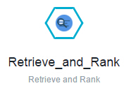

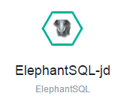


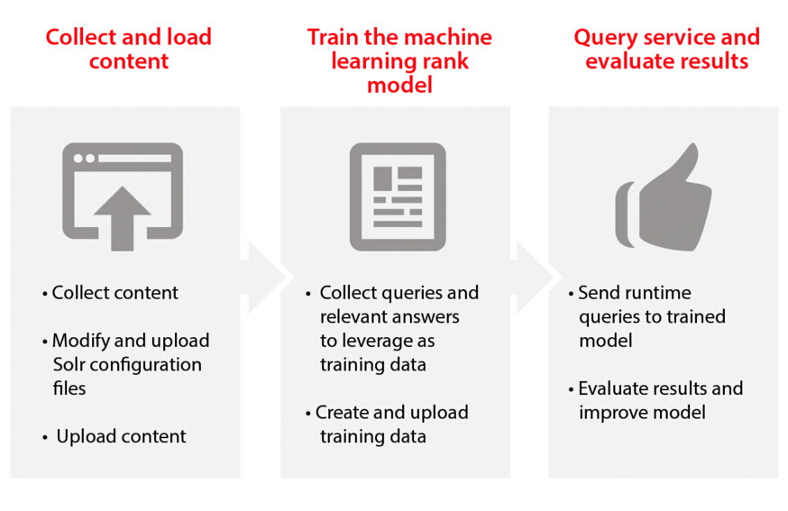
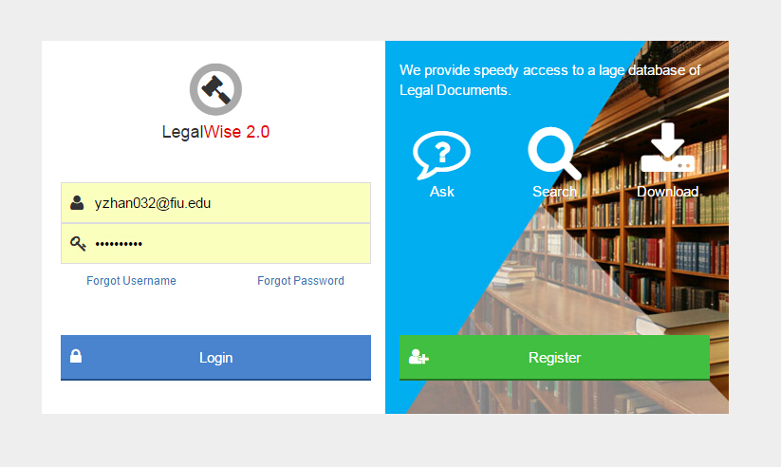
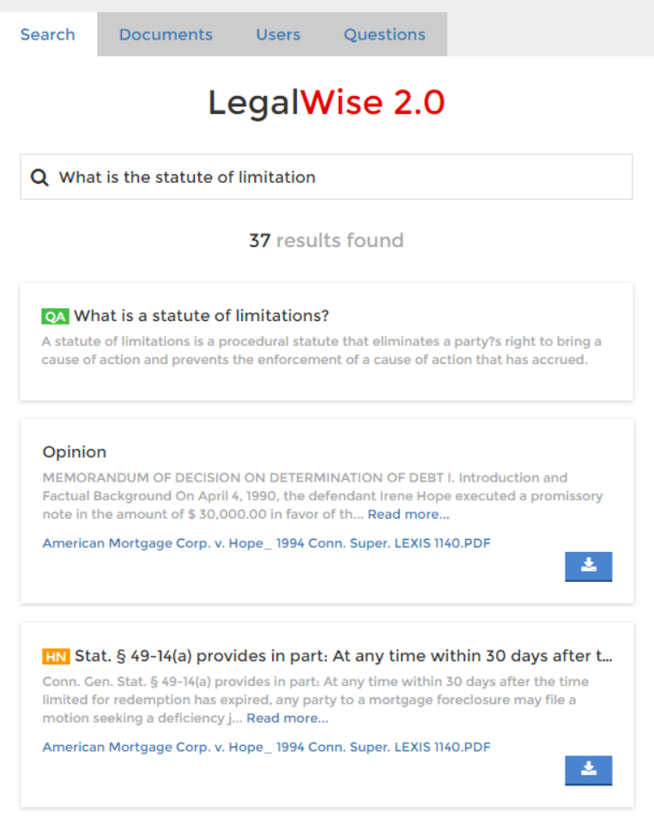
Senior Project, Spring 2016
Student | Yang Zhang Florida International University
Mentor | Jaime Borras CTO at GeoToll
Instructor | Masoud Sadjadi Florida International University
LegalWise 2.0
PROBLEM
CURRENT SYSTEM
REQUIREMENTS
The following problems are strictly linked to the daily work of law professionals (lawyers, associates, law students, etc.).
LegalWise 1.0
REGISTERED USERS SHOULD BE ABLE TO…
LegalWise 1.0 is the first version of this application. It provides a fast way of searching for content in legal documents, and obtain answers from a very small list of legal questions. Version 1.0 is a valid attempt to solve the problems at hand, but it has the following functional flaws:
Search for content in legal cases.
Users will enter a textual criteria, and the system will show a lit of legal documents that match the criteria in any way.
Legal professionals, while working on current cases, perform research to find out how previous courts have decided on cases with similar fact patterns. This cases are PDF files, and legal associates have to read them one by one to determine which ones might be useful.
1
1
Download legal case documents.
Each result provided to users should contain a link to download the legal document related to the result.
2
Document upload not supported. This limits the automatic growth of the database as only developers can add new legal documents.
Obtain answers to legal questions.
Users will enter a question and the system should provide answers as well as related documents.
Legal professionals, law associates, and law students browse legal books and documents manually to find legal concepts and law definitions. There is no specialized system that provides answers to legal questions in terms of concept, case history, law definitions, etc.
3
2
No specialized processing of legal documents. Only textual matches within whole documents are considered. No headnotes or question-answer pairs extraction.
ADMINISTRATORS SHOULD BE ABLE TO…
Upload legal documents.
Administrators should be able to upload legal documents, which should be automatically available to regular users.
No administrative control of registered users. Administrative tasks, such as locking an user, have to be performed by a developer.
1
Add question and answer pairs.
Administrator should be able to add precise answers to common questions to increase the accuracy of the service.
2
Unclean and unintuitive user interface. Poor design and uneven flow.
Control user access and privileges.
Administrators should be able lock, unlock, activate, and deactivate regular users.
Ineffective
Inefficient
Expensive
3
SYSTEM DESIGN
OBJECT DESIGN
IMPLEMENTATION
PRESENTATION
In order to have the system return recommended answers to legal questions, we used Watson™ Retrieve and Rank service of IBM Bluemix and hosted the application on IBM Bluemix cloud server.
Client Device
BlueMix (PaaS) Instance
JSP Pages (Index, Documents etc.)
Web Browser
HTTP
Liberty for Java
ElephantSQL
BUSINESS
CLOSED
Services (Search, Upload, etc.)
<<REST>>
HTTP
Retrieve and Rank
Document Conversion
PERSISTENT
CLOSED
Client System
Connectors, wrappers
API Caller
DATABASE
CLOSED
PostgreSQL (ElephantSQL)
LegalWise 2.0 is a web application built and hosted on IBM Bluemix™ (PaaS) and written in Java, using Liberty profile as runtime. Apache Maven is used as building profile. The Watson Retrieve and Rank and Document Conversion services are used to aid in the indexing and document conversion processes. ElephantSQL is used as the database hosting service, which leverages the PostgesSQL DBMS as a service. All this services are integrated in the Bluemix platform.
CLOSED
LAYERED ARCHITECTURE PATTERN
LegalWise 2.0 was built using a Layered Architecture, strictly broken down into 4 layers. The Presentation layer contains all UI/UX components, mainly JSP pages. The Business layer includes the logic of all services offered by the application. The Persistent layer contains data access components such as connectors and wrappers. The Database layer encapsulates the PostgresSQL database that store all persistent information of the application.
All layers in the system are closed: Each layer can only access the layer right next to it in the order.
The legal documents and training data were indexed and trained by Retrieve and Rank service implemented in LegalWise 2.0. The Retrieve and Rank service combines Apache Solr and a sophisticated machine learning capability to provide more relevant legal answers automatically by using these machine learning algorithms.
VERIFICATION
SCREENSHOTS
SUMMARY
Two sunny day and one rainy day test cases for each use case were applied for the system test.
Below is an example of a sunny day system test case.
Login page
Authentication is required in order to access the application.
LegalWise 2.0 is a user-friendly web application that answers legal questions using artificial intelligence technologies. It does not only “search” the legal question, but also “answer” the legal question like a human answers questions.
It also provides an automated process to upload and index legal documents, which will then be shared with law professionals based on the content of these documents.
Our web application allows the registered users to search big databases and retrieve answers in just a few seconds, which makes the valuable time of our legal professionals more profitable.
Test Case Id | Ask a question 06
Test Purpose | Check if the improved system return a more accurate answer.
Test Setup | Go to search page. Enter question “What is the right of appeal?” Click “Search” button.
Test Output | Number Found: 8 Key:id Value:42 Key:body value:HN1 The right of appeal is had only when granted by constitutional or statutory provision. … ...
Expected Output | A number of ranked results listed with the id of #42 as the first answer. The answers are from the head notes part of each indexed legal case instead of the whole document.
Search page
Here, users can ask questions and search legal documents.
In this case, a question is asked and the system shows the answers to the question as well as legal document content that is related to the question subject.
To test drive our system,
Ask one of our developers for a trial user, and then just navigate to the following URL and start searching:
http://legalwise2ui.mybluemix.net/
THANK YOU!!
ACKNOWLEDGEMENT
The completion of LegalWise 2.0 would not have been possible without the help and support I received from my teammate Fernando Gomez and my project owner and mentor Jaime Borras. I would also like to thank Dr. Mark Finlayson for his valuable guidance, Dr. Masoud Sadjadi and Mohsen Taheri for the instructions, feedback, and patience, Dr. Robert Loredo for his support of the IBM Retrieve and Rank service, David Jaramillo for his support from the IBM end, and last but not least, to all my peers in the senior project class who sat attentively throughout our presentations.

