Slide 1








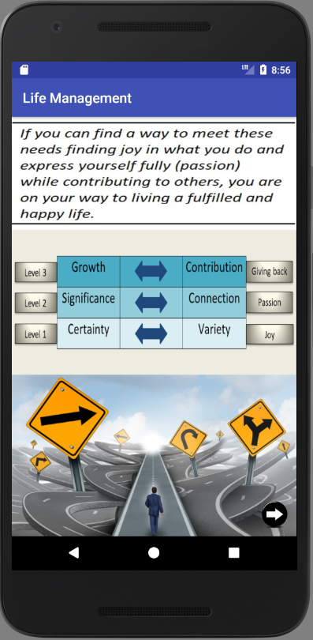
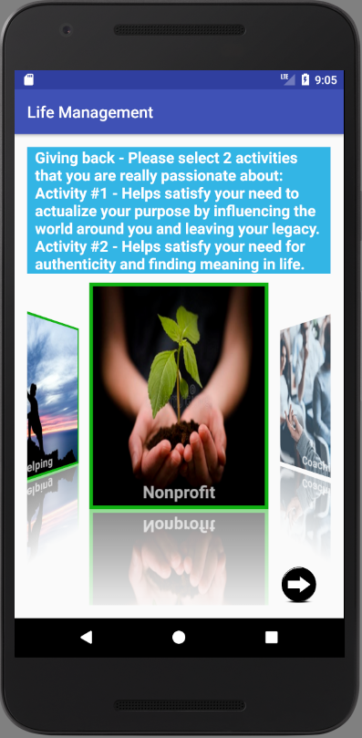
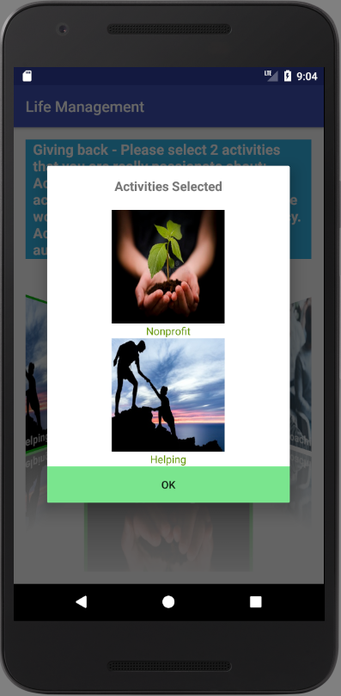
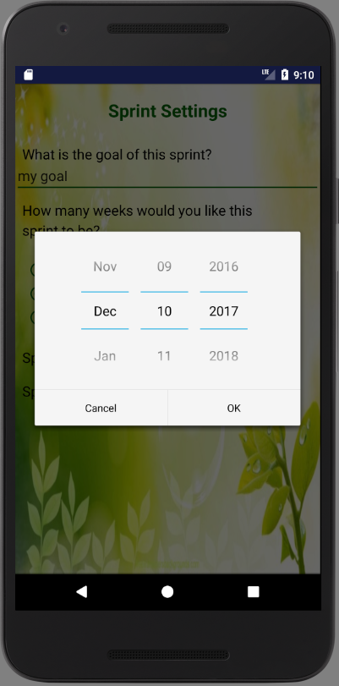
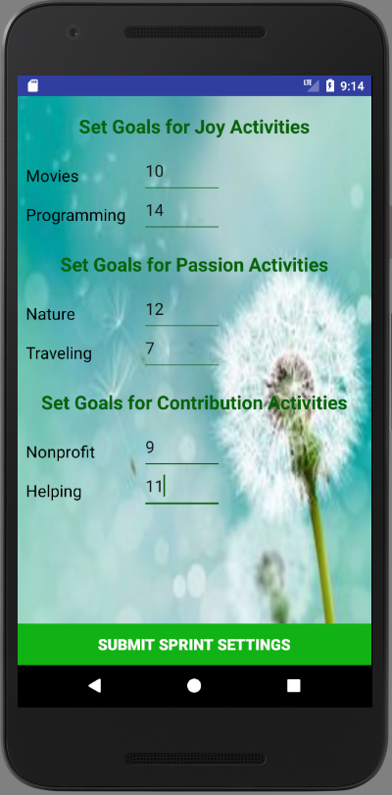
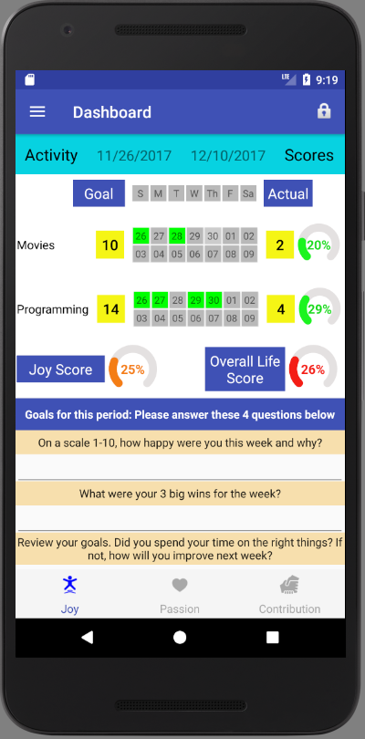
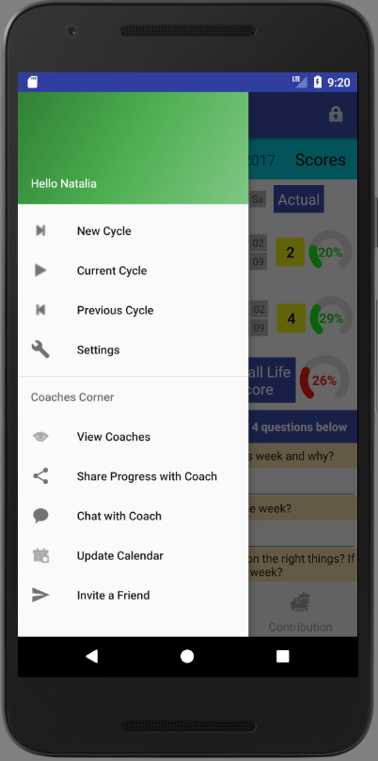
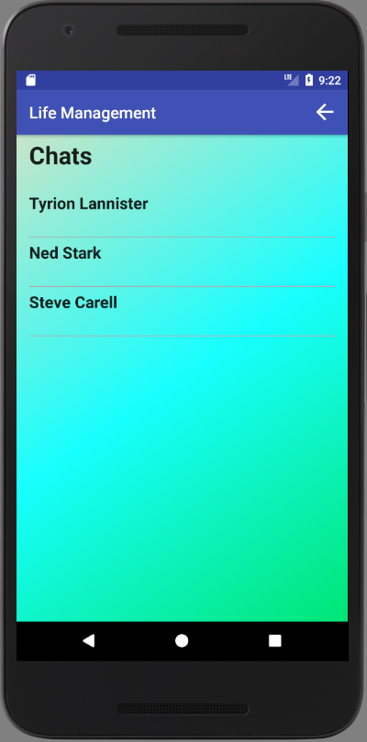
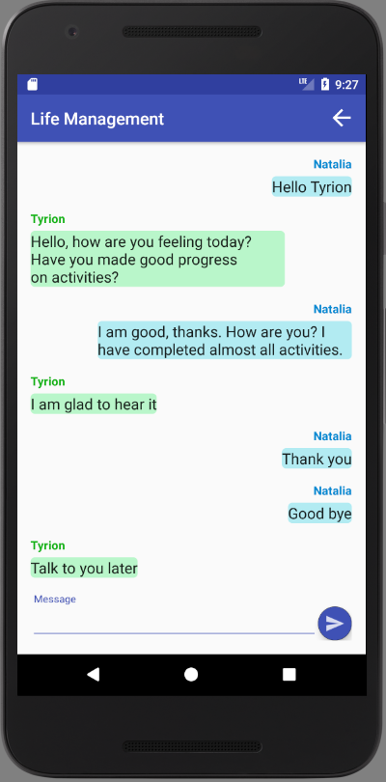
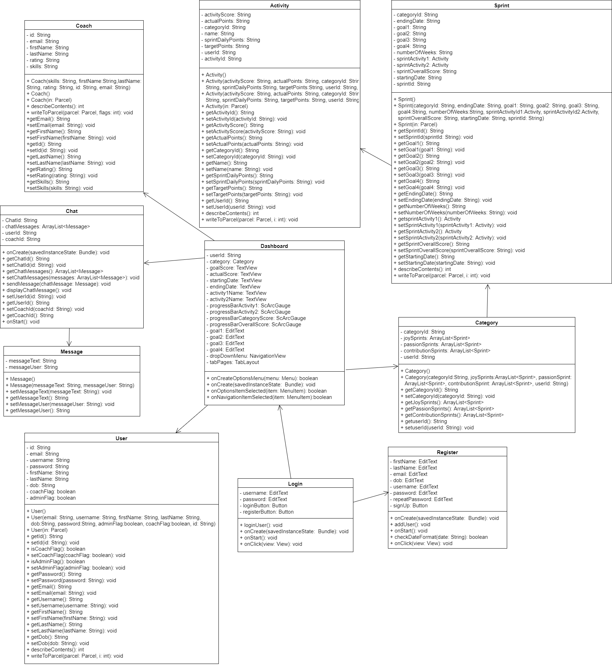
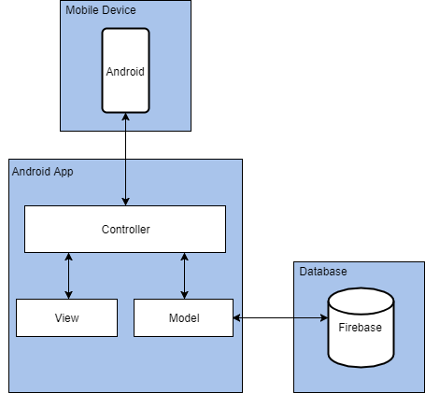
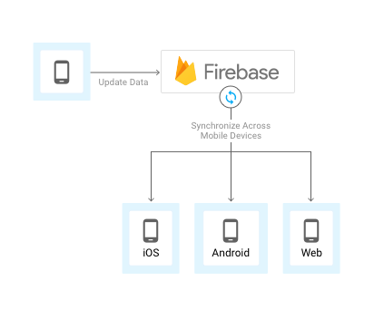
School of Computing & Information Sciences
Senior Project, 2017, Fall
Life Management Mobile App 2.0
Student: Natalia Filippova, Florida International University
Mentor: Ranjeet Deshmukh, Crossmatch
Professor: Masoud Sadjadi, Florida International University
Problem
Solution
Current System
Many people feel lack of purpose, fulfillment and contentment in their life.
People spend a lot of time on things that do not really matter and feel unsatisfied deep inside.
There is a need to help people find happiness and meaning in life.
The solution is to help people progressively build better version of themselves through:
Finding joy in what they do
Doing things that they are passionate about
Finding a meaningful way to give back to others
Mobile app that helps people:
Select and stay focused on activities that help find sense of joy, passion and contribution.
Update and visualize people’s progress.
View and communicate with life coaches.
Screenshots
Picture 1: Joy, passion,
contribution introduction .
Picture 2: Choose contribution activities .
Picture 3: Contribution activities selected.
Picture 4: Set up new sprint.
Picture 5: Set up activities goals.
Picture 6: View user’s dashboard and progress.
Picture 7: View navigation menu in dashboard.
Picture 8: Select coach to chat.
Picture 9: Chat with coach.
Requirements
Object Design
Implementation
The system allows users:
View joy, passion, contribution introduction page (pic 1)
Select activities that bring sense of contribution (pic 2 and 3)
Start new sprint setting up time period and activities’ goals (pic 4 and 5)
View user’s dashboard and visualize their progress (pic 6 and 7)
Select and communicate with life coaches (pic 8 and 9)
Safely sign out of the application
The application was developed
using Android Studio 2.3.3 IDE
Java for programming language in combination with Android SDK tools
XML for defining user interface
Firebase Realtime Database for data storage and synchronization across Android and iOS mobile devices
Agile project management using Mingle
Git for source control
Verification
Summary
Test Case ID | SelectTwoDifferentActivities (sunny day)
Purpose | Validate that user can successfully select two different activities
Preconditions | User is logged in and presented with contribution activities User has selected two different activities
Expected Result | Selected activities should be marked as selected by having green frames around images. Dialog window with selected activities should be displayed. Next button should be displayed.
Actual Result | Selected activities are marked as selected by having green frames around images. Dialog window with selected activities is displayed. Next button is displayed.
Status | Pass
Life Management Mobile app helps users find happiness and purpose in their life.
Users can update, visualize and assess their progress to make necessary adjustments in their life.
Users can communicate with life coaches for support and guidance.
Picture 10: Class Diagram.
System Design
Test Case ID | SelectTwoEqualActivities (rainy day)
Purpose | Validate that user is not allowed to select two equal activities
Preconditions | User is logged in and presented with contribution activities User has selected two equal activities
Expected Result | Selected activities should not be marked as selected by not having green frames around images. Dialog window with selected activities should not be displayed. Next button should not be displayed. Contribution activities should be displayed for user to make selection.
Actual Result | Selected activities are not marked as selected by not having green frames around images. Dialog window with selected activities is not displayed. Next button is not displayed. Contribution activities are displayed for user to make selection.
Status | Pass
Picture 11: Unit Test.
Picture 12: System Architecture. Firebase Realtime Database.
Acknowledgement
The material presented in this poster is based upon the work supported by Ranjeet Deshmukh (mentor) and Ravi Agarthi (contributor). I am thankful for the help that I received from my group members, Lazaro Fernandez (Android app) and Eric Rado (iOS app), as well as for the support and guidance provided by Masoud Sadjadi (Instructor) and Leila Zahedi (Teaching Assistant).
Notes:
1

