Slide 1

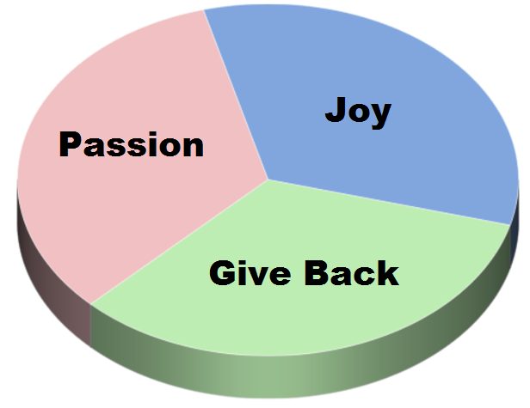

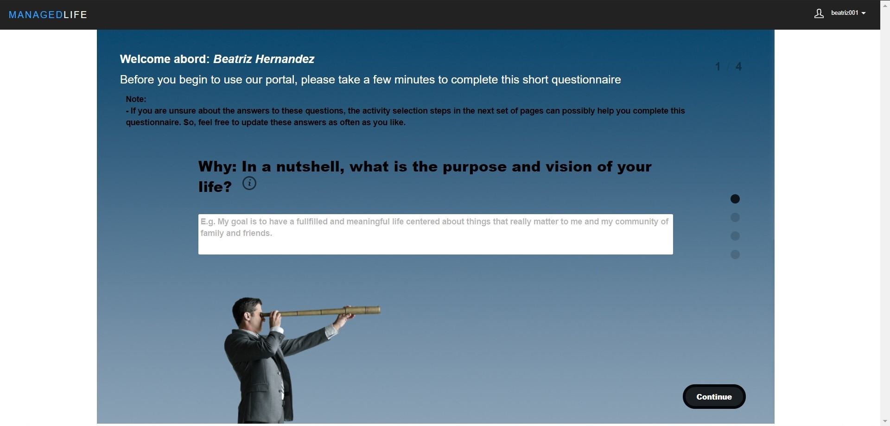
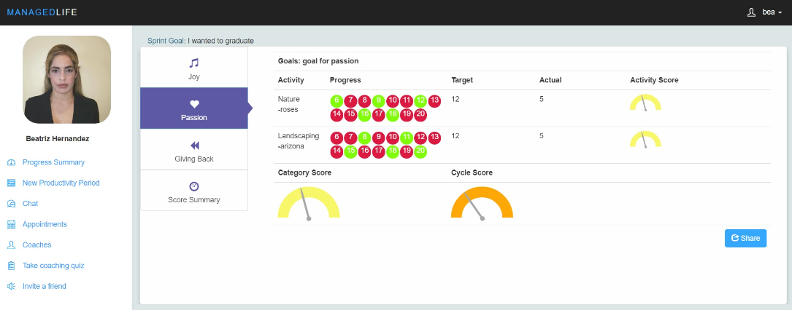
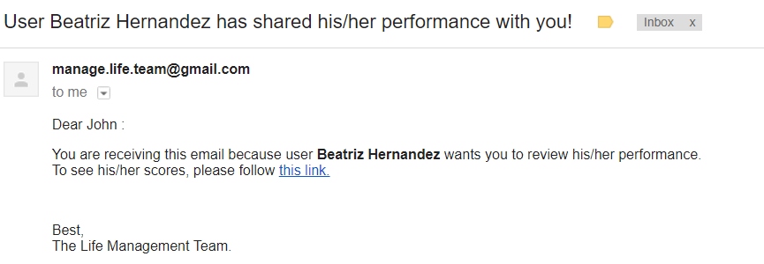
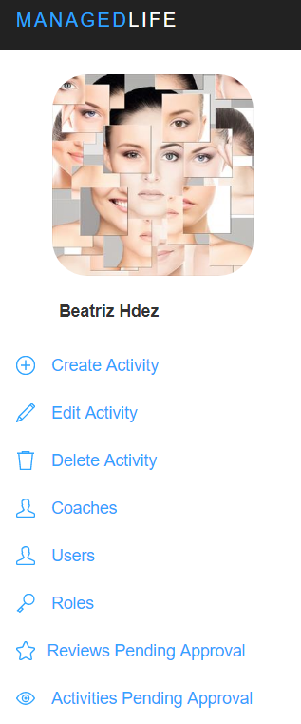
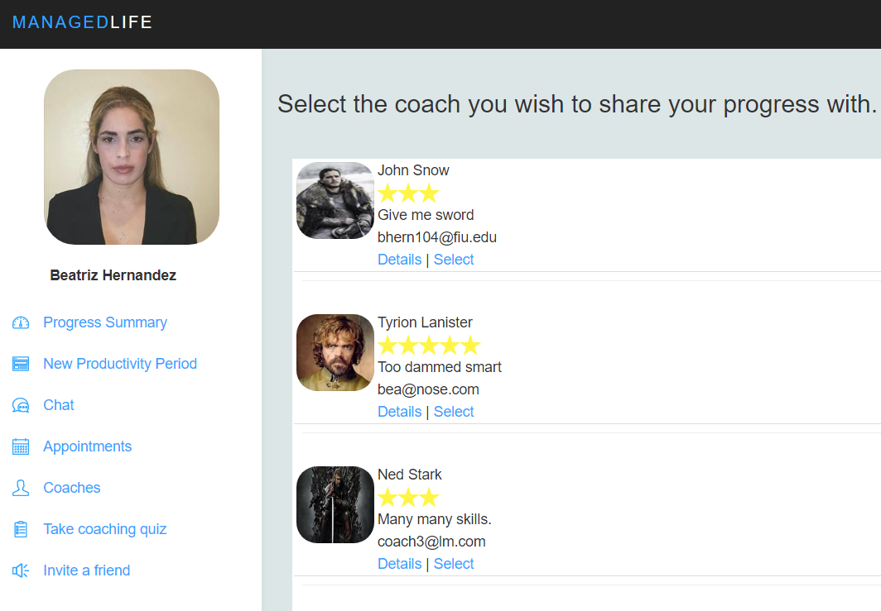
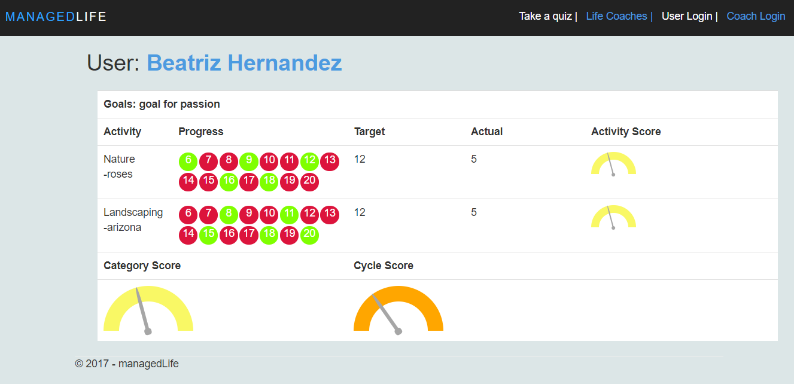
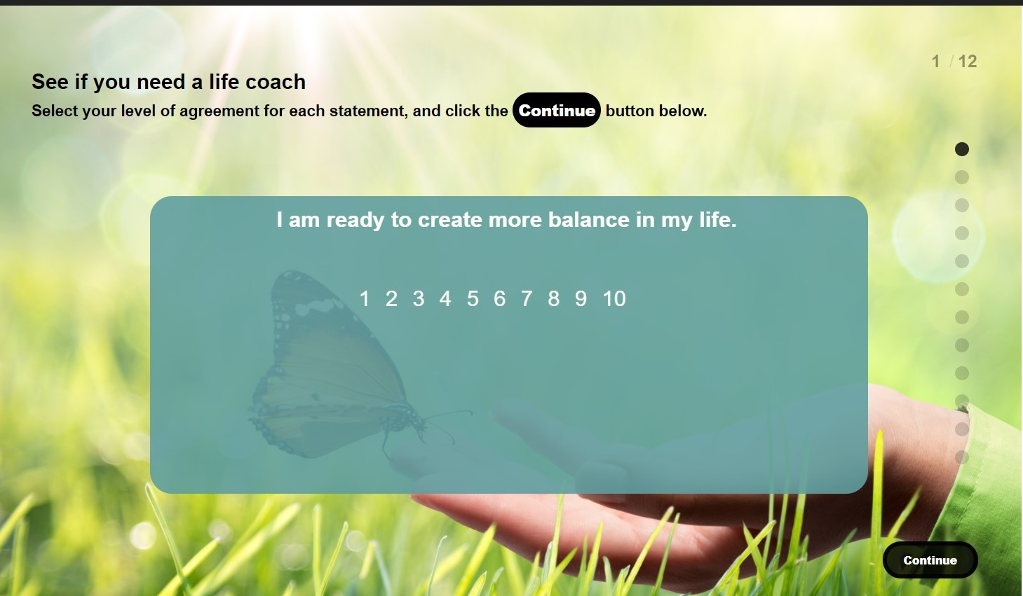
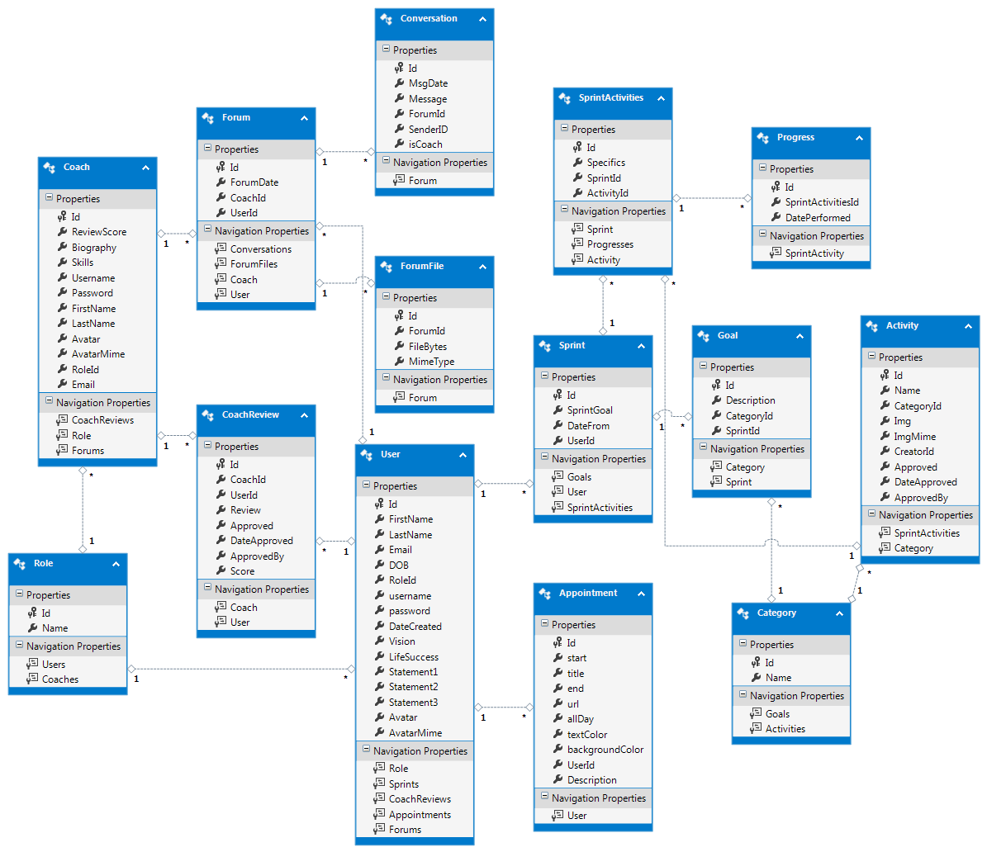
School of Computing & Information Sciences
Senior Project, 2017, Summer
Life Management 1.0
Student: Beatriz Hernandez, Florida International University
Mentor: Ranjeet Deshmukh, CrossMatch
Instructor: Masoud Sadjadi, Florida International University
Problem
Solution
Current System
Most people lack a sense of fulfillment and purpose in life.
The increased use of technology has added extra distractions.
People take refuge in social media as a escape from reality.
Research has shown that success is progressively built.
There are 3 principles that will potentially lead to success:
Finding JOY in your life.
Following your PASSION.
Making a meaningful contribution to others. (GIVE BACK)
Provides a platform to keep track of your daily progress.
Put users in touch with Life coaches.
Help users identify areas of their life that need attention.
Keep people focus on their vision.
Screenshots
5- Email received by the selected Coach
3- User Dashboard, notice the share button.
1- Initial questionnaire to extract the vision or life Goal of the User.
7- Features available to Site administrators.
2- Coaching quiz to find out if the User is ready to be managed by a Life Coach.
4- List of available coaches to which you can share your progress.
6- Coach view of shared category.
Requirements
System Design
Users can identify their vision after taking a questionnaire (pic 1).
Users and guest can take a quiz to determine if they are ready to contact a life coach. (pic 2)
Users can share their progress with a coach of choice. (pic 3 and 4)
Coaches can review the progress of the Users, at Users’ request. (pic 5 and 6)
Site admin can manage Coaches, Activities, Users and Roles in the system. (pic 7)
Implementation
Summary
The application was implemented using MVC 4.0, ASP.NET technologies, and C# for server side.
Entity Framework 6.0.0.0 for entity management.
Microsoft SQL Server 2012 for DBMS
Jquery, HTML5, CSS3, Javascript, Ajax for front end.
Agile organizational schemas in Mingle.
Git for source Control.
Site and Database hosted in Azure.
People are everyday more obsessed with technology and social media.
Spending too much time on social media has been linked to depression and isolation.
This solution provides a healthy alternative to social media, by encouraging a change of perspective.
It focus on helping people reach their potential and feeling useful to society.
Acknowledgement
Poster content is based on the ManagedLife, a project that was completed thanks to the collective efforts of Fernando Mojena (team member), Ranjeet Deshmukh (mentor) and Ravi Agarthi (contributor). Special thanks to Robert Hacker (FIU Startup) for the good advise and feedbacks.
Notes:
1

