Slide 1

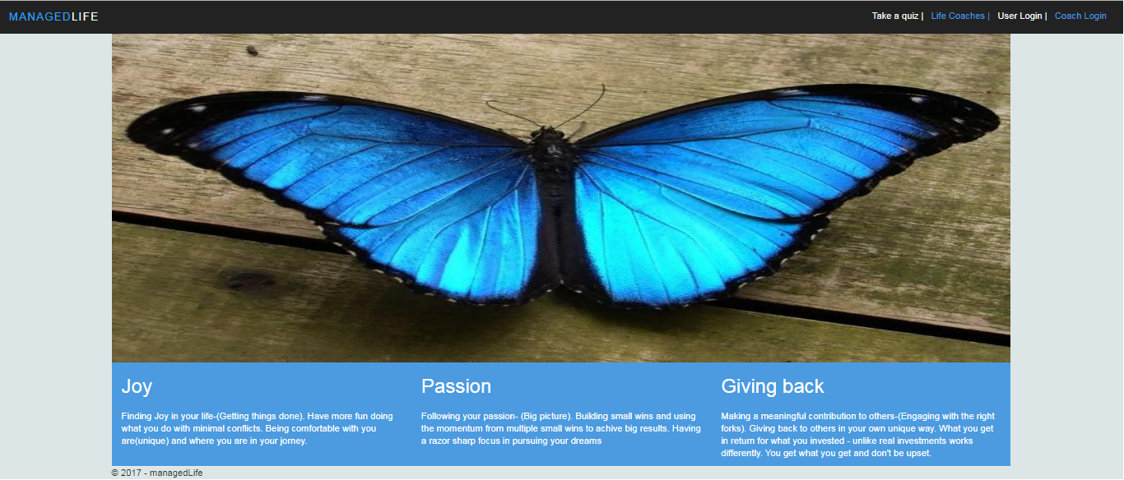
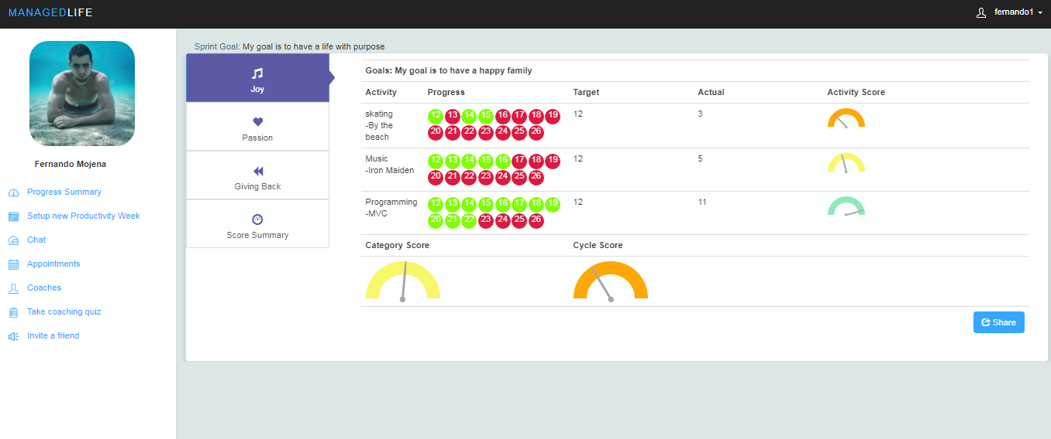
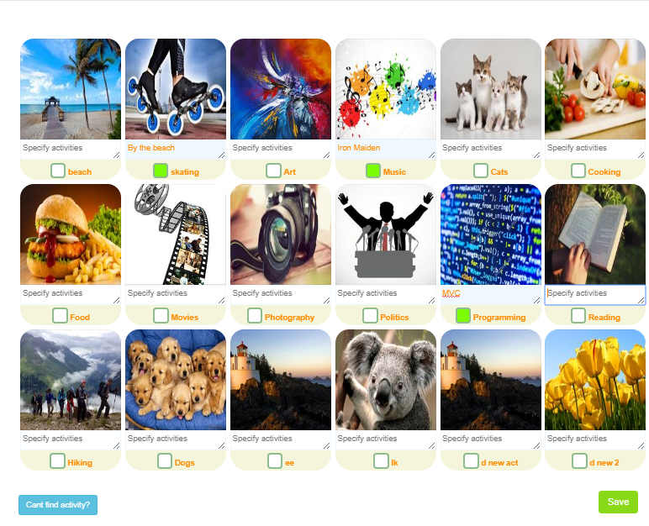
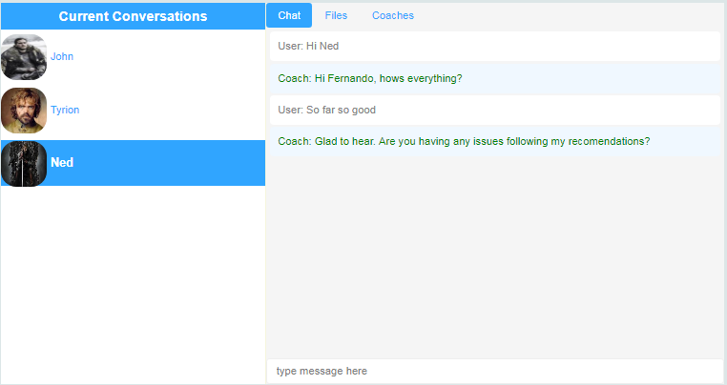
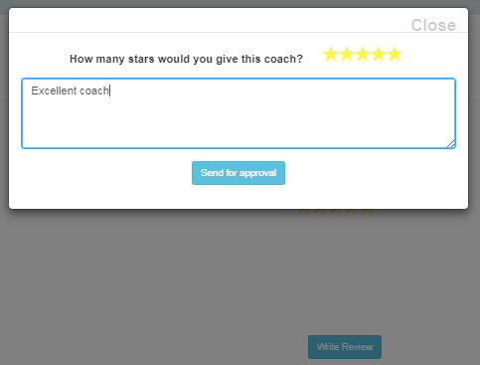
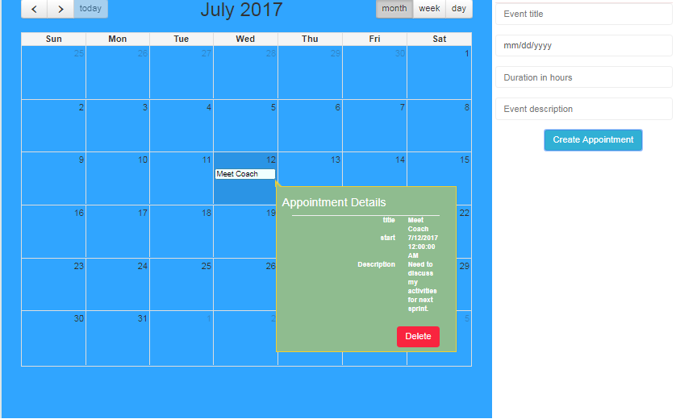
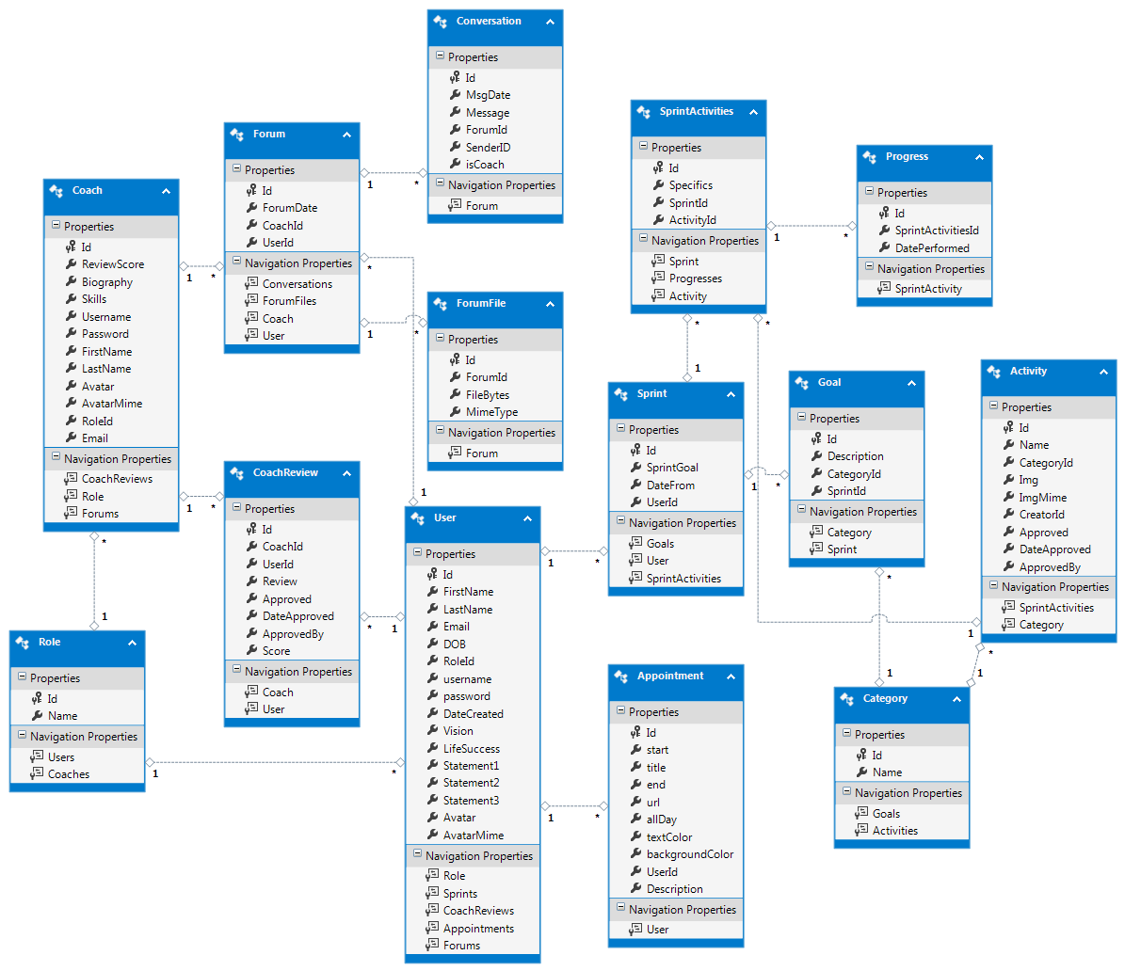
Senior Project, Summer 2017
Life Management 1.0
Managed
Life
Student: Fernando Mojena Amaya, Florida International University
Mentor: Ranjeet Deshmukh, Crossmatch
Instructor: Masoud Sadjadi, Florida International University
Problem
Solution
Many people lack purpose and fulfillment in their life.
Social Media addiction makes people lose focus and waste time.
There is a need to help people find purpose in a fun and engaging manner.
Research on Productivity and Positive Psycholog led to “ManagedLife”.
A place to manage daily activities.
Track progress and see statistics.
Interactive platform to communicate with Life Coaches.
Requirements
Picture 1: Home page. Landing page of the website
Contributions
Users can:
create an account and setup a sprint.
select activities for each category.
track and update progress.
share progress with Coaches.
communicate and share files with Life Coaches.
Interface for selection of Activities.
Progress tracking in Dashboard and statistics update.
Appointments Calendar
Chat with Coaches
File Sharing with Coaches
User reviews for coaches
Picture 2: User Dashboard-Progress Tracking. Users update daily activities.
Picture 3: Activity Selection. Users select activities when setting up sprint.
Picture 4: Chat. Users can communicate with coach and share files.
Picture 5: Coach Review. Users can create reviews for coaches.
Picture 6: Calendar. A calendar to show and create appointments.
Implementation
Summary
Site was implemented using MVC 4.0 and Asp.NET technologies.
Entity Framework 6.0.0.0 for entity management.
Microsoft SQL Server 2012 for DBMS.
C# for server side.
Jquery, HTML5, CSS3, Javascript, Ajax for front end.
SignalR for Chat.
Agile organizational schemas in Mingle.
Git for source Control.
Site and Database hosted in Azure.
Many people lack sense of purpose and fulfillment in their lives.
Research suggests that specific areas in life (Joy, Passion, Contribution) are essential for happiness.
ManagedLife uses those concepts to help users with time management.
By tracking daily activities and having a visual representation, users see their progress towards success.
Life Coaches are available for guidance.
Picture 7: Entity Model. ManagedLife entity model extracted from Visual Studio.
Acknowledgements: Poster content is based on the ManagedLife, a project that was completed thanks to the collective efforts of Beatriz Hernandez (team member),
Ranjeet Deshmukh (mentor) and Ravi Agarthi (contributor). Special thanks to Robert Hacker (FIU Startup) for reviewing and tearing this website apart.

