Slide 1









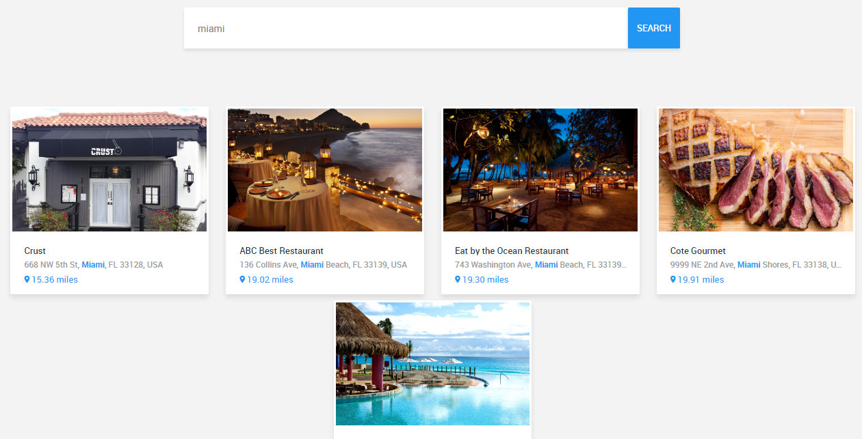
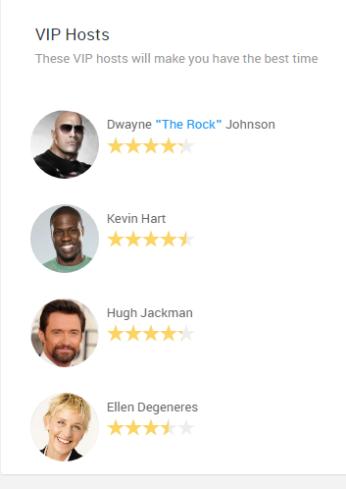
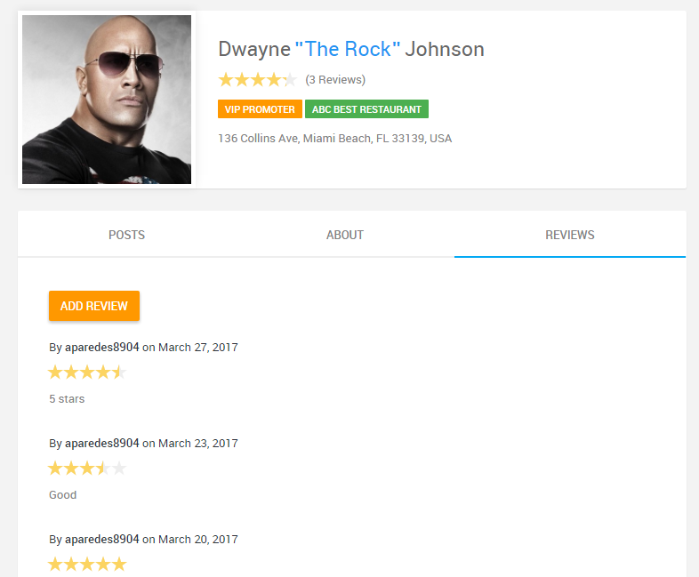
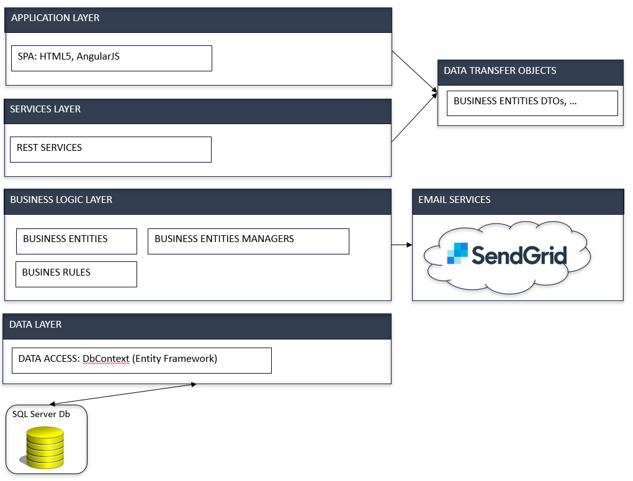
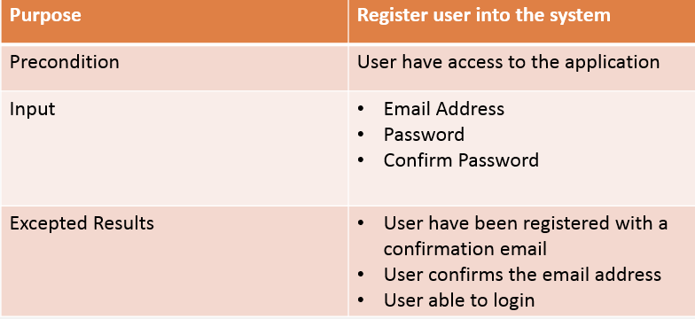
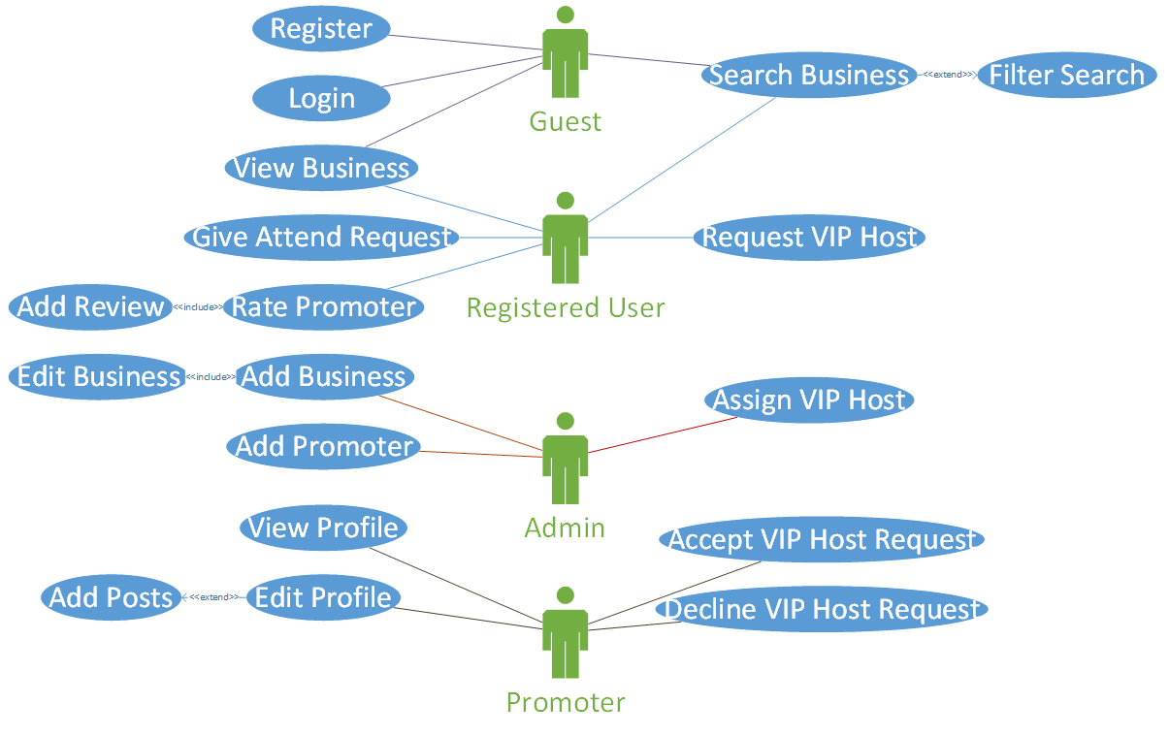
School of Computing & Information Sciences
Senior Project, 2017, Spring
MYVIPCITY 1.0
Student: Darshana Sebastian, Florida International University
Mentor: Mohsen Taheri, Florida International University
Instructor: Masoud Sadjadi, Florida International University
Problem
Tourism is a trade which enhances the revenue of a country. Most of the tourists will not be having ideas on where to go in a particular place. It will be time consuming for a visitor to browse multiple websites to make better decisions.
Solution
A web portal which allows the users to search/filters the businesses according to their demands at a particular location. This will allow them to easily take decisions regarding where to go, give attend request and will also provide the users with VIP Host service.
Current System
The current system allows user to:
Search businesses
Give Attend Request
Choose VIP Hosts
Rate VIP Hosts
Choose the type of service
Screenshots
Requirements
Requirements in the web application include:
Login with a user account
Search/Filter Businesses
Choose Business
Give Attend Request
Choose VIP Hosts
Choose Type of Service
Rate and Review VIP hosts
System Design
Implementation
Visual Studio IDE were used to create a cross-platform system
Rules and Data are stored in an SQL Server.
Microsoft Azure is used as a web server to host the system.
HTML is used as a User Interface.
Sendgrid is used as an email service provider
Verification
Object Design
Summary
This project is the first release of the attempt for a tourism based web portal for South Florida.
This application will be extremely useful for attracting tourists into a particular location. And as the need arises it can be used throughout the United States.
Acknowledgement
The material presented in this poster is based upon the work supported by my mentor Mohsen Taheri and Instructor, Prof. Masoud Sadjadi. I am thankful to the help that I received from my group member, Angel Parades.
Notes:
1

