Slide 1





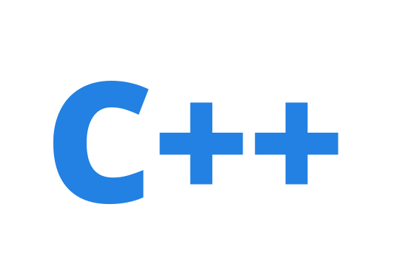


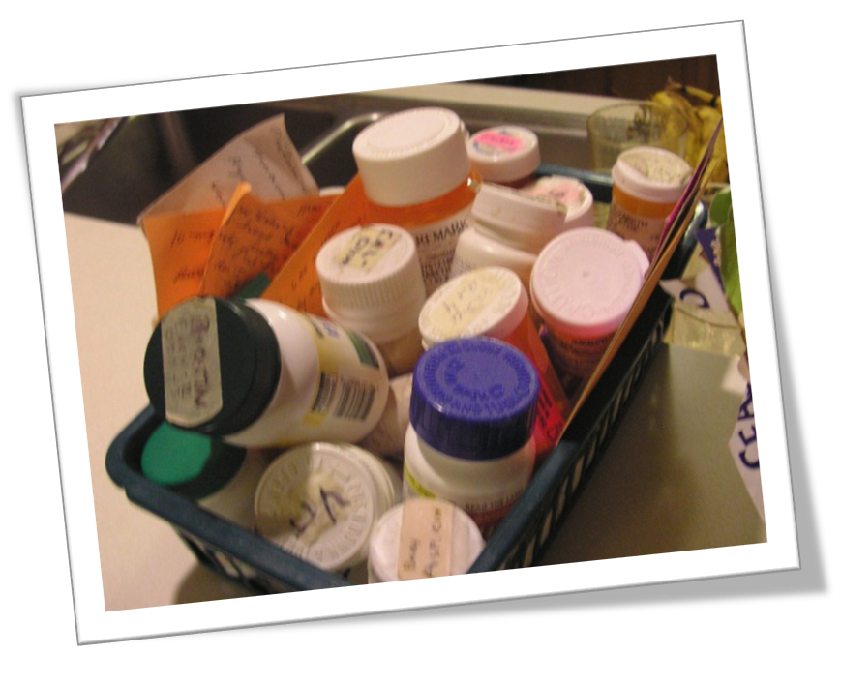
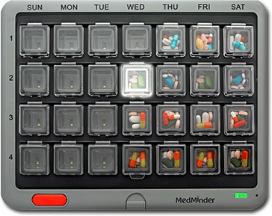
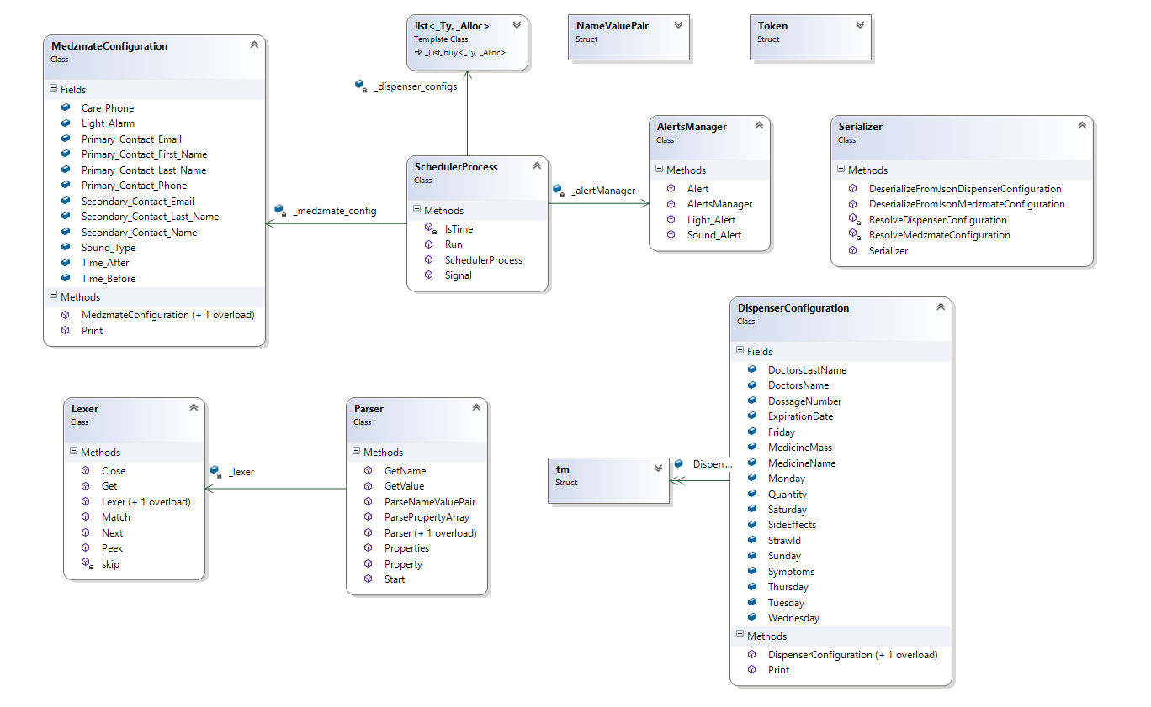
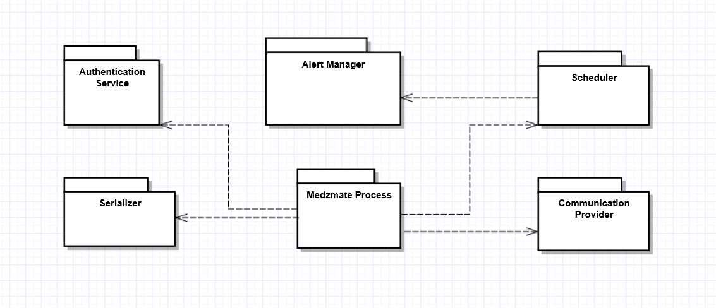
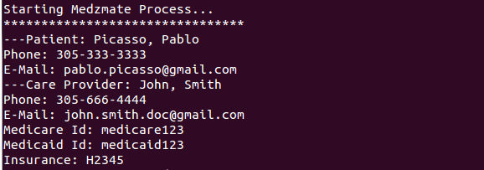
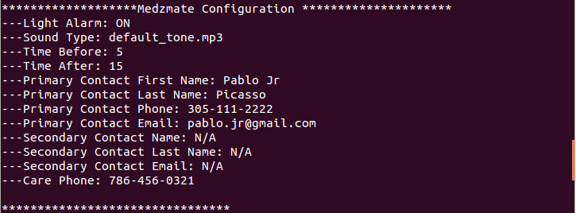
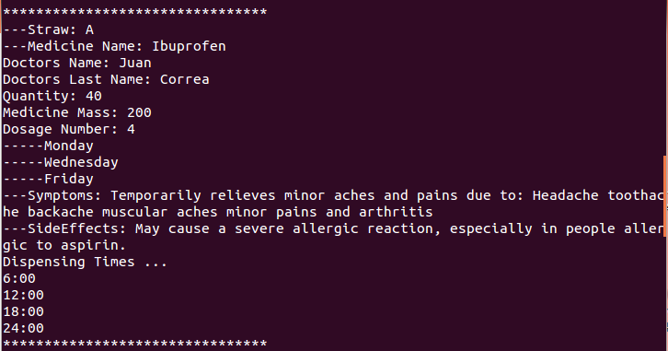
School of Computing & Information Sciences
Senior Project, Fall 2015
Medzmate 1.0
Student: Juan C. Correa, Florida International University
Mentor: Peter Dickson, Florida International University
Instructor: Masoud Sadjadi, Florida International University
Problem
Current System
Requirements
The medical and pharmaceutical industries face multiple issues at the time of dispensing medicines to elderly. These issues arise on several stages of the process—during the dispensing in the pharmacy, making the home delivery and finally ensuring the patient takes the right medication at the right time. Health care providers spend millionaire sums to guarantee accuracy on every stage of this process and it is still highly susceptible to errors.
The target customers for the Medzmate largely use a pill box.
1. Only the health care employee should be able to add/remove medicine information, and/or modify the schedule.
2. The Medzmate station should be able to respond to incoming request from the mobile application and store the received JSON files in the device’s file system. Existing files will be overwritten.
3. Upon receiving new configuration files the running process must be restarted and it has to reload all the saved configurations—patient’s information, straws and global configuration.
4. The Medzmate process will react accordingly to the configuration stored. It will trigger the right type of alarms on time for the corresponding straws.
5. Using the standard output the process will display all the data received or calculated. Version 1.0 will throw alarms by displaying the type of configured signal as a text in the console.
From which daily doses (morning and night) are sorted using compartments.
Current systems are not under the control and supervision of a pharmacist who can check on actual dispensing vs scheduled and then communicate with the patient via the device/technology.
System Design
Object Design
Implementation
NetBeans: Great IDE to use in Ubuntu with native C++ compilers and standard libraries that compile in several Linux flavors . Used as the development environment for the code running within the Medzmate Station.
Ubuntu: Free operating system with better capabilities than Raspbian to use as development environment for the Medzmate Station software.
Node js: Platform focused on building server-side applications in JavaScript. (Needed for the web service on the Medzmate station).
Raspbian: Free operating system based on Debian optimized for the Raspberry Pi hardware.
Verification
Screenshots
Summary
The main objective of our test plan is to find and report as many bugs as possible to improve the integrity of our program. We created unit tests for the Medzmate mobile application and the Medzmate Station functions. However testing would not be complete without an exhaustive exercise of integration testing between both programs. Among the Medzmate Station unit test suite we can find:
Lexer Tests-Peek() function.
Lexer Tests-Next() function. E.g.
      Preconditions:
      JSON test file in hard drive.
      Input Data:
        [ { “name” : “Medicine Name”, “value”: “Ibuprofen 2345”}]
        Steps to be executed:
        Initialize Lexer with test file“TestResources/LexerTest.JSON”.
        Call Next() function.
        Call Next() function.
        Call Next() function.
        Call Match(“name”) function.
        Call Next() function.
        Close Lexer.
      Expected result:
        Lexer is initialized.
        Returns token “[“.
        Returns token “{“.
        Returns token “”“.
        Skips “name”
        Returns token “”“.
        Lexer Closed.
Using standard software engineering techniques and following the SCRUM methodology we were able to deliver a prototype of Medzmate, a revolutionary product intended to help elderly patients to receive their daily medications in an easy and timely way. This solution contains a software suite to support all the features planned for its 1.0 version.
Despite the fact that the hardware mechanism to dispense the pills was not available during development, we were able test the software by emulating the signaling through a console application in a raspberry pi device.
Acknowledgement
I am thankful for the help received from my team member Pedro Montero, and the support provided by my friends and family, specially my wife.

