Slide 1











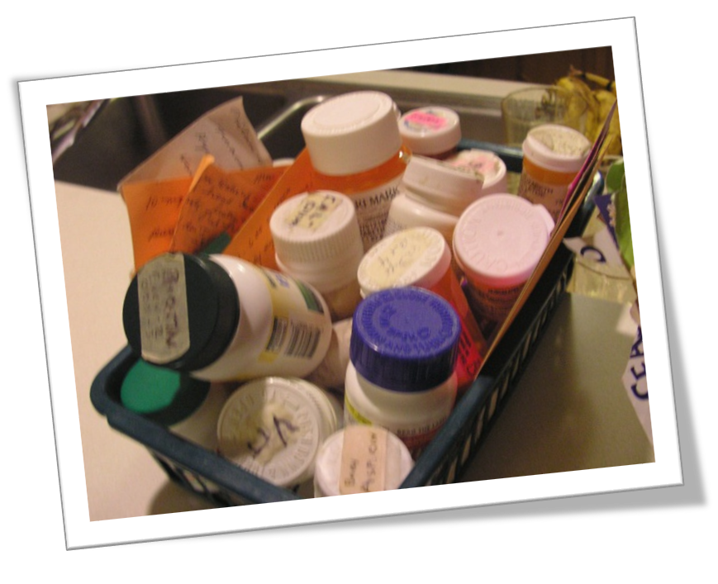
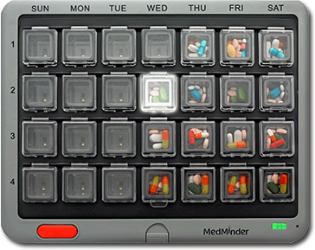
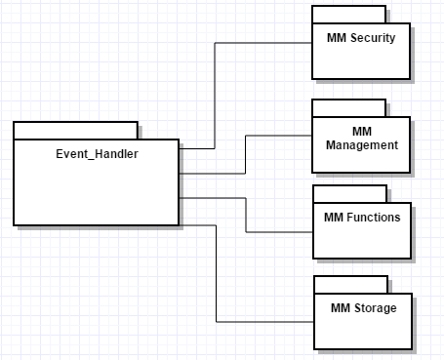
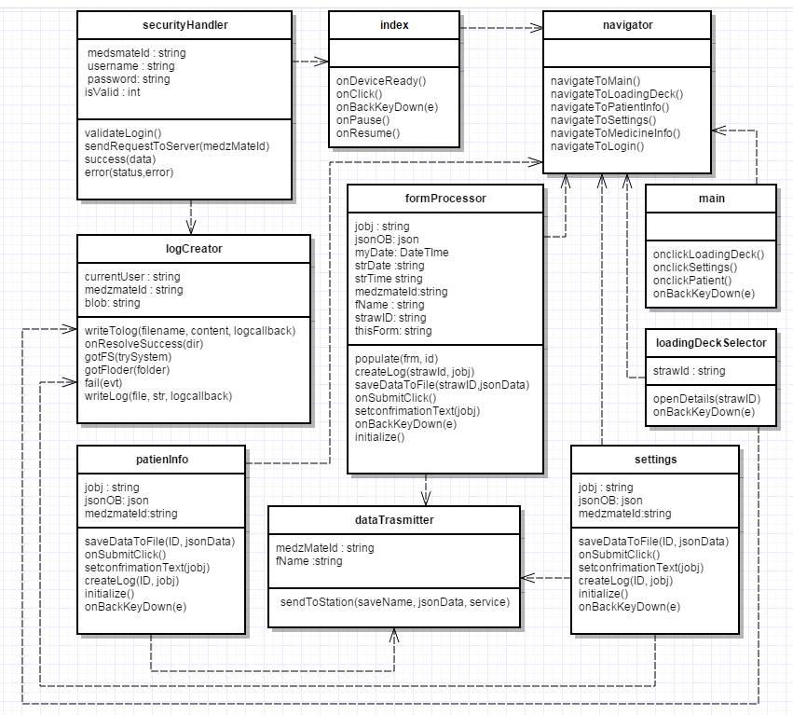
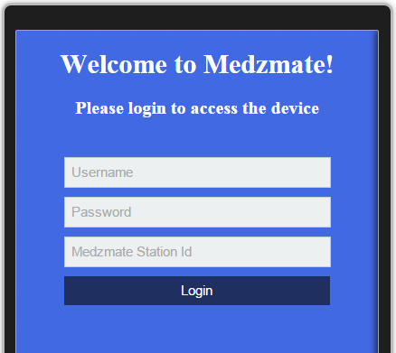
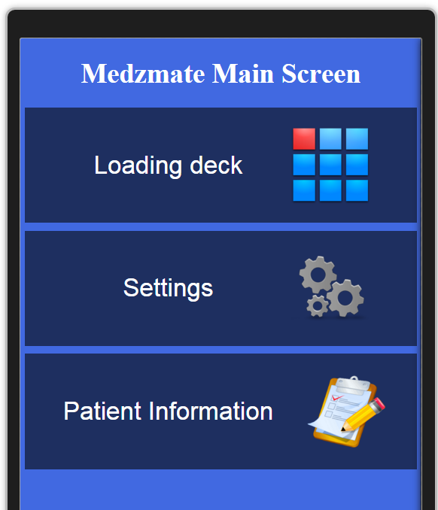
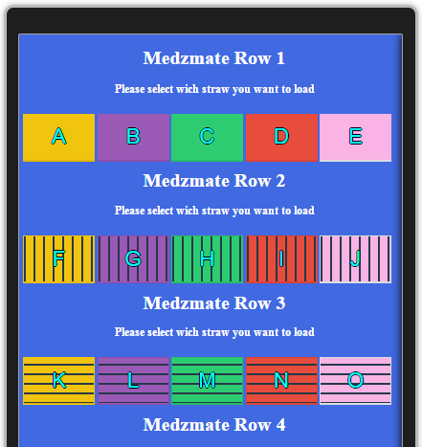
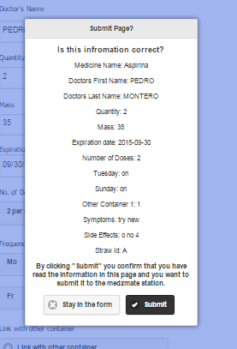
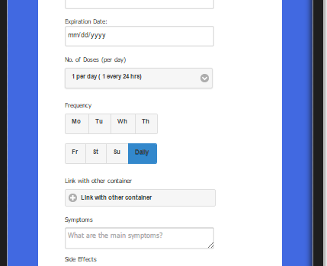
School of Computing & Information Sciences
Senior Project, Fall 2015
Medzmate
Student: Pedro Montero, Florida International University
Mentor: Peter Dickson, Florida International University
Instructor: Masoud Sadjadi, Florida International University
Problem
Current System
Requirements
The medical and pharmaceutical industries face multiple issues at the time of dispensing medicines to elderly. These issues arise on several stages of the process--during the dispensing in the pharmacy, making the home delivery and finally ensuring the patient takes the right medication at the right time. Health care providers spend millionaire sums to guarantee accuracy on every stage of this process and it is still highly susceptible to errors.
The target customers for the Medzmate largely use a pill box.
1.Only the health care employee should be able to add/remove medicine information, and/or modify the schedule.
2.Medicine info screen should mimic the loading dock of the Medzmate.
3.The pharmacist can select a slot in the loading deck and a form will pop to enter detailed information about the medicine for that slot.
4.The user should be able to select among multiple forms of notifications
5.The initial screen will allow the user to enter a unique id so that the app can connect to the any Medzmate.
6.Forms should be validated for required fields
7.A popup message should appear on submit, displaying the data and a message “By clicking Send you acknowledge that the information above is correct and you are responsible for its accuracy”
8.On submit, data will be saved and sent to the station.
9.On cancel, the user will stay on the form to continue filling the data or correcting it.
From which daily doses (morning and night) are sorted using compartments.
Current systems are not under the control and supervision of a pharmacist who can check on actual dispensing vs scheduled and then communicate with the patient via the device/technology.
System Design
Object Design
Implementation
Apache Cordova: Platform that wraps our HTML/JavaScript app into a native container which can access the device functions of several platforms, allowing one set of code to target nearly every phone or tablet on the market today.
jQuery Mobile: Used to design a single highly-branded responsive application that will work on all popular smartphone/ tablet, and to enhance forms input to be touch-friendly, including the addition of a set of touch-friendly UI widgets.
Node js: Platform focused on building server-side applications in JavaScript. (Needed for the service on the Medzmate station)
Raspbian: Free operating system based on Debian optimized for the Raspberry Pi hardware
Verification
Screenshots
Summary
Test 003F – Verify user can not submit without the Frequency.
Preconditions:
User must be on medicine detailed information form
Input Data:
Medicine name = Aspirin
Doctor’s name = Pedro Montero
Pills quantity = 1
Expiration Date (MM/DD/YY) = today + 1 month
Mass = 1
Dosage frequency (per day) = 4
Frequency (days of the week) = null
Link with order container (type A, B, C) = none
Symptoms = some Symptoms
Side Effects = thinned blood
Steps to be executed:
Enter data
Click button ‘Submit’
Expected result:
Form scrolls to Frequency y field and display a “Required field message”
Using standard software engineering techniques and following the SCRUM methodology we were able to deliver a prototype of Medzmate, a revolutionary product intended to help elderly patients to receive their daily medications in an easy and timely way. This solution contains a software suite to support all the features planned for its 1.0 version.
Despite the fact that the hardware mechanism to dispense the pills was not available during development, we were able test the software using the actual devices by emulating the signaling of the mechanism through a console application in the raspberry pi.
Acknowledgement
I am thankful to the help that I received from my group member Juan Correa, and the support provided by my family, especially my wife.

