Slide 1



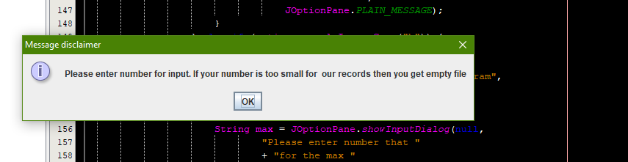
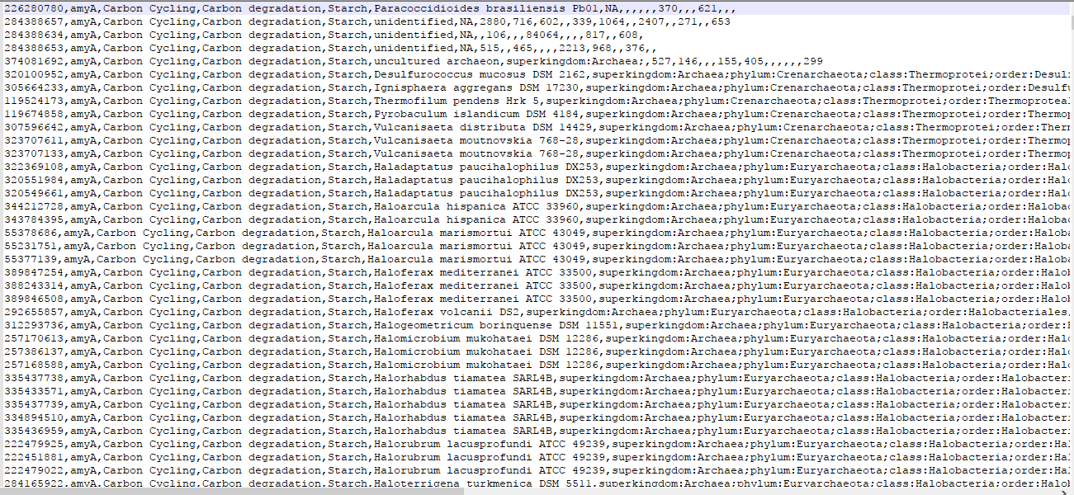
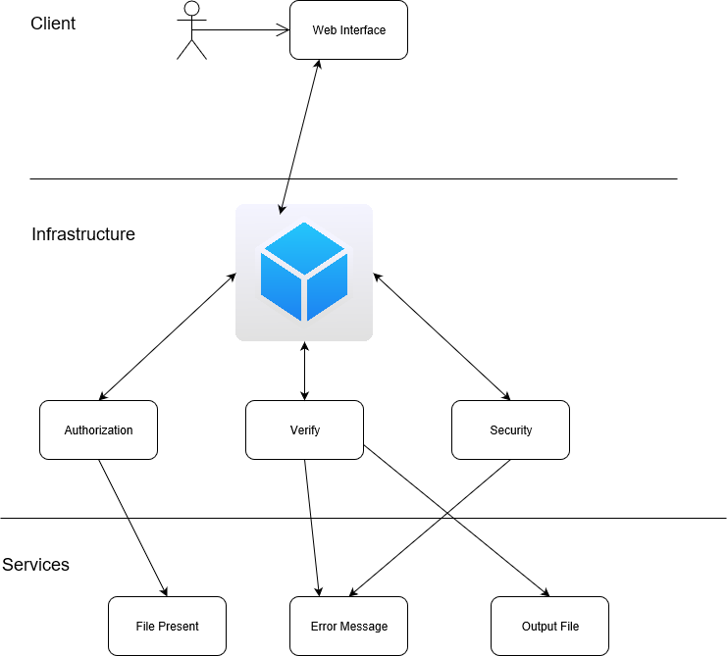
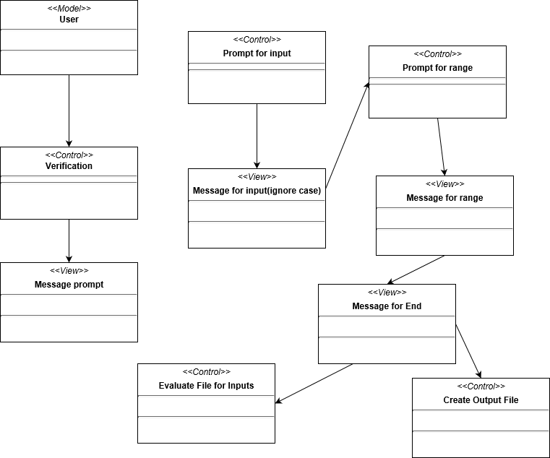
School of Computing & Information Sciences
Senior Project, 2017, Fall
Microdata and Algorithms 1.0
Student: Christian Molto, Florida International University
Mentor: De Etta Mills, International Forensic Research Institute and Forensic DNA Profiling Facility Director
Professor: Masoud Sadjadi, Florida International University
Problem
Biological Department of Florida international University wanted to have a system to work with large files of data.
Needed to reduce large data into manageable workload.
Needed user friendly query system.
Can handle any size file of data.
Solution
The solution was to create a query system from the ground up that can handle any data size put to it. The development team decided that using java was the most expedient language to implement the solution.
System requires a file.
A set of inputs with a range.
Any other limits the user inputs can be added.
Current System
Used Microsoft Access for queries.
System could not handle the large data file.
Could not differentiate from one entity to another.
Screenshots
Requirements
Require input file.
Need any input from gene name to organism.
Need a minimum and maximum range.
Input can be in lower or uppercase letters.
Must create empty for absence of input.
Have an error message and a complete message.
System Design
Implementation
Netbeans was used to craft the program.
Can be used on any computer system.
Output and input file in same directory.
Verification
The system was created with a bottom up approach. It was first created with asking the system for input that can range from gene name to organism name. The program then produce an output file with user inputs shown. Afterwards, a minimum and maximum filter was added to further reduce the size of the data to more manageable levels. The last thing to added was a ignorecase feature so the user can type their inputs with no worries of case sensitivity. If there were no input for any categories, then the program will create an empty file and display a message indicating that the program was done.
Object Design
Summary
System can receive large data files.
Create output file with all items specified by user.
Ease of use with reduce workload.
Acknowledgement
The material presented in this poster is based upon the work supported by Robin Stubbs who worked with the team by providing suggestions and additional features. I am thankful to the help that I received from my group member, Michael Garrett and a former teacher Dr. Trevor Cickovski.
Notes:
‹#›

