Slide 1



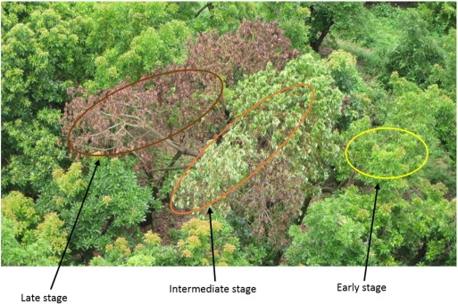
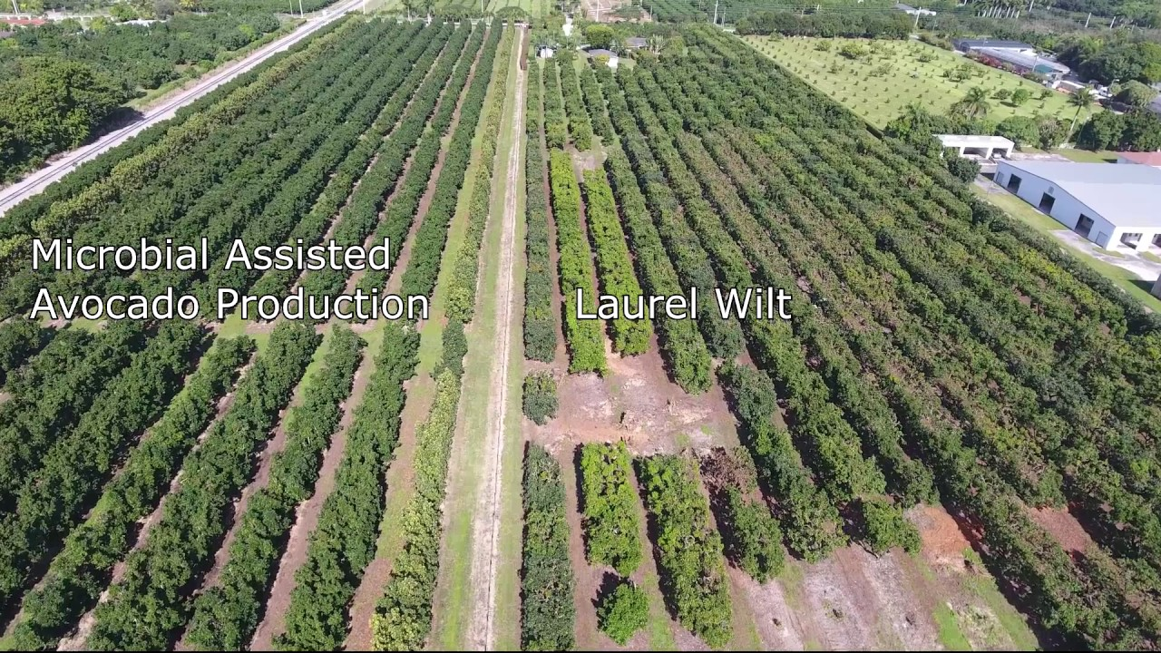
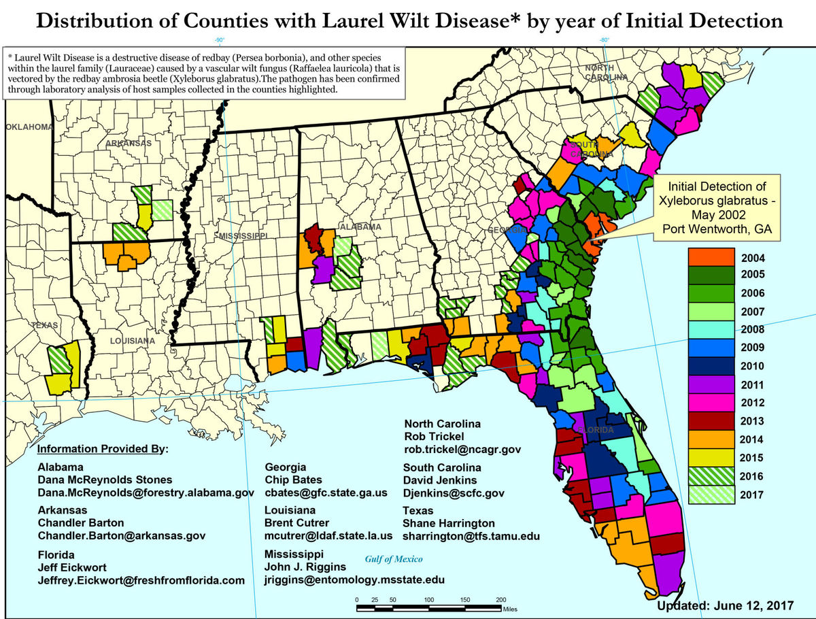
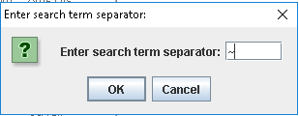
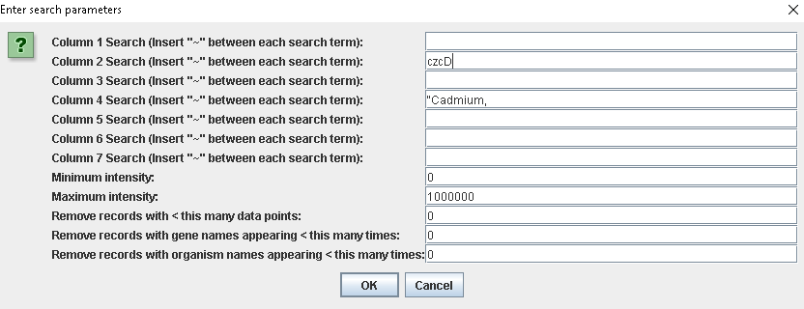
School of Computing & Information Sciences
Senior Project, 2017, Fall
Microdata & Algorithms 1.0
Student: Michael A. Garrett, Florida International University
Mentors: DeEtta K. Mills, Robin C. Stubbs, FIU MSFS
Professor: Masoud Sadjadi, Florida International University
Problem
Biologists must often sift through large datasets.
To find genetic correlations, large parts of the dataset need to be excluded from the machine learning process.
Solution
Provide the ability to create a data subset based on user-entered parameters.
Possible applications include fungicide for laurel wilt and human cadaver time since death.
Current System
The user applies our system to an input file with an arbitrary number of categories and sets of data values. Each set of data could correspond to, for example, the data values of one cadaver.
Screenshots
Laurel wilt affects avocado, Sassafras, and Laurel wilt is spread by a fungus. Our If left alone, the disease will slowly
redbay trees. The avocado industry in project will be used to biologically spread throughout the US and
Florida alone makes sales of over $65 engineer a genetically-optimized possibly to Mexico, which exports
mllion annually. fungicide to counter this threat. over 2$ billion in avocados annually.
Requirements
Filter datasets containing around 100000 records, each of which contains around 7 categories and up to several hundred gene intensity data points per unit of time.
Create datasets based on filtered data, which can be recursively filtered or datamined.
System Design
The user specifies a string to separate each given categorical search term.
The product matches with all records containing at least one of the specified search terms in the appropriate category.
Implementation
In one .csv input file, the user enters comma-separated category names in the header. Then, the beginning of each new set of data is marked with #. The output file follows the same format.
The product can recognize any number of categories and sets of data points, making it highly adaptable.
Verification
All numeric filters have been tested with nonnumeric characters, decimal values, and empty strings.
Through test-driven development, the product has been configured to correctly handle quotation marks, commas, and other special characters within categorical values.
Acknowledgement
The material presented in this poster is based upon the work supported by DeEtta Mills. I am thankful to the help that I received from my group member, Christian Molto.
Notes:
<number>

