Slide 1






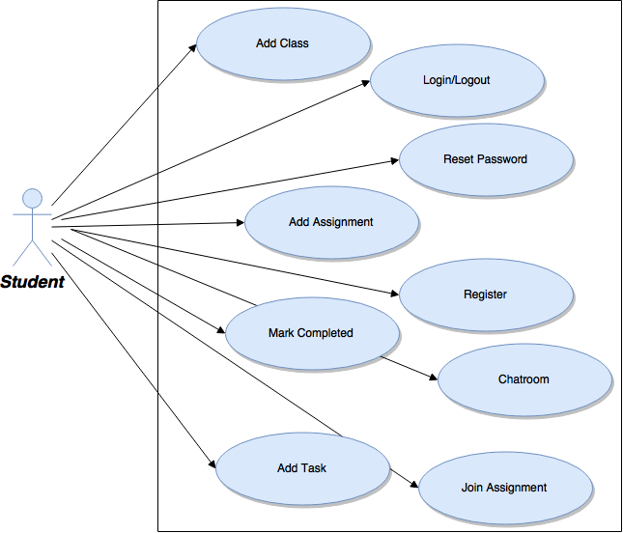
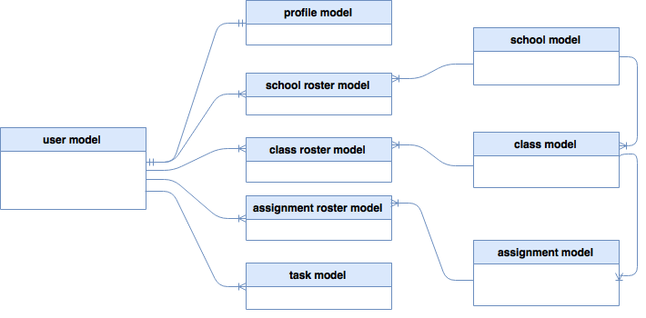
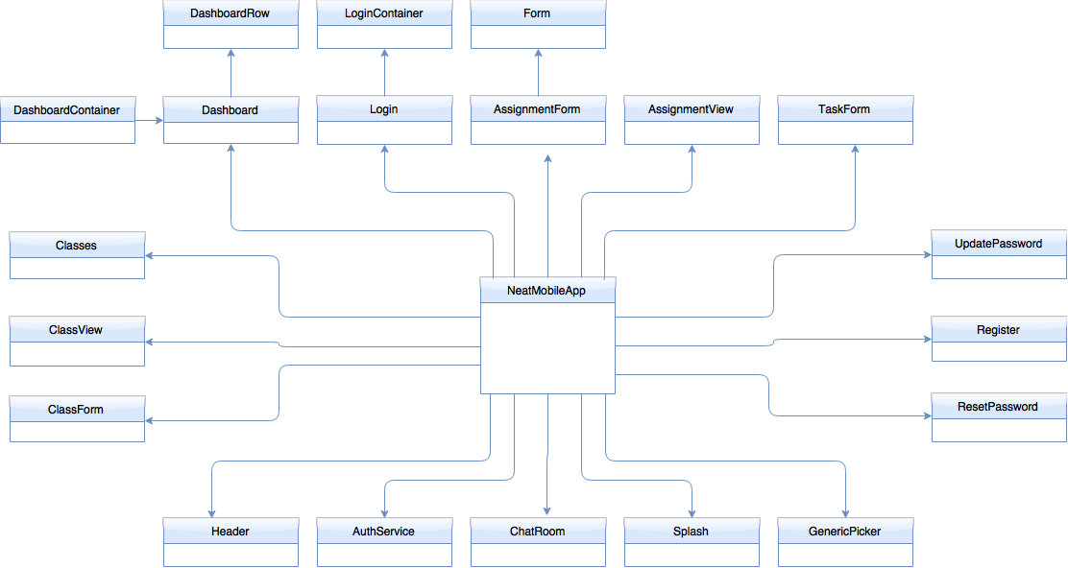

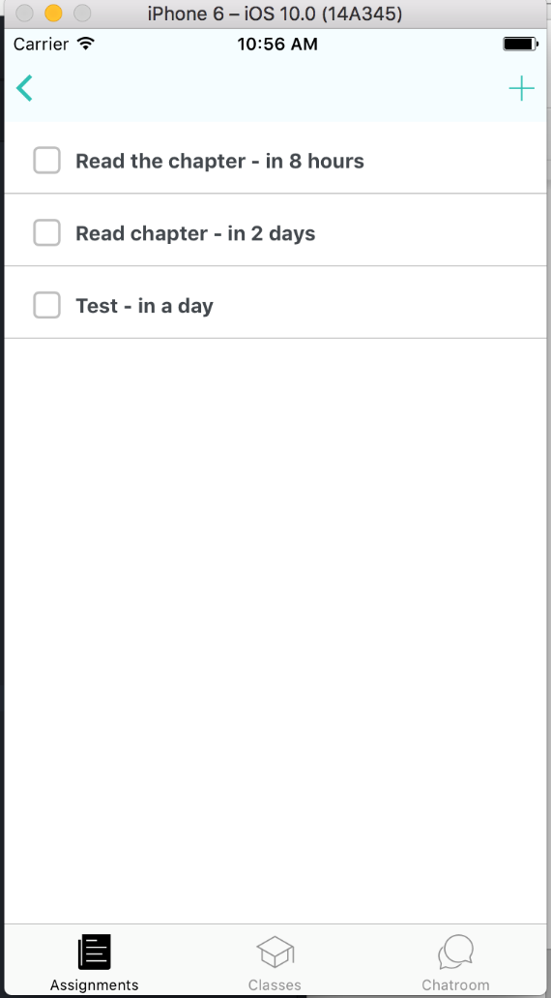
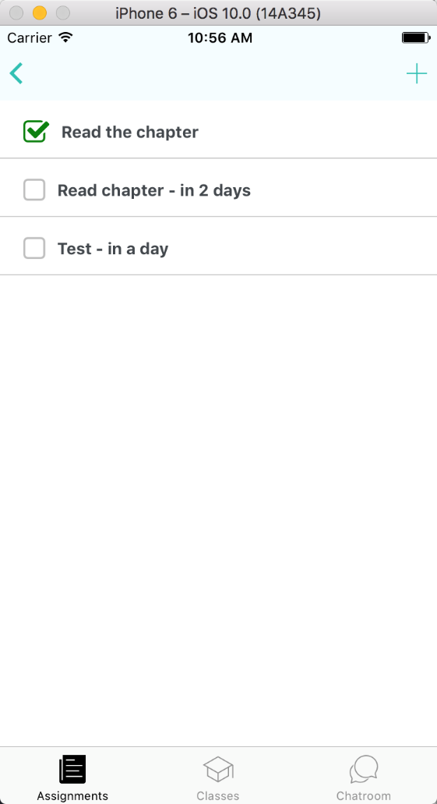
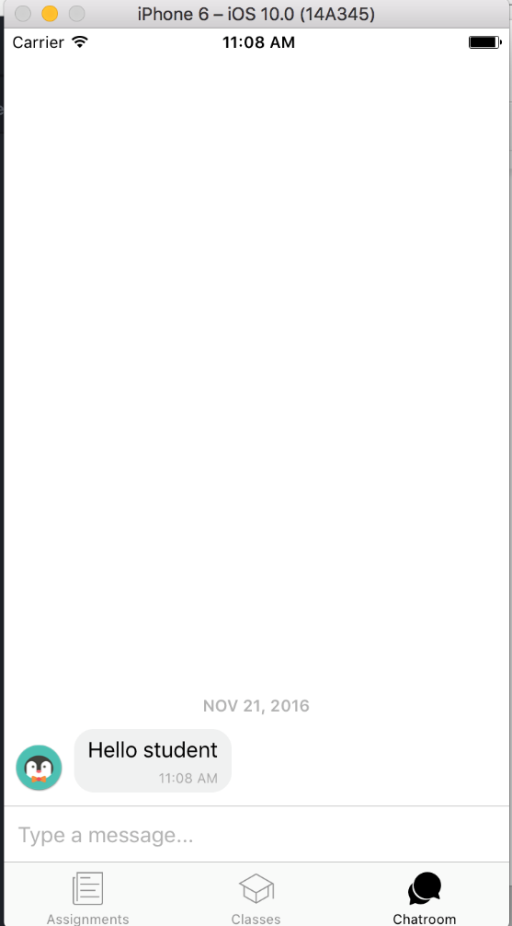
School of Computing & Information Sciences
Senior Project, 2016, Fall
NEAT
Student: Pierre Jimenez, Florida International University
Mentor: Mohsen Taheri, Florida International University
Vladan Lavolic, Florida International University
Instructor: Masoud Sadjadi, Florida International University
Problem
Current System
Requirements
A student has a huge gamut of schoolwork to go through: projects, homework, and studying for tests. Knowing how to organize these different assignments can be difficult and lead to anxiousness as the deadline approaches.
The system is ready to be used for a self-driven student. A student can setup their classes, assignments and tasks. The system is also primed for work on the next version which will have teacher-driven assignments and out-of-class help.
My Contributions were as a full-stack developer. I constructed the initial model for our repository and the abstraction layer in the backend server. In the front-end I created a chatroom UI in preparation for a forthcoming feature. I also implemented a toggle for tasks so that students can check-off what they have completed.
Solution
Object Design
The Neat app breaks down assignments into manageable tasks. The key difference with other task management software is that Neat not only tells the user when the assignment is due and how much they have yet to complete, but what assignment needs attention first regardless of due date.
Back-end
Implementations
System Design
Hybrid Front-End
The system is based on a client server model. The back-end takes care of accessing the database and the front-end takes care of rendering the data supplied by the backend and receiving user input
Front-end
Back-End
Server Code
Repository
Chatroom UI Sequence
Screenshots
Operating System
Verification
Completing A Task
Chatroom UI
Test Case 1 (Sunny Day)
Purpose
Ensure user can type input and have it appear in chat
Precondition
User logged in and user in chatroom UI
Input
Keyboard presses
Expected Result
Keyboard strokes appear on the screen after pressing enter
Actual Result
Keyboard strokes appear on the screen after pressing enter
Test Case 2 (Rainy Day)
Purpose
Ensure that if a user presses the chatroom icon while in the chatroom, the chat is not reset
Precondition
User logged in and in chatroom
Input
Click chatroom icon
Expected Result
No change in view
Actual Result
No change in view
Summary
Task management app for tracking progress based on priority
Users are can signal if they have finished a task
Users can save assignment data into their accounts
Acknowledgement
The material presented in this poster is based on the work of Giselle Pacheco, Justin Lopez, Pachev Joseph, Nelson Cruz, Fernando Campo, and Gabriel Fernandez.
I am thankful to the help that I received from my fellow developers and the start-up team at large.

