Slide 1



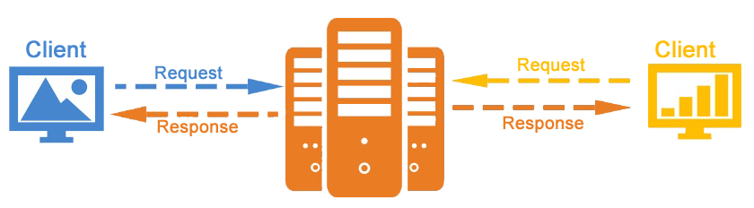


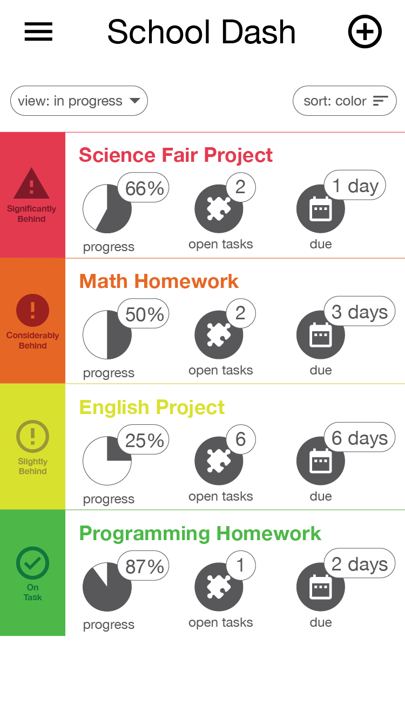
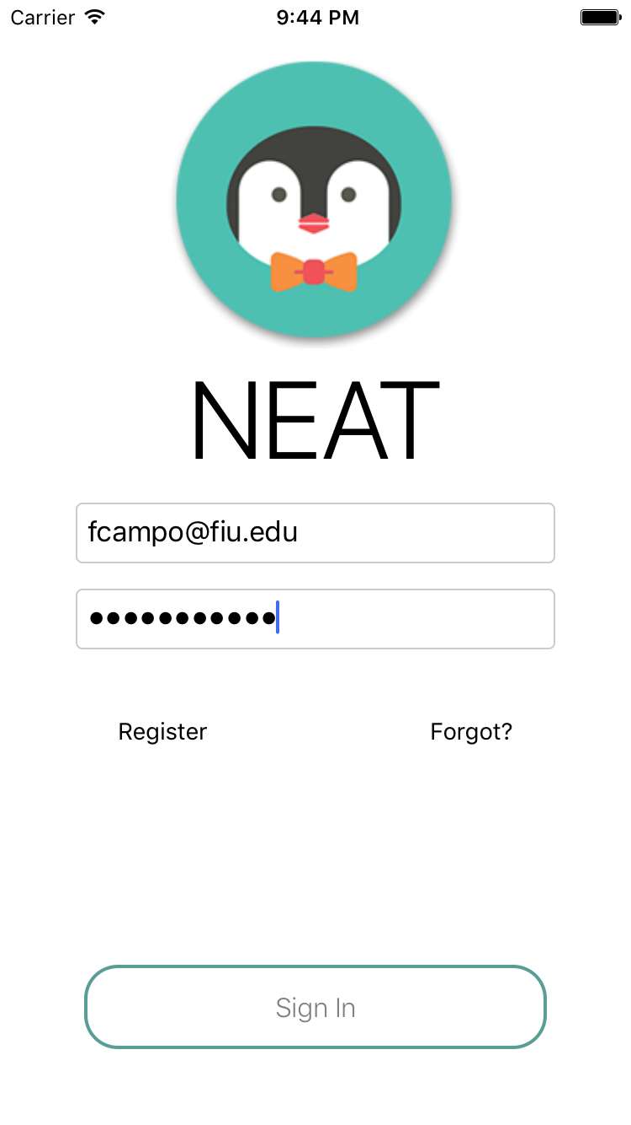
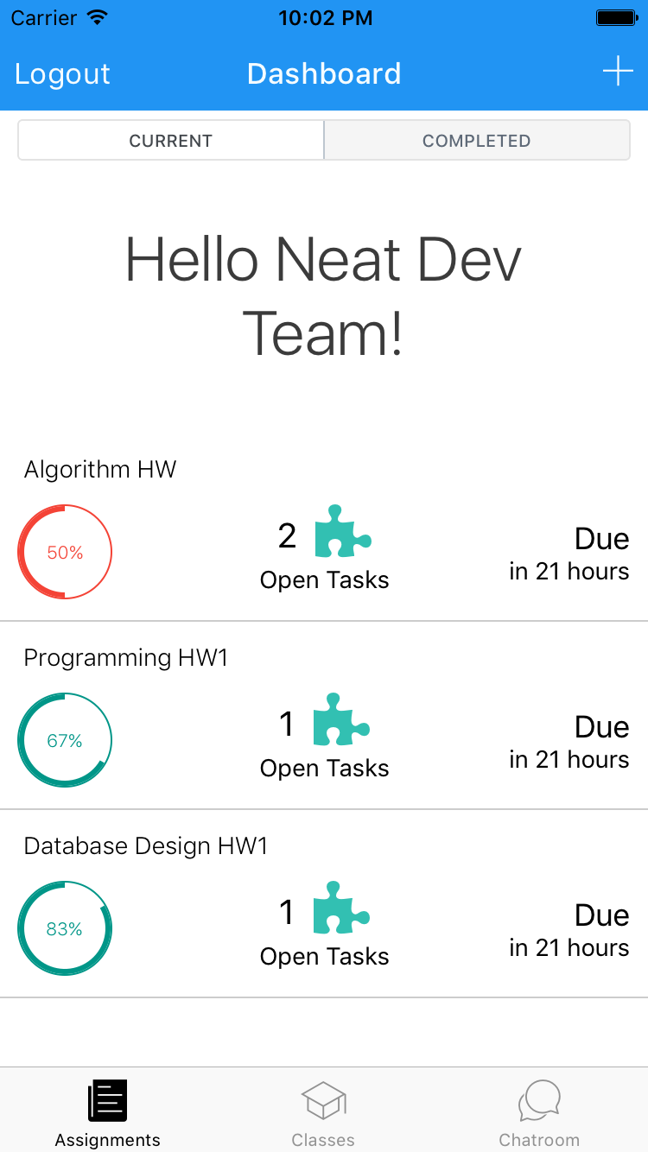



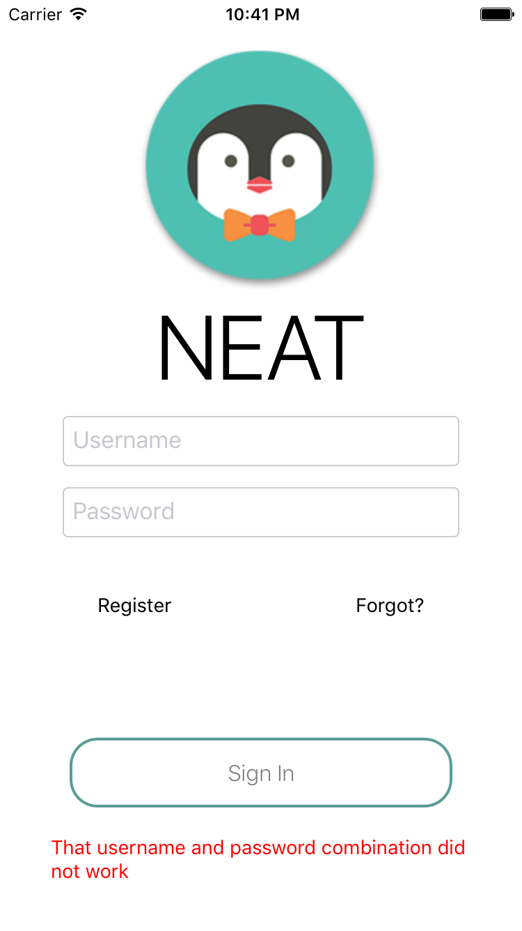
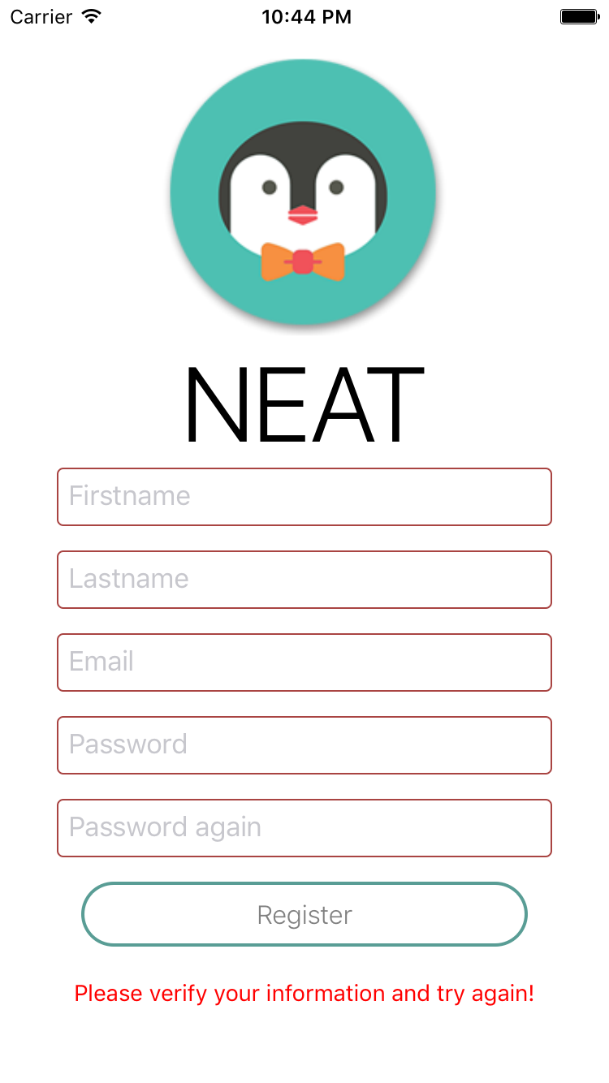
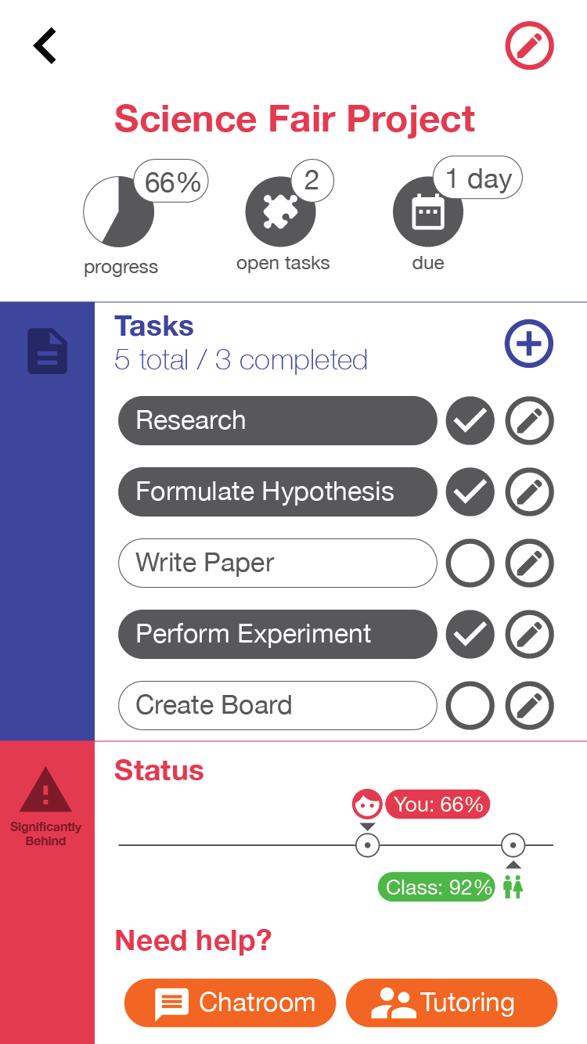
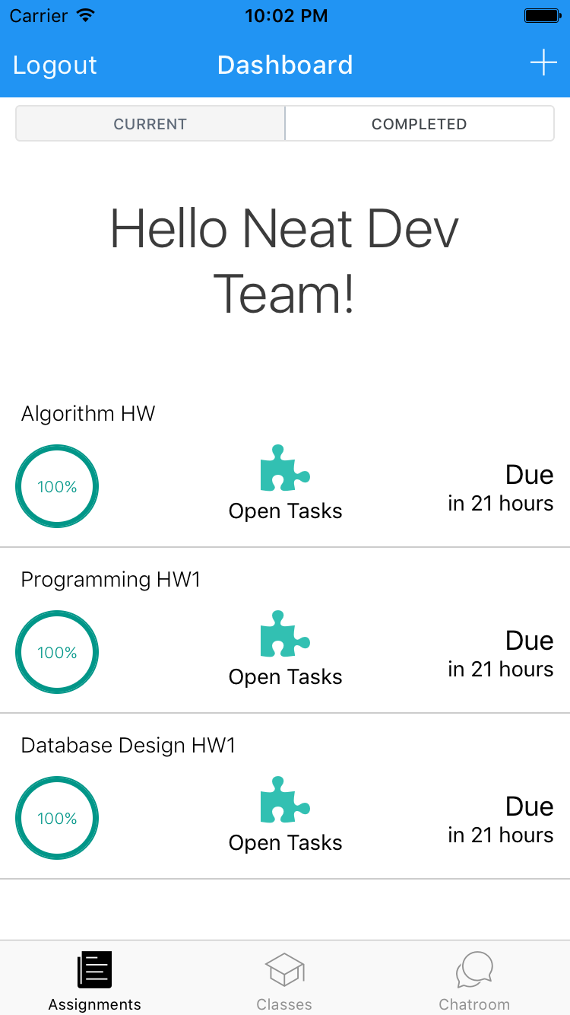
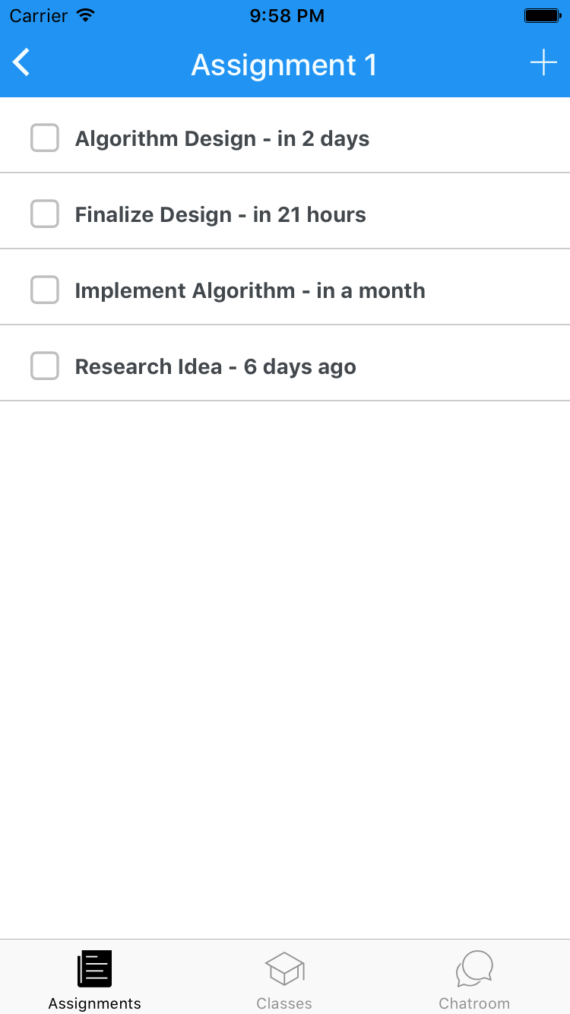
School of Computing & Information Sciences
Senior Project, 2016, Fall
NEAT v. 1.0
Student: Fernando Campo, Florida International University
Mentor: Moshen Taheri, Ranjeet Deshmukh, Vladan Lavolic
Instructor: Masoud Sadjadi, Florida International University
Problem
Can we teach children a mindset for breaking down complexity in the classroom? Neat study will empower students to own and re-create their learning experience making it more fun, meaningful and engaging using Agile and Lean principles.
Current System
The system is ready to be used for a NEAT student. A student can setup their classes, assignments and tasks. The system also works for NEAT classes which will have teacher-driven assignments and out-of-class help.
Requirements
Provided Functionality to Users:
Create Class and Join NEAT classes
Create Assignments
View Assignments
Create Tasks
Mark Task Done
Show Progress
Contributions
Overall system architecture design and technology selection.
Selection of React Native was crucial for native mobile app for iOS and Android.
Utilizing stateless functional component to ease testing and leverage proper best practices for React Native.
Separation of presentational and functional components.
Object Design
Solution
Our solution provides students with a framework that helps break down complex projects into smaller, manageable tasks for better classroom engagement and higher learning outcomes.
With our smart algorithm, assignments are given statuses based various metrics and notifies the user on their likelihood of due date completion.
System Design
Implementation
Hybrid Mobile App:
Mobile OS:
Backend Server:
Database:
The system is based on a client server model. The back-end takes care of accessing the database and the front-end takes care of rendering the data supplied by the backend and receiving user input.
Screenshots
Mocks
Implementation
Verification
Verification and validation of some of the inputs are done on the mobile app, which cause errors to appear as red text. For example, during Login and Registration.
Summary
Neat Study puts a new spin on Task Management, allowing you to complete task while staying on track in the long term. Neat gives the user the flexibility to break down assignments and Collect performance in electronic portfolio to find the most efficient way to study based on your data.
Acknowledgement
The material presented in this poster is based upon the work supported by Fernando Campo. I am thankful to the help that I received from my group members, Giselle Pacheco, Gabriel Fernandez, Pachev Joseph, Nelson Cruz, and Pierre Jimenez, as well as the support received from Mohsen Taheri, Vladan Lalovic and Ranjeet Deshmukh.
Notes:
1

