Slide 1






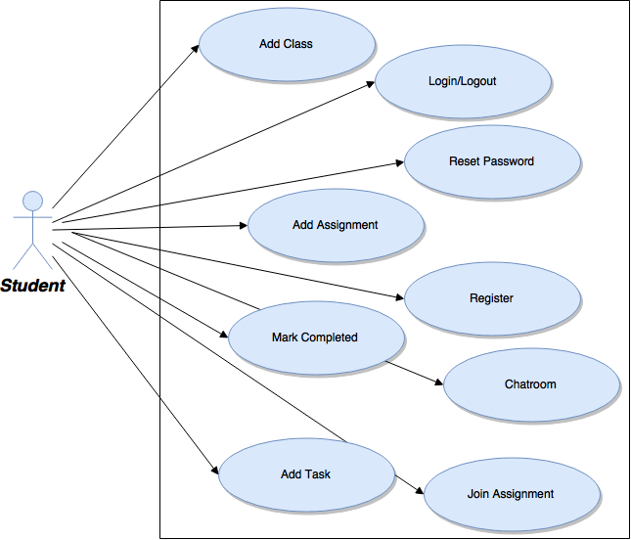
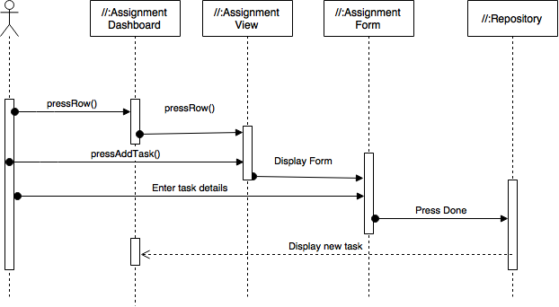
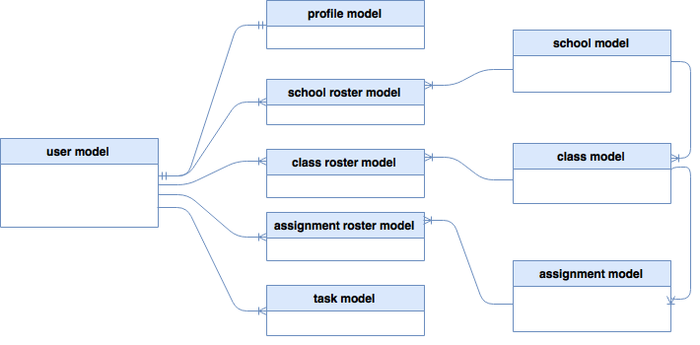
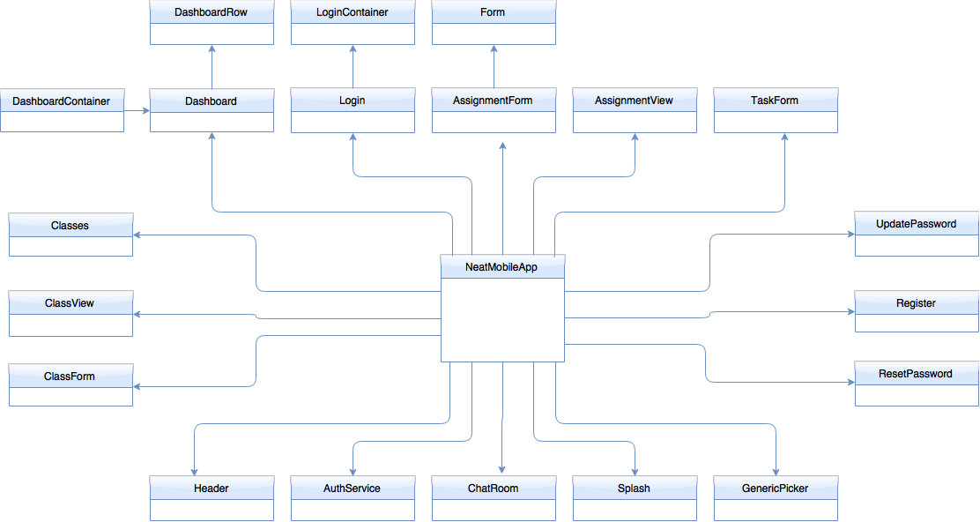

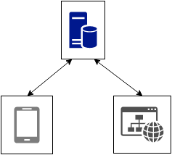

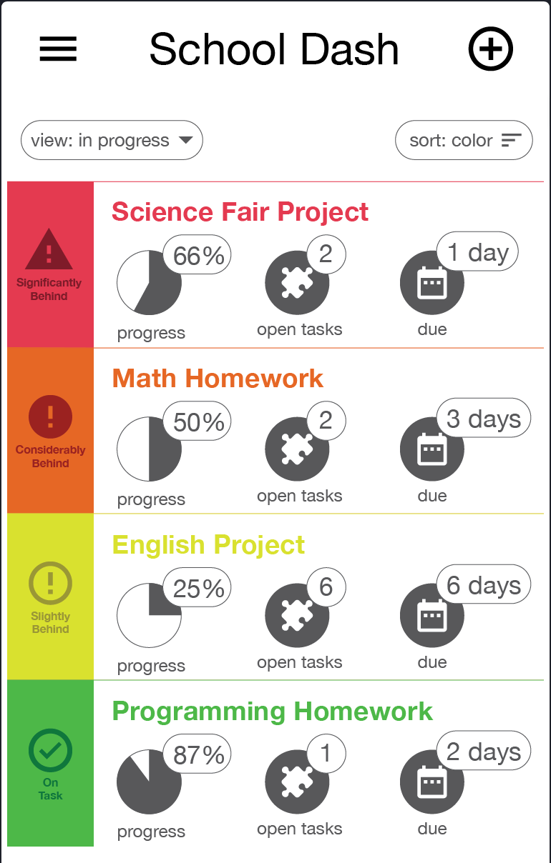
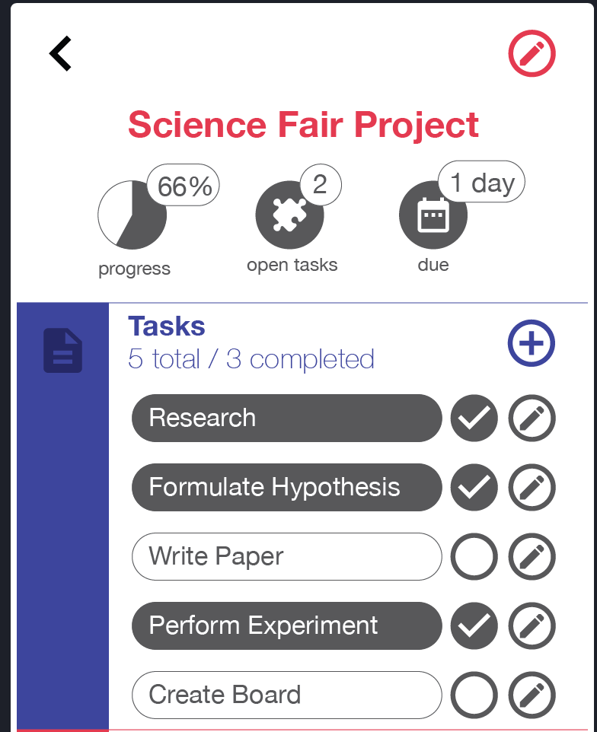
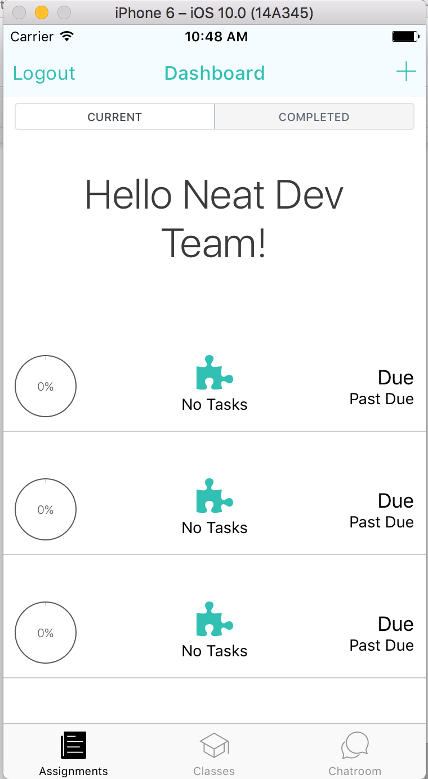
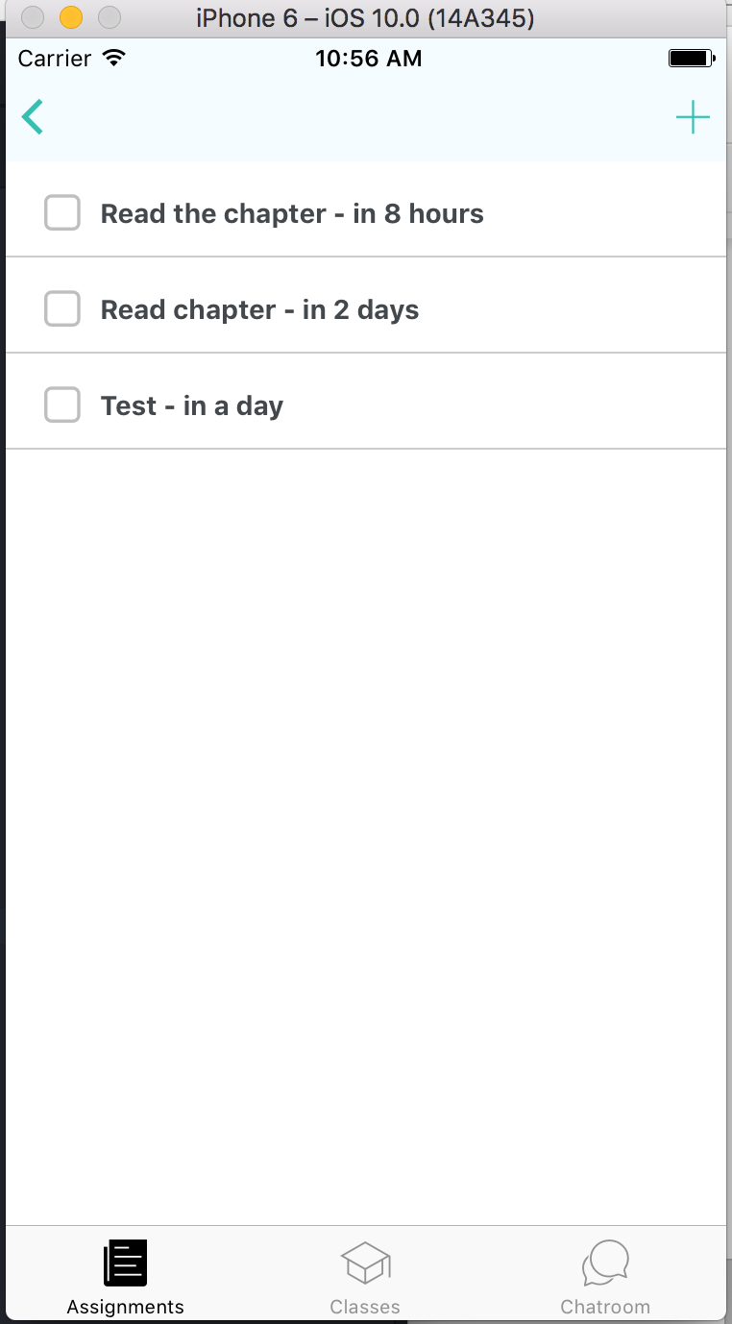
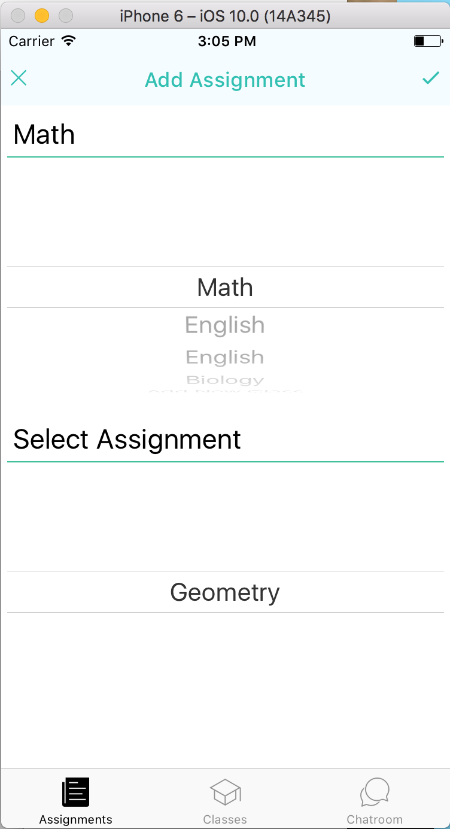
School of Computing & Information Sciences
Senior Project, 2016, Fall
NEAT 1.0
NEAT
Student: Giselle Pacheco, Florida International University
Mentor: Mohsen Taheri, Florida International University
Vlad Lalovic, Florida International University
Ranjeet Deshmukh, Neat Company
Instructor: Masoud Sadjadi, Florida International University
Problem
Current System
Requirements
A majority of students procrastinate on homework due to not knowing how or where to start. When assignments feel like they are impossible to complete students will usually hold of on starting them. More importantly students do not have a way of proactively planning how to complete their assignments.
Our current system allows students to create their own classes, assignments, and tasks. The system also allows students to join assignments, this functionality is for the case in which a teachers are creating the assignment
Solution
Object Design
Most of my contribution was on the front end. On the Front end I created functionality for adding tasks and assignments. I also implemented the ability to join assignments. As a team we created a dashboard that is appealing and easy to navigate.
The Neat app breaks down assignments into manageable tasks. The difference between the Neat app and other task management apps is that Neat prioritizes assignments based on which assignment needs attention first despite what the due date is.
Implementations
System Design
Back-End Server Code
A client server model was used for the system.
The database is accessed by the backend.
The front-end renders the data supplied by the backend and user input
Hybrid Front-End
Repository
Screenshots
Operating System
Verification
Test Case 1 (Sunny Day)
Purpose
Ensure user can add assignment
Precondition
User is logged in
User has added a class
User is part of a school
Input
Class is selected
Assignment Name
Due date of the assignment
Expected Result
User can see an added assignment on the dashboard
Actual Result
Added assignment on the dashboard
Test Case 2 (Rainy Day)
Purpose
Ensure that if a user does not select an assignment, assignment is not added
Precondition
User is logged in
User is part of a school
Input
User selected a Neat class
Expected Result
No change in view
Actual Result
No change in view
Summary
Task management app for tracking progress based on due dates
Users have the ability to add task
Users have the ability to join or make their own assignments
DASHBOARD
TASKLIST
JOIN ASSIGNMENT
Acknowledgement
The material presented in this poster is based on the work of Pierre Jimenez, Justin Lopez, Nelson Cruz, Fernando Campo, and Gabriel Fernandez.
I am thankful to the help that I received from my fellow developers and the start-up team at large.

