Slide 1









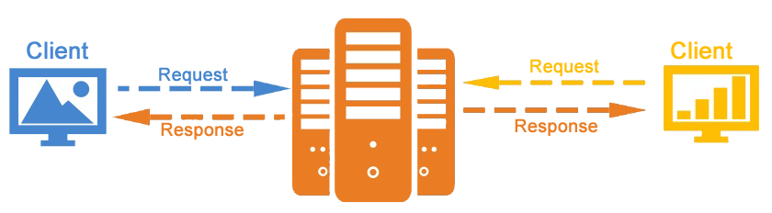
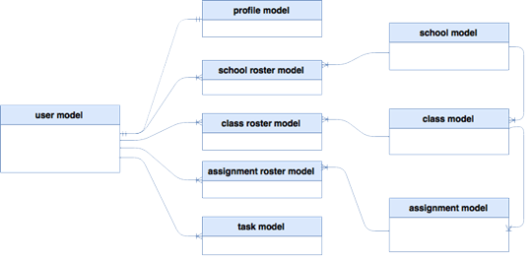
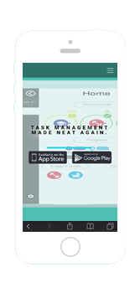
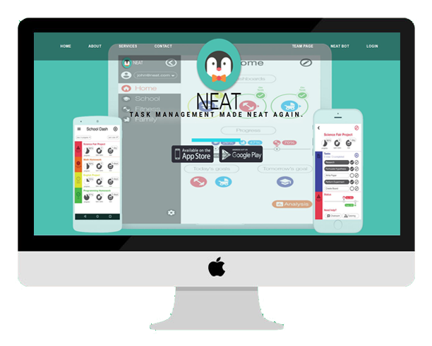
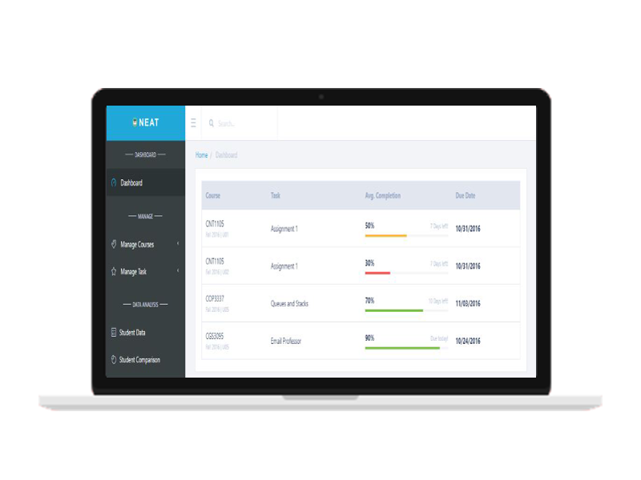
School of Computing & Information Sciences
Senior Project, 2016, Fall
NEAT 1.0
Student: Justin Lopez, Florida International University
Mentors: Mohsen Taheri, Vladan Lalovic, Ranjeet Deshmukh
Instructor: Masoud Sadjadi, Florida International University
PROBLEM
CURRENT SYSTEM
REQUIREMENTS
With many smart phone users turning to task managing apps to log their productivity, Neat Study provides time based plans of completion and allows users to see how much needs to be done, per day, in order to accomplish their goal or assignment.
Neat Study also needed a website which allows users to be informed of Neat Study, any future updates, news and location of download.
Problems Solved:
Full construction of website.
Well Constructed user experience.
Begin implementation of Teacher Dash, allowing Teachers to view courses created.
Status:
Running live @ neatstudy.com
My Core Contributions:
Currently Neat Study is in an operable state, all functional requirements are working and meet the expectations of the product owner. Its Core Features are:
Well designed theme and navigation bar.
View Services Provided.
Outbound Links to the Google Play and Apple Store for download.
Provide Functionality to App:
Allow students to join a University.
Create, Update and View Classes, Assignments, and Task.
Join pre-made classes.
Provide Functionality to Website:
Application download via Google Play or Apple Store.
View product information & services provided.
View Team page along with filters.
Provide Neat Study Contact information with Email Form.
Beautiful Modern Frontend Design.
SYSTEM DESIGN
OBJECT DESIGN
IMPLEMENTATION
App Frontend:
Web Frontend:
Backend:
Database:
Operating System:
The system is based on a client server model. The client makes a request to the server and the backend accesses the database, while the front-end displays the data and takes user input.
VERIFICATION
SCREENSHOTS
SUMMARY
Test Case 1 (Sunny Day)
Purpose
Ensure that emails are sending to the correct email addresses, with the correct subject and body text.
Precondition
The user is on the Contact Section and Neatstudy is running. The user has filled out all of the forms on the messaging page.
Input
The User fills in the user name, receiver addresses, message subject, and message body for the message that is to be sent. Then user presses the “Send Message” button.
Expected Result
The message should be sent to
neatstudy@outlook.com with the correct subject
and message body text.
Actual Result
The message was sent to neatstudy@outlook.com
with the correct information. PASS
Test Case 2 (Rainy Day)
Purpose
Ensure that emails are not being sent with
erroneous receiver addresses/subjects/body text
from the form.
Precondition
The User is on the Contact Section.
Input
User has not filled out a receiver email address, a
subject, a message body, or all 3. Then user
presses the “Send Message” button.
Expected Result
The email will not be sent due to a lack of the required parameters for message.
Actual Result
Server replied asking for necessary information to send email. PASS
Neat Study puts a new spin on Task Management, allowing you to complete task while staying on track in the long term. Neat give the user the flexibility to break down assignments and Collect performance in electronic portfolio to find the most efficient way to study based on your data.
Mobile Friendly
Neatstudy.com
Neat Teacher Dash
ACKNOWLEDGEMENT
The material presented in this poster is based upon the work supported by Justin Lopez. I am thankful to the help that I received from my group members: Giselle Pacheco, Gabriel Fernandez, Pachev Joseph, Nelson Cruz, Fernando Campo and Pierre Jimenez, as well as the support received from Mohsen Taheri, Vladan Lalovic and Ranjeet Deshmukh.
Notes:
1

