Slide 1

<Next Generation Networking for Virtual Reality and Game Player Collaborative and Multiplayer>
Team Members: <Bradley Marzouka, Gabriel Taveras> Product Owner: Dr. Francisco Ortega
Instructor: Masoud Sadjadi School of Computing and Information Sciences Florida International University
Future Work
<Spring 2017>
Notes:
7 seconds.( I will select 2 best slides (i will give them extra points and students will present for CIS committee)
Greet your audience, thank them for attending your presentation, introduce yourself, introduce your project, introduce your team members, and quickly indicate what each of you did in a high-level manner, and put more emphasis on your part/contribution.

Slide 2
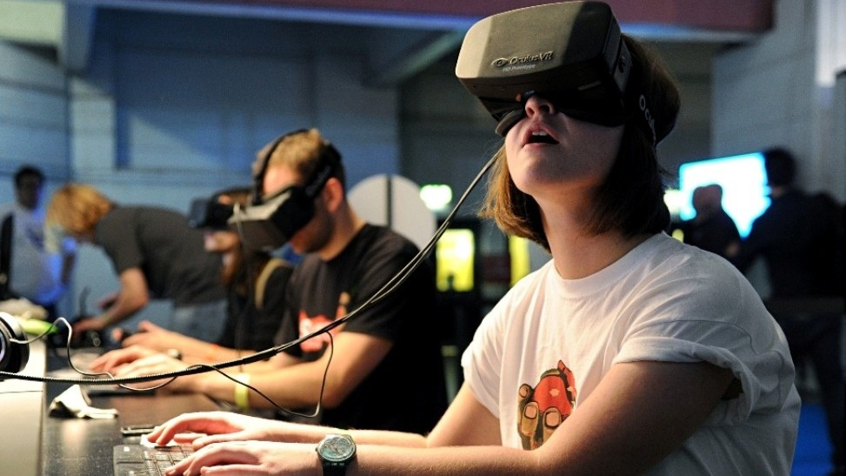
Notes:
10 seconds.
Introduce the problem that the whole project (in all versions) tackles with GIF or screenshot.

Slide 3
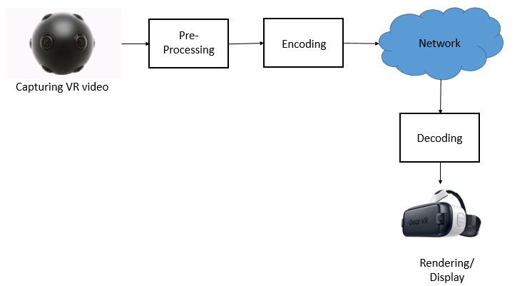
Notes:
20 seconds.
Introduce the problem that the your project (in new version) tackles with GIF or screenshot.

Slide 4
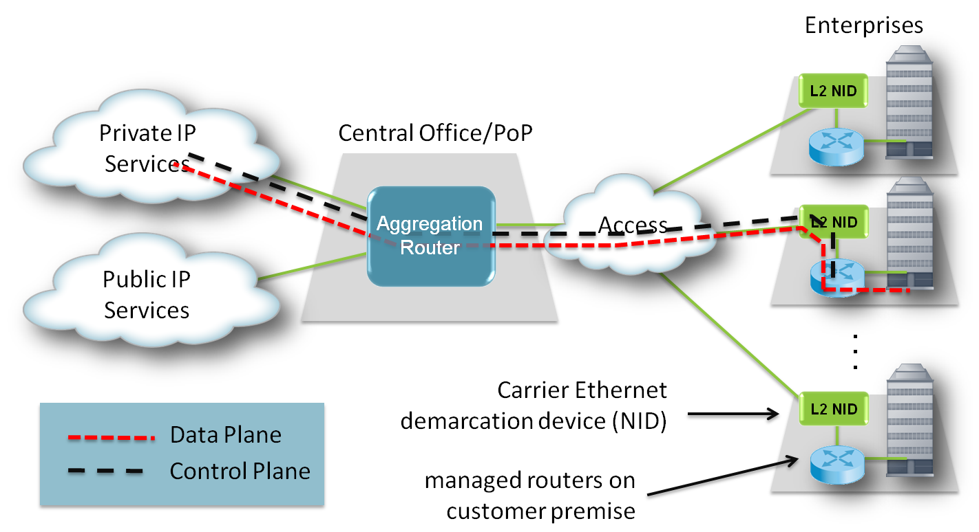
Notes:
20 seconds
System design: Highlight the parts that you contributed to them.
1. System decomposition; identify the architecture patterns used
2. System deployment – h/w and s/w requirements

Slide 5
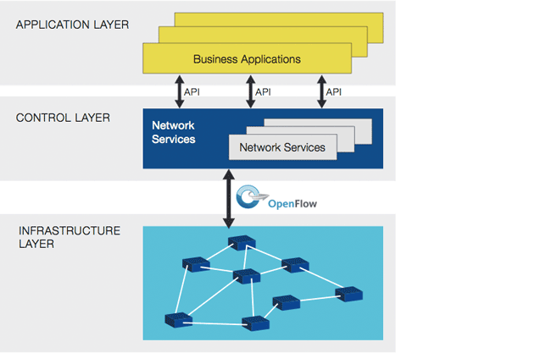

Slide 6
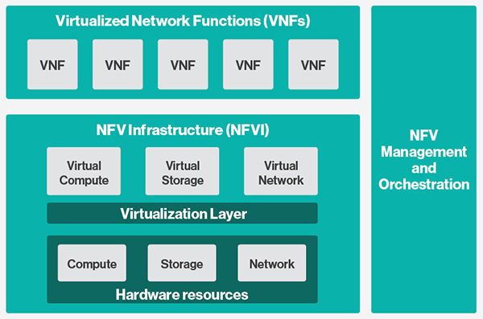

Slide 7
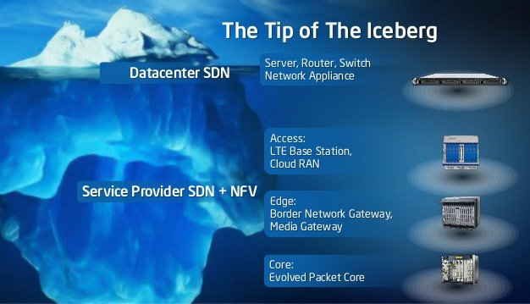
Notes:
5 seconds
Show the Use Case Diagram for the whole project. Highlight your use cases.

