Slide 1





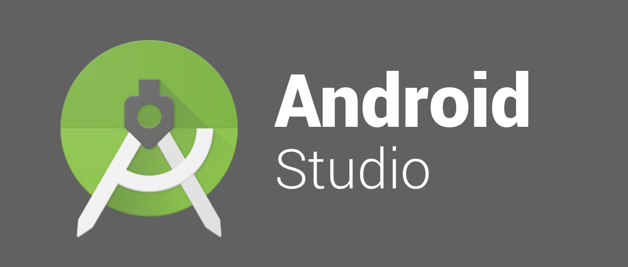
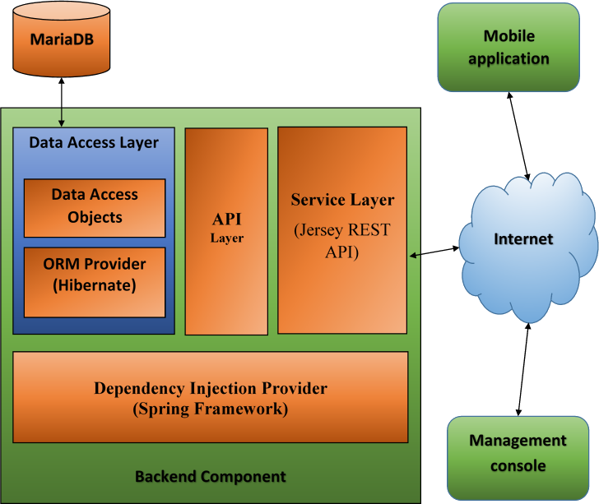
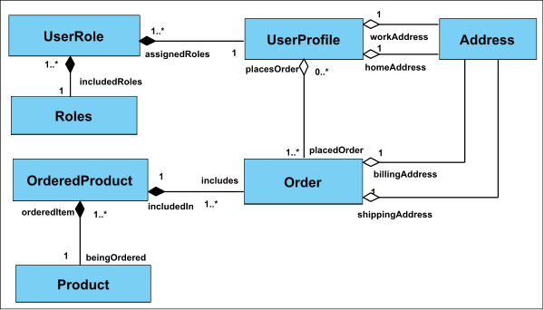
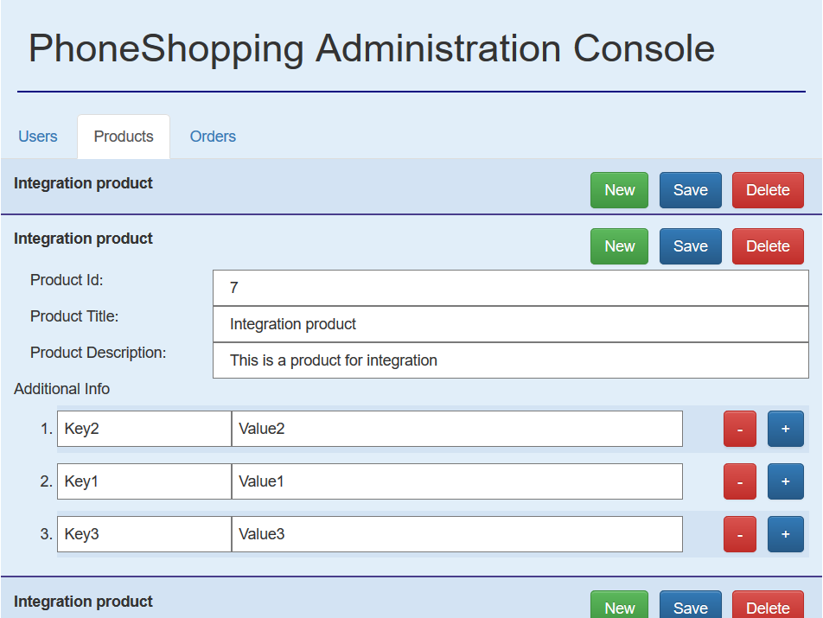




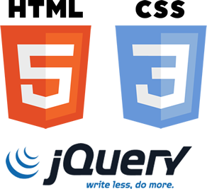




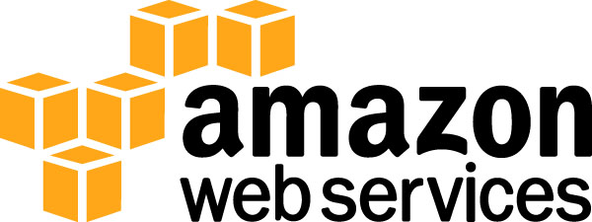


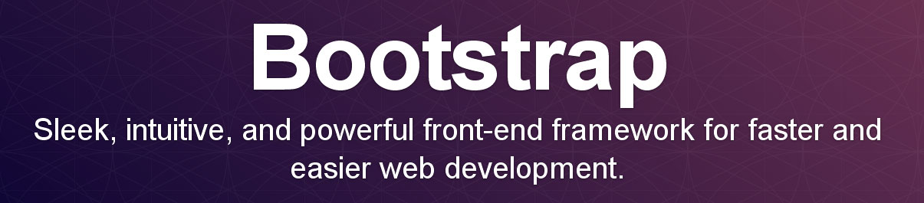
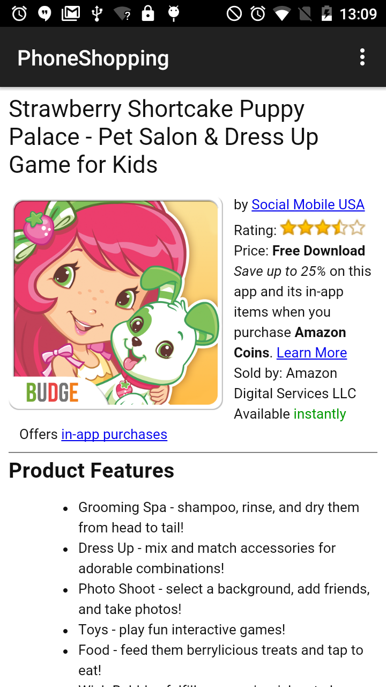
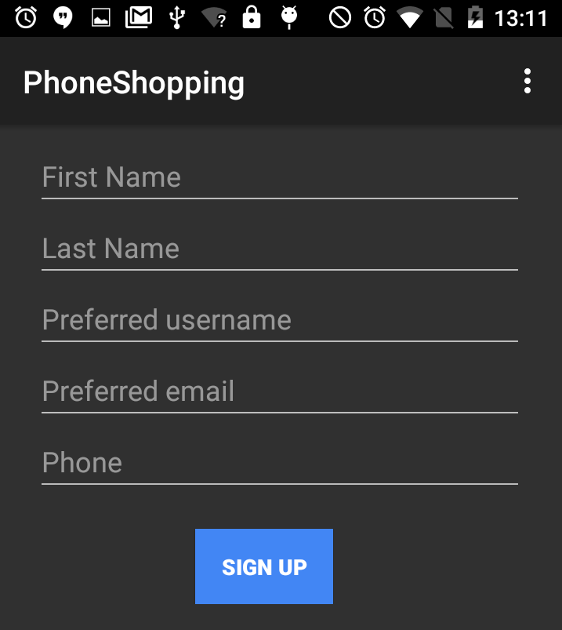
Advanced Software Engineering – Fall 2016
Phone Shopping Network 1.0
Student: Dewan Moksedul Alam, Florida International University
Mentor: Charles L. Green, Social Mobile USA
Mentor: Mohsen Taheri, Florida International University
Instructor: Masoud Sadjadi, Florida International University
Problem
Solution
The Ads of products will be pushed to the phones using another service named “Adups”. Then the application in scope will do the following
Provide a way to interact with the Ads
Show the terms and conditions of using the app to the first time users that they must conform
Provide a way to register if the user is not registered
Show the detailed information about the advertised product
Provide a way to proceed to purchase
Provide a notification about the payment options
As part of the “Lifeline Obama Phone” program more than 3 million smart phones are distributed to low income families. These phones can be a powerful media to reach the end users to
Offer them great deals on necessities
Provide flexible purchasing model that they could not get otherwise
Help in establishing credit
This also could be a powerful tool for the distributor to generate revenue by
Advertising products
Selling products
Commission from sells from phone
To combine these two ideas to establish a successful business model a software system is required.
Owner’s point of view
We need an application for mobile phones capable of presenting Ads to the users
That should guide the users towards successful purchase of the product
That should manage a profile for more suitable offers
Solution provider’s point of view
An android application to facilitate the interaction between the end user and the business model
A management console for the service provider
A back end application that serves as the engine to the model.
Requirements
Relationships among the major conceptual objects of the system
System Design
Object Design
Primary architecture is Server-Client
Internal components mostly follow MVC
Client side – MVC and MVVM
Android mobile application
Web-based management console
Server side - Layered
REST Web-service endpoints
API layer
Business logic layer realizing the API
Data Access Layer (JPA and Hibernate)
Dependency Injection to connect layers
MariaDB database
Test case 1 (Sunny day)
Purpose: To ensure that the user must conform the terms and conditions
Precondition: The mobile app is launched for the first time
Expected Result: The terms and conditions page is shown and the user must accept.
Actual Result: The terms and conditions page is shown. The user must accept to proceed. If does not accept, the terms and conditions screen will be continued to be shown
Test case 2 (Rainy Day)
Purpose: To test if the user provides a unique “username” during registration.
Precondition: The tester provides already existing username during registration and provides valid information to all other required fields
Expected Result: The system fails to create a user for the provided username
Actual result: The server application fails by raising an exception mentioning that a user is already present with the provided username.
Verification
Screenshots
Tools, technologies and frameworks used in the implementation
Implementation
The phone shopping network will enable a new horizon of opportunities for both the end users and the service providers. The end users i.e. the low income families can be able to get great offers of savings. At the same time the service providers of the life line program can be able to generate revenue from the phones that remains under utilized other wise.
Summary
Acknowledgement
The material presented in this poster is based upon the work supported by Dewan Moksedul Alam and Khaja Mohammed. I am thankful to the help that I received from my group members and mentors.
Notes:
1

