Slide 1









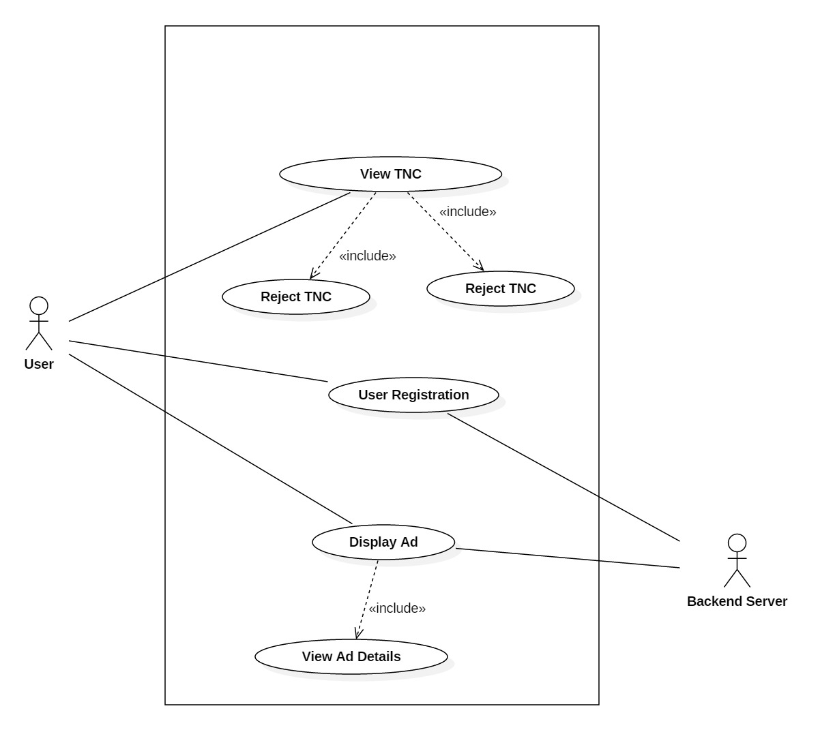
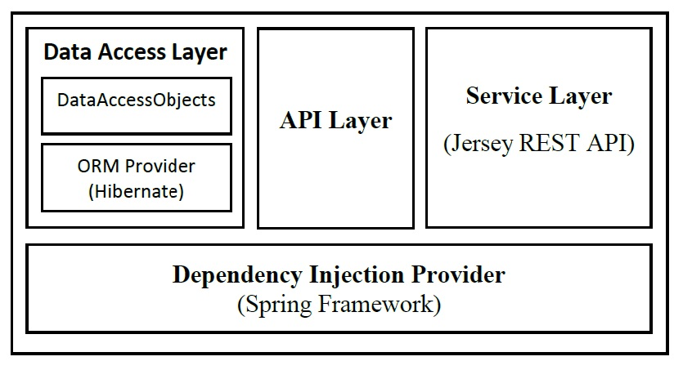
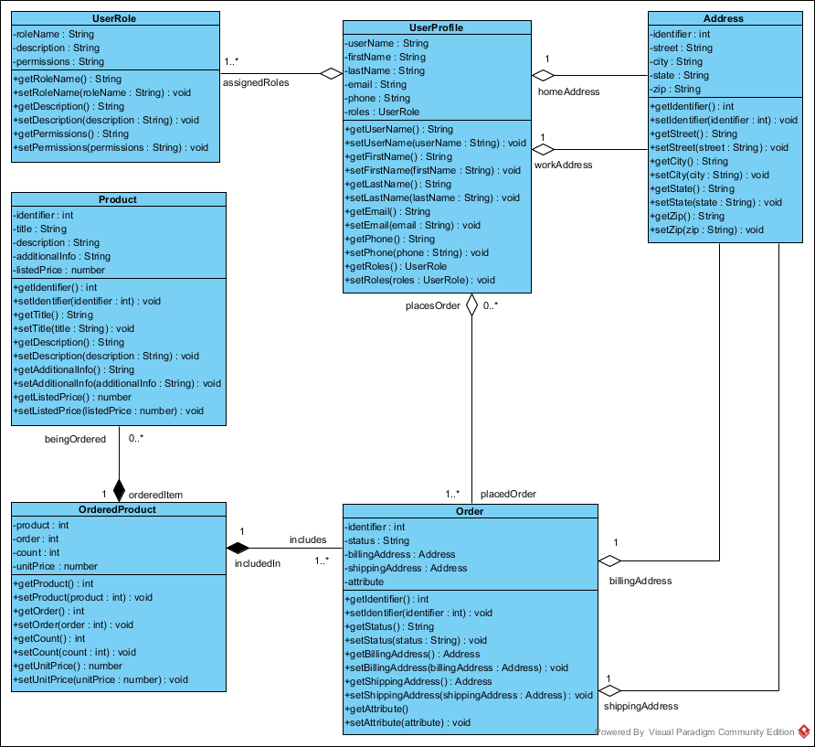
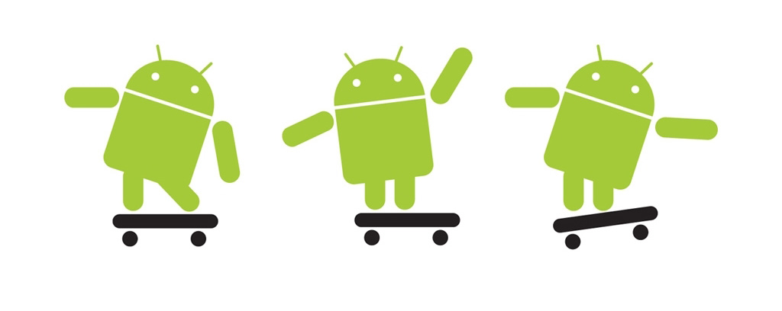





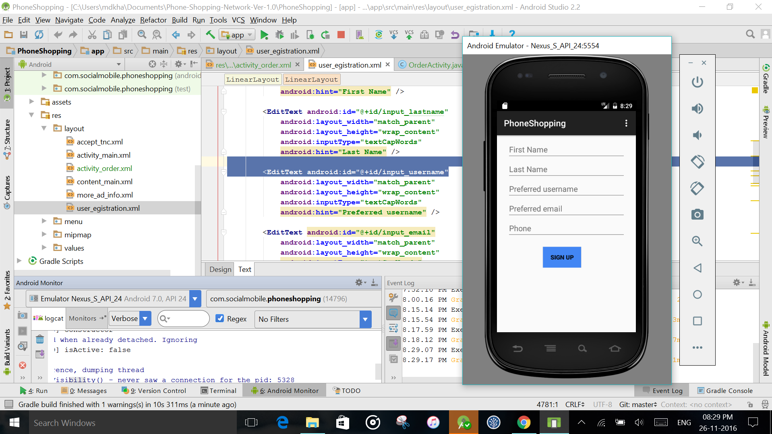
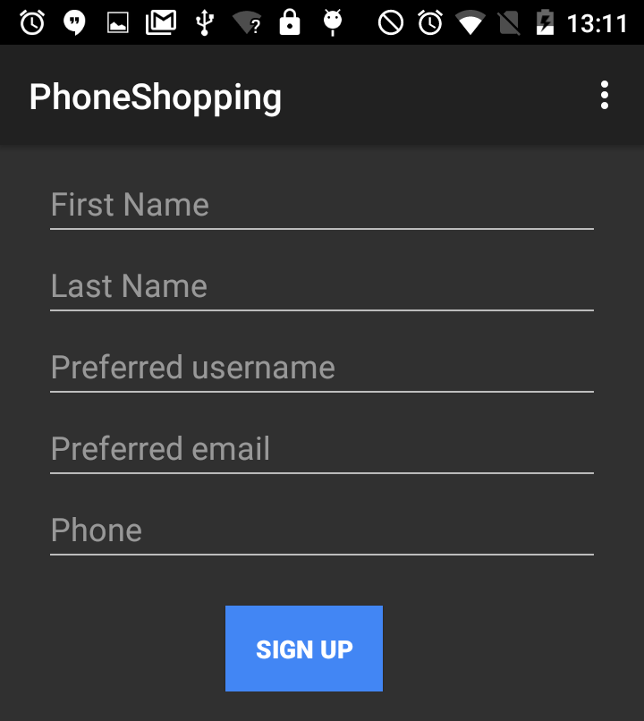
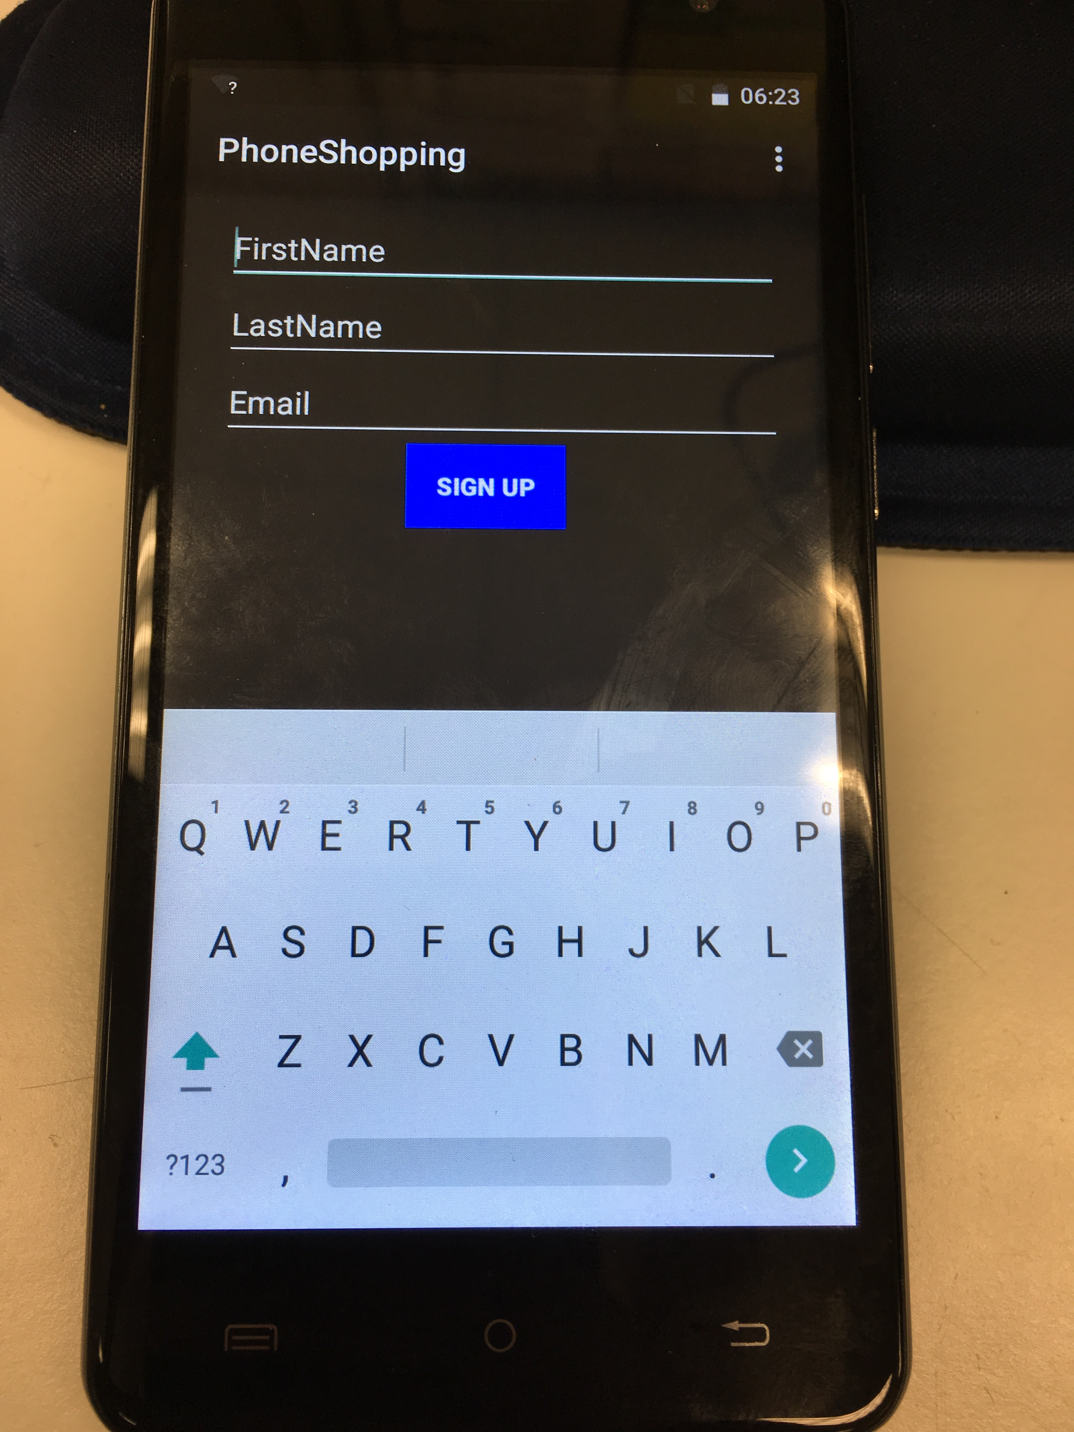
School of Computing & Information Sciences
Advanced Software Engineering- Fall 2016
Phone Shopping Network Ver 1.0
Student: Khaja Mohammed, Florida International University
Mentor: Mohsen Taheri, Florida International University
Charles L. Green, Social Mobile , USA
Instructor: Masoud Sadjadi, Florida International University
Problem
We are looking to do a test trial of 500 to 1000 phones that are part of the Lifeline "Obamaphone" program and hopefully expand from there. These phones are all in the hands of low income families that could benefit from great deals on necessities as well as help in establishing credit.
Solution
Developed mobile application that can be pushed on to the phones.
ADUPS FOTA technology is used to push the ads.
This Application shows user ads.
User can purchase a product.
Application collects user data
Current Status
Phone Shopping Network Ver 1.0
As this is the first version of it, it is not completely developed
My Core Contribution
Registration module
Registration UI Design
Front-end development of Registration and Product page of the application
Product page UI design
Pair programming other modules
Requirements
Registration module allows user to register
The User information is sent to the server
The backend application is used to view & Use the information
Registration page UI gives great look to the application
Order Product activity gives user view product
Order activity page UI gives great look to the application
System Design
Object Design
Implementation
This application is developed using android technology, Java & XML used at client side application, Java Spring framework, Hibernate, and JSON at server side, MariaDB as a database.
Architecture is Client-Server
Client side – MVC
Server Side- Layered
Verification
Screenshots
Summary
Test case 1 (Sunny day)
Purpose: To ensure that the user must register
Precondition: The user is not registered before
Expected Result: The user registration page sends data to the server.
Actual Result: The User registration page accepts data and send to the server.
Test case 2 (Rainy Day)
Purpose: To test if the user registration page provide unique username.
Precondition: Provided already existing username during registration
Expected Result: The system fails to create a user for the provided username
Actual result: The server application fails to accept the information by raising an exception mentioning that a user is already present with the provided username.
The phone shopping network will provide new opportunities for both the end users and the service providers. The end users i.e. the low income families can be able to get great offers of savings. At the same time the service providers of the life line program can be able to generate revenue from the phones that remain not useful. It also helps build credit of the user.
Acknowledgement
The material presented in this poster is based upon the work supported by ADUPS, Social Mobile & Florida International University. I am thankful to the help that I received from my group member, Dewan Moksedul Alam.
Notes:
1

