Slide 1







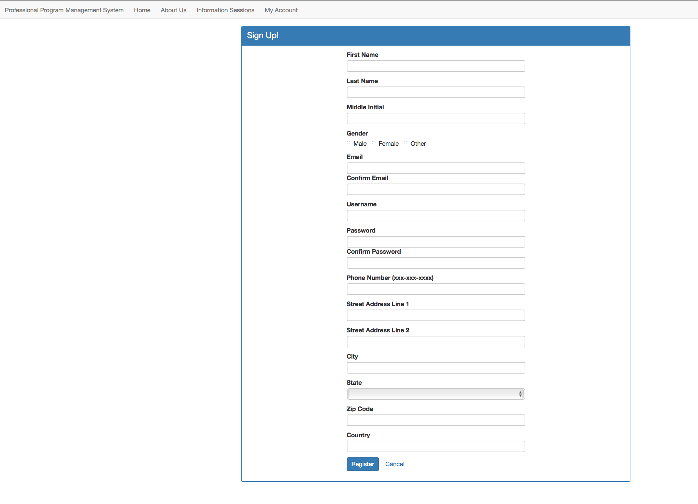
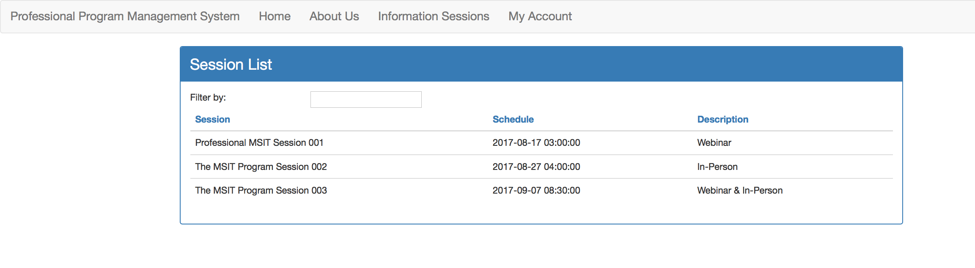
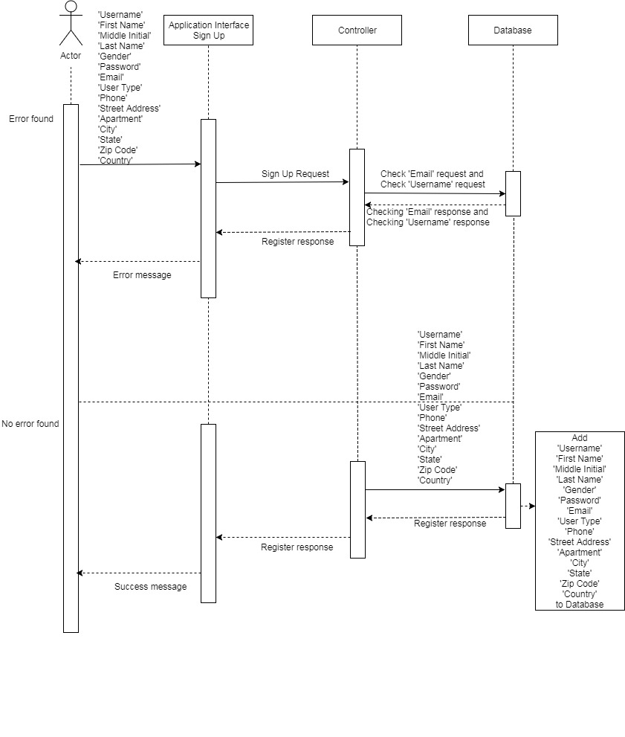
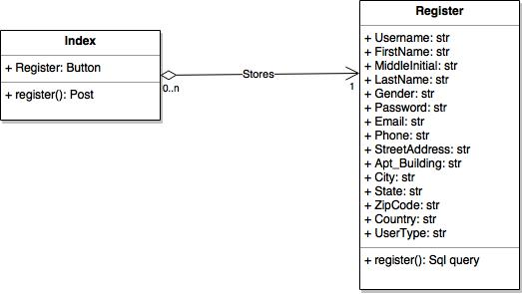
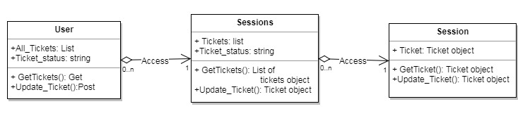
School of Computing & Information Sciences
Senior Project , 2017, Summer
Professional Program Management System
Student: Joana Fraga, Florida International University
Mentor: Nagarajan Prabakar, Florida International University
Instructor: Masoud Sadjadi, Florida International University
Problem
The Professional Master of Science in Information Technology website does not have a method for:
Reporting issues
Communicating with administrators
Tracking currently enrolled students
View and edit schedules for available courses.
Solution
The product-owner envisioned a centralized a web application that provides a ticketing system.
Our team’s approach was to:
Create a web portal to keep track of currently enrolled students
Provide users availability to safely change credentials
Develop a ticketing system to establish communication with support staff
Current System
Currently, the only means to notify administrators are via e-mail or calls to technical support resulting in increased wait times and decreased user satisfaction.
There is no managed solution to maintain student enrollment records.
Screenshots
Figure2: Information Sessions List
Figure1: Registration Form Template
Requirements
Allow users to create accounts using unique username and personal information.
Allow users to change credentials safely.
Allow users to access account and manage their own ticketing requests.
Allow system to grant access depending on user role.
Allow administrator to view all available tickets and respond.
System Design
Implementation framework for user interface:
Angular 2
NodeJs
HTML5
Implementation framework for back-end:
PHP
MySQL
Implementation
Sample implementation for user registration.
Verification
The system verifies credentials for usernames.
Username registration forms validate user input data and uniqueness of usernames.
Object Design
Registration
Information sessions
Summary
Users are able to register to the website using personal information and generate credentials.
Users are able to see all available information sessions.
Acknowledgement
The material presented in this poster is based upon the work supported by Joana Fraga. I am thankful to the help that I received from my group member, Jose Casanova, and to the product owner, Nagarajan Prabakar.
Notes:
1

