Slide 1





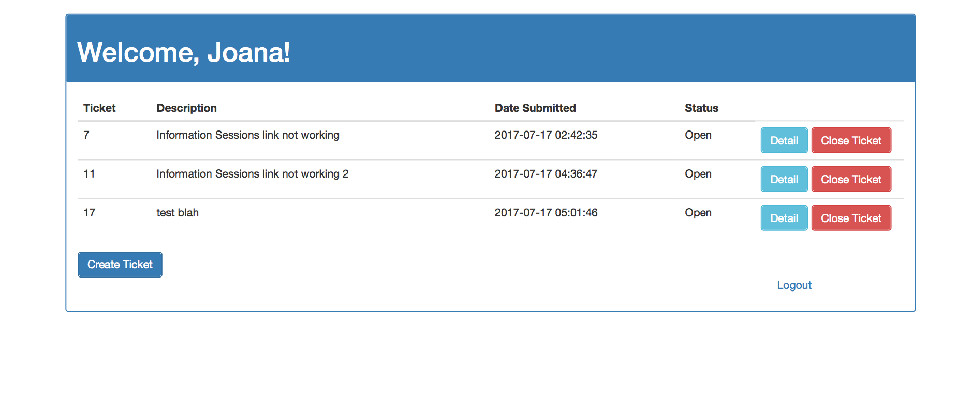
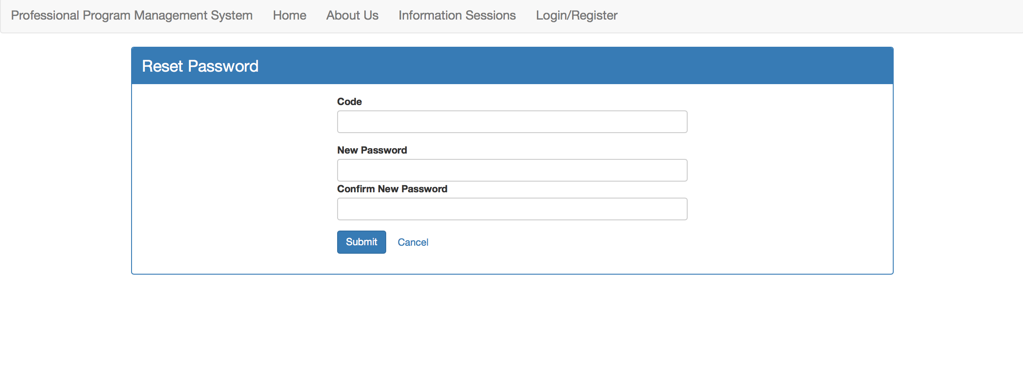
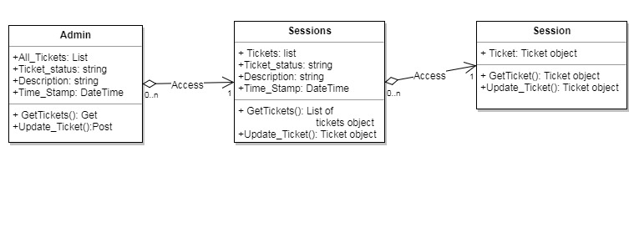
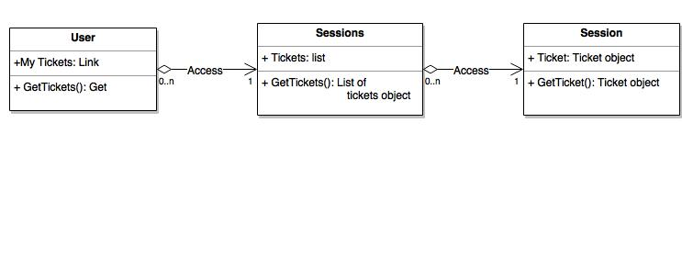
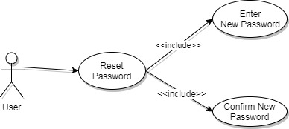
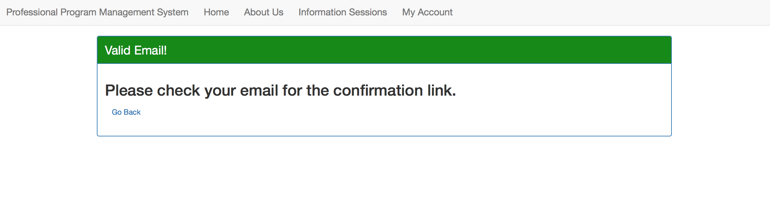

School of Computing & Information Sciences
Senior Project, 2017, Summer
<Professional Program Management System>
Student: Jose Casanova, Florida International University
Mentor: Nagarajan Prabakar, School of Information and Computing Sciences
Instructor: Masoud Sadjadi, Florida International University
Problem
Provide secure central system for professional FIU students taking courses.
Have ways for users to communicate with administrators.
Solution
Maintain a web portal usable by all students of program.
Provide users ability to change credentials safely.
Have a ticketing system where students can express issues.
Current System
A general website exists, but has no management aspects to it.
User requests or concerns are sent through email.
Screenshots
Picture 1 – A code is sent along with an email, enforcing security when resetting a password.
Picture 2 – A student’s view of the ticketing system with referenced in the solution with the ability to create tickets.
Requirements
Users must already possess account with the system to use.
Users must be able to access email selected when registering.
Users must be students in order to create own tickets.
Users must have created tickets for administrators to change them.
System Design
Implementation
Resetting password feature uses email verification to function.
Code is sent to user email to be input to allow resetting.
Students can create tickets, administrators can edit them.
Email sent to student and administrators upon ticket changes.
Editing a Ticket
Creating a Ticket
Verification
Verification, both for resetting a password, and for creating or editing tickets, is done through email.
Object Design
Summary
Reset password feature allows for greater user security.
Ticketing system enables conversations between students and administrators.
Changing a Password
Viewing Tickets
Acknowledgement
The material presented in this poster is based upon the work supported by Jose Casanova. I am thankful to the help that I received from my group members, Joana Fraga, and to my Product Owner, Nagarajan Prabakar.
Notes:
1

