Slide 1



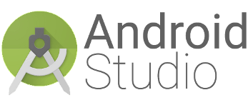
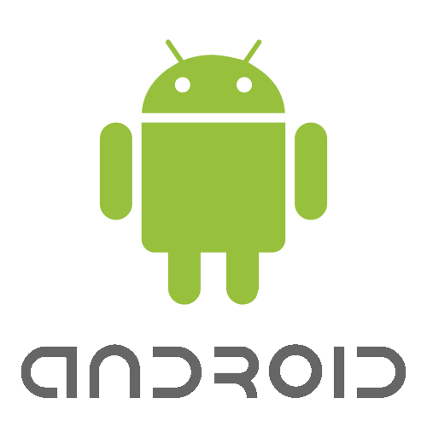


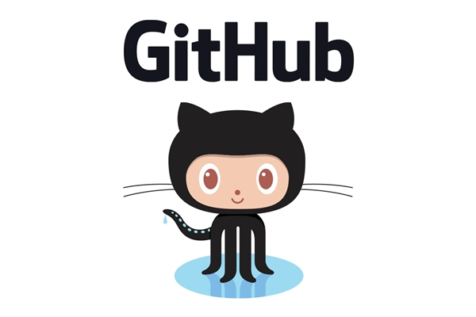

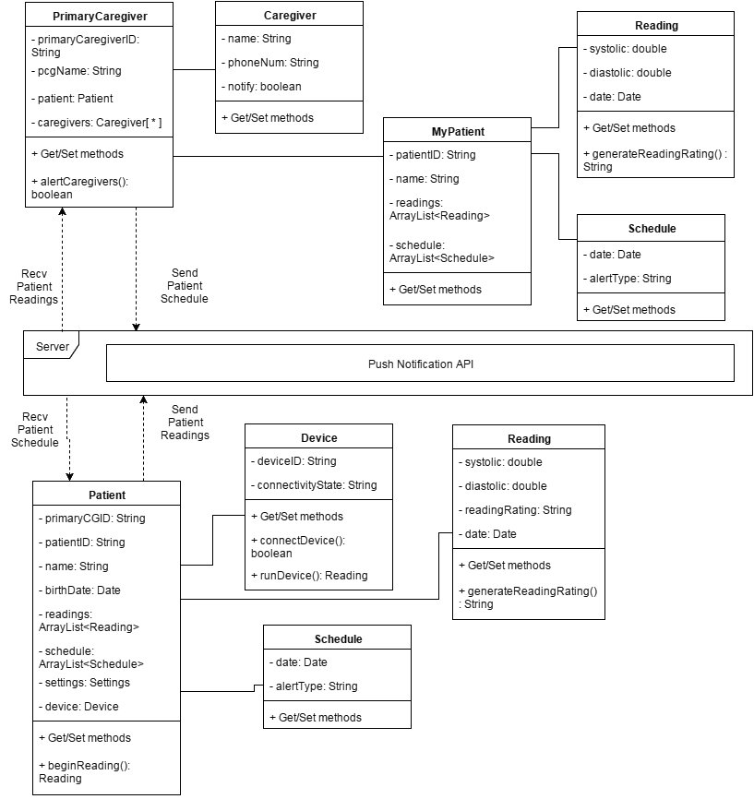


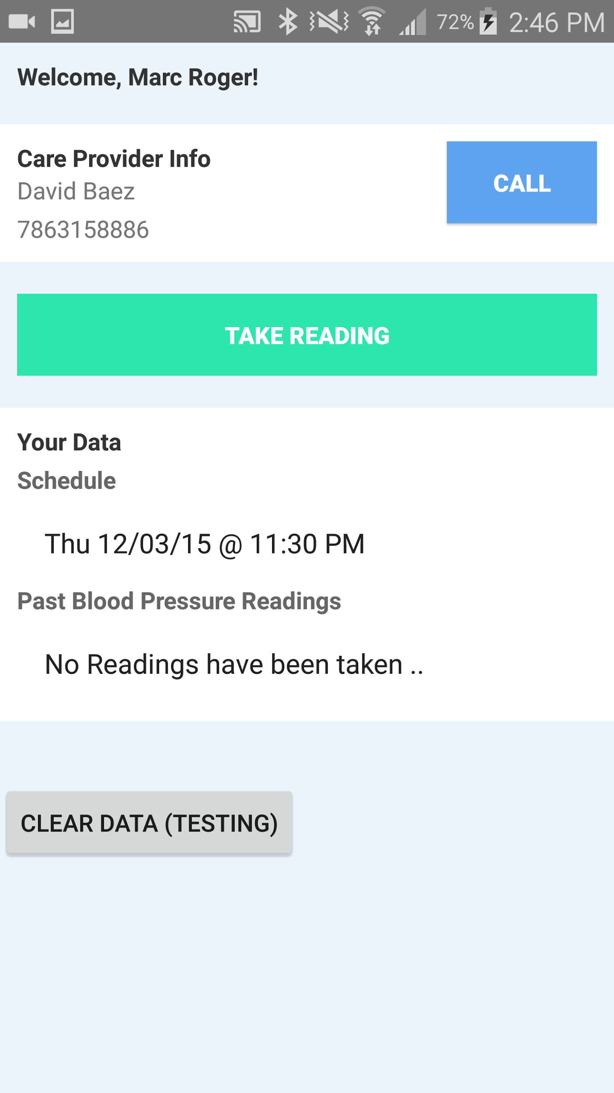
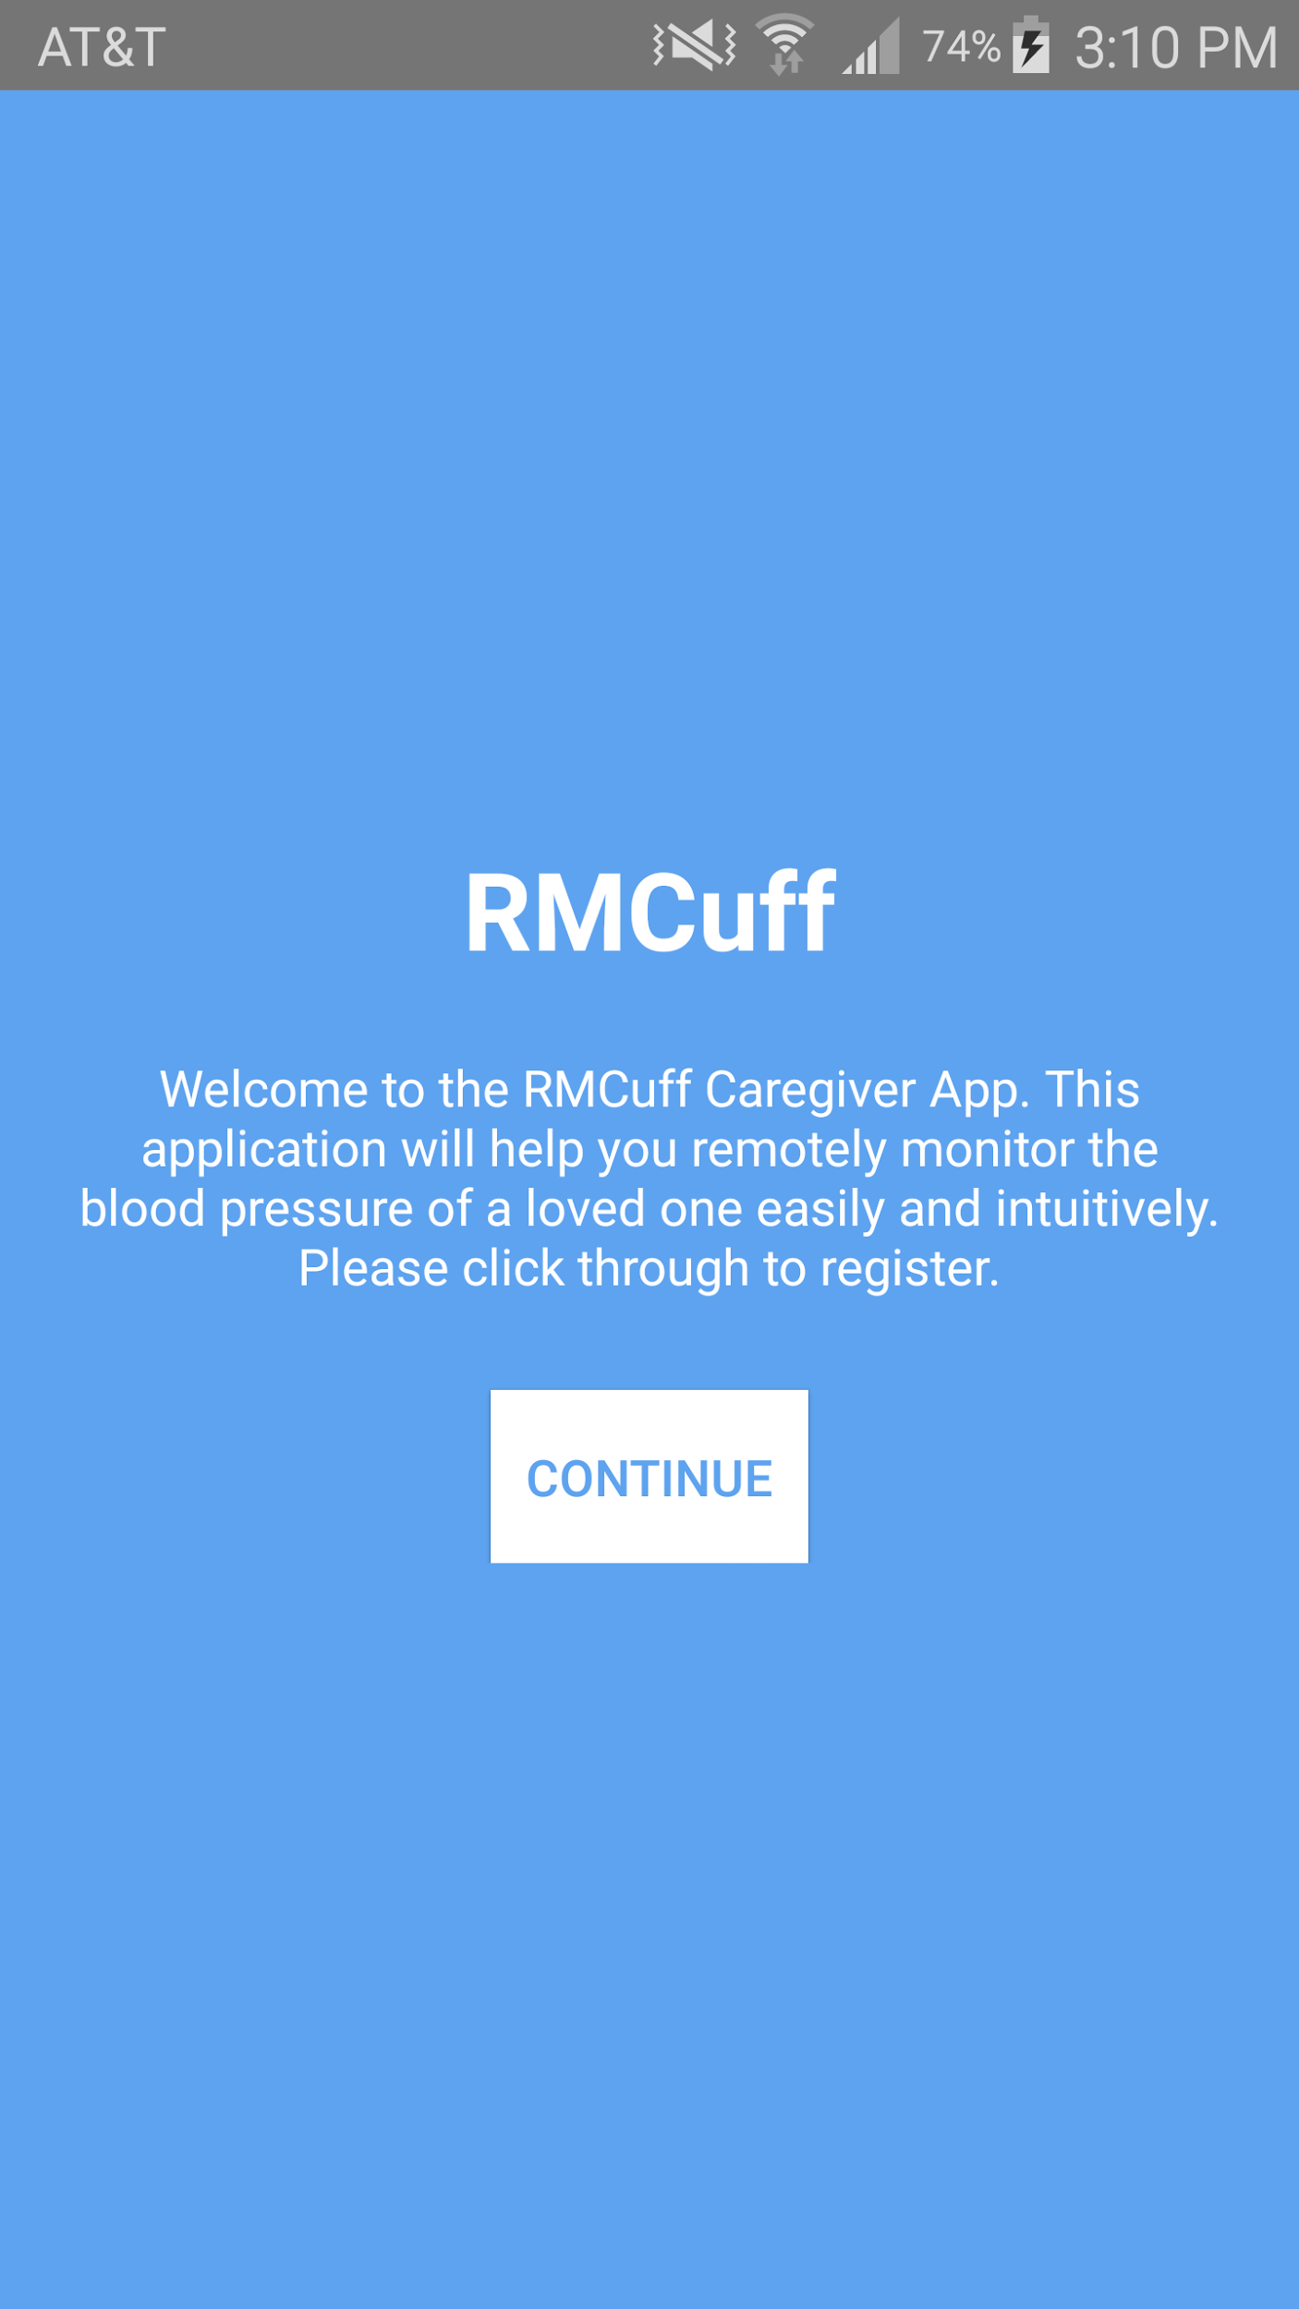
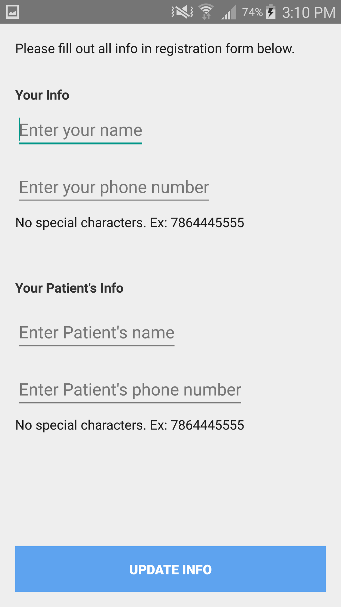
School of Computing & Information Sciences
Senior Project, 2015, Fall
RMCuff
Student: David Baez, Florida International University
Mentor: Peter Dickson, RMCuff
Instructor: Masoud Sadjadi, Florida International University
Problem
System Design
Since the advent of wearable technology, health applications have become extremely popular and have flooded mobile device application stores.
Most of these health applications are geared around tracking fitness statistics such as distance traveled and calories burned for young adults.
The feature complexity and user interfaces of many of these applications are geared towards a younger audience who grew up with and are savvy of, technology.
They are also meant for self tracking, which isn’t very ideal for elderly individuals who lack the technological skills and self motivation, and require the help of a related primary caregiver to stay on top of things.
Current System
Mobile Applications for tracking blood pressure in older adults such as iHealth exist, but they fail to remain minimal and simple enough for the elderly to use easily.
They lack functionality for the caregivers of a blood pressure patient to track results and set blood pressure schedules.
iHealth keeps track of blood pressure, weight, calories consumed and burned, sleep, and so on.
It provides diary and goal tracking features.
Excess of functionality leads to use complexity and user interface complexity.
In the current non-software system, a primary caregiver takes the responsibility of tracking the blood pressure of a patient, usually a loved one, over the phone with a few occasional personal visits.
Typically they would tell the patient to take their blood pressure at a certain time, and just have to take their word for it.
The patient and caregiver largely communicate over the phone, and a patient is able to lie about reading outcomes, to longer support negative habits.
It requires a lot of responsibility on the patient side and a lot of trust on the primary caregiver side.
Major Contributions
Screenshots
Server-side PHP Push Notification API
Local Push Notification sending, handling, and automated waking
Application User Interface
Text Notification reports for secondary caregivers
User registration
Caregiver Schedule setting functionality
Requirements
Implementation
The system will allow Patients to automatically send their Primary Caregiver blood pressure reading data, via push notification, once a reading is performed.
The system will allow the Primary Caregiver to send their Patient a scheduled reading time and date via push notification.
The system will allow Patients to be automatically notified, via push notification, when it is time for a scheduled reading.
The system will allow both the Patient and Primary Caregiver to track the Patient’s blood pressure readings and schedule.
The system will allow Primary Caregivers to send out patient blood pressure text reports to Secondary Caregivers, which may include other family members, physicians, etc.
The system follows a MVC primary architecture and Client/Server secondary architecture. The technologies used to implement the system are:
Android Framework: Used to implement the software solution in mobile application form. Making use of the Java programming language, XML, and Android SDK.
Pushbots and Google Cloud Messaging: Used to implement push notification sending/receiving and automatic device waking.
Server-side PHP API: Implements Pushbots API to create our own custom push notifications delivery system.
Verification
Automated system tests were conducted through an android emulator
These tests tested:
The registration of a caregiver and patient
The ability to schedule a reading
The push bot service for sending the information between apps
Text Reports for secondary caregivers
User Interface
Phone call shortcut functionality
Summary
Elderly blood pressure patients face a problem, they lack a way to effectively leverage technology and the help of loved ones (caregivers) to stay on top of their blood pressure monitoring and reporting.
The current system health tracking software solutions are very popular at the moment, but they are riddled with over-functionality and complicated user interfaces which are very difficult for the elderly to use. Elderly blood pressure patients require a minimal product that is intuitive, and helps them easily track their blood pressure.
The proposed solution, with the use of a custom push notification API, allows the Primary Caregiver and Patient to work in a collaborative manner to track, schedule, and report Patient blood pressure readings. It makes use of a minimal interface to make the process simpler for the elderly.
Acknowledgement
The material presented in this poster is based upon the domain knowledge and creative problem solution ideas supported by Peter Dickson. I am thankful to the help that I received from my group member, Marc Roger.
Notes:
1

