Slide 1




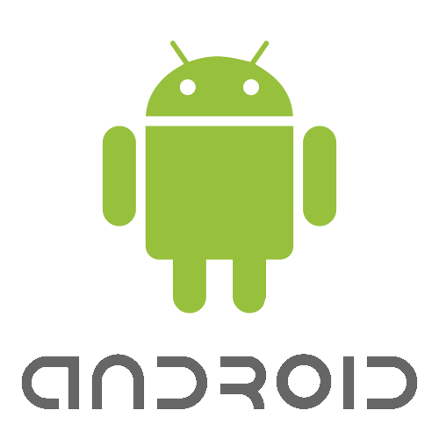




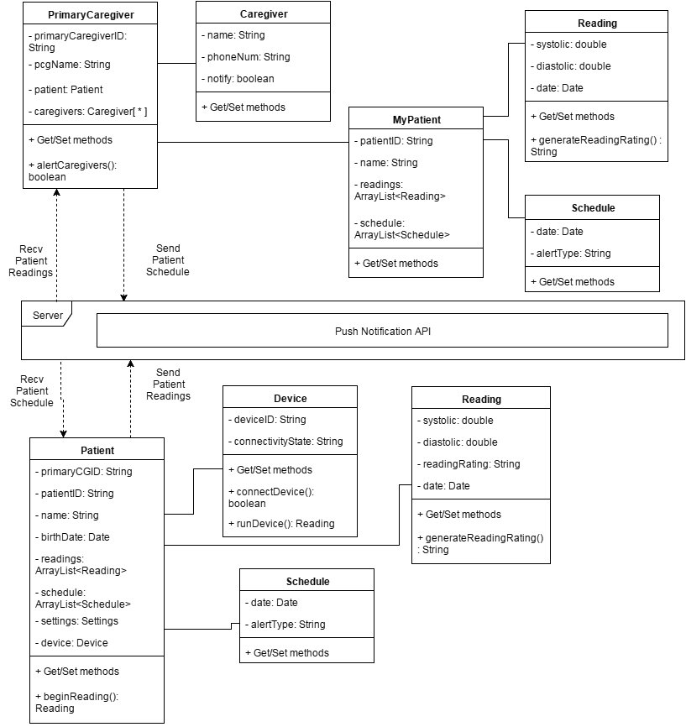
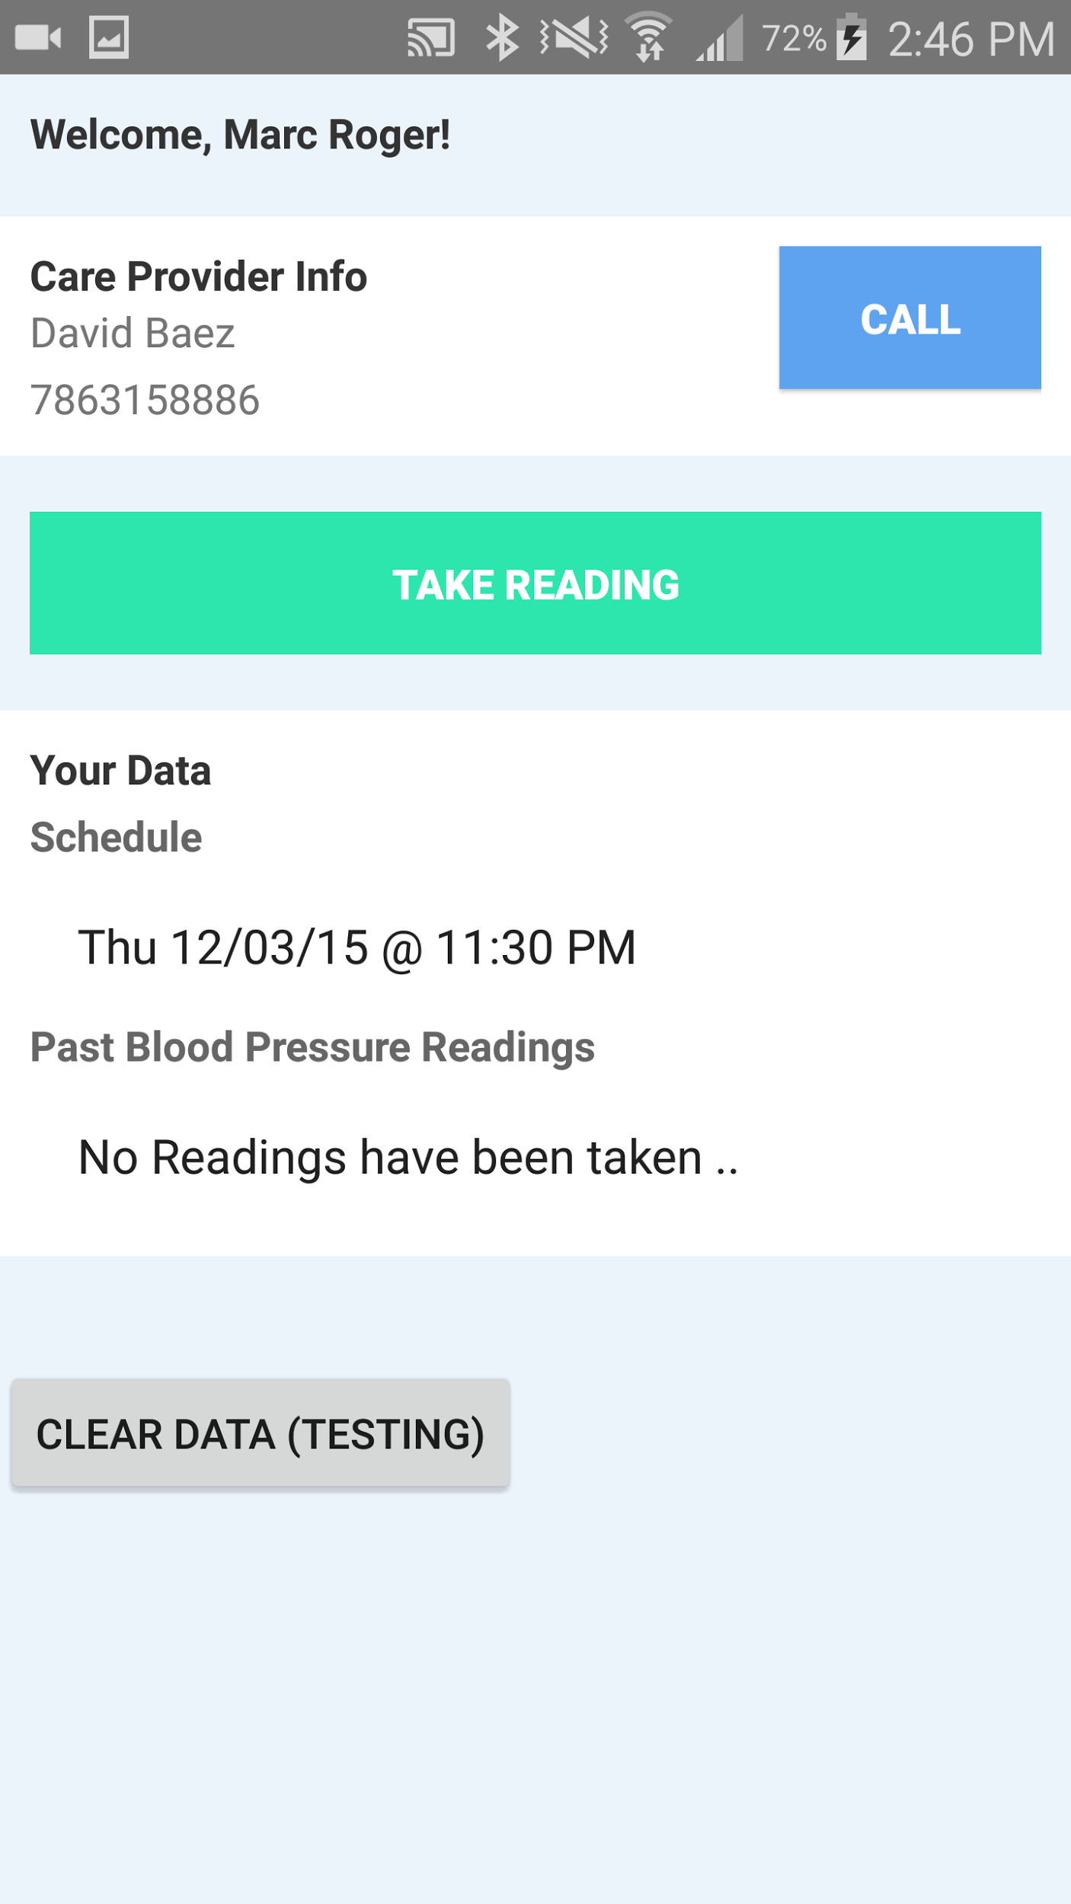
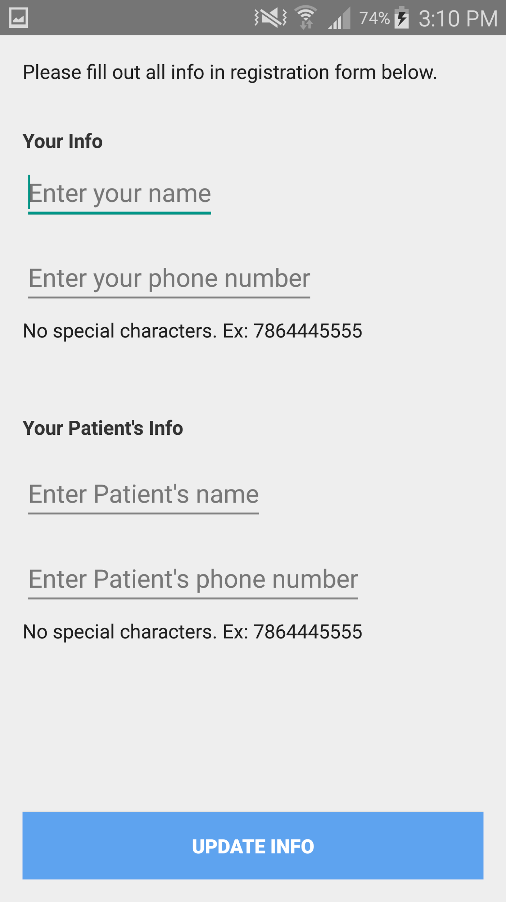


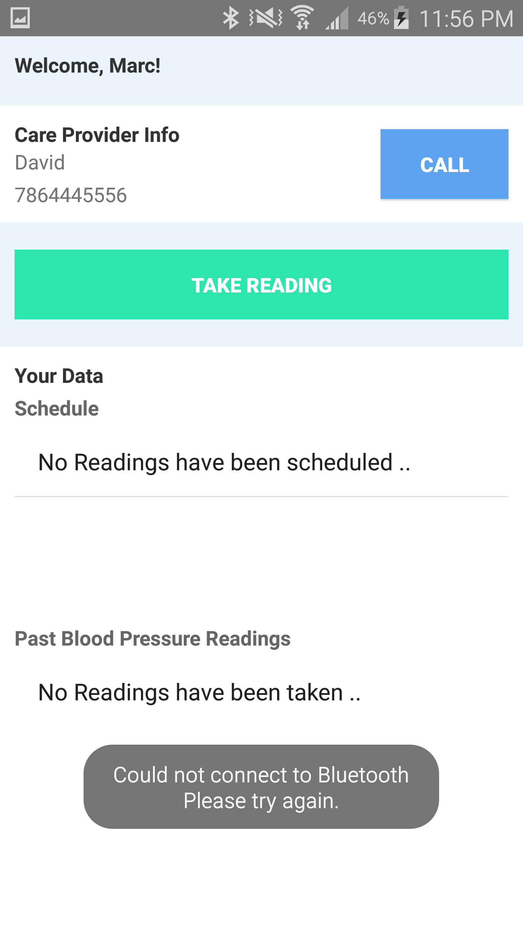
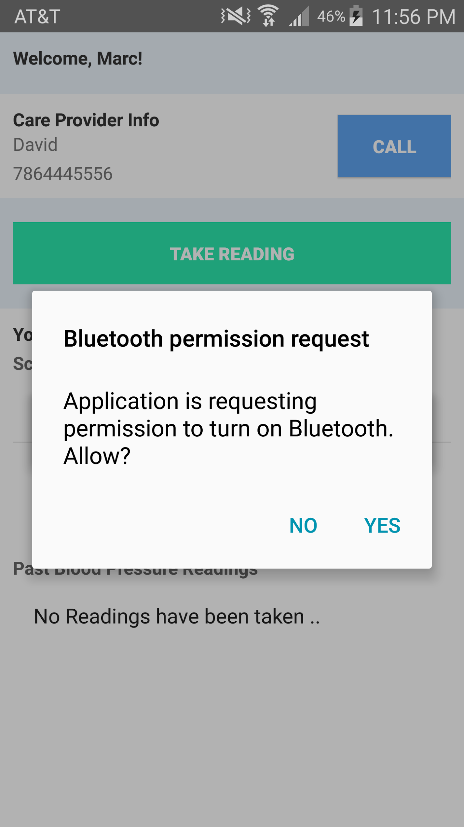
School of Computing & Information Sciences
Senior Project, 2015, Fall
RMCuff
Student: Marc-Antoine Roger, Florida International University
Mentor: Peter Dickson, RMCuff
Instructor: Masoud Sadjadi, Florida International University
Problem
System Design
Since the advent of wearable technology, health applications have become extremely popular and have flooded mobile device application stores
Most of these health applications are geared around tracking fitness statistics such as distance traveled and calories burned for young adults
The feature complexity and user interfaces of many of these applications are geared towards a younger audience who grew up with and are savvy of, technology
They are also meant for self tracking, which isn’t very ideal for elderly individuals who lack the technological skills and self motivation, and require the help of a related primary caregiver to stay on top of things
Current System
Mobile Applications for tracking blood pressure in older adults such as iHealth exist, but they fail to remain minimal and simple enough for the elderly to use easily
They lack functionality for the caregivers of a blood pressure patient to track results and set blood pressure schedules
iHealth keeps track of blood pressure, weight, calories consumed and burned, sleep, and so on
It provides diary and goal tracking features
Excess of functionality leads to use complexity and user interface complexity
In the current non-software system, a primary caregiver takes the responsibility of tracking the blood pressure of a patient, usually a loved one, over the phone with a few occasional personal visits
Typically they would tell the patient to take their blood pressure at a certain time, and just have to take their word for it
The patient and caregiver largely communicate over the phone, and a patient is able to lie about reading outcomes, to longer support negative habits
It requires a lot of responsibility on the patient side and a lot of trust on the primary caregiver side
Screenshots
Requirements
Implementation
Verification
The system will allow Patients to communicate with a custom blood pressure cuff via Bluetooth
The system will remember the bluetooth device to allow easier connections after first use
Once a bluetooth reading has been successfully performed, the reading will be pushed automatically to the caregivers app
The system will allow the Primary Caregiver to send their Patient a scheduled reading time and date via push notification which will automatically notify the patient at the right time
The system will allow both the Patient and Primary Caregiver to track the Patient’s blood pressure readings and schedule
Implementation of the bluetooth functionality of the MVC is as follows:
An arduino was used as a bluetooth device to simulate readings from an actual device
The app connects to the arduino by searching nearby devices for a predefined device name that is unique only to RMCuff devices
Once connected the app stores the unique device address for future connections to skip future searching
When the user selects “Take Reading”, a message is sent to the arduino with the command to generate a random reading
The reading is passed back to the app and displayed to the patient
Testing of the bluetooth arduino code was done through an arduino simulator
Serial input of bluetooth commands were stubbed
Serial output of blood pressure readings were verified against
Testing of the bluetooth app code was a mix of android test scripts
Scripts simulated install and user interaction with the installed APK
And with automated testing on an emulator
Summary
Elderly blood pressure patients face a problem, they lack a way to effectively leverage technology and the help of loved ones (caregivers) to stay on top of their blood pressure monitoring and reporting
The current system health tracking software solutions are very popular at the moment, but they are riddled with over-functionality and complicated user interfaces which are very difficult for the elderly to use. Elderly blood pressure patients require a minimal product that is intuitive, and helps them easily track their blood pressure
The proposed solution allows the Primary Caregiver and Patient to work in a collaborative manner to track, schedule, and report Patient blood pressure readings. It makes use of a minimal interface to make the process simpler for the elderly
Acknowledgement
The material presented in this poster is based upon the domain knowledge and creative problem solution ideas supported by Peter Dickson. I am thankful to the help that I received from my group member, Marc Roger.
Notes:
1

