Slide 1







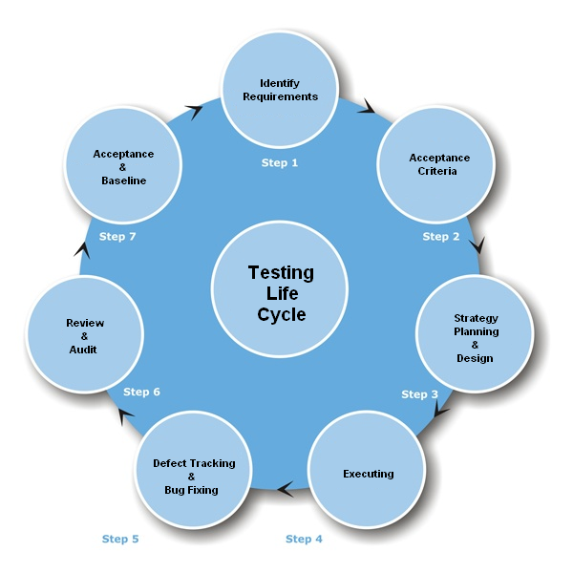
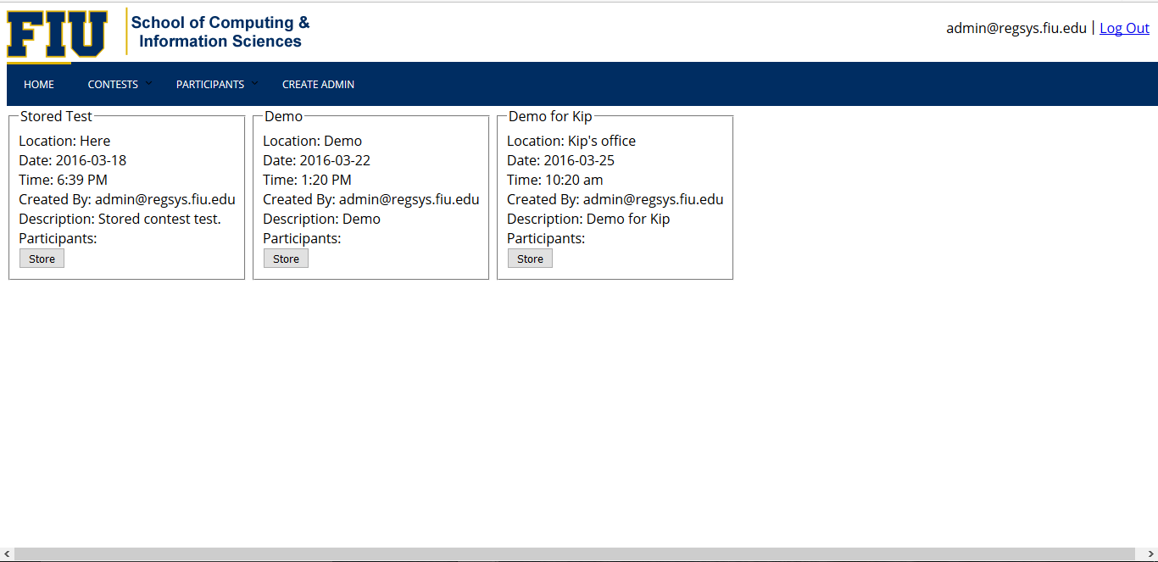
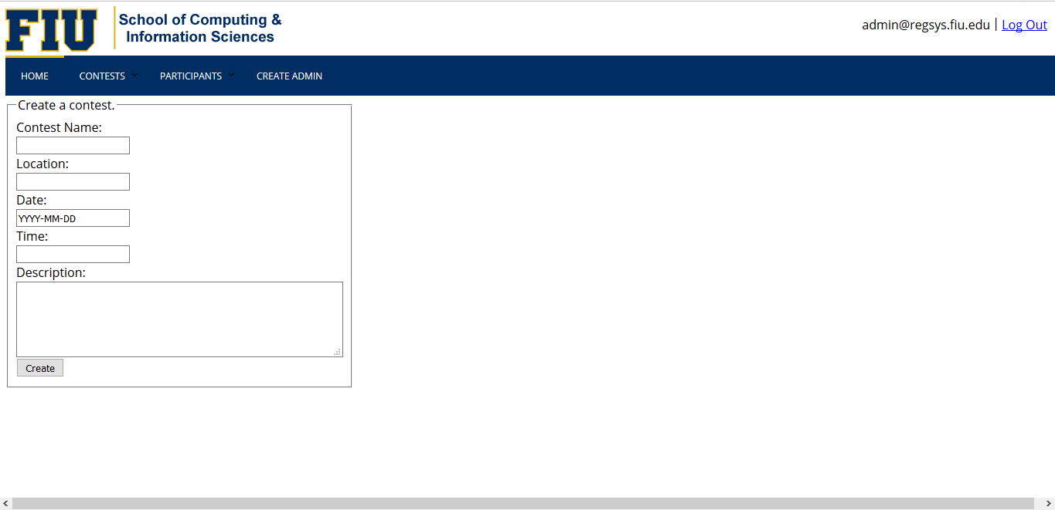
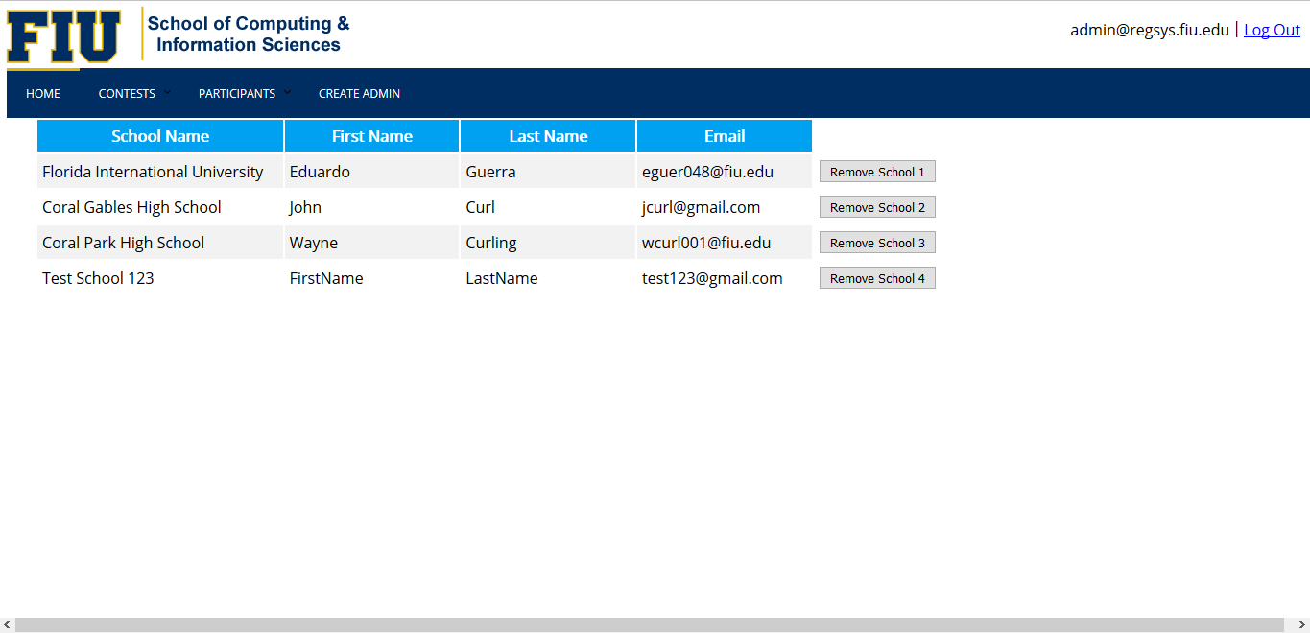
Contest Registration System v1.0
Student: Eduardo Guerra, Florida International University
Mentor: Kip Irvine, Florida International University
Instructor: Masoud Sadjadi, Florida International University
School of Computing & Information Sciences
Senior Project, 2016, Spring 2016
Problem
Current System
Requirements
The Ultimate Software Academy for Computer Science Education holds programming competitions for high school student teams, but the current system is far too clunky and inefficient to be used. In Phase 1 of this project, we sought to create an interactive web site that makes it easy for coaches and contest administrators to collaborate on the registration process.
The current system for registering for the high school programming competitions consists of a single PHP page with a form for data entry. Interested coaches enter their information, which is stored and later used as a mailing list. This forces contest administrators to rely on email and conversation history to keep an up-to-date view of the status of a contest and its participants.
1. Use role-based authentication to create separate profiles for coaches and administrators.
2. Allow coaches and administrators to create and modify accounts with passwords.
3. Allow registered coaches to create new team registrations.
4. Allow registered coaches to modify or delete team registrations.
5. Allow registered administrators to view/modify/delete registered teams.
6. Allow registered administrators to send email notifications to coaches and team members.
7. Allow registered administrators to view and sort lists of teams, team members, and coaches.
8. Allow all registration data from a single contest to be archived for later retrieval.
System Design
Object Design
Implementation
HTML5/JavaScript for Presentation Tier
Java/JSP for Application Tier
MySQL for Data Tier
Verification
Screenshots
Summary
Contest Registration System is a system that allows programming team coaches and contest administrators to easily collaborate on contests by having all pertinent information centralized on the site. The newly implemented system allows coaches to create/edit teams without needing to notify administrators of every change to the roster, while also allowing administrators to have a wholesome view of a contest and its participants.
Stored Contests Page
Create a Contest Page
Big Bang Integration Testing
Acknowledgement
List of Participating Schools
The material presented in this poster is based upon the work supported by Kip Irvine. I am thankful to the help that I received from my group members, Wayne Curling.

