Slide 1







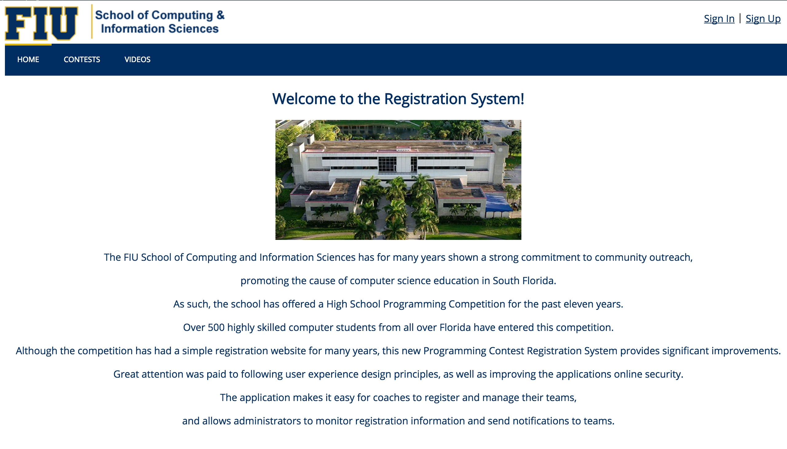
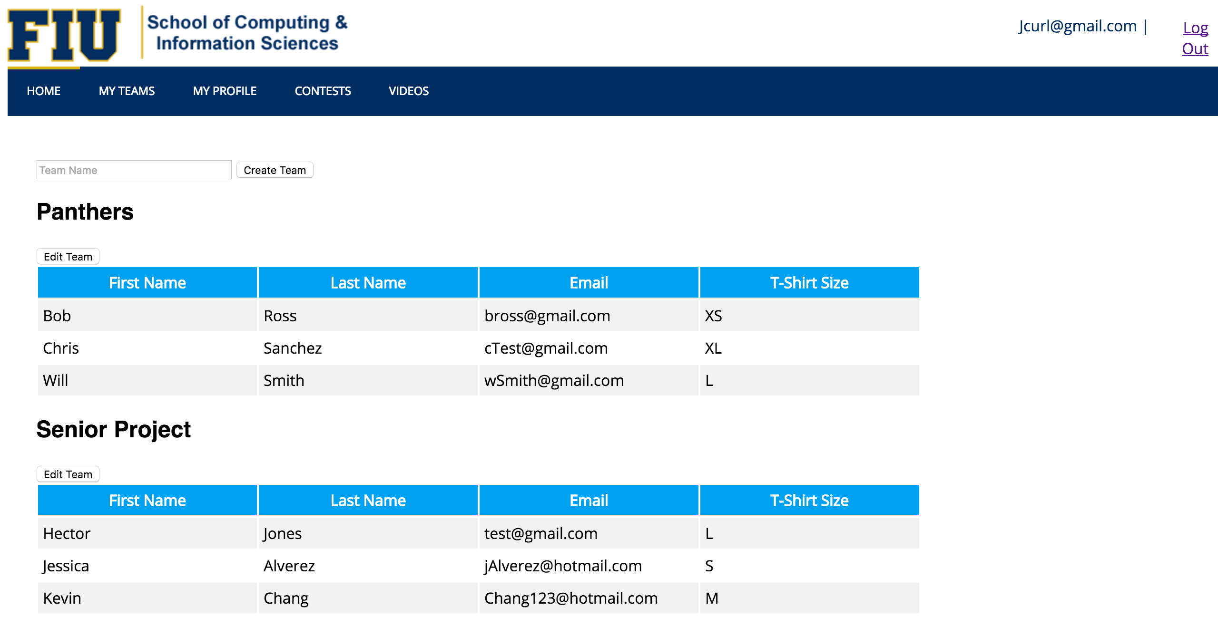
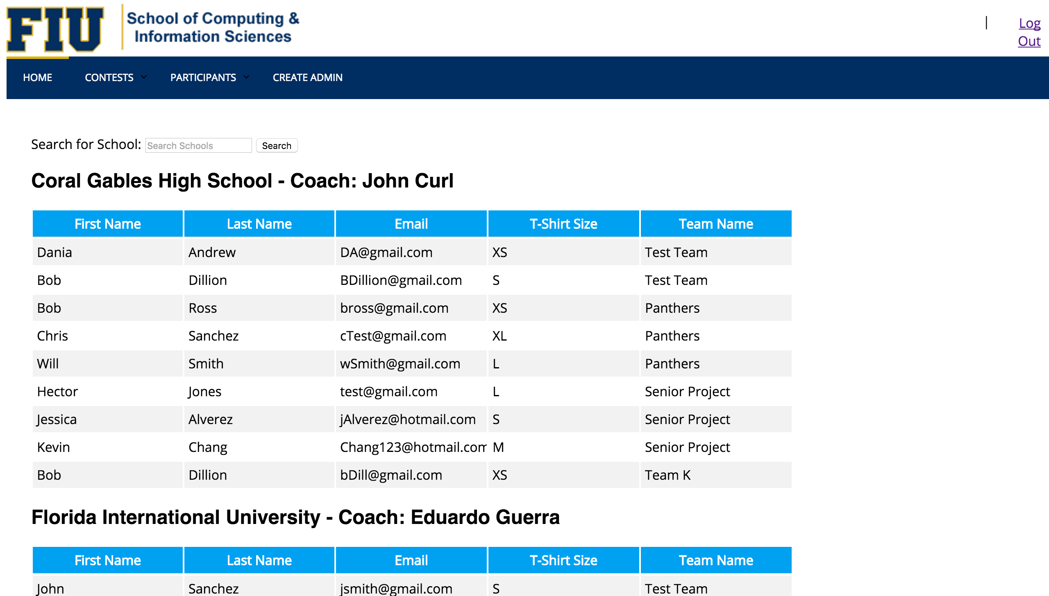
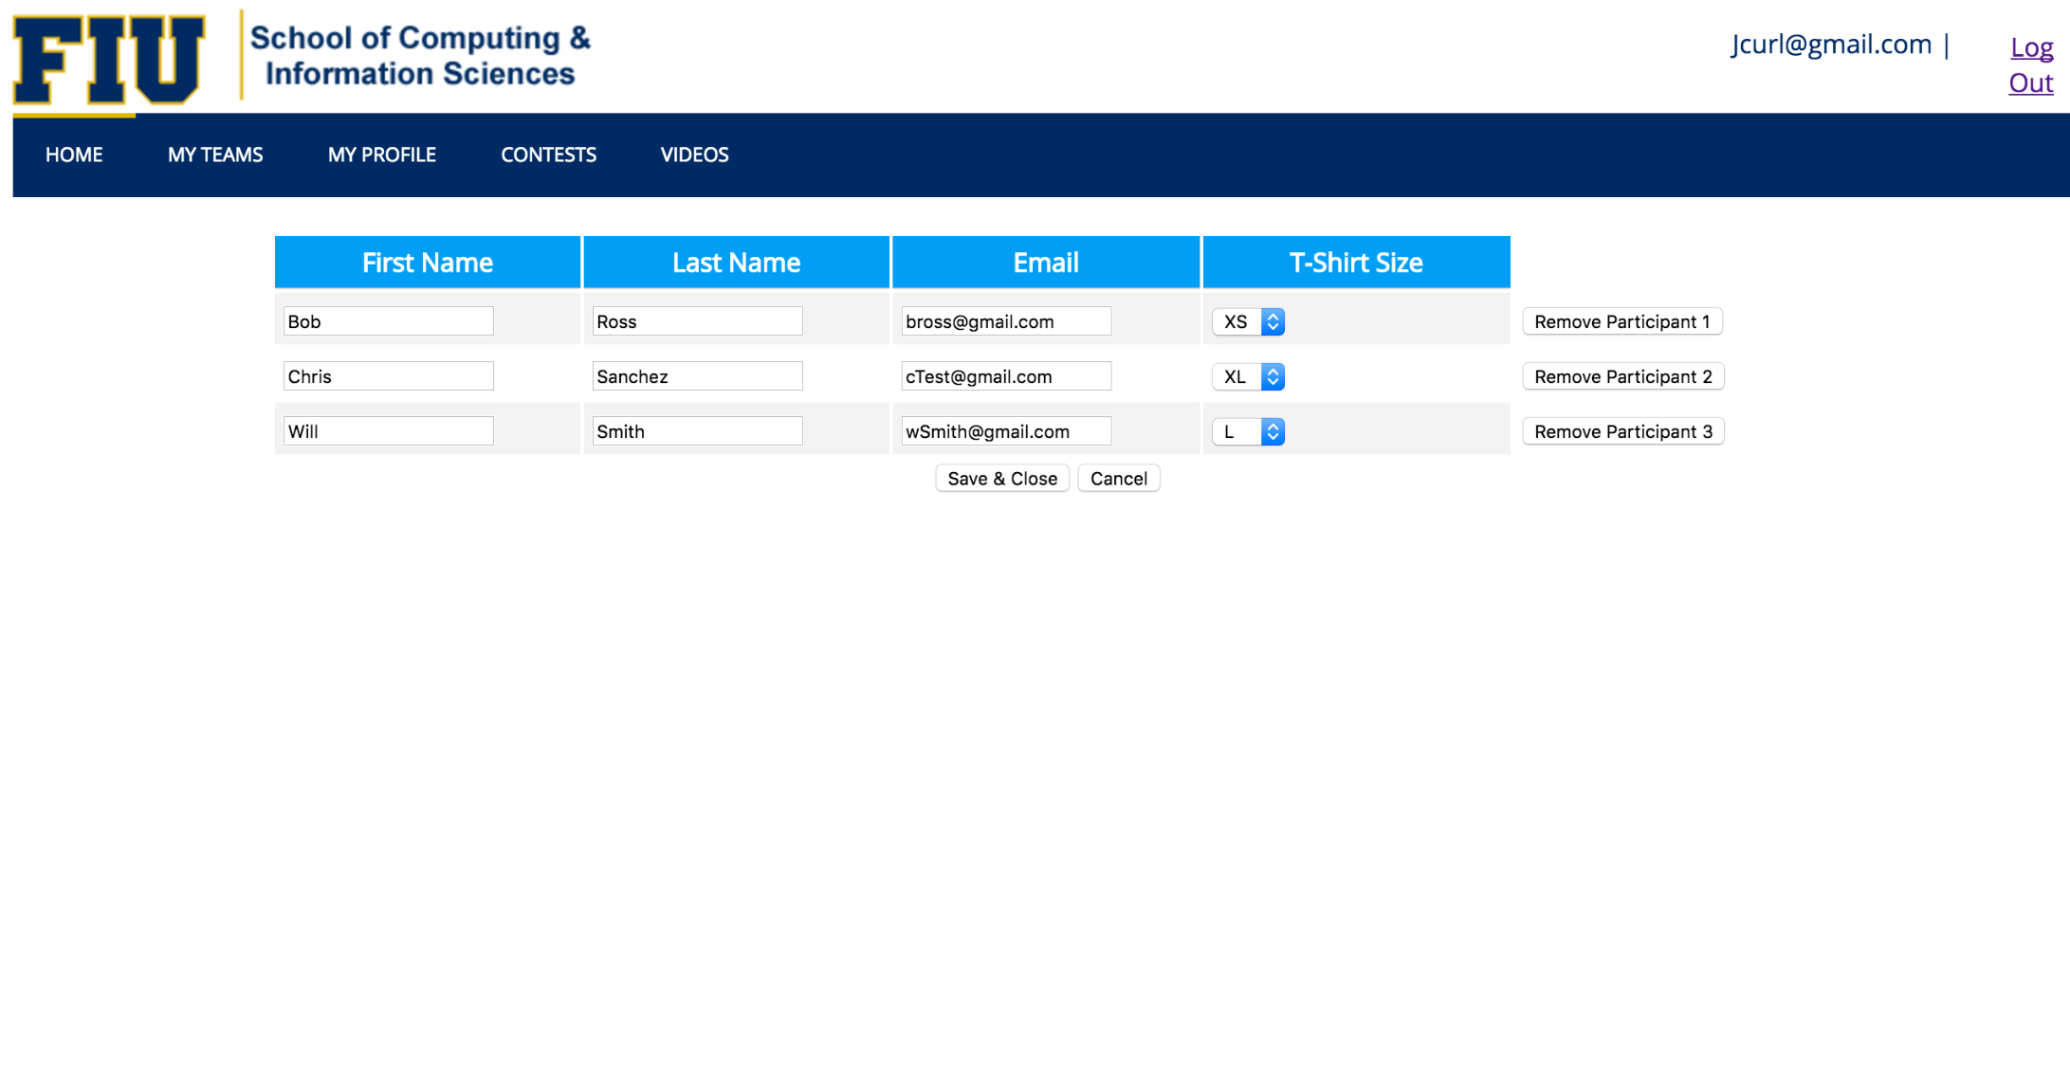
Senior Project, 2016, Spring 2016
School of Computing & Information Sciences
Contest Registration System v1.0
Student: Wayne Curling, Florida International University
Mentor: Kip Irvine, Florida International University
Instructor: Masoud Sadjadi, Florida International University
Problem
Current System
Requirements
The Ultimate Software Academy for Computer Science Education holds programming competitions for high school student teams. However with the competitions growing every year the current process of organization such a large event has become inefficient and time consuming for both project organizers and coaches of teams. This project set out to create an interactive website that makes it easy for coaches and contest administrators to collaborate on the registration process.
The programming competition put on by Ultimate Software and Florida International University has the bulk of its work structured around the contest organizers. Currently the programing competition website gives information about current and previous competitions and the ability for coaches so sign up there team for an upcoming competition. The teams are then placed in a database and will be extracted in excel format for the competition organizer/administrator to review.
Use role-based authentication to create separate profiles for coaches and administrators.
Allow coaches and administrators to create and modify accounts with passwords.
Allow registered coaches to create new team registrations.
Allow registered coaches to modify or delete team registrations.
Allow registered administrators to view and search registered teams.
Allow registered administrators to send email notifications to coaches and team members.
Allow registered administrators to view and sort lists of teams, team members, and coaches.
Allow all registration data from a single contest to be archived for later retrieval.
System Design
Object Design
Implementation
The Contest Registration System uses a modified version of the LAMP stack. A Linux machine running Apache Tomcat is hosting the webserver for the website. Java was used for any application logic and calls to the MySQL database. Java Servlet Pages were used to display information to the user. HTML 5 was used for all front end development.
Verification
Unit and subsystem testing for the Contest Registration System were done manually by my partner and I after the completion of every user story. Integration testing was done using the Big Bang method due to time constraints. Testing was done manually for both coach and administrator with satisfactory results.
Screenshots
Summary
The new Contest Registration System allows for both coaches and competition organizers to collaborate on the registration process for the annual high school programming competition. The simple design and use will accommodate the growing audience for any future competitions.
Acknowledgement
The material presented in this poster is based upon the work supported by Kip Irvine. I am thankful to the help that I received from my group member Eduardo Guerra.

