Slide 1










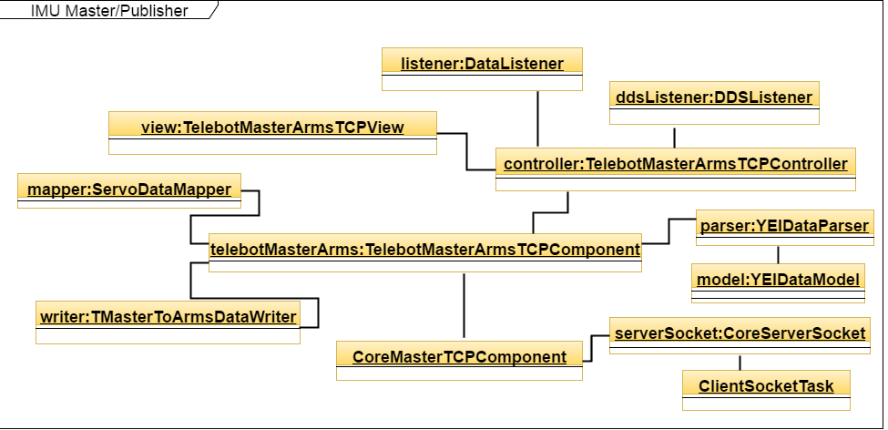
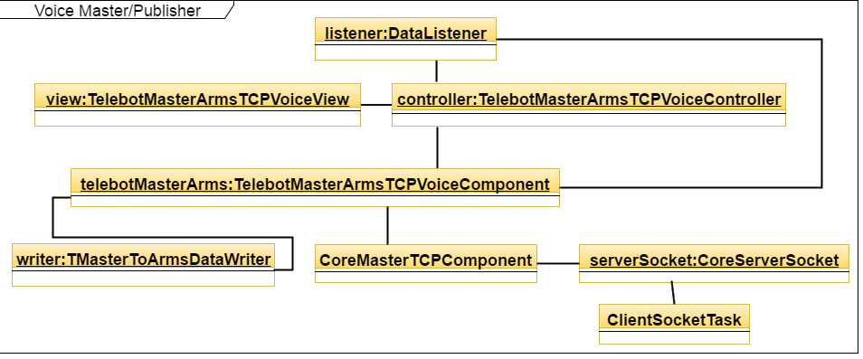
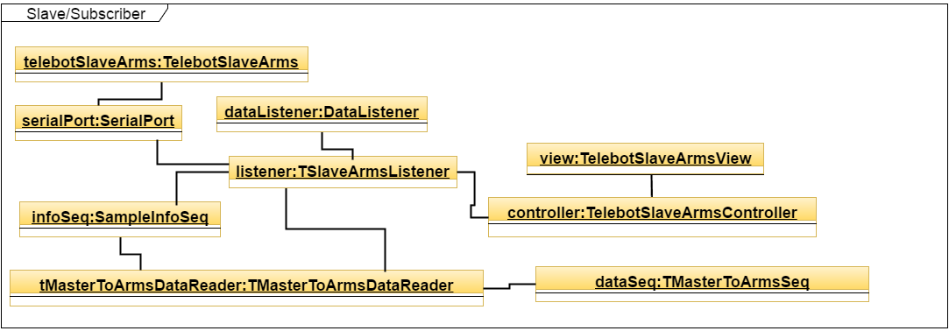
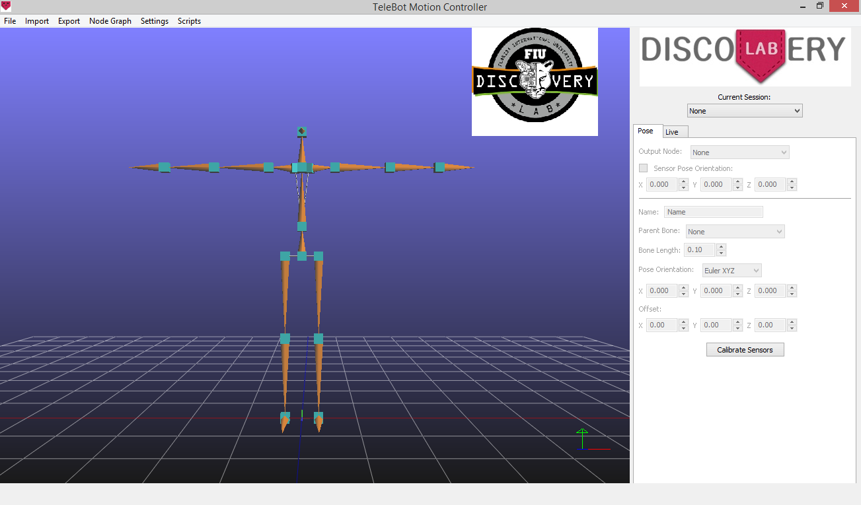
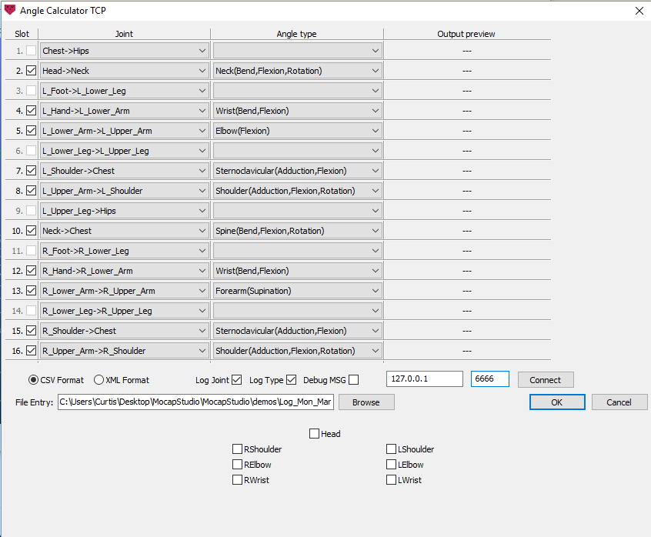
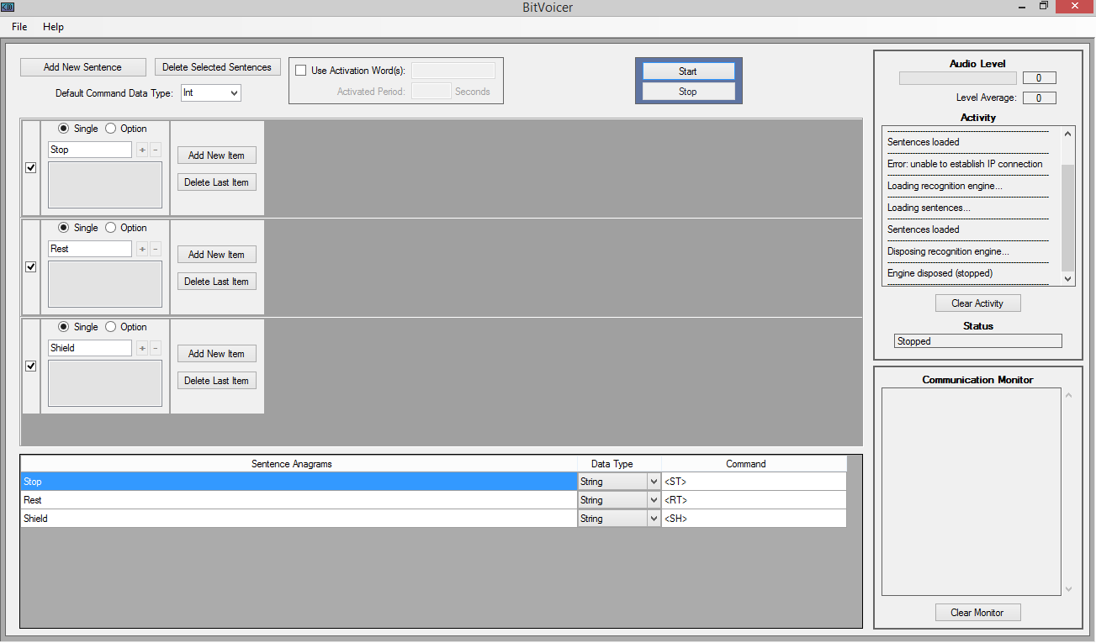
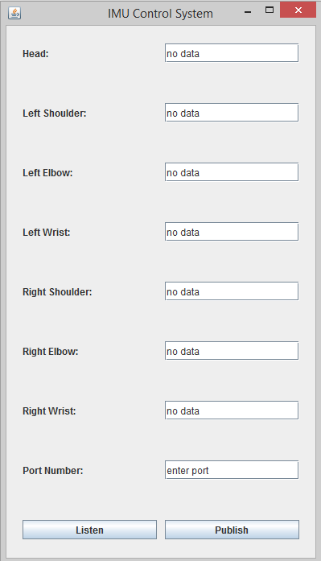
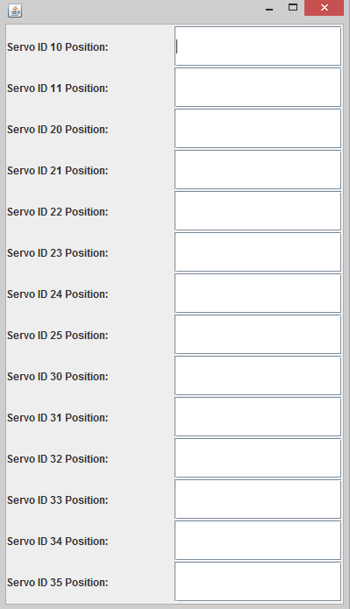
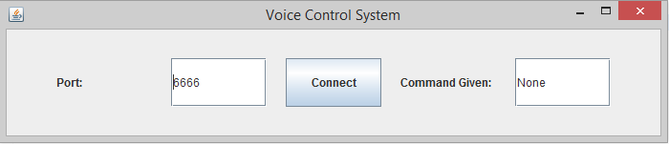
School of Computing & Information Sciences
Senior Project, 2016, Spring
Robotic Arm Manipulation
Student: Shadeh Ferris-Francis, Florida International University
Mentor: Nagarajan Prabakar, Ph.D.
Instructor: Masoud Sadjadi, Florida International University
Problem
Current System
User Stories for Proposed System
In Spring of 2012, U.S. Navy Reserve Lieutenant Commander Jeremy Robins donated $20,000 to the Discovery Lab of Florida International University for the creation of a telepresence robot to assist disabled police and military veterans in their return to the workforce.
This robot, TeleBot, provides a mode of remote law enforcement surveillance so that officers can patrol locations and interact with citizens in normal or emergency situations. TeleBot has been featured in many media outlets around the world due to its low cost and creation from off-the-shelf parts.
The arm subsystem implementation discussed on this poster is part of the “third iteration” of the TeleBot prototype.
TeleBot arm subsystem operation should be user-friendly with a low learning curve; the potential for a variety of interfaces, such as sensor-based or voice-based control, should be available so that officers with different disabilities can seamlessly switch devices in order to manipulate the robotic arms in a way that is suitable to their operational needs. [1]
The current system consisted only of the IMU Control System. To operate TeleBot’s arms, the Operator strapped the 3-Space Sensor wireless IMU sensors along her hands, lower and upper arms, back shoulders, chest, and head. As the Operator moved her arms, data from the these IMUs were transmitted to the motion-capture software, the YEI 3-Space MoCap Studio. Real-time angular coordinate data (X, Y, and Z) was calculated for the head and wrist, elbow, and shoulder joints of the left and right arms and transmitted via TCP/IP to the IMU Master/Publisher program.
In the Master program, the collected angular coordinate data for each joint, the maximum and minimum angular coordinate ranges for each joint of the Operator, and the maximum and minimum servomotor position units corresponding to that specific joint were input into a mapping formula, which produced a respective servomotor position unit. The Master program, using a Java-based framework utilizing the Real Time Innovation (RTI) Data Distribution Service publish-subscribe message-passing protocol, formatted and packaged this data into a servo identification number, servo position unit, and servo speed unit for each joint movement, which was then published onto a “topic”, or a message “mailbox” in accordance to the publish-subscribe protocol.
On Linux-based TeleBot, a subscribing Java-based Slave program listened and read the data from the topic, and passed this data to the Robotis CM-700 controller, which communicated with six daisy-chained Robotis Dynamixel servo actuators on each robot arm and two in the robot neck. These servomotors rotated to the position units given in the sent data, mimicking the arm movements of the Operator. [1]
As an Operator of the IMU Control System :
  694: I want to activate IMU Master/Publisher Program DDS Publishing when I click Publish so that activating communication to the DDS Topic is quick, and I can stream data from MoCap Studio without Publishing being activated.
  735: I want to see a display Angular Data Received for Each Joint in IMU Master/Publisher GUI so that I can monitor accuracy of the data received from the IMU sensors.
  742: I want to Process Angular Data to Servomotor Units with IMU Master/Publisher Program so that the servomotors can process the data received.
  743: On the Operator PC, I want to give the port number and connect to the port at a click of a button in the IMU Master/Publisher Program so that connecting to MoCap Studio is simple and ports are interchangeable.
  768: I want when MoCap Studio is stopped, servomotor rest position data should be sent so that the Robot's servomotors are not strained from the weight of the arms when not in use.
As an Operator of the Voice Control System :
  769: I want to Process commands to Servomotor Units with Voice Master/Publisher Program so that a command can move the robotic arms to rest, stop, and shield positions.
  770: I want to give the port number and connect to the port at a click of a button in the Voice Master/Publisher Program so that connecting to the Voice Control System is simple and ports are interchangeable.
System Design
Object Design
Implementation
Verification
Screenshots
Summary
Test Case ID: 694-I001-SunnyDay
Purpose: When the Publish button is pressed, the DDS Publishing and Data Writing should be activated.
Test Case ID: 694-I002-RainyDay
Purpose: When MoCap Studio and the IMU Master/Publisher are not connected, the DDS Publishing and Data Writing should not be activated.
Test Case ID: 694-I003-RainyDay
Purpose: When the sensors are not connected, the DDS Publishing should not have anything written in the console/posted to the Topic.
Test Case ID: 735-I001-SunnyDay
Purpose: Test that joint data is written in the appropriate joint slot in the GUI.
Test Case ID: 735-I001-RainyDay
Purpose: Test that joint data is not updated or erroneous data is not written in the GUI at the point when MoCap Studio and IMU Master/Publisher are disconnected.
Test Case ID: 735-I001-RainyDay
Purpose: Test that erroneous data is not being written to the GUI when MoCap Studio and the IMU Master/Publisher are connected and the sensors are not turned on.
Test Case ID: 742-I001-SunnyDay
Purpose: Test that streaming angular data from MoCap Studio can be processed into servo positions by the IMU Master/Publisher.
Test Case ID: 742-I002-RainyDay
Purpose: Test that when null angular data from Mocap Studio is received, no output is processed by the IMU Master/Publisher.
Test Case ID: 743-I001-SunnyDay
Purpose: When the port number is entered and the Listen button is clicked, the IMU Master/Publisher should listen to that port.
Test Case ID: 768-I001-SunnyDay
Purpose: When MoCap Studio is disconnected from the IMU Master/Publisher, the servomotor rest positions should be written to the DDS Topic.
Test Case ID: 768-I002-RainyDay
Purpose: When MoCap Studio is disconnected from the IMU Master/Publisher, the servomotor rest positions should be written to the DDS Topic only once.
Test Case ID: 768-I003-RainyDay
Purpose: When MoCap Studio is connected to the IMU Master/Publisher, the servomotor rest positions should not be written to the DDS Topic.
Test Case ID: 769-I001-SunnyDay
Purpose: When the Operator says the voice commands “Stop”, “Shield” or “Rest”, the Robot’s arms should adjust to the appropriate position corresponding to that command.
Test Case ID: 769-I002-RainyDay
Purpose: When the Operator says a phrase other than a voice command, no data should be processed.
Test Case ID: 770-I001-SunnyDay
Purpose: When the port number is entered and the Listen button is clicked, the Voice Control Master/Publisher should listen to that port.
Test Case ID: 770-I002-RainyDay
Purpose: When the port number has not been entered and the Listen button is clicked, a message asking the user to enter a valid port number should be displayed.
The aim and continuous goal of the evolution of this implementation is to provide the user friendliness and accessibility needed for officers with various physical abilities and operational preferences to utilize this law-enforcement telepresence robot at their ease.
References
[1] Shadeh Ferris-Francis, Jong-Hoon Kim, Ph.D., and Irvin Steve Cardenas, “Robotic Arm Manipulation Using Motion Capture and Open Source Software,” Discovery Lab of Florida International University, Miami, FL, Oct. 2015.
Acknowledgement
Gratitude is expressed to my partner Curtis Fox, Mentor Dr. Nagarajan Prabakar, Dr. Jong-Hoon Kim, Lieutenant Commander Jeremy Robins, Research Coordinator Colonel Jerry Miller, SCIS Director S.S. Iyengar, and to Manuel Garcia, Hunter Michko, and the past and present members of the Discovery Lab.

